Slide 2
N.1, N.2,…, subject + 都 + V.
英语，汉语，我都（会）说。
I can speak English and Chinese.
TASK 1

Slide 3
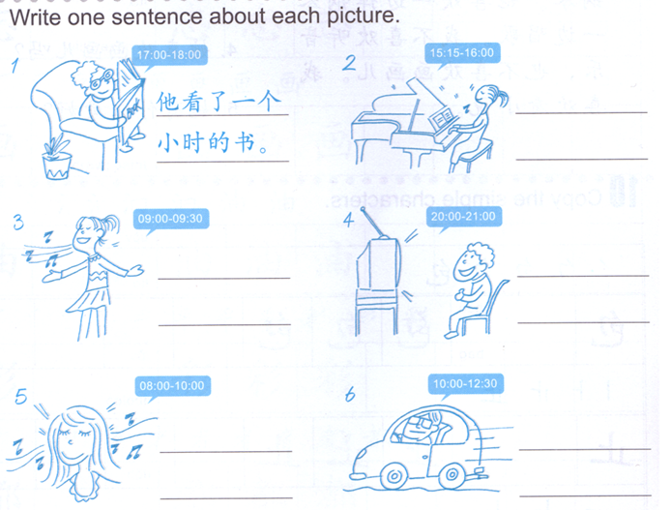
Subject + V. + 了 + duration + 的 + N.
TASK 2

Slide 4
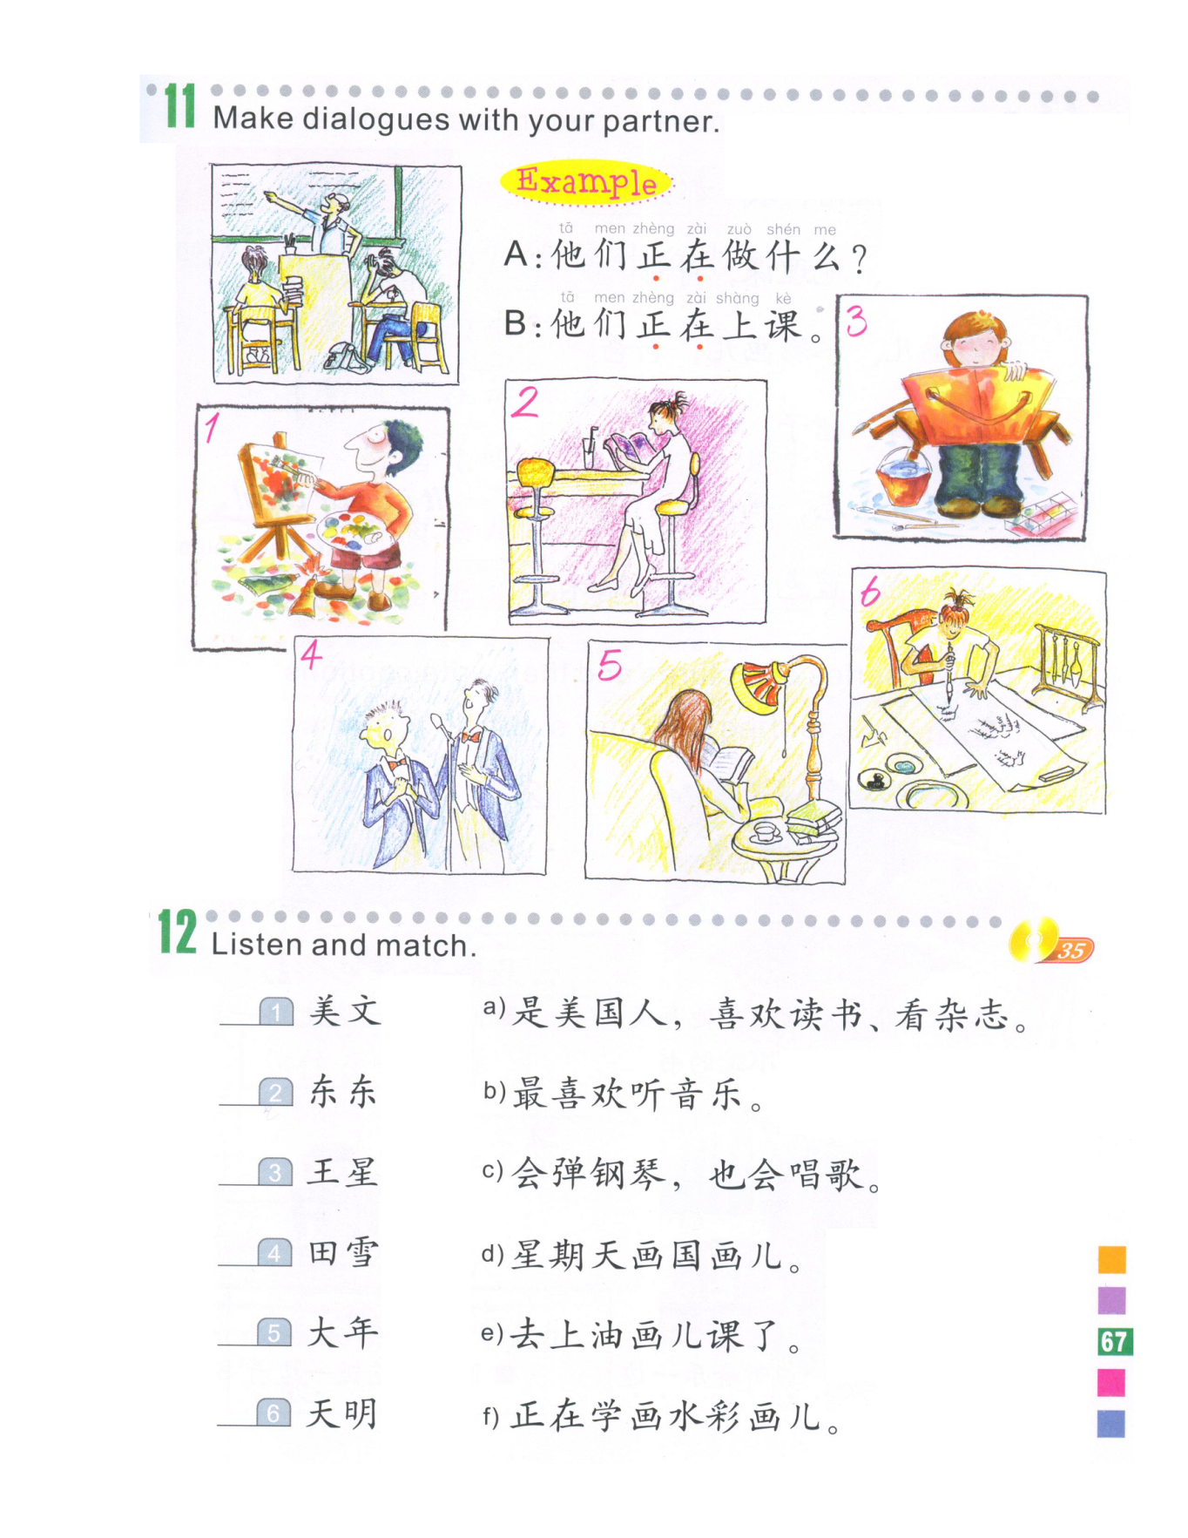
Task 3
3. A: Subject + 正在做什么？
3. B: Subject + 正在…。
1. A: Subject + 正在做什么？
B:Subject + 正在…。
5. Subject + 正在做什么？
2. A: Subject + 正在做什么？
5. Subject + 正在…。
B:Subject + 正在…。
看杂志
Read magazine
6. A:Subject + 正在做什么？
4. A: Subject + 正在做什么？
6. B: Subject + 正在…。
4. B: Subject + 正在…。
写书法
Write calligraphy

Slide 5
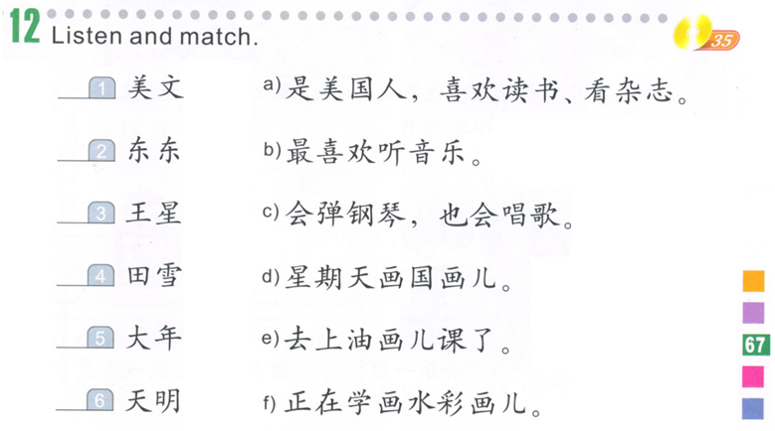
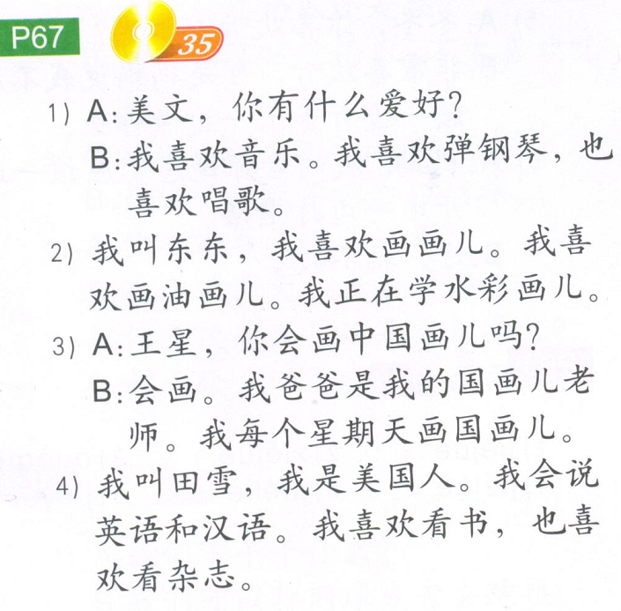
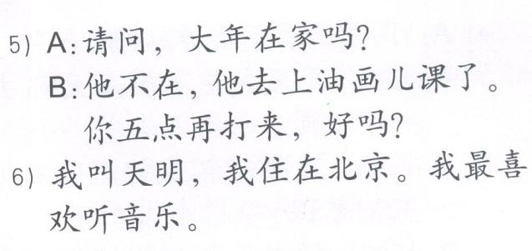
Task 4 听力 WIX
C
F
D
A
E
B
1.
2.
3.
4.
5.
6.

Slide 6
http://www.purposegames.com/game/can-you-find-the-hobbies-game

Slide 7
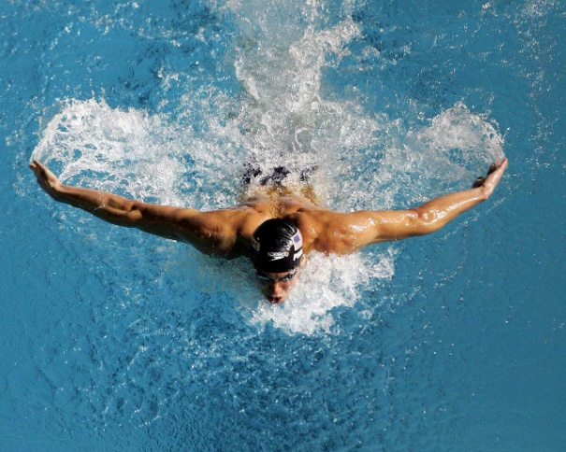
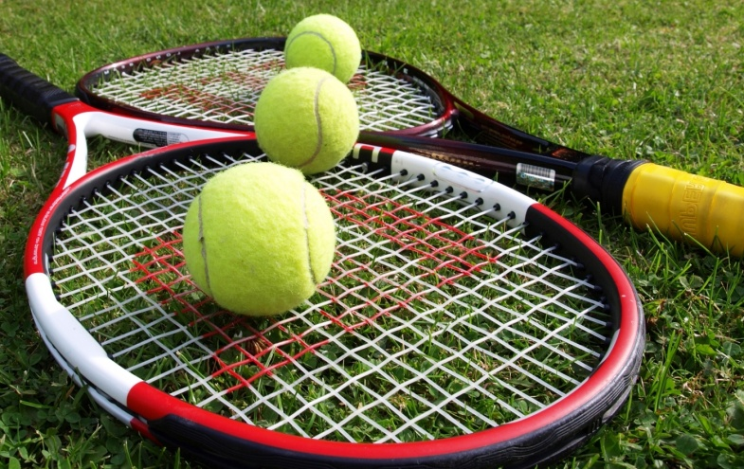

Slide 8
Translate in English
A:你在家最喜欢做什么？
B:我在家最喜欢看电视。
A:你每天看几个小时的电视?
B:我每天看两个小时的电视，你呢？
A:我不喜欢看电视，我喜欢看书，我有时候一边看书一边吃饭。

Slide 9
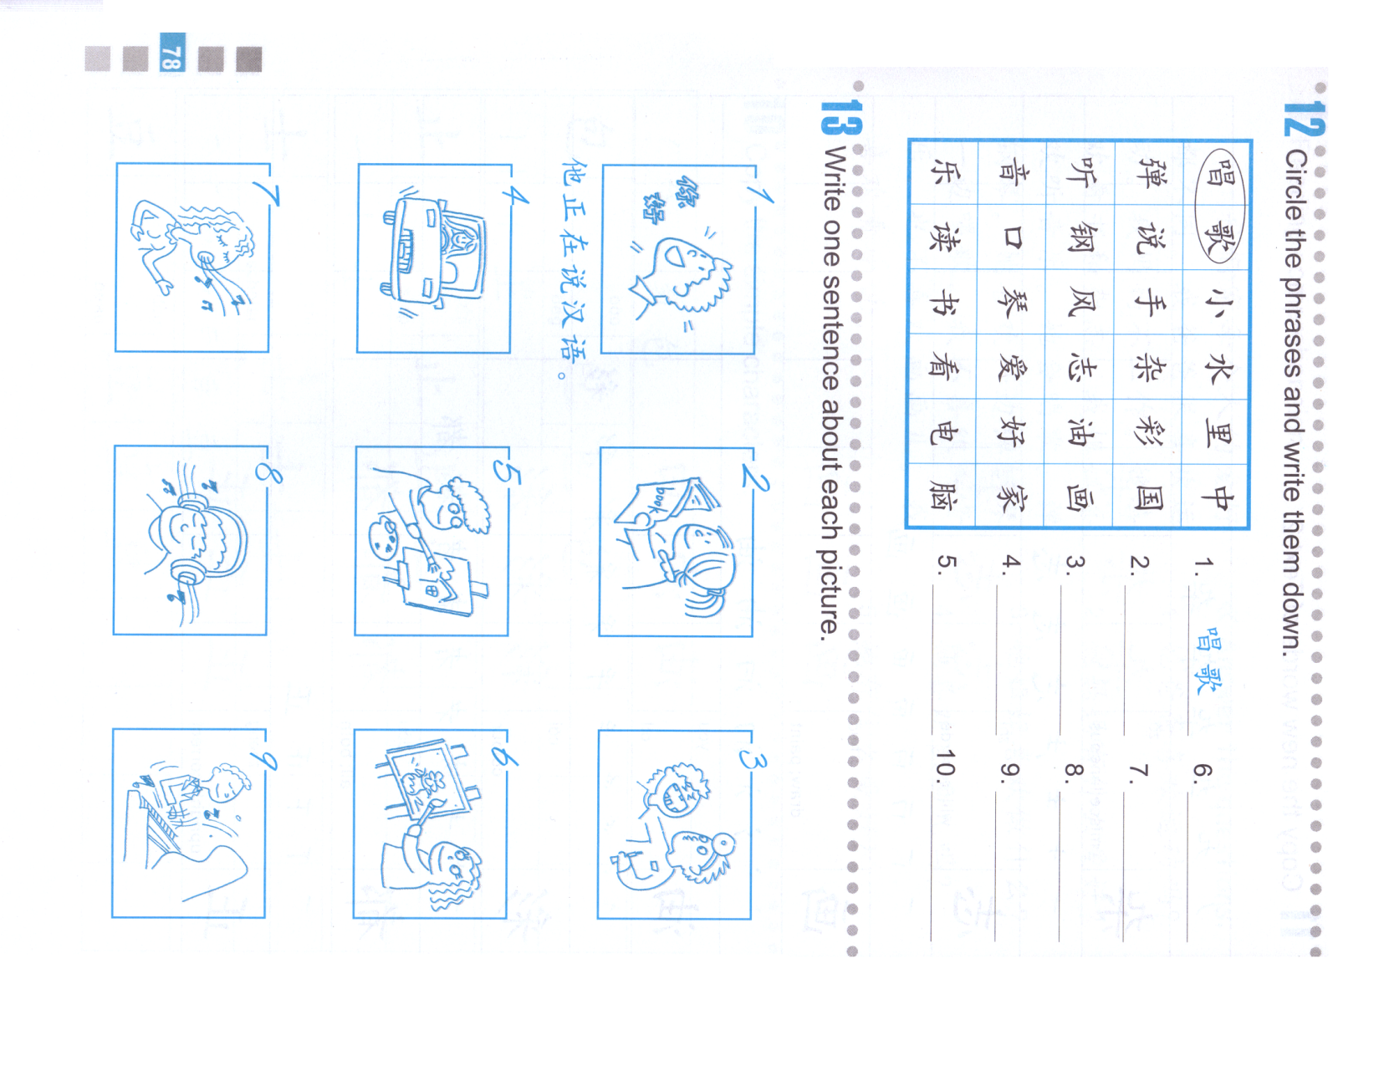
2
1
DO NOW-Translation:
Subject + 正在 + do sth.

Slide 10
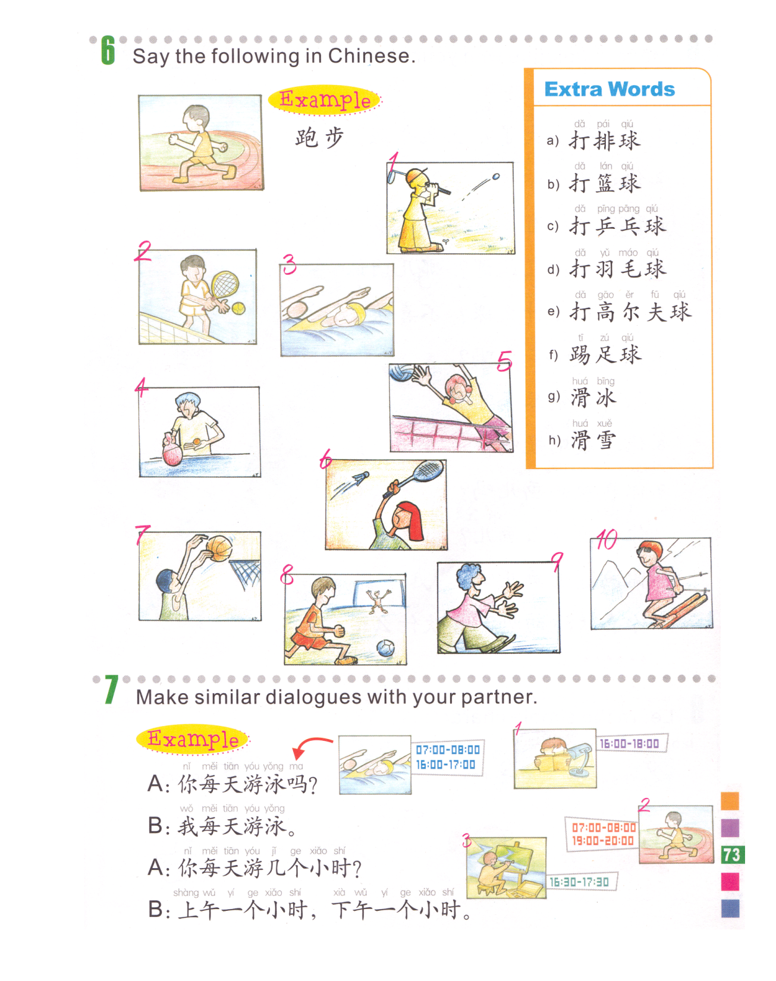
Example:
A: Do you swim everyday?
B: I swim everyday.
A: How many hours do you swim everyday?
B: 1 hour in the morning, 1 hour in the afternoon.
3
2. Run 跑步
A: Do you run every day?
You + every day + run +吗？
B: I run every day.
I + every day + run.
A: How many hours do you run every day?
You + every day + run (v.) +几个小时 + 的 + run (N.)？
B: 1 hour in the morning (early morning), 1 hour in the evening.
Early morning + 1 hour, evening + 1 hour.
打网球
游泳
3.Paint oil paintings
A: Do you paint oil paintings every Week?
You + 每星期 + paint oil paintings +吗？
B: I paint oil paintings every week.
I + 每星期 + paint (V.) oil paintings
A: How many hours do you paint every week?
You + 每星期 + paint (V.) + 几个小时 + 的 + oil painting？
B: 1 hour.
1 + measure word + hour.
1. Read books 读书
A: Do you read books every day?
You + every day + read books + 吗？
B: I read books every weekend.
I + everyday + read books.
A: How many hours do you read books every day?
You + every day + read 几个小时 + 的 + books？
B: I read books for 2 hours in the afternoon.
I + afternoon + read + 2 hours + 的 + books.
的泳？

Slide 11
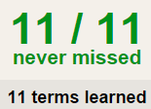
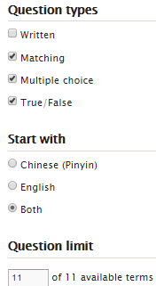
4 QUIZLET Hobbies 2 each section is 20%
Learn-Make sure you finish 100%
Speller-Make sure you finish 100%
Scatter-The time needs to be within 35 seconds.
Test- Create New Test after you change the settings to:
NOTES:
10/10
This number has to be 100
This number doesn’t matter.
10/10
The comment doesn’t matter.
10
This number has to be 12
This number has to be less than 40
10 of 10

Slide 12
Translate on your own paper.
我周末(weekend)常常去我朋友的家。我喜欢跟她一起看电视和读书。我们有时候读一个小时的书，有时候读四十分钟的书。我们通常一边看电视，一边说话。这个星期三上午九点，我们正在看电视。

Slide 13
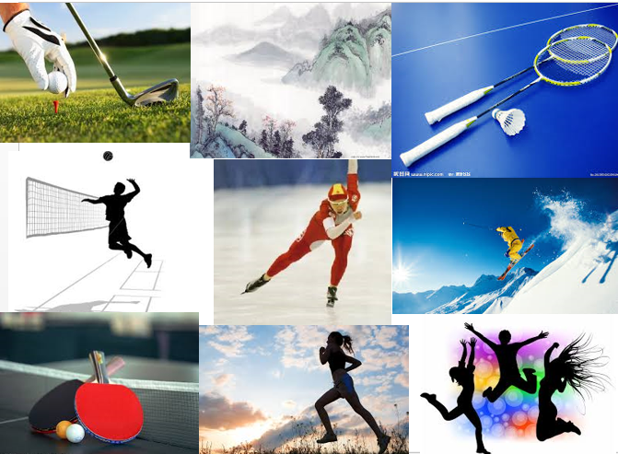
http://www.purposegames.com/game/hobbies-2-game

Slide 14
很喜欢-喜欢-不太喜欢-不喜欢
Task 1
like …very much - like… - don’t really like… - do not like…
我很喜欢唱歌。I like singing very much.
我喜欢唱歌。I like singing.
我不太喜欢唱歌。I do not really like singing.
我不喜欢唱歌。I do not like singing.
Write down 4 sentences using “很喜欢-喜欢-不太喜欢-不喜欢”.
1.
2.
3.
4.

Slide 15
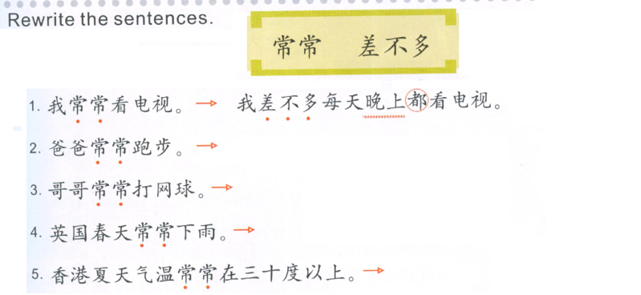
Task 2
Subject + 差不多 + frequency + 都 + do something.
often
almost
Frequency:每星期二和五
Frequency:每星期
Frequency:每天
Frequency:每天

Slide 16
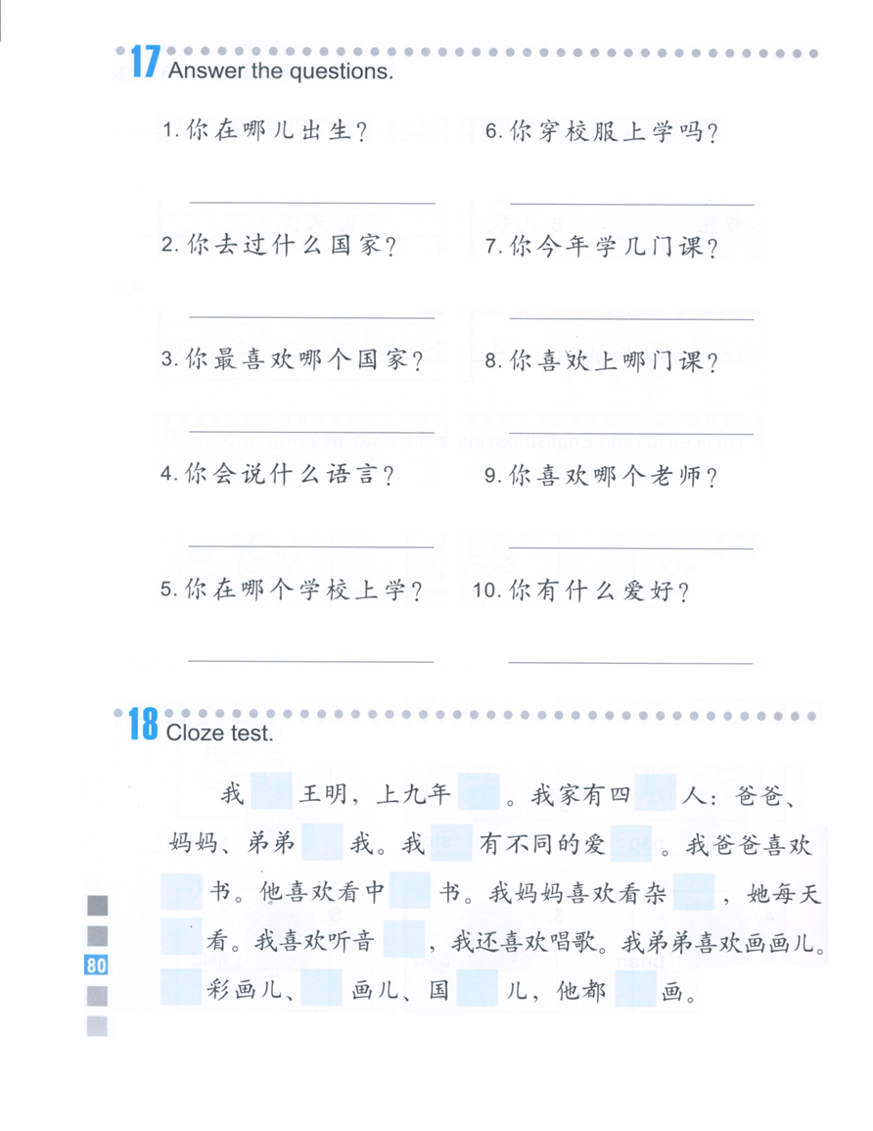
TASK 3
Answer the questions based on the small paper.
Sentence structures:
1. Change 你 to 我，change 哪儿 to the place you were born.
2. Change你 to 我，change什么国家 to the countries you have been to.
3. Change 你 to 我，change 哪个国家 to the countries you like the most.
叫
级
口
4. Change 你 to 我，change 什么语言 to the languages you can speak.
和
们
好
5. Change 你 to 我，change 哪个 to the name of the school you go to.
6. Change you to I, take out MA..
看/读
文
志
7. Change 你 to 我，change 几 to the number of the classes you take this year.
都
乐
8. Change 你 to 我，change 哪门课 to the name of the classes you like.
油
画
会
9. Change 你 to 我，change 哪个 to the name of the teacher you like.
水
10. Change 你 to 我，change 有to 喜欢，change 什么爱好 to the hobbies you have.

