Slide 1
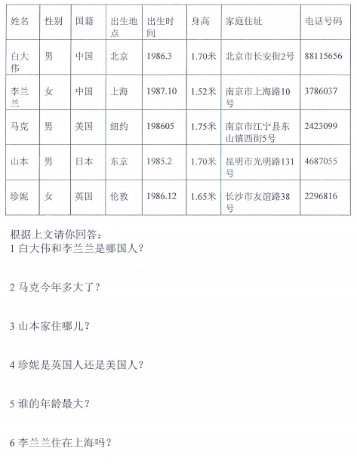
Reading Comprehension 1
Answer the questions in complete sentences.

Slide 2
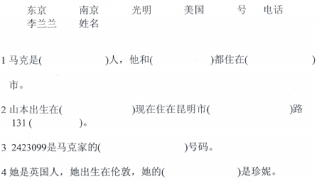
Fill in the blanks using the given words.

Slide 3
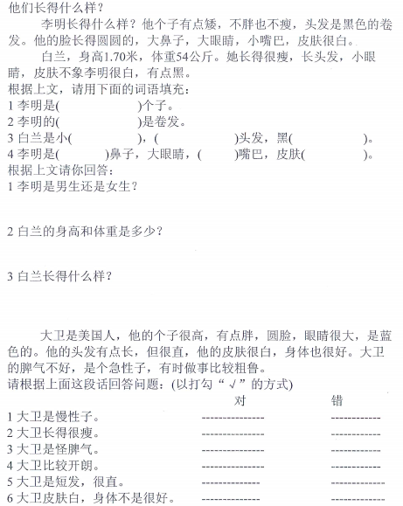
Reading Comprehension 2
Fill in the blanks.
Answer the questions using complete sentences.
True or False

Slide 4
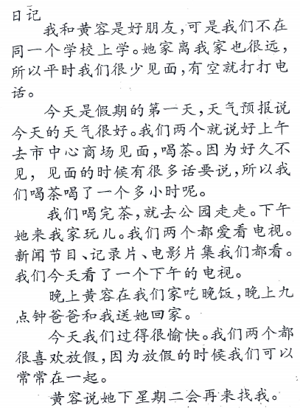
Writing:
Make a list of what “ I “ did today.

Slide 5
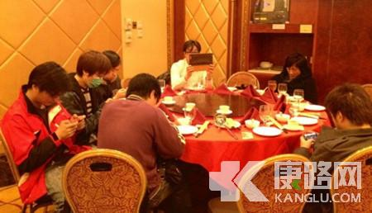
Oral:
Talk about what you see on the photo.
3 minutes

Slide 6
造句
因为…所以…。
虽然…但是…。
…比…难/复杂or容易/简单。
如果…会…。
…被…吃/喝/开/做了。

Slide 7
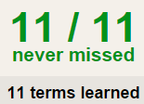
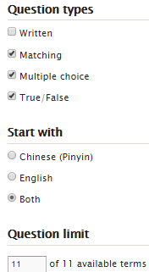
TASK 1 QUIZLET instructions – 庆祝春节 each section is 20%
Learn-Make sure you finish 100%
Speller-Make sure you finish 100%
Scatter-The time needs to be within 40 seconds.
Test- Create New Test after you change the settings to:
Do NOT check!
笔记notes:
15/15
This number has to be 100
This number doesn’t matter.
15/15
Speak CHINESE!
The comment doesn’t matter.
10
This number has to be 15
This number has to be less than 40
15 of 15

Slide 8
春节前的准备工作：
买吃的（食物）
除夕晚上一定要吃：
饺子
因为：
小孩子/小朋友过年时会：
给长辈拜年
人们拜年时一般说
压岁钱一般在：
红色的信封里（红包）

Slide 9
1.写
2.可以用笔记
3.下次演示：
最多不超过7分钟

Slide 10
听力
http://www.bbc.co.uk/schools/primarylanguages/mandarin/culture_and_places/festivals/

