Slide 1
DO NOW- on your own paper, just the blanks.
吗，有，叫，在，个
1.你__什么名字？
2. 我有两__妹妹。
3. 你是学生__？
4. 我爸爸__学校工作。
5. 我家__五口人。

Slide 2
chong wu
Dong wu
Animal(s)
Pet(s)
动物
宠物

Slide 3
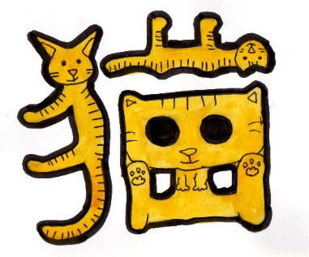
mao
Cat(s)
猫

Slide 4
gou
Dog(s)
狗

Slide 5
zhi
Measure word for dogs/cats
只
In between a/an/number/this/that/how many & dogs/cats

Slide 6
My good friend has a cat.
Wo de hao peng you you yi zhi mao.
我的好朋友有一只猫。
How many dogs do you have?
Wrong: 几狗你有？
You have how many + measure word + dog?
Ni you ji zhi gou?
你有几只狗？

Slide 7
da
Xiao
Big/large
Small/tiny/little
大
小

Slide 8
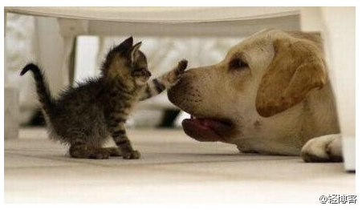
What would you want to name this picture in Chinese?
大猫和小狗
小猫和大狗

Slide 9
Subject + am/is/are + adjective:
No “am/is/are” in Chinese.
Her dog is big.
Her dog + hen + big.
Ta de gou hen da.
very/quite
她的狗很大。

Slide 10
niú
yáng
Cow/ox
goat/sheep
牛
羊

Slide 11
tou
Measure word for cow/ox and goat/sheep
头

Slide 12
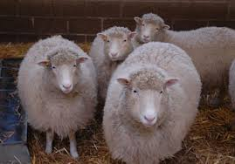
四头羊
五头牛

Slide 13
Take out your cellphone
Go to:
Kahoot.it Game PIN:
Nickname: Your first name
If you don’t provide your real name, you will be deleted by Ms. Feng

Slide 14
Task 1 Write the words down in the boxes. Name: Date:
Characters | Pin yin | English | Characters | Characters | Characters | Characters | Characters | Characters | Characters | Characters | Characters | Characters
动物 | dong wu | animal
宠物 | chong wu | pet
猫 | mao | cat
狗 | gou | dog
只 | zhi | MW for dog and cat
大 | da | big
小 | xiao | small
很 | hen | very
牛 | niu | cow
羊 | yang | goat/sheep
头 | tou | MW for cow and goat/sheep

Slide 15
Task 2: Translate the sentences in characters.
Task 3: Cut and glue the following words.
I have 2 big dogs and 3 small cats.
Hints: I have 两 MW big dog and 3 MW small cat.
That school is big.
Hints: That MW school 很 big.
Does your family have a cow?
Hints: Your family has a MW cow 吗？
Is this goat yours?
Hints: This MW goat is yours 吗？
My pet
3 cats
5 dogs
His sheep
10 schools

Slide 16
Sample:
http://www.classtools.net/connect/
http://www.classtools.net/connect/201509_fAPZmR

Slide 17
QUIZLET T or F

Slide 18
热身：
Fill in the blanks.
1. My dog is big.
Wo de gou hen da.
我的狗__大。
2. Our high school is small.
Wo men de gao zhong hen xiao.
我们__高中很小。
2. They have a small cat.
Ta men you yi zhi xiao mao.
他们__一只小猫。

Slide 19
niǎo
mǎ
bird
horse
鸟
MW for birds is “只”
马
一只鸟
这只鸟
那只鸟
几只鸟?

Slide 20
pi
measure word for horse(s)
2 horses
Liang pi ma=两匹马
That horse
Na pi ma=那匹马

Slide 21
小马
Xiao ma
pony

Slide 22
Yu
she
fish
snake
鱼
蛇

Slide 23
tiao
measure word for fish and snakes
条
My teacher has 4 fish.
Wo de lao shi you si tiao yu.
我的老师有四条鱼。

Slide 24
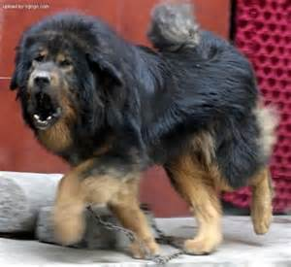
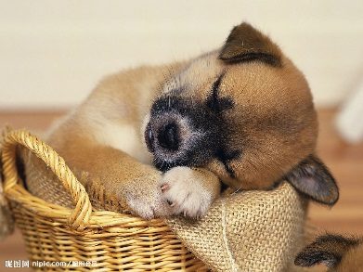
xiong
Ke ai
Fierce/ferocious
Lovely/cute
凶
可爱

Slide 25
猪 zhū pig
MW:头 Example: 一头猪
鸡 jī chicken
MW:只 Example: 一只鸡
鸭 yā duck
MW:只 Example: 一只鸭

Slide 26
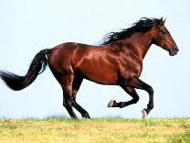
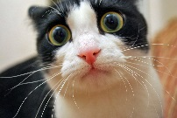
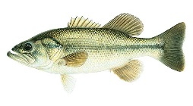
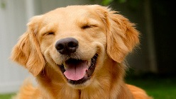
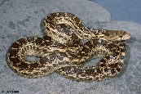
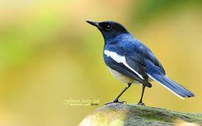
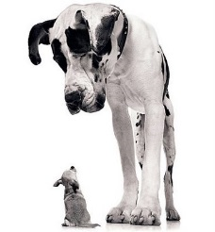
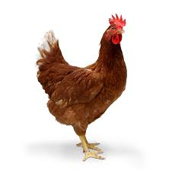
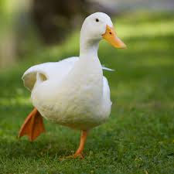
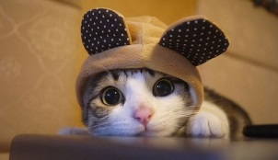
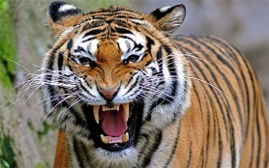
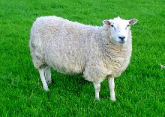
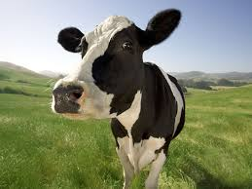
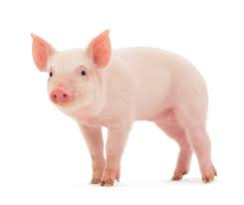
Animals & Measure Words for animals & Adjectives
MW-
猫
MW-
Reason:
狗
MW-
Reason:
Adjectives:
MW-
Reason:

Slide 27
http://www.purposegames.com/game/d8014a323e

Slide 28
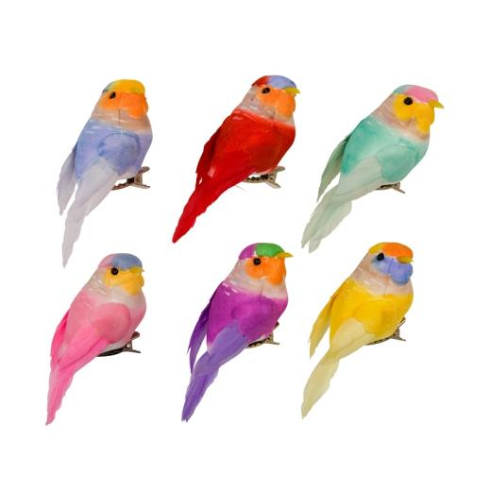
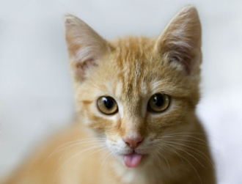
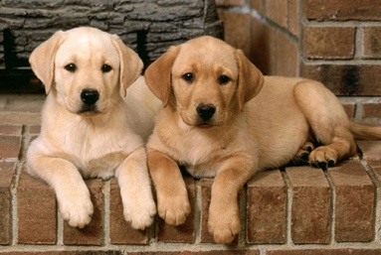
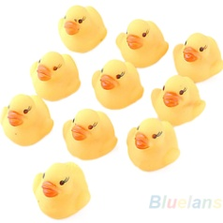
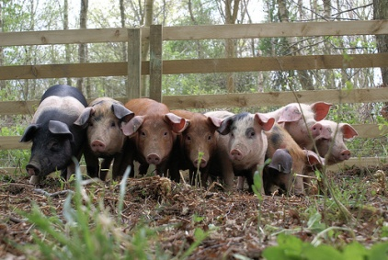
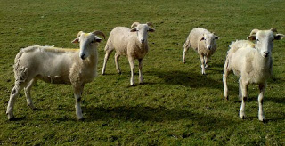
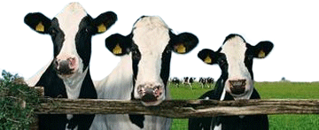
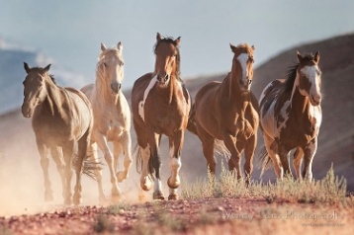

Slide 29
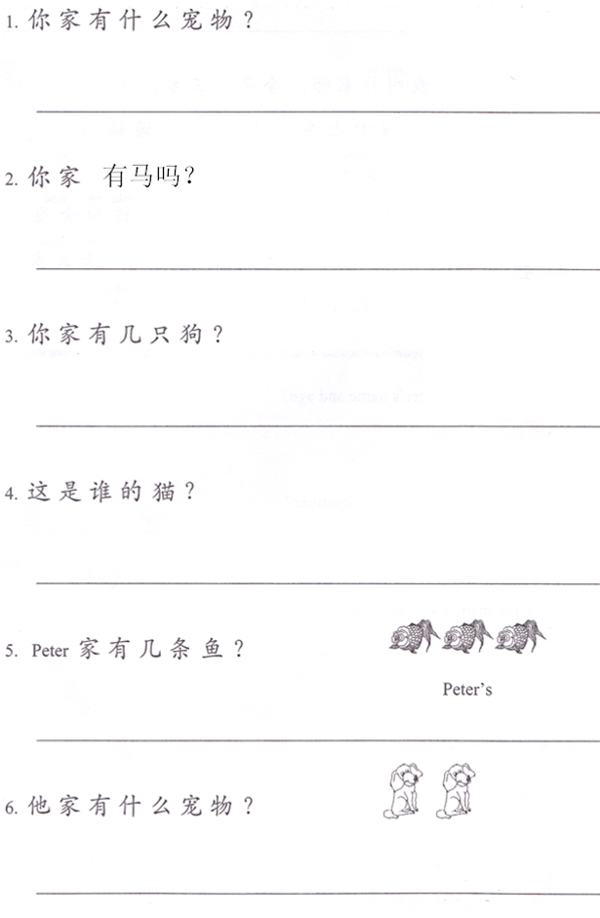
Animal Unit Test (Open Book)
Section 1: Answer the questions in complete sentences on the lines using the structures provided. (30%)
姓名：_____________
Change 你 to 我，take out 什么宠物，change it to the pets you have.
1._________________________________________
2._________________________________________
3._________________________________________
4._________________________________________
5._________________________________________
6._________________________________________
Yes: Change 你 to 我, take out 吗.
No: Change 你 to 我, take out 吗,change 有to 没有
Change 你 to 我，take out 几，change it to the a number.
Change 谁 to a person.
take out 几，change it to the number of the fish.
take out 什么宠物，change it to the pets you see.
Number + MW + dog

Slide 30
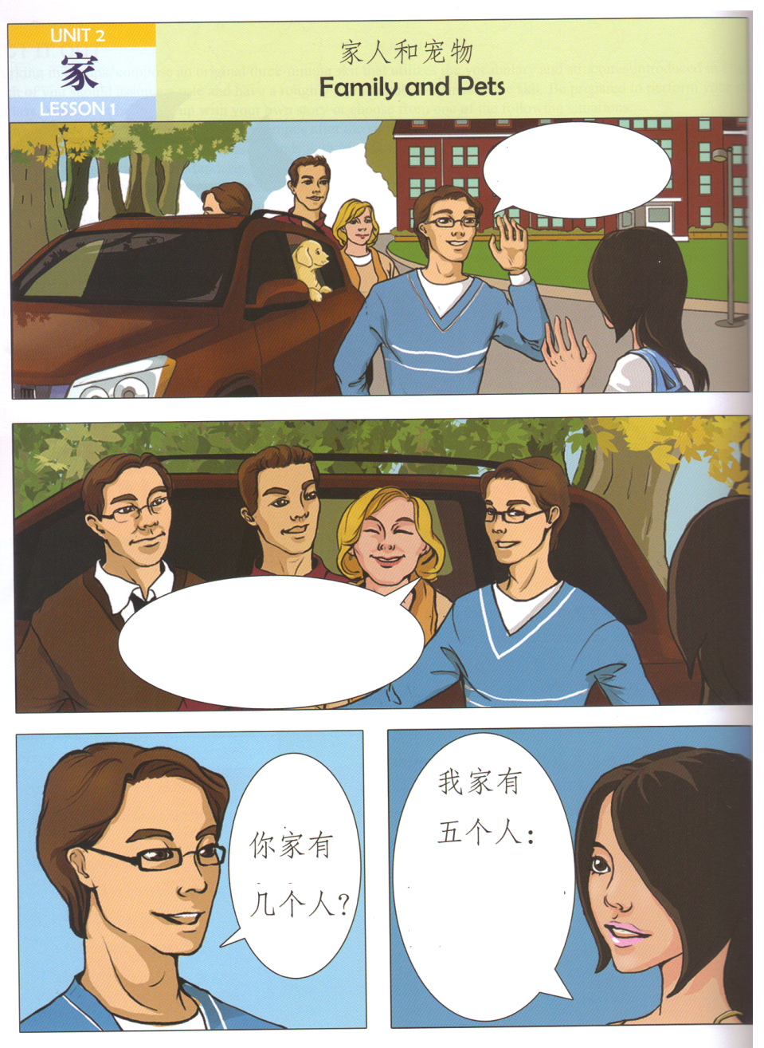
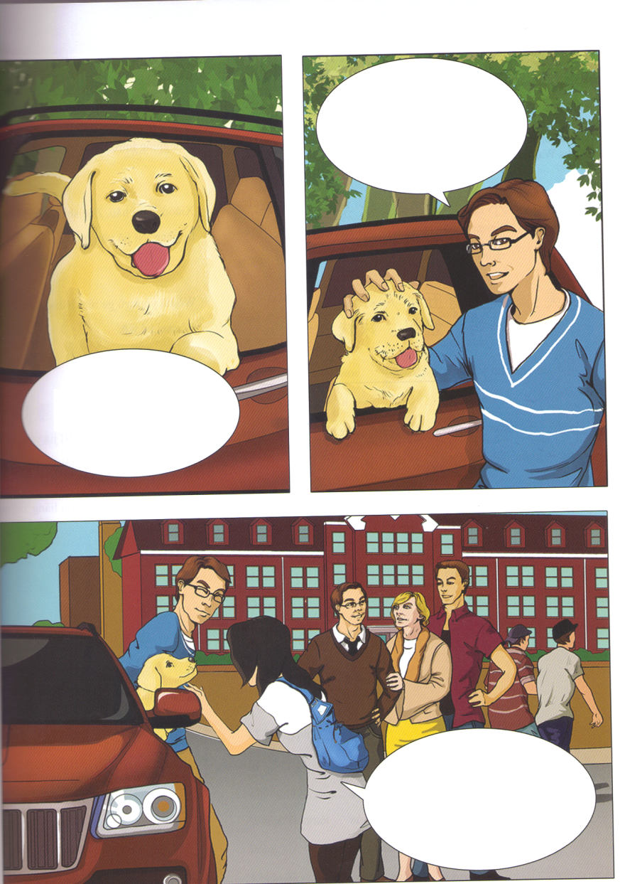
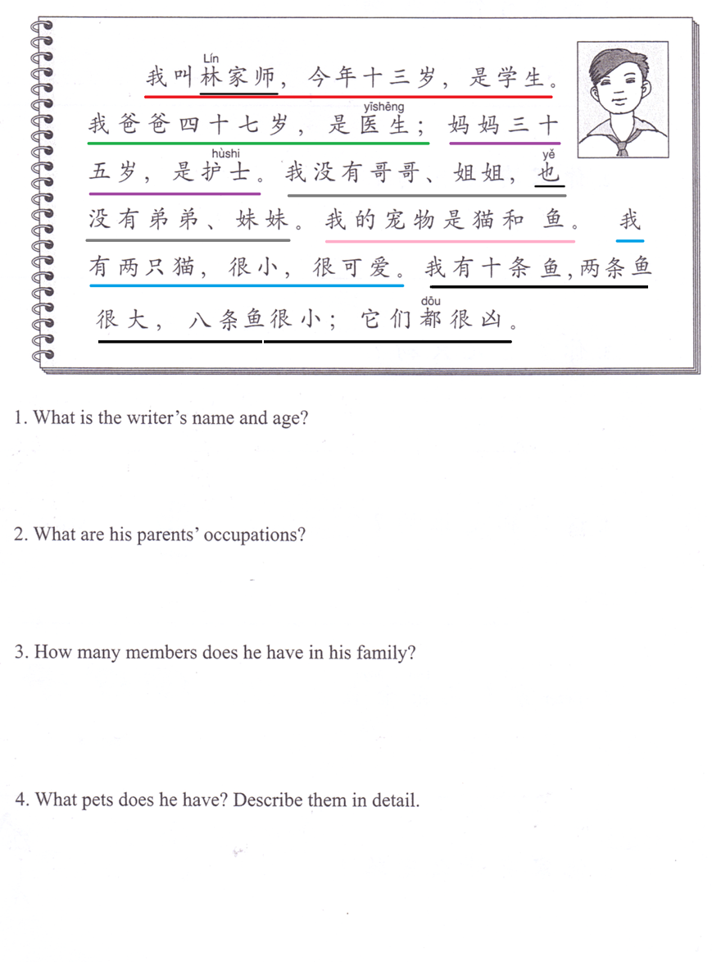
Section 2: Match the sentences with the pictures.
30%)
Section 3: Answer the questions in English.
(40%)
A.他们是我妈妈，爸爸和哥哥。
B.你好。
C.你的狗很可爱！
D.妈妈，爸爸，两个妹妹和我。
E.这是我的狗。
F.我的狗今年两岁。

