Slide 1
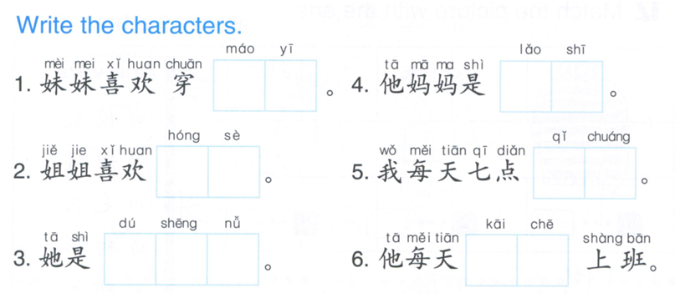
DO NOW
毛衣
老师
红色
起床
独 生 女
开车

Slide 2
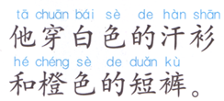
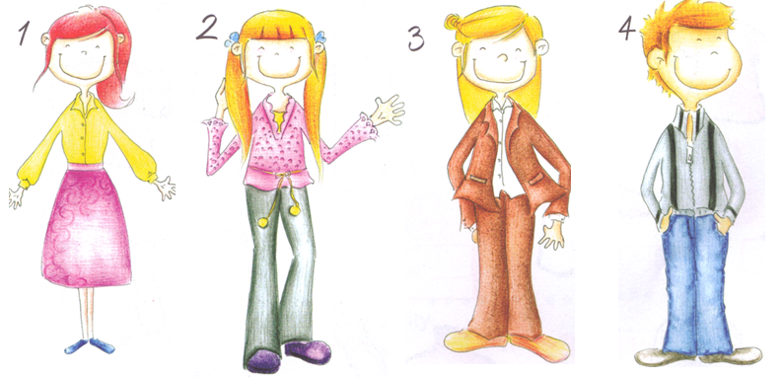
TASK 1:
Choose 1 people out of 4 to describe as the example shown, you can NOT use your notes, you will need to memorize the sentences, you will be called in 20 minutes.
EXAMPLE:
Chen shan
衬衫

Slide 3
Task 2
牛
1, character
2, characters
3, characters
2, characters
1, character
Now live in Shanghai

Slide 4
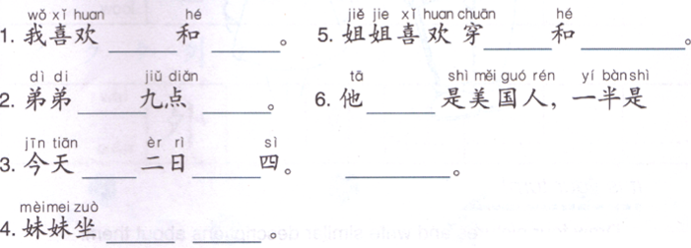
Task 3: Choose 1 answer for each blank, you do NOT need to use all of the answers in the word bank, there are more than 1 correct answers for each blank. If you have the same answers as another student, you will be called to explain /translate the sentences.
This section will be on your Unit Test.
吃早饭， 澳大利亚人， 短裤， 校车， 上学，
毛衣， 九月， 星期， 裙子， 衬衫， 牛仔裤，
汽车， 十二月， 每天， 每星期六， 下学，
去北京， 日本人， 地铁， 去纽约， 红色，
蓝色， 上午， 橙色， 上课， 起床，
粉色， 黄色， 一半， 中国人， 三月， 飞机，
是

Slide 5
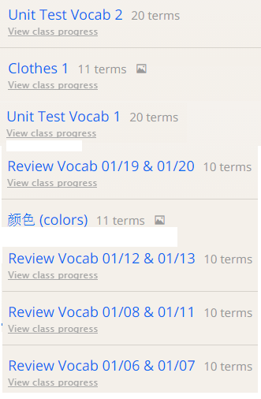
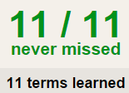
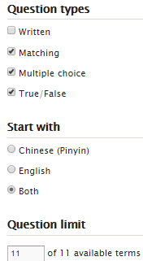
TASK4 QUIZLET instructions – all the previous sets
Flashcard-Go over all the words
Learn-Make sure you finish 100%
Speller-Make sure you finish 100%
Scatter-The time needs to be within 30 seconds.
Test- Create New Test after you change the settings to:
List of the sets assigned this semester:
This number doesn’t matter.
10/10
This number has to be 100
10/10
The comment doesn’t matter.
10
This number has to be 13
This number has to be less than 40

Slide 6
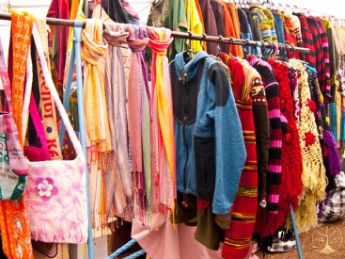
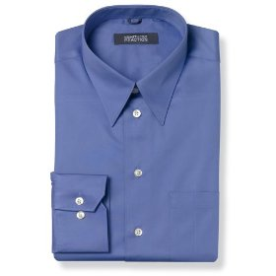
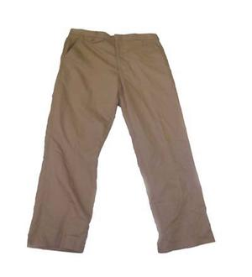
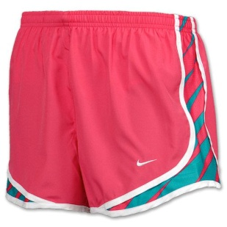
衣服
衬衫
汗衫
长裤
短裤
裙子

Slide 7
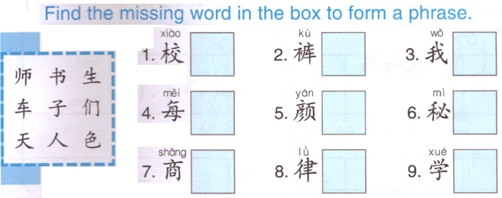
DO NOW
A B C
A2
B2
C2
1
2
3
A3
C3
B1
B3
A1
C1

Slide 8
TASK1 QUIZLET instructions – accessories each section/20%
Flashcard-Go over all the words
Learn-Make sure you finish 100%
Speller-Make sure you finish 100%
Scatter-The time needs to be within 30 seconds.
Test- Create New Test after you change the settings to:
笔记notes:
This number doesn’t matter.
10/10
This number has to be 100
10/10
The comment doesn’t matter.
10
This number has to be 13
This number has to be less than 40

Slide 9
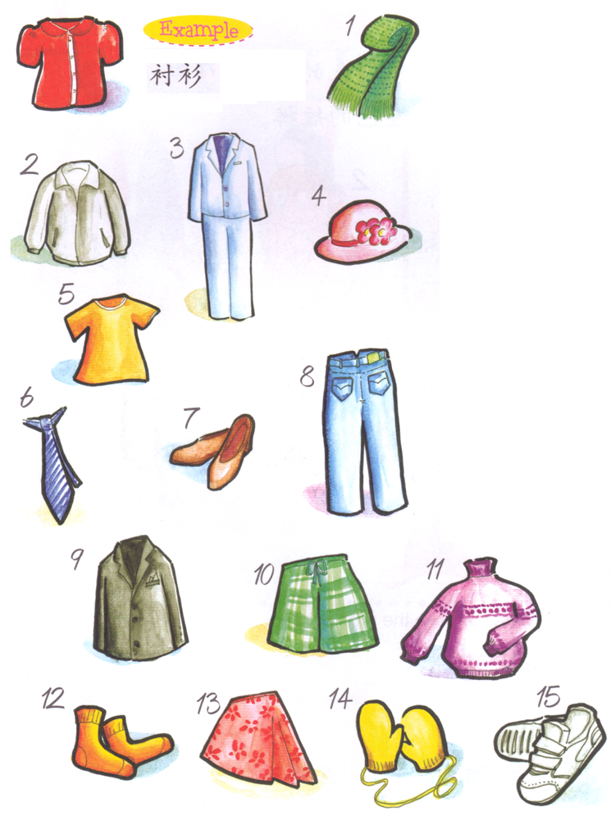
Task 2: Write down the words to match the pictures.

Slide 10
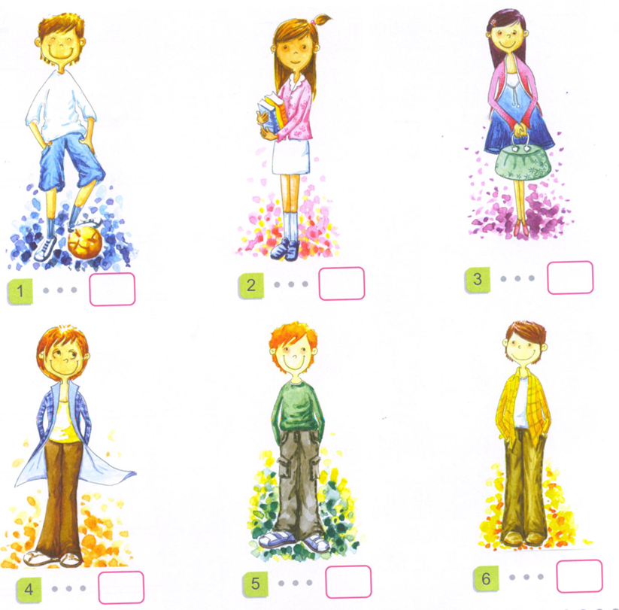
Task 3 : Read the sentences and figure out if they match the pictures.
他穿白色的衬衫和蓝色的短裤。
她穿粉色的衬衫和紫色的裙子。
她穿红色的毛衣和棕色的裙子。
她穿绿色的外套和黑色的长裤。
他穿灰色的衬衫和黑色的牛仔裤。
他穿橙的衬衫和黑色的长裤。
T

Slide 11
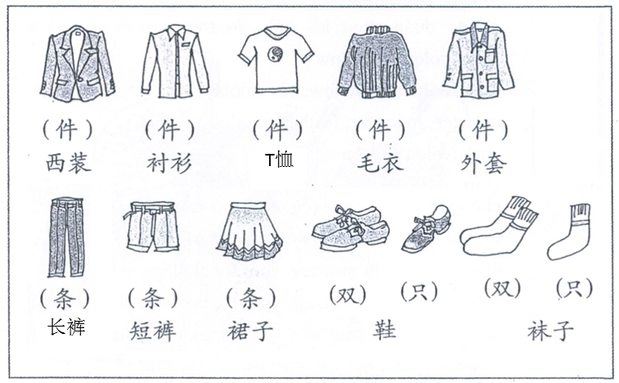
Task 4: Choose 8-10 kinds of clothes in the picture to describe using the structure. (number, color)
suit
pair
pair
一双鞋/袜子 = 两只鞋/袜子
Number + MW + color + 的 + clothes
Example: a pair of blue jeans
1 + MW + blue + 的 + jeans
Yi + tiao + lan se + 的 + niu zai ku
一条蓝色的牛仔裤

Slide 12
Find 10 words in the box and write them down on your paper. 10% /each word

Slide 13
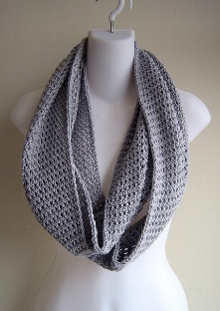
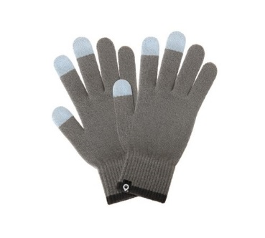
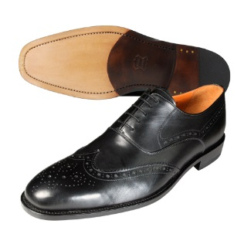
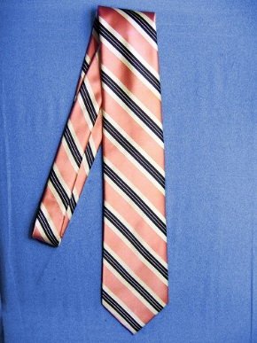
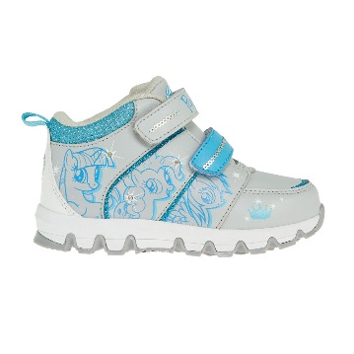
帽子
围巾
手套
皮鞋
领带
运动鞋

