Slide 1
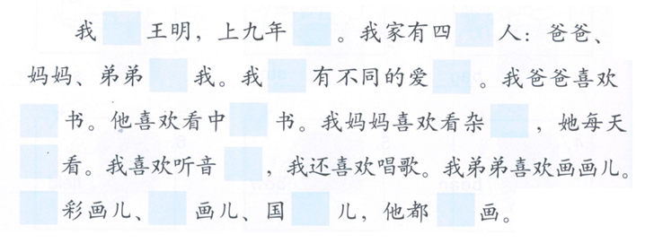
DO NOW:
Am/is called
Grade level
MW for people
and
we
hobbies
read
Chinese
magazine
music
都
Water color paintings
Oil paintings
Chinese paintings
can

Slide 2
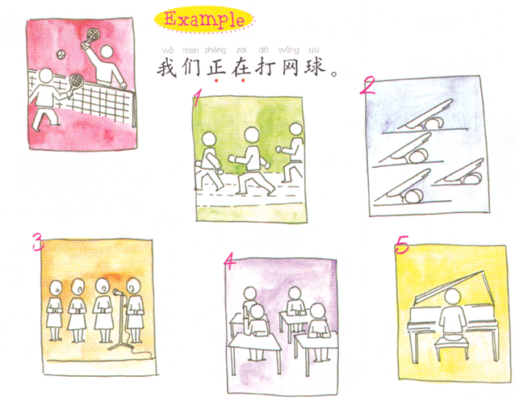
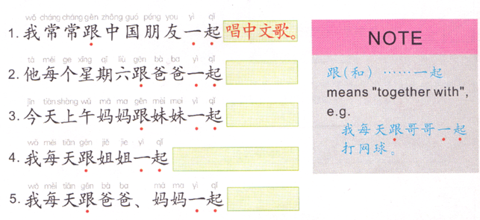
Task 1:
Subject + 正在 + do something.
Task 2:
Person 1 + 跟 + person 2 + 一起 + do something.
Person 1 does something with person 2.

Slide 3
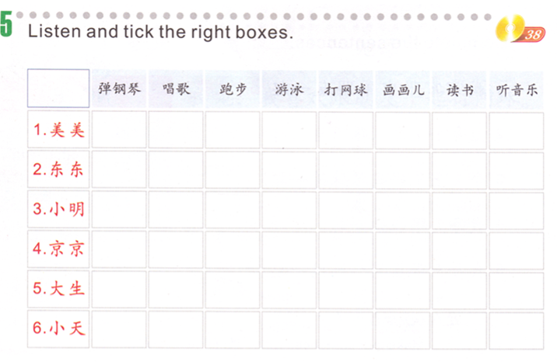
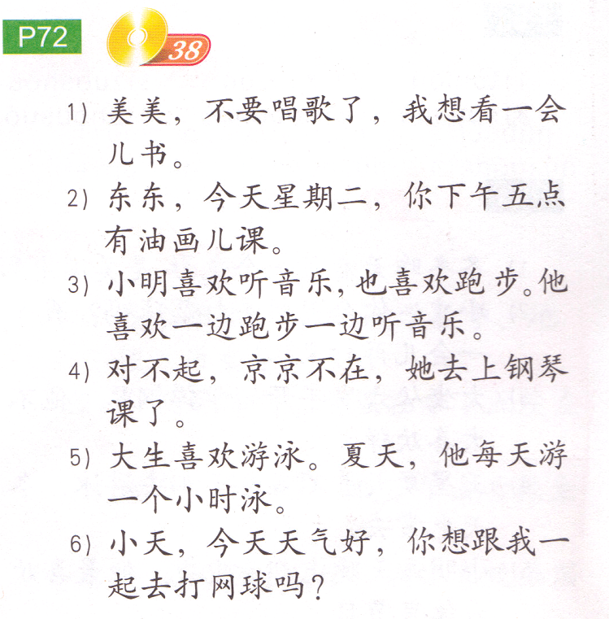
TASK 3: check the activities each person does.
Ms. Feng’s website:
http://jfeng1.wix.com/chinese

Slide 4
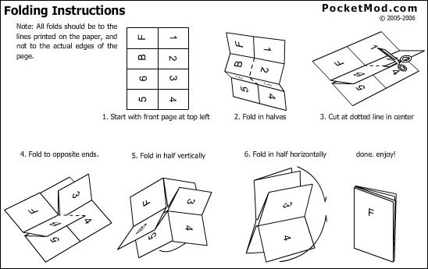
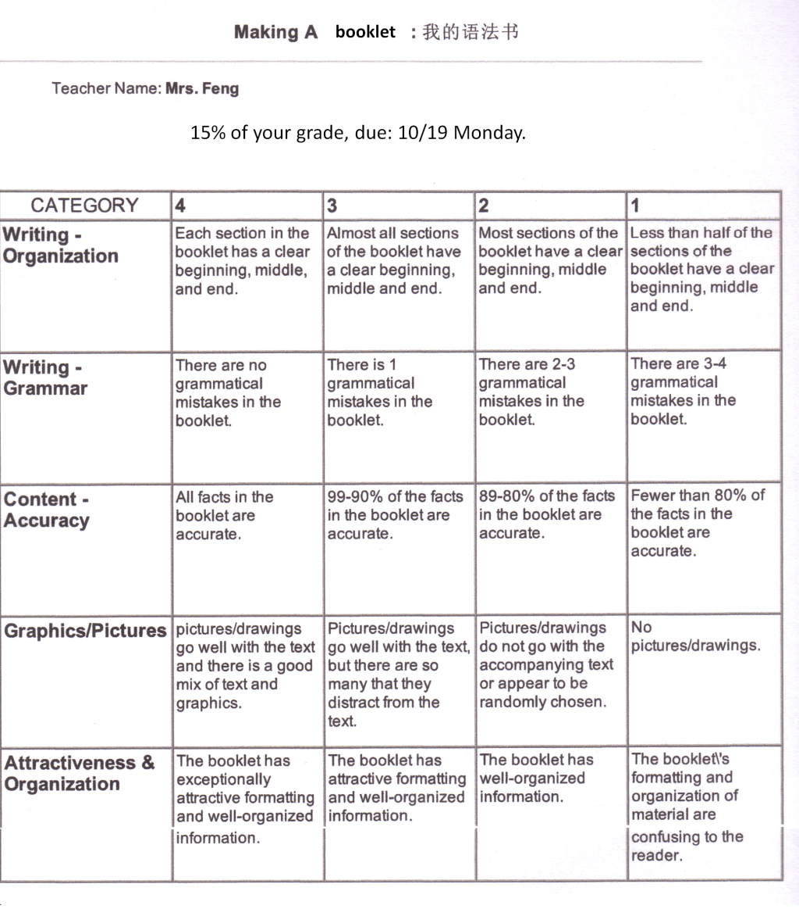
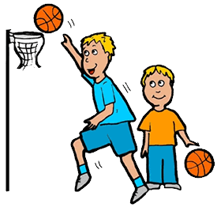
Project: 我的语法书
Fold your construction paper to a booklet.
Front cover:
1st page example:
Page1: …跟…一起
Page 2: 一边…一边…
Page 3: …正在…
Page 4: V.+ duration + N.
Page 5: V. + 了
Page 6: 差不多 + frequency + 都
5. 15% of your grade, due: 10/19 Monday.
我的语法书
姓名：john
班级：中文二
…跟…一起
Structure:
Person 1 跟 person 2 一起 do something
Meaning:
Do something with someone
Sentence:
我跟爸爸一起打篮球。
I play basket ball with dad.
picture/drawing:

Slide 5
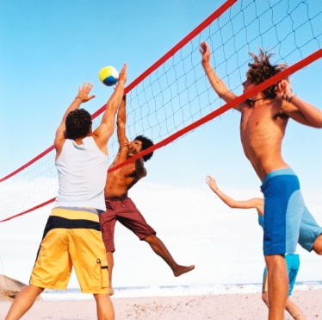
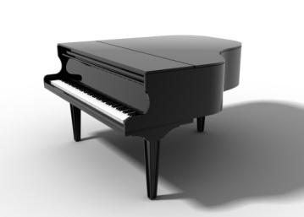
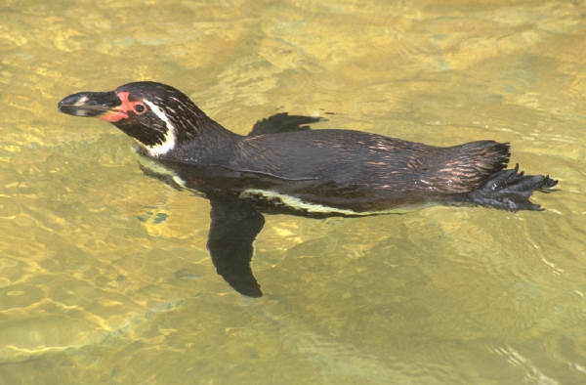
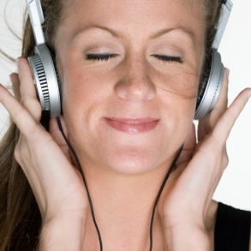
爱好
弹钢琴
唱歌
听音乐
跑步
游泳
打排球

Slide 6
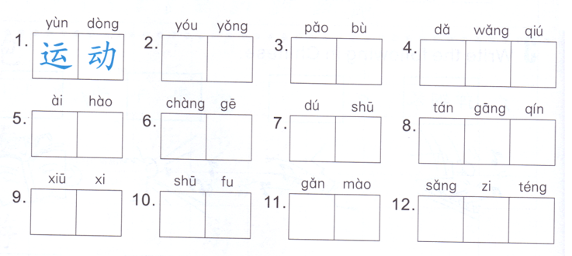
DO NOW

Slide 7
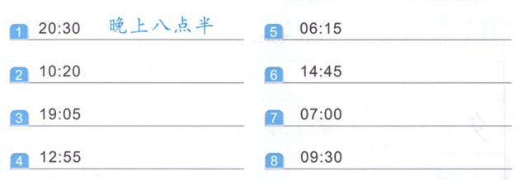
Task 1 Write down the time of the day and the time.
2:45 pm
7:05 pm
Lunch time
Time of day + time
Time of day:
早上—上午—中午—下午—晚上
Time:
Number + 点 + number + 分

Slide 8
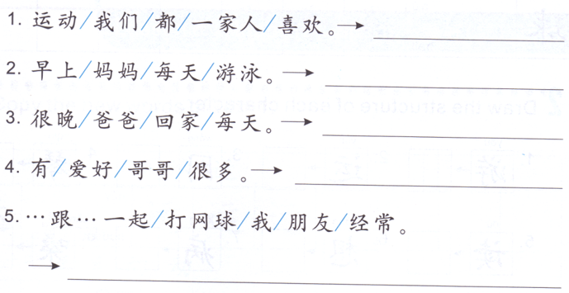
Task 2: Rearrange the words to form sentences.

Slide 9
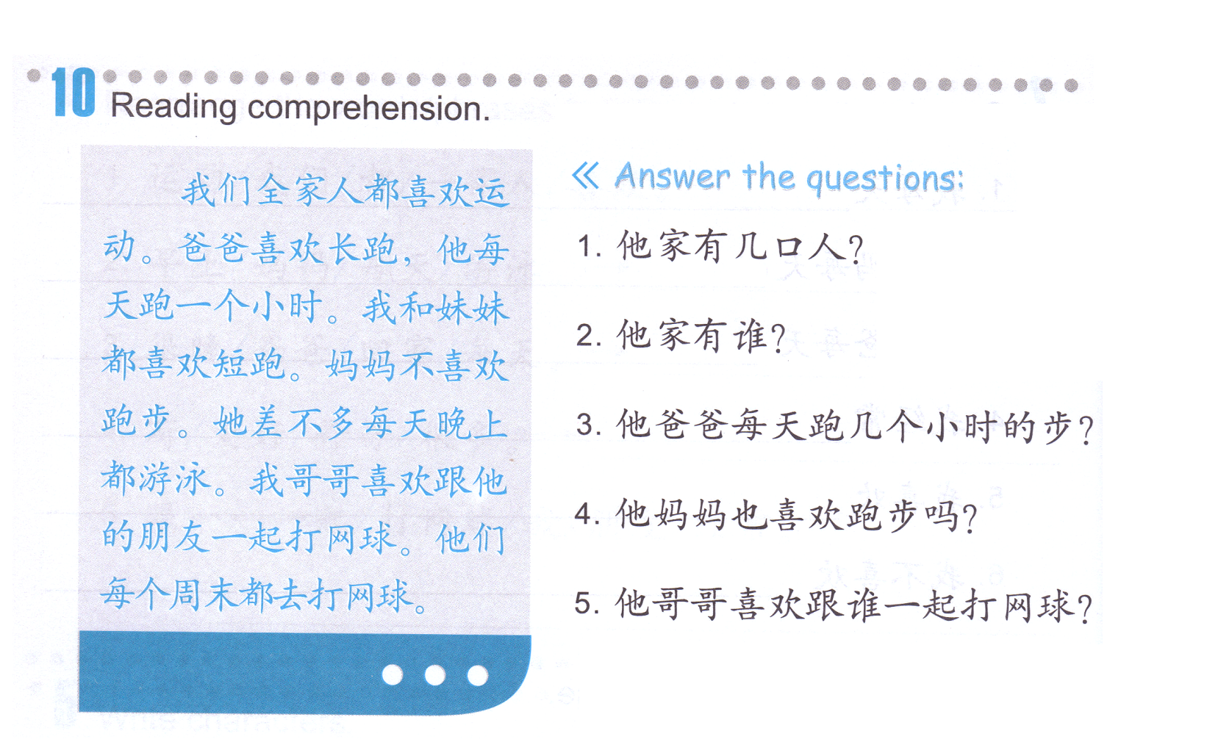
Task 3: Reading comprehension, mark down the answers on the paragraph.
Long distance run
他家有五口人。
他家有妈妈，爸爸，妹妹，哥哥和他。
short distance run
他（爸爸）每天跑一个小时的步。
她不喜欢跑步。
差不多
他（哥哥）喜欢跟他的朋友一起打网球。

