Slide 1
In which sentence would you need the following words?
的，个，您，们
Hello, grandma.
There are 5 people in my family.
That is my book.
Are you guys students?
您
吗
个
的

Slide 2
How old are you? (over 10)
你几岁？ B. 她几岁？ C. 我几岁？
Who is that teacher?
谁是那个老师。
那是谁的老师？
那个老师是谁？
What is that?
这是什么？ B. 那是什么？ C. 什么是那？
Whose mom is she?
是那你的妈妈？
他是谁的妈妈？
她是谁的妈妈？

Slide 3
The omission of “的”
When “de” is used to show relationship, if it’s a close human relationship, “de” is commonly omitted.
Example:
My mom
Wo de ma ma
我的妈妈
Wo ma ma
我妈妈
My family
Wo de jia
我的家
Wo jia
我家

Slide 4
True or false (correct the answer if it’s false)
的
我书包
他的爸爸
你爷爷
我剪刀
他奶奶的书
的

Slide 5
To describe a place/location
zai
Be at/in/on
在

Slide 6
jia
Measure Word for school(s) and majority of the pubic places.
家
2 schools
2 + jia + school
Liang jia xue xiao
两家学校

Slide 7
study
eat
work
Xue xi
Chi fan
Gong zuo
学习
吃饭
工作

Slide 8
Someone works/studies/eats at a place.
Someone + at + a place + works/studies/eats.
Someone + zai + a place + works/studies/eats.
Someone + 在 + a MW place + 工作/学习/吃饭。

Slide 9
I work at a school.
I at a school work.
Wo zai 1 + MW + school gong zuo.
我在一家学校工作。

Slide 10
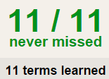
我 | 你 | 他 | 她 | 妈妈 | 爸爸
妹妹 | 弟弟 | 姐姐 | 哥哥 | 爷爷 | 奶奶
朋友 | 男朋友 | 女朋友 | 儿子 | 女儿 | 和
小学 | 初中 | 高中 | 大学 | 公司 | 邮局
警察局 | 医院 | 图书馆 | 商店 | 饭店 | 餐厅
上学 | 工作 | 吃饭 | 卖东西 | 买东西 | 学生
老师 | 经理 | 工人 | 警察 | 医生 | 服务员
Homework: QUIZLET 09/01 Homework (5 tasks)
Will be your quiz (dictation) on 09/02
Flashcard-Go over all the words.
Learn-Make sure you finish 100%
Speller-Make sure you finish 100%
4. Scatter-The time needs to be within 40 seconds.
5. Test- click “Create New Test” after you change the settings to:
10/10
100%!!
10/10
DONE!!!
10
Less than 40
Class assignment:
You choose 5 people to write about, for each person, you write 3 sentences (job, age, work place).
Example:
Person 1 :my mom
1st: my mom 是 teacher。(job)
2nd: She 35 岁。(age)
3rd: She 在一家 school work。(work place)
Use quizlet 08/31 class assignment reference as the reference.
Use as many words as possible.
Question types
Written
Matching
Multiple choice
True false
Start with
Chinese(pin yin)
English
Both
Question Limit
10 of 10 available terms

Slide 11
我 | 你 | 他 | 她 | 妈妈 | 爸爸
妹妹 | 弟弟 | 姐姐 | 哥哥 | 爷爷 | 奶奶
朋友 | 男朋友 | 女朋友 | 儿子 | 女儿 | 和
小学 | 初中 | 高中 | 大学 | 公司 | 邮局
警察局 | 医院 | 图书馆 | 商店 | 饭店 | 餐厅
上学 | 工作 | 吃饭 | 卖东西 | 买东西 | 学生
老师 | 经理 | 工人 | 警察 | 医生 | 服务员
Homework: QUIZLET 08/31 Homework (5 tasks)
Will be your quiz (dictation) on 09/02
Flashcard-Go over all the words.
Learn-Make sure you finish 100%
Speller-Make sure you finish 100%
4. Scatter-The time needs to be within 40 seconds.
5. Test- click “Create New Test” after you change the settings to:
10/10
100%!!
10/10
DONE!!!
10
Less than 40
Class assignment:
You choose 5 people to write about, for each person, you write 3 sentences (job, age, work place).
Example:
Person 1 :my mom
1st: my mom 是 teacher。(job)
2nd: She 35 岁。(age)
3rd: She 在一家 school work。(work place)
Use quizlet 08/31 class assignment reference as the reference.
Use as many words as possible.
Question types
Written
Matching
Multiple choice
True false
Start with
Chinese(pin yin)
English
Both
Question Limit
10 of 10 available terms

Slide 12
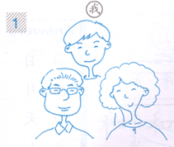
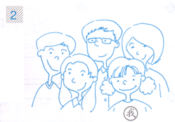
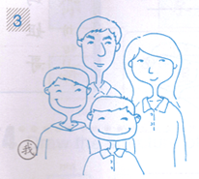
Character writing：
UNIT 1 TEST
Study Guide
Part 1
1.你 2.我 3.他 4.他 5.的 6.们 7.在 8.个 9.家 10.有
Matching：
1.笔 2.尺子 3. 剪刀 4. 橡皮 5. 书
Describe the picture using the following sentences：
我家有___个人，他们是____,____和____。
Rearrange the numbers from big to small or small to big.
九十九，一，九，十六，二十七，三，五十，六十，七十九，三十八，四十四，八十二
Finish the conversation in characters:
A:你好。
B:_____。
A:我是Mary,你是谁？
B:___是John.
A:我十五岁，是学生。
B:我也(also)十五___。
A:我家___五个人，他们是___，爸爸，妈妈和两个姐姐。
B:我也（also) 有___个姐姐。
A:这是______书？
B:这是我的书。

Slide 13
closure

Slide 14
Nan hai zi
Nü hai zi
Boy(s)
Girl(s)
男孩子
女孩子

Slide 15
kou
(kǒu) can be the measure word for the number of family members. You can also use 个 (ge) instead.
口
There are 3 people in my family.
My family has 3 people.
Wo (de) jia you san kou ren.
我（的）家有三口人。

Slide 16
ma
Question word – When you are expecting “yes/no” answer.
吗
Examples:
Are you a student?
2. Is this your book?
3.Are you American?

Slide 17
“是”questions:
Is this your book bag?
This is your book bag ma?
zhè shì nǐ de shū bāo ma?
这是你的书包吗？

Slide 18
shì
“是”answers:
bú shì
Yes/am/is/are
No/am not/is not/are not
是
不是

Slide 19
“是”answers: YES.
Yes, this is my book bag.
shì , zhè shì wǒ de shū bāo .
是，这是我的书包。
Chinese answer YES to a question by repeating the verb used in the question.

Slide 20
“是”answers: NO.
No , this is not my book bag.
bú shì , zhè bú shì wo de shū bāo.
不是，这不是我的书包。
Chinese answer NO by saying the negative form of the verb used in the question, which is bú shì不是。

Slide 21
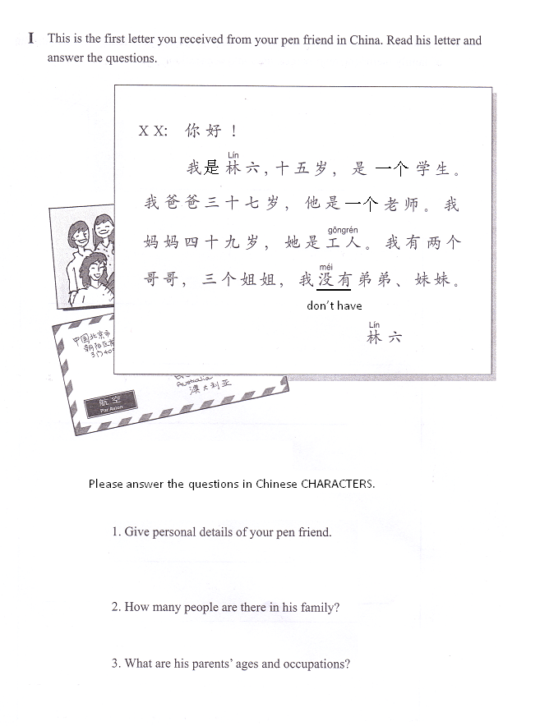
他是林六，十五岁，是一个学生。
他家有八/口人。
他爸爸三十七岁，他是一个老师。 他妈妈四十九岁，她是工人。

Slide 22
Class Assignment:
Draw a picture of 4 people.
Write a conversation to describe the picture, using the template below.
You conversation needs to match your picture.
你: 这是你的照片(picture)吗？
你的朋友: 是。这是my person 1，这是my person 2。
你: 这个person/girl/boy是谁?
你的朋友: She/he是my person 3。
你: 这个person/girl/boy是your person 4吗？
你的朋友: 不是，he/she是my…。
你: Your person 4 has brother/sister…吗？
你的朋友: he/she 没有(doesn’t have)… 。

Slide 23
Homework: QUIZLET 09/02 Homework (5 tasks)
Flashcard-Go over all the words.
Learn-Make sure you finish 100%
Speller-Make sure you finish 100%
4. Scatter-The time needs to be within 40 seconds.
5. Test- click “Create New Test” after you change the settings to:
10/10
100%!!
10/10
DONE!!!
10
Less than 40
Question types
Written
Matching
Multiple choice
True false
Start with
Chinese(pin yin)
English
Both
Question Limit
10 of 10 available terms

