Slide 1
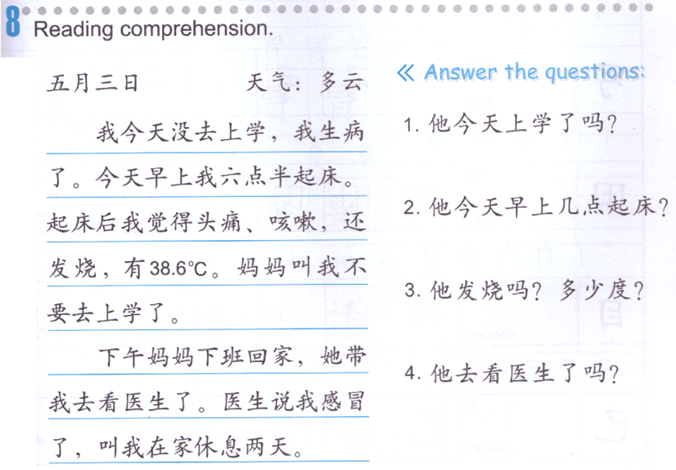
DO NOW-mark down the question words.

Slide 2
Add level 2 Quizlet class
Do
生病1
生病2
生病3

Slide 3
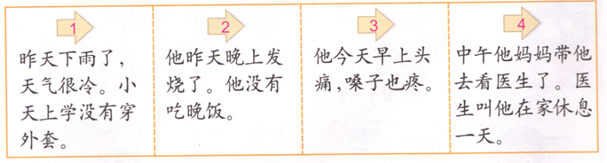
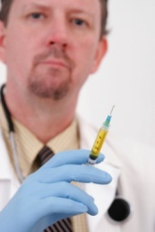
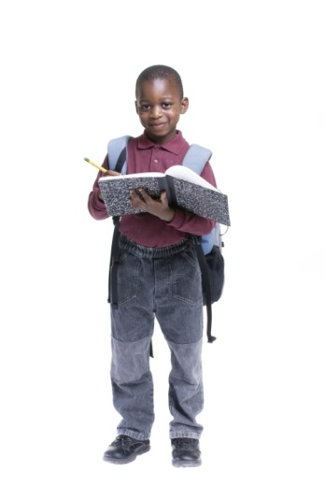
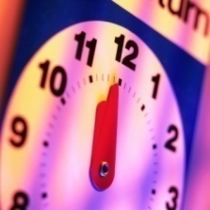

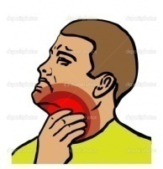
Task 1
Name:
Date:

Slide 4
Task 2

Slide 5
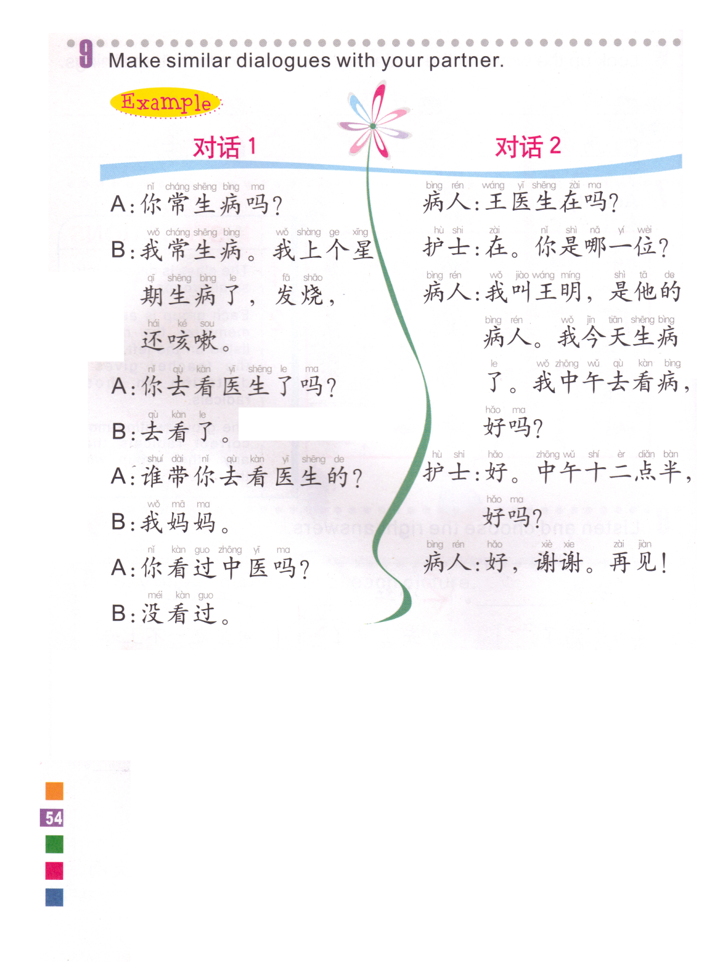
Task 3
A: Does your grandma often get sick?
B: Yes. She got sick last month, she was having a fever, a cold. She was also coughing.
A: Has she seen her doctor?
B: Yes.
A: Who took her to see her doctor?
B: My mom.
A: Has she seen a traditional Chinese doctor?
B: Yes./No.
Is Doctor Wang there?
常=常常often
上个星期=last week
Yes, Who is this?
Next week
下个星期
This is WM, I am his patient. I got sick today. I will go to hospital at noon, is it ok?
Do you get sick often?
yes. I was sick last week, I had a fever and I was coughing.
Ok. ! 12:30 at noon, is it good?
了？
Did you see your doctor?
That’s good, thank you. Bye.
Yes.
Who took you to see doctor?
My mom.
“去过”
Have been to
看过
Have seen
中医 zhong yi
traditional Chinese doctor
Have you see any traditional Chinese doctor?
No.

Slide 6


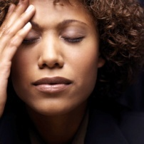
生病
生病
看医生
没有
头痛
发烧
咳嗽

