Slide 1
DO NOW: Matching.
Purpose game: You will need to get 7 correct answers to get a 100!

Slide 2
青菜=蔬菜

Slide 3
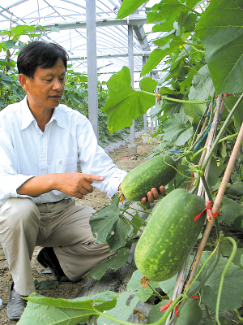
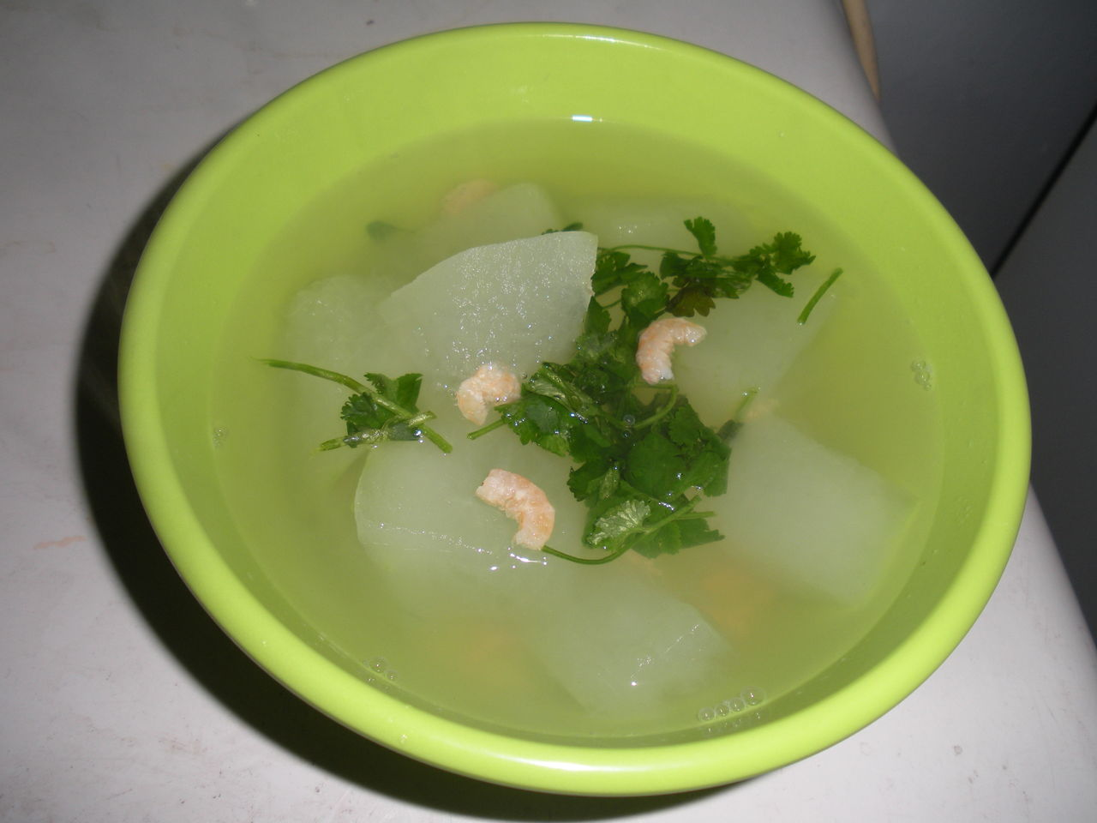
冬瓜

Slide 4
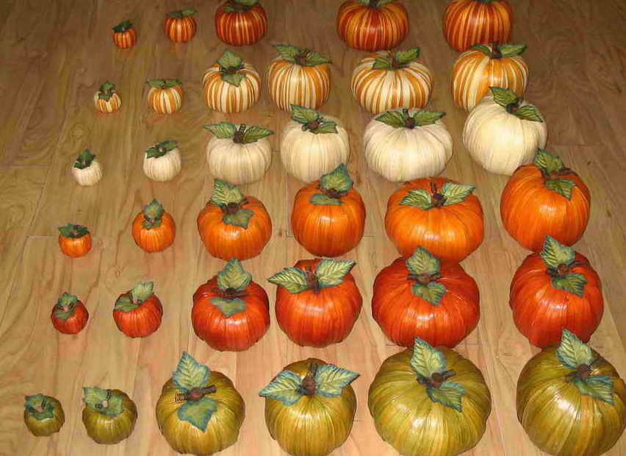
南瓜

Slide 5
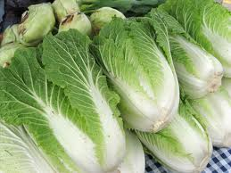
大白菜

Slide 6
A,B,C, I + 都 + like +V.

Slide 7
生
蔬
生菜 lettuce
蔬菜 vegetable
菜花(儿） cauliflower
花

Slide 8
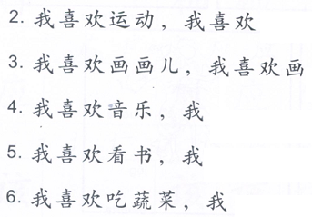
…,…等等。
…,…etc.
1. 我喜欢水果，我喜欢苹果，香蕉等等。

Slide 10
should
Subject + from + age + start + do something
Let’s
Besides...also…

Slide 11
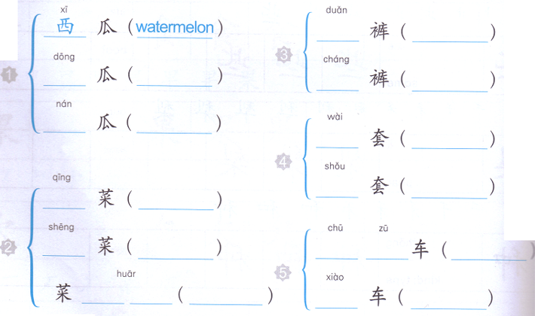
DO NOW:

Slide 12
QUIZ- Matching.
Purpose game: You will need to get 7 correct answers to get a 100!
http://www.purposegames.com/game/match-the-nouns-with-the-verbs-quiz

Slide 13
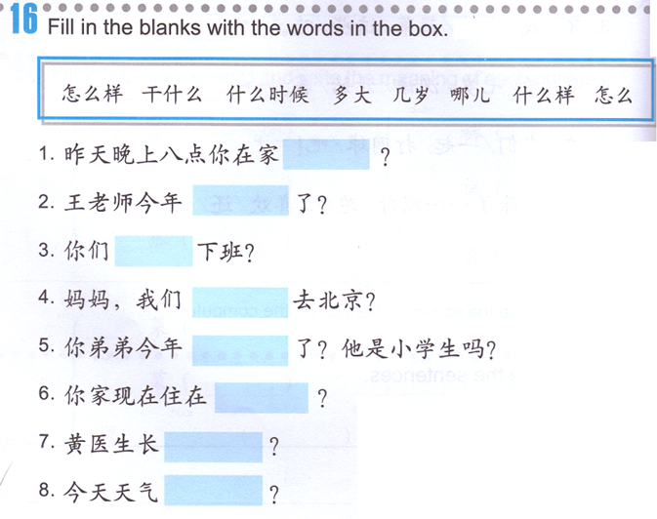
Group Assignment:
How’s
Do what
When
How old
(adults)
How old
(kids)
Where
What does someone look like?
How

Slide 14
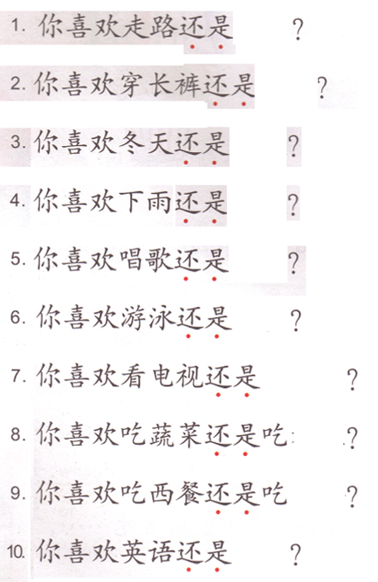
Task 1: Choose 1 word to put in each sentence and write the complete sentences on a separate sheet of paper.
A 还是 B？ A or B?
坐公共汽车
短裤
中文
西班牙语
晴天
下雪
裙子
法餐
坐出租车
秋天
夏天
德语
阴天
看电影
春天
跳舞
中餐
跳高
玩电脑游戏
日餐
篮球
弹钢琴
水果
跑步
开车

Slide 15
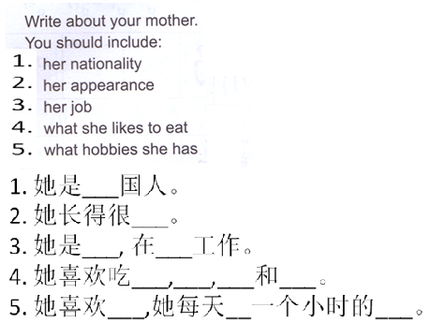
Task 2: On the same paper where you put Task 1 on.

Slide 16
黄色
红色
蓝色
水果
妈妈
你
爸爸
家
？
？
猫
狗
马
动物
？

Slide 17
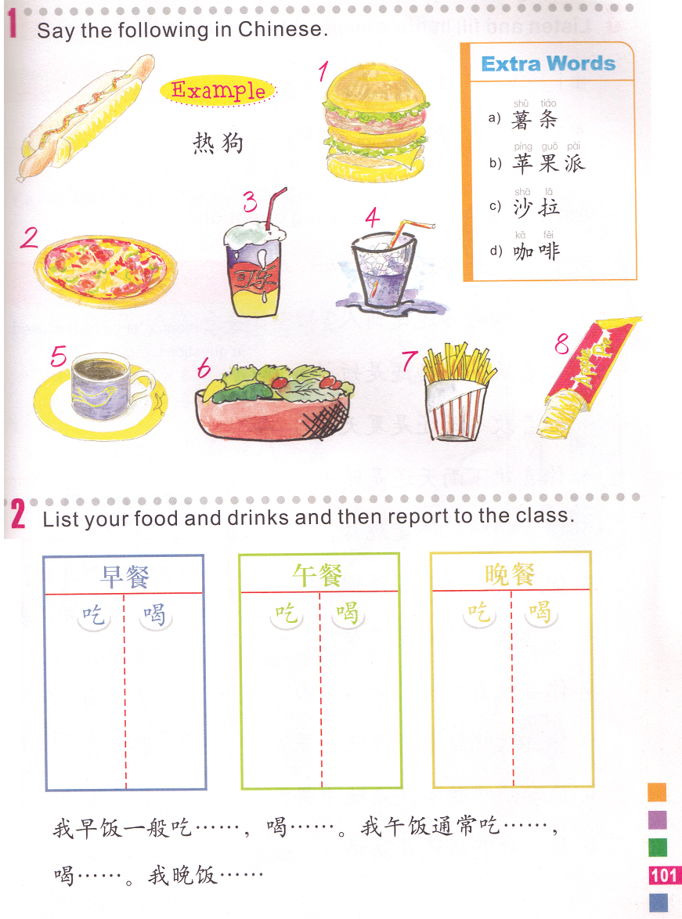
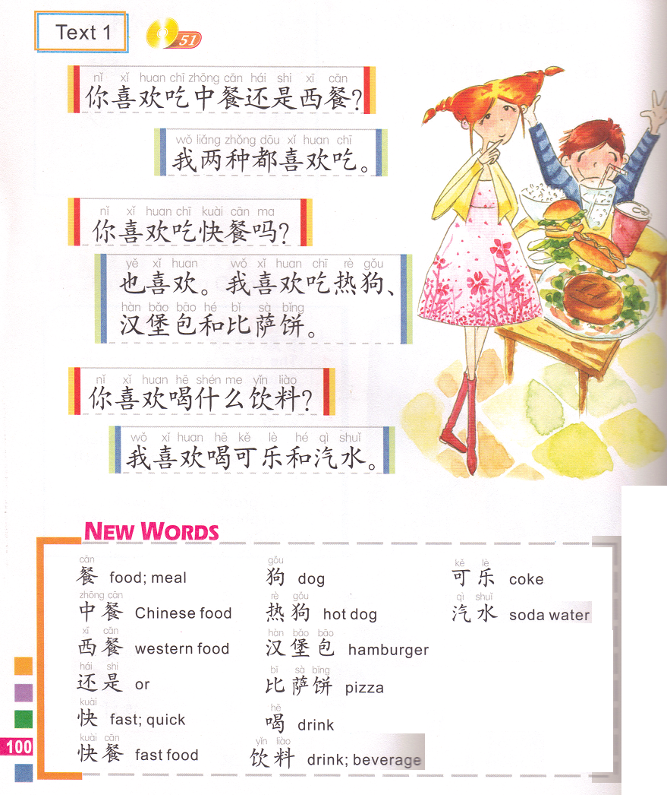
汉堡包
Do you like (eating) Chinese food or western food?
I like (eating) both.
Do you like (eating) fast food?
比萨饼
汽水
我
可乐
I (also) like fast food. I like (eating) hamburgers & pizza.
D 咖啡
C 沙拉
A 薯条
B 苹果派
What beverage do you like (drink)?
I like (drinking) coke and soda water.
usually
usually
经常吃…,喝…
usually

Slide 18
黄色
红色
蓝色
颜色
妈妈
你
爸爸
家
猫
狗
马
动物

Slide 19
IF you do NOT have any missing assignment, please translate the conversation in characters on the same paper.
A: Does your little brother like eating fruits?
B: He likes fruits very much.
A: What fruits does he like?
B: He likes strawberries, watermelons, apples and bananas. What about you?
A: I don’t like those fruits, I like pears the most.
B: Do you eat fruits everyday?
A: I eat 2 kinds everyday. What about you?
B: I don’t eat fruits everyday. But my mom says that I should eat fruits everyday.
A:
B:
A:
B:
A:
B:
A:
B:

Slide 20
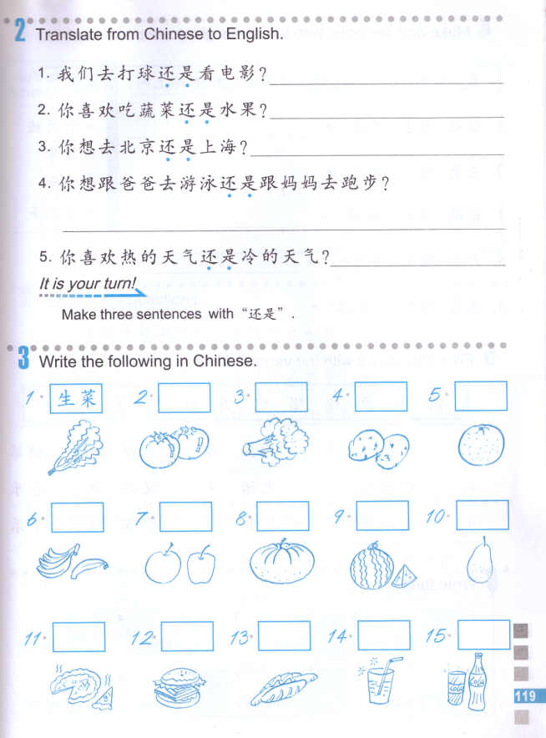
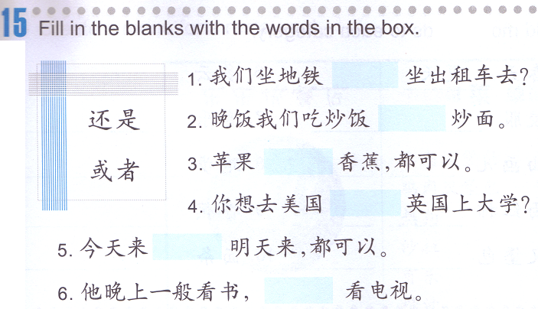

Slide 21
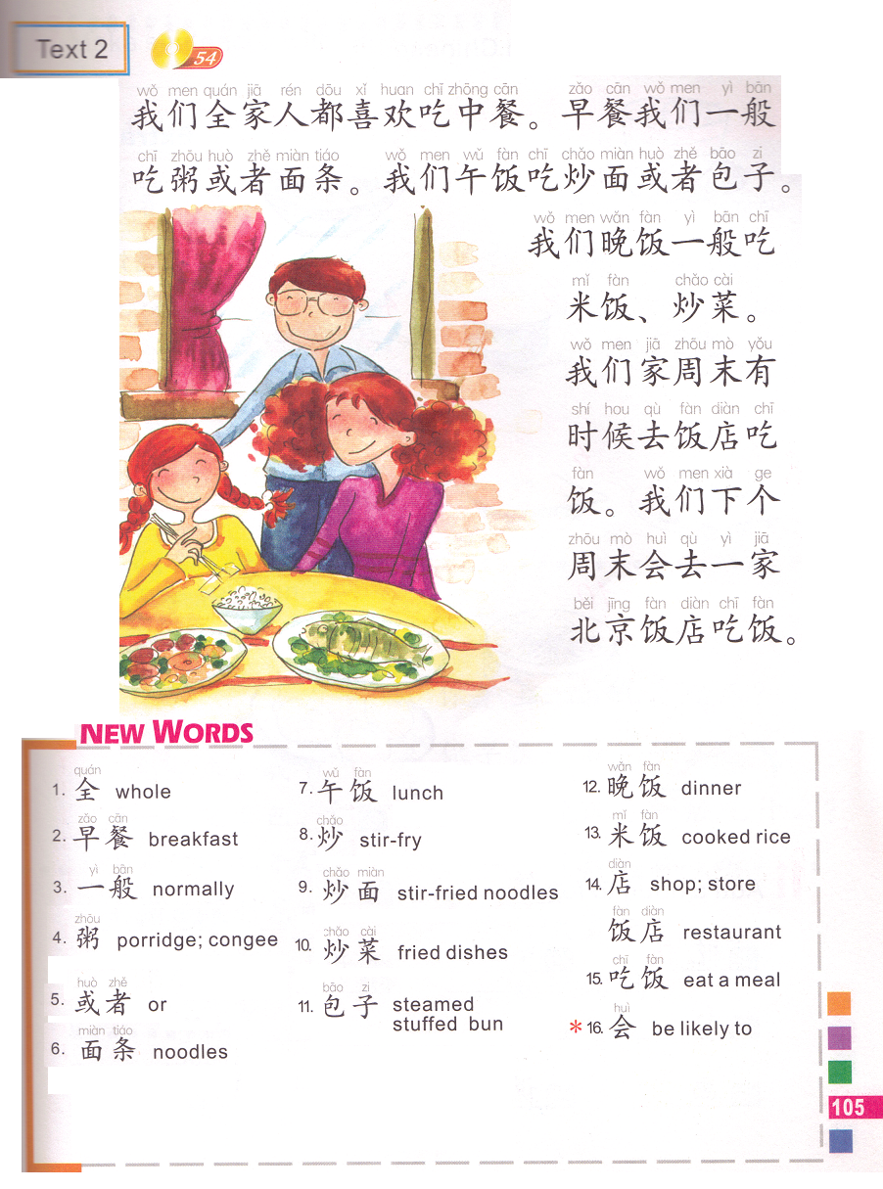
Our whole family all like eating Chinese food.
We normally eat porridge or noodles for breakfast.
We eat stir-fried noodles or steamed stuffed buns for lunch.
We normally eat rice (and) fried dishes for dinner.
Our family go to a restaurant to eat(go out to eat) sometimes on weekends.
We are likely to (going to) go to a BJ restaurant to eat next weekend.

