Slide 1
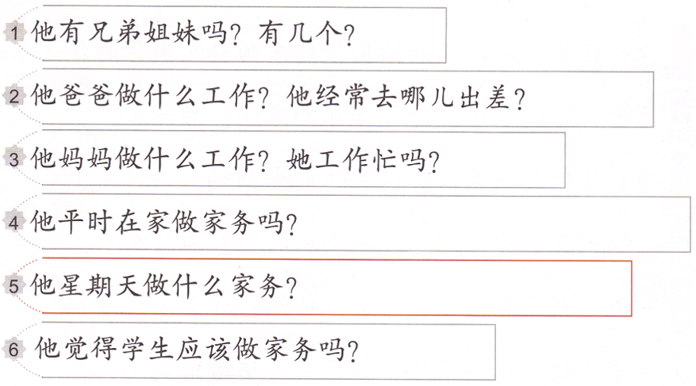
Task 2 Listen to jfeng1.wix.com/Chinese and answer the questions.
(1-4 & 6) Numbers or yes/not 5:write down the chore you heard
Task 2 Listen to jfeng1.wix.com/Chinese and answer the questions.
(1-4 & 6) Numbers or yes/not 5:write down the chore you heard
Task 2 Listen to jfeng1.wix.com/Chinese and answer the questions.
(1-4 & 6) Numbers or yes/not 5:write down the chore you heard
Task 2 Listen to jfeng1.wix.com/Chinese and answer the questions.
(1-4 & 6) Numbers or yes/not 5:write down the chore you heard

Slide 2
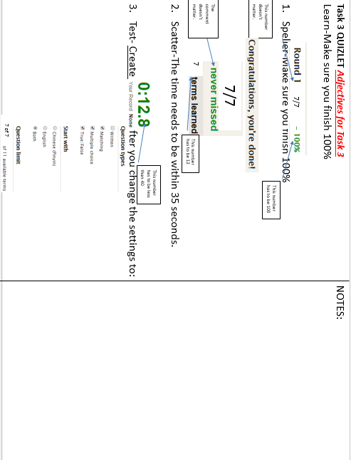

Slide 3
Task 4
Write a paragraph using the following sentence structures. (IB Level 1 requires more details)
Talk about who does what house chores in your household.
Make sure you use the words you learned in this unit.
Using:
我家有…。(number + MW + 人)
我是…(student)，妈妈是…,爸爸是…。
我平时在家…(always/often/sometimes/never)做家务。
我从…(Monday/Tuesday…)到(Friday/Saturday…)会…(chore1)和…(chore2)。
我周末的时候还会帮妈妈和爸爸…(chore3)。父母经常跟我说，…(I am a good child./I am very helpful (I + very + 爱帮忙。)…
我不太会…(chore4)，因为…。(example: 我不太会剪草，因为剪草很难。)
我…(很/非常/特别)喜欢做家务，我觉得…。(N. + 太 + adj. + 了！)
(做家务 + 太 + 难/累/脏/烦人 + 了！)
(做家务 + 太 + 好/有用/轻松 + 了！)

