Slide 1
“自己” 是什么？
我自己的=我的
你自己的=你的
她自己的=她的
他自己的=他的

Slide 2
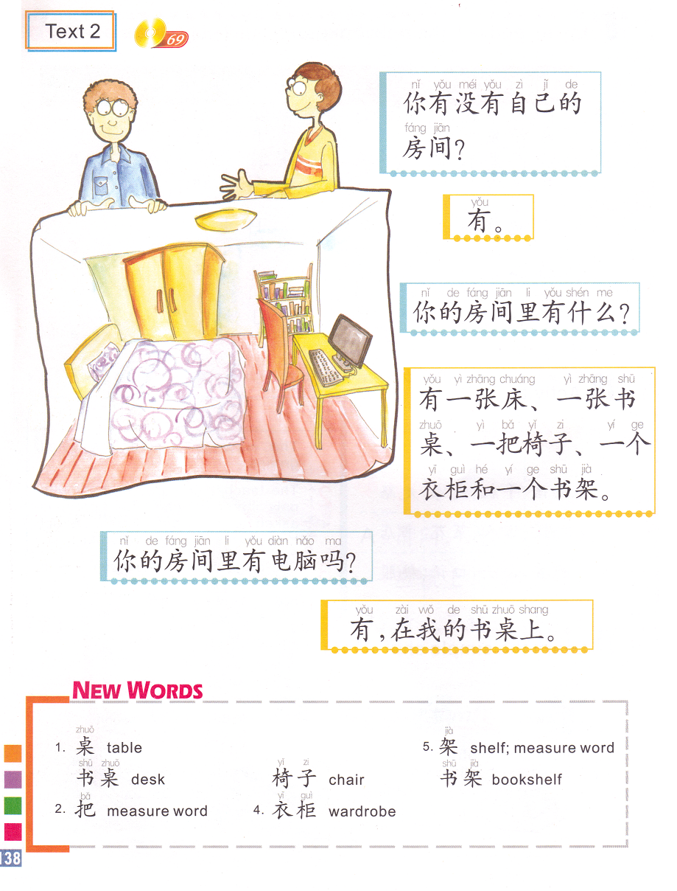
自己的 one’s own
Do you have your own room?
你有没有自己的房间？
=
你有自己的房间吗？
Yes.
What do you have in your room?
There is a bed, a desk, a chair, a wardrobe and a bookshelf in my room.
我的房间里面
Is there a computer in your room?
Yes, the computer is on my desk.
有，我的电脑在我的书桌上面。
床: bed
书桌: writing desk
椅子:chair
衣柜:wardrobe
书架:bookshelf
房间:room
你的房间里: in your room
MW:
张
把
个

Slide 3
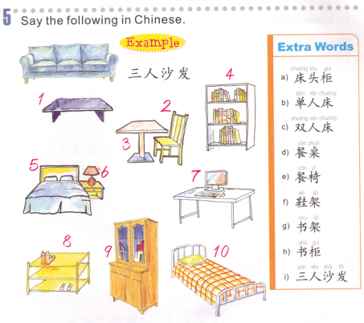
Task 1: Use the hints to figure out all the furniture:
床-bed 桌子-table/desk 鞋: shoes 椅子:chair 书: books 茶: tea
I
G
K
E
D
C
A
J
F
H
B
J.电脑桌
K.茶几

Slide 4
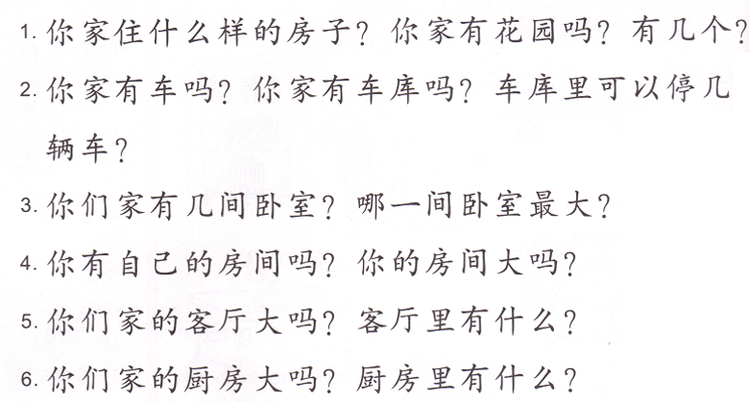
Task 2: Groups of 2 students (Class Assignment grade)
WRITE YOUR ANSWERS ON YOUR OWN PAPER, EACH GROUP ONLY NEEDS TO TURN IN ONE.
Answer the questions bases on the picture you are assigned in complete sentences.
在几层?
At least 3 items
Number + MW + item
You say:
我家住大/小房子。
我家有…口人。
我家有一个车库。

Slide 5
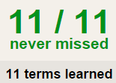
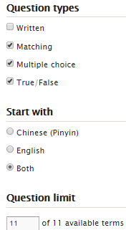
Task 3 QUIZLET Furniture 1 each section is 20%
Learn-Make sure you finish 100%
Speller-Make sure you finish 100%
Scatter-The time needs to be within 35 seconds.
Test- Create New Test after you change the settings to:
NOTES:
10/10
This number has to be 100
This number doesn’t matter.
10/10
The comment doesn’t matter.
10
This number has to be 12
This number has to be less than 40
10 of 10

Slide 6
客厅
你的房间
厨房

Slide 7
1 car garage
你的房间
厨房
客厅

Slide 8
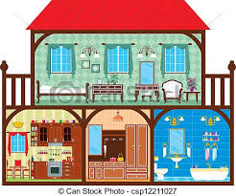
2 cars garage
你的房间
厨房&客厅

Slide 9
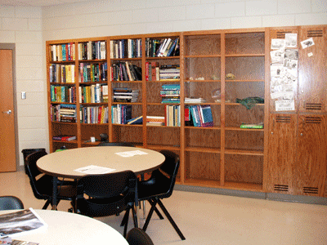
在二层 有两层
True or false
我的书房有六把椅子
我的书架很大很高。
我没有很多书。
我的桌子都是黑色的。
书房里有一张桌子。
书柜在书架的右面。
我的书房可以坐四个学生。

Slide 10
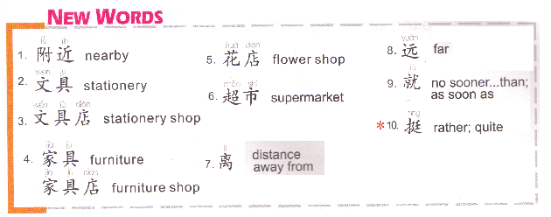
1. Place附近有…
2.等=等等 etc.
3. Place 1 离 place 2 … (See 2)
4. Walk + Duration (5 minutes) + 就到了。
It takes 5 minutes to walk there .

Slide 11
Task 1 QUIZLET Places 1 each section is 20%
Learn-Make sure you finish 100%
Speller-Make sure you finish 100%
Scatter-The time needs to be within 35 seconds.
Test- Create New Test after you change the settings to:
NOTES:
10/10
This number has to be 100
This number doesn’t matter.
10/10
The comment doesn’t matter.
10
This number has to be 12
This number has to be less than 40
10 of 10

Slide 12
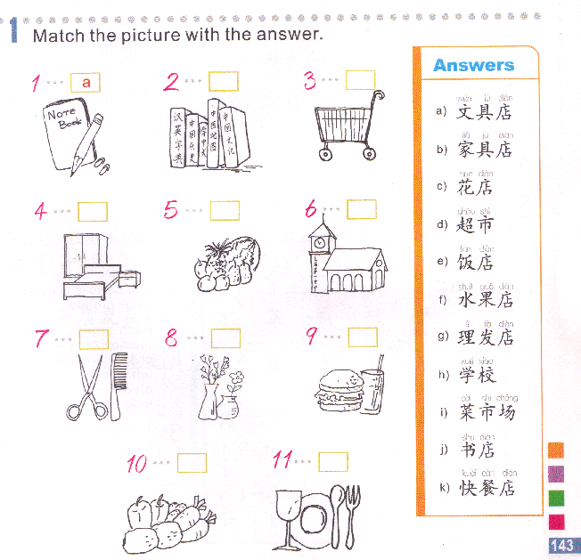
Task 2

Slide 13
Task 3
Not too far
Quite far
Quite close
Very close

Slide 14
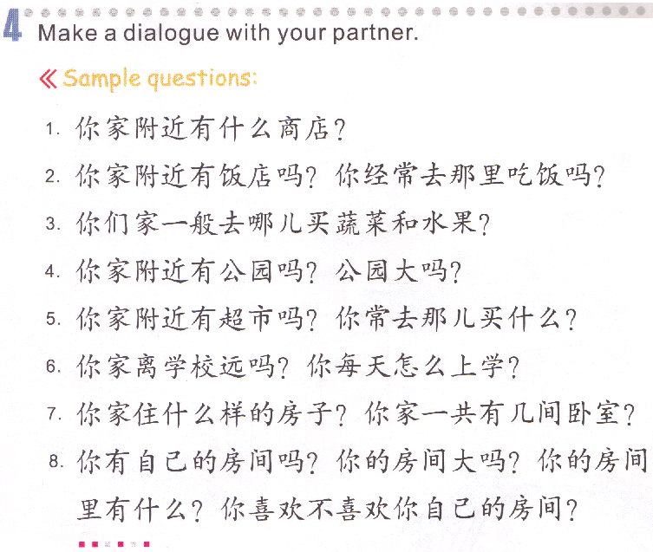
Task 4
When you answer, you need to change all the 你 to 我。
Change 什么商店 to any kind of shop or store, keep everything else.
Q1: take out 吗，keep everything else. Q2: take out 吗，keep everything else.
Change 哪儿 to supermarket, grocery market or fruit market, keep everything else.
Q1: Take out 吗，keep everything else. Q 2: Take out 吗，add 很/非常/特别 in front of 大 or add 不 in front of 大, keep everything else.
Q1: Take out 吗，keep everything else. Q 2: change 什么 to the stuff you buy in the supermarket, keep everything else.
Q1: Take out 吗， add 很/非常/特别 in front of 远 or add 不 in front of 远。Q2: Change 怎么 to drive a car/ ride school bus/walk, keep everything else.
Q1: Change 什么样的房子 to what kind of house you live in (big house/small house)，keep everything else.Q2: Change 几 to a number, keep everything else.
Q1: Take out 吗, keep everything else. Q2: Take out 吗，add 很/非常/特别 in front of 大 or add 不 in front of 大, keep everything else.Q3: Change 什么 to at least 2 kinds of furniture in your room, add 和 in between last 2 furniture, keep everything else. Q4: Yes answer: take out the 不喜欢 part, keep everything else. No answer: take out the 喜欢 part, keep everything else.

Slide 15
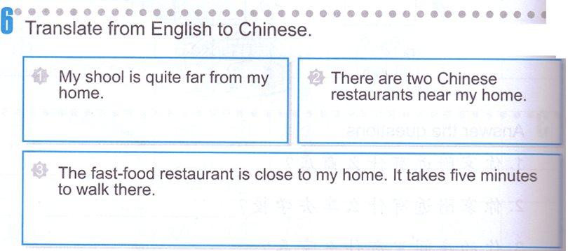
DO NOW
Reference: Last time’s notes.

Slide 16
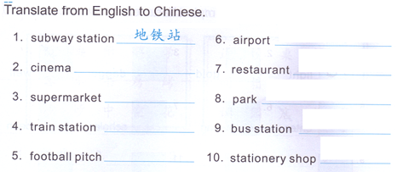
Task 1: write down the Chinese words on the lines.
Reference: QUIZLET Places 1&2
Next time you will have a MATCHING quiz. 10 words out of QUIZLET Places 1&2.
STUDY! STUDY! STUDY!
Movie theater
zoo
Shoe store
library

Slide 17
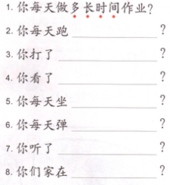
TASK 2 : Complete the questions.
Subject + (everyday/every morning…) + V. + (了) + how long + N.?
你 每天 打 多长时间 篮球？
run
ballgame
TV/movie/book
car
piano
music
Place + live + 了
+ how long?

Slide 18
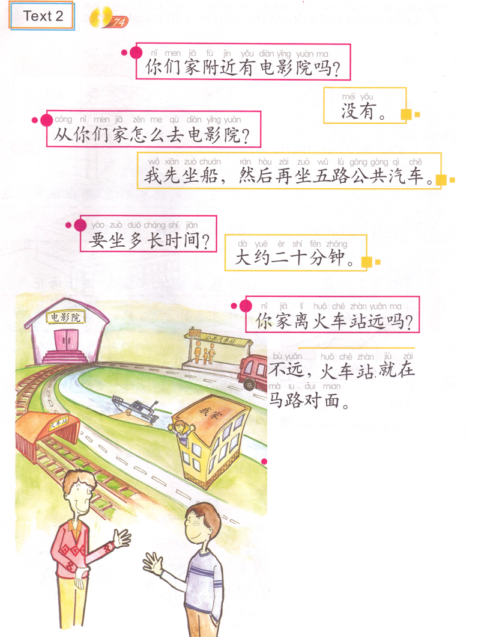
从place A 怎么去 place B?
How do you get to place B from place A?
Is there any movie theater nearby your house?
How do you get to the movie theater from your house?
2. … 先…然后… first…then…
我先坐船，然后坐公共汽车。
No.
3. 你要坐多长时间公共汽车？
You + need to + ride/drive + how long + public bus?
How long does your bus ride take?
I ride a boat first, then ride Route 5 public bus.
你
About 20 minutes.
How long does your ride take?
4. 大约: About
Is the train station far from your house?
A: Is there any book store nearby your house?
B: No.
A: How do you get to the book store from your house?
B: I ride a public bus first, then walk.
A: How long does the bus ride take?
B: About 10 minutes.
A: Is the bus stop far form your house?
B: Very close.
Not far, the train station is across the street from my house.
TASK 3: Translate the conversation based on the reference on your own paper.

Slide 19
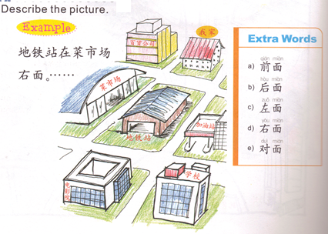
TASK 4 :”对” 还是 “错”, if it is “错”的，correct it.
我家
百货公司
菜市场
上/后
右
下/前
左
中间
加油站
地铁站
学校
电影院
1
地铁站离我家很远。 ( )
加油站在学校的后面。 ( )
电影院和学校都离我家不远。 ( )
百货公司在加油站的右面。 ( )
地铁站在我家和电影院的中间。 ( )
2
3
4
5

Slide 20
Task 5 QUIZLET Places 2 each section is 20%
Learn-Make sure you finish 100%
Speller-Make sure you finish 100%
Scatter-The time needs to be within 35 seconds.
Test- Create New Test after you change the settings to:
NOTES:
10/10
This number has to be 100
This number doesn’t matter.
10/10
The comment doesn’t matter.
10
This number has to be 12
This number has to be less than 40
10 of 10

Slide 21
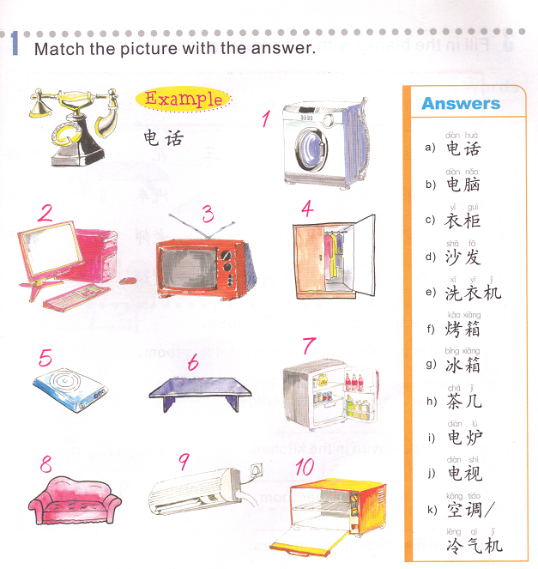
E
B
J
C
I
H
G
K
D
F

Slide 22
TASK 1:
Subject + 先 + V. + transportation, 然后 + V. + transportation + go to a place.
1. Ride a boat & ride a taxi. Go to New York
3. Walk & ride subway. Go to school
2. Drive a car & ride a train. Go to work
4. Walk & ride a train. Go to school
6. Ride public bus & walk. Go to my house.
5. Walk & ride public bus. Go to the park.

Slide 23
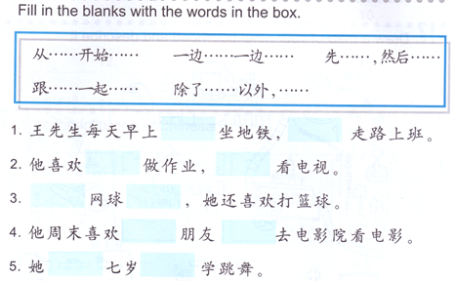
TASK 2:
From…start…
Do 2 things at the same time
First…then…
Do something with someone
Besides…

Slide 24
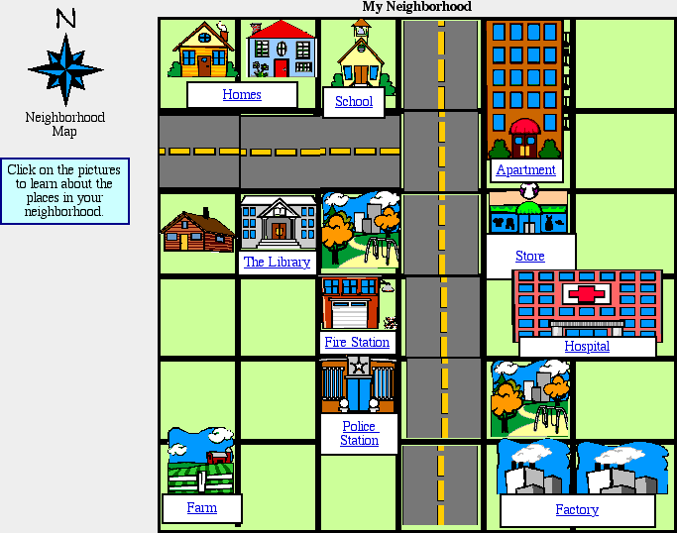
Task 3:
Describe this neighborhood.
You will need to use at least use:
2 在sentences,
A在B（的）+ P.
2 离 sentences,
A离B quite far/close/not far/close.
2 附近 sentences,
A 附近有 B.
You are required to write 6 places on the picture.
You need to describe if they like the neighborhood and how much you like it or not.
我很/非常/特别喜欢我的社区。

Slide 25
1. 超市
2.书店
3.饭店
4.理发店
5.学校
6.动物园
7.飞机场
8.图书馆
9.医院
10.鞋店

Slide 26
Task 4 QUIZLET Places 3 each section is 20%
Learn-Make sure you finish 100%
Speller-Make sure you finish 100%
Scatter-The time needs to be within 35 seconds.
Test- Create New Test after you change the settings to:
NOTES:
10/10
This number has to be 100
This number doesn’t matter.
10/10
The comment doesn’t matter.
10
This number has to be 12
This number has to be less than 40
10 of 10

