Slide 1
Research based mini project:中国新年 (Chinese New Year)
Format: Mini poster on construction paper
Grade: will be a TEST grade (35% of your overall grade)
You must finish the project TODAY in class and turn it in at the end of the period.
Why is 中国新年 also called Spring Festival ?
How many days do Chinese people celebrate 中国新年? (5 or 10 or 15)
When is 中国新年 this year? (from…to…)
List at least 1 tradition that Chinese people do on each day of the 中国新年celebration.
List 3 中国新年 traditional food.
Choose 3 of the following 中国新年 traditions to explain : (At least 50 words each)
You will need to draw some pictures to match what you write
A: 守岁(shou sui) B: 红包(hong bao)/压岁钱(ya sui qian) C: 年夜饭(nian ye fan)
D: 春运(chun yun) E: 春联(chun lian) F: 年画(nian hua) G: 爆竹(bao zhu)
7. You will each get 1 sheet of construction paper, you can decide how you will use it.
Example: 5th day: eat dumplings.

Slide 2
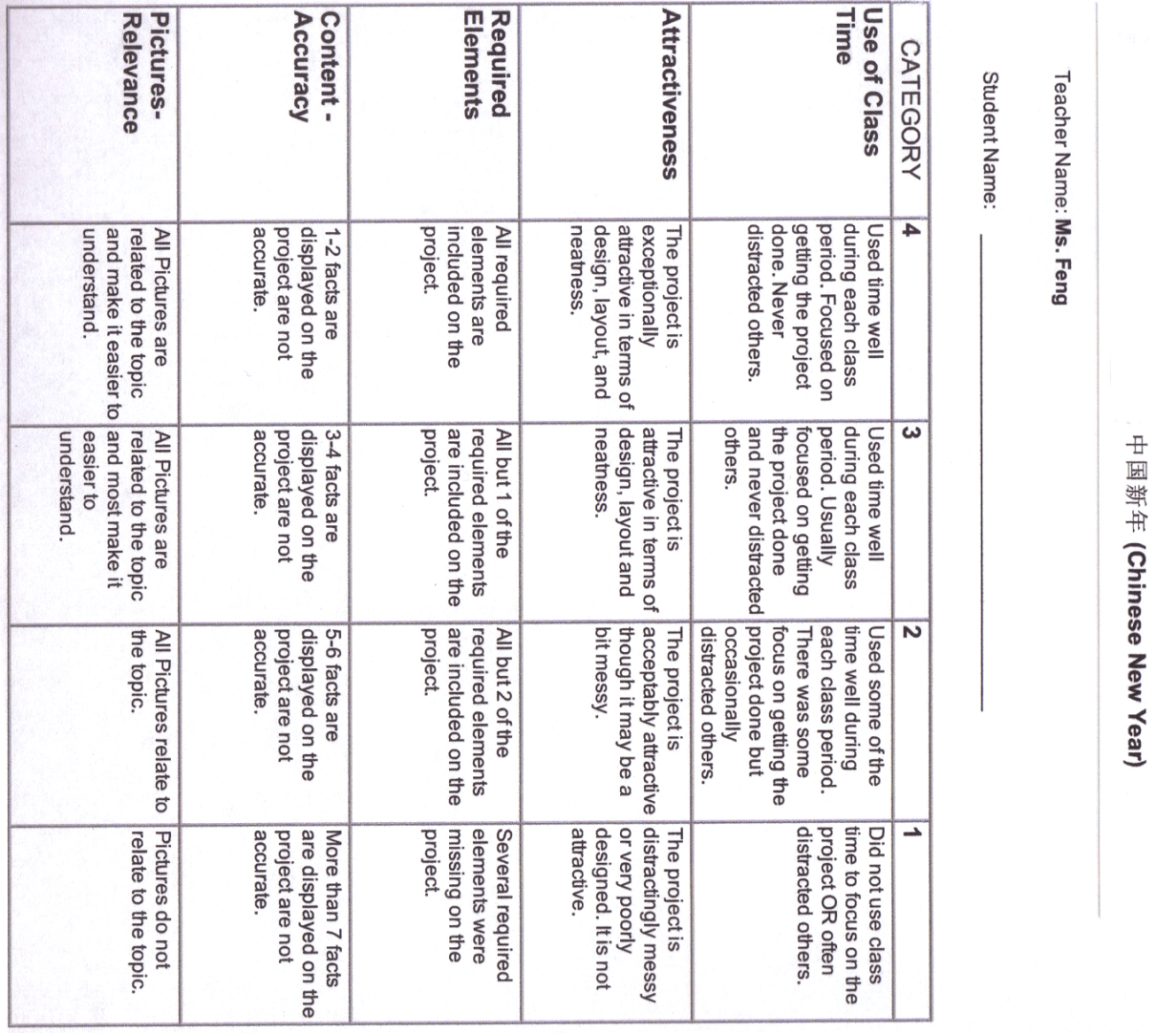
If you finish your project early, you are allowed to work on you missing assignments.

Slide 3
DO NOW:
T or F
1. 三十 + 八= 三十八
2. 九十二 – 四十四 = 八十六
3.四十二 + 九 = 三十三

Slide 4
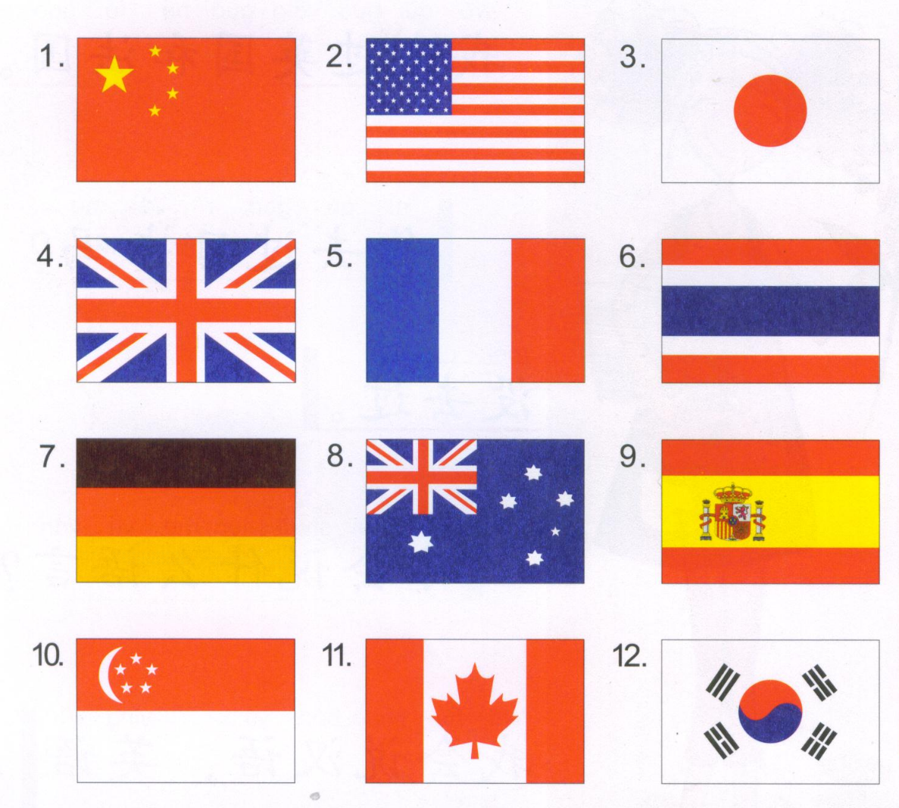
Task 1: Match the countries with the flags.
zhong guo 中国
Ri ben 日本
Mei guo 美国
Mo si ge 墨西哥
Fa guo 法国
Ying guo 英国
Xi ban ya 西班牙
Han guo 韩国
Ao da li ya 澳大利亚
Jia na da 加拿大
De guo 德国

Slide 5
NOTES:
Where were you born?
I was born in China.
You + at + where + born?
I + at + China + born?
ni + zai + na er + chu sheng?
wo + zai + zhong guo + chu sheng。
你在哪儿出生？
我在美国出生。
What countries have you been to?
I have been to China.
You + have been to + what countries?
I + qu guo + China.
你去过什么国家？
我去过中国。

Slide 6
Task 2: class assignment due TODAY!
Match the boxes to form words, phrases, Questions & Answers.
Glue the words on the construction paper.

Slide 7
Task 3: Due next period. (03/10)
His daughter is Mexican (Mexico-墨西哥), she speaks Spanish well. (She + Spanish + speak + de得+ very good) She has been to Mexico and Spain. She has not been to America. She can speak a little bit English.
Mexican = Mexico + 人.
She + Spanish + speak + de得+ very good
Has been to = 去过
Has not been to=没去过. A little bit = 一点儿

Slide 8
Match the languages with the countries
汉语
日语
英文
法语

Slide 9
Collect HW

Slide 10
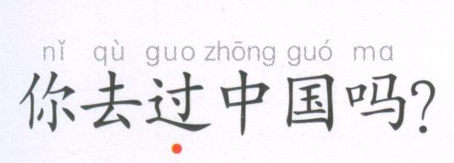
Have you been to China?
Yes.
No.
Yes, I have been to China.
No, I haven’t been to China.
Qu guo, wo qu guo zhong guo。
Mei qu guo, wo mei qu guo zhong guo.
去过，我去过中国。
没去过，我没去过中国。

Slide 11
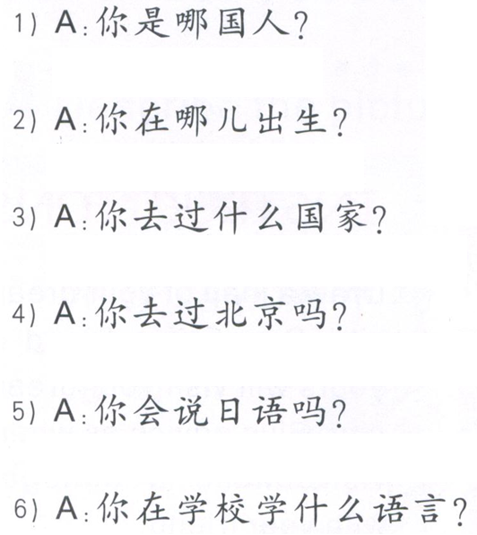
Task 1: Read the following questions. Use QUIZLET as reference. Ms. Feng will randomly ask you to read 3 sentences to her.
Task 2: scratch out the question word of each question?
Task 3: Answer the questions in complete sentences.
我是中国人。

Slide 12
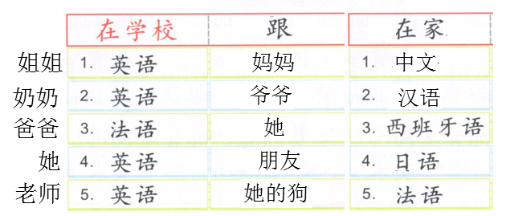
TASK 4 : Write 5 sentences fowling the examples provided.

Slide 13
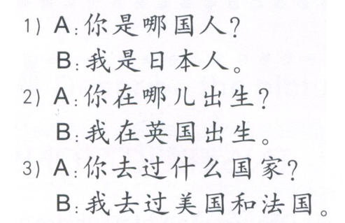
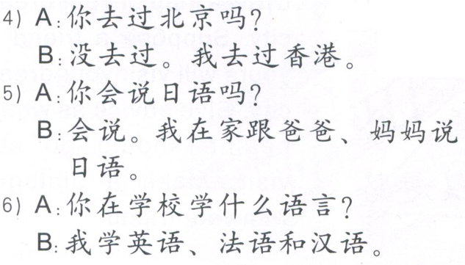
TASK 5: Choose the answers based on what you read.

Slide 14
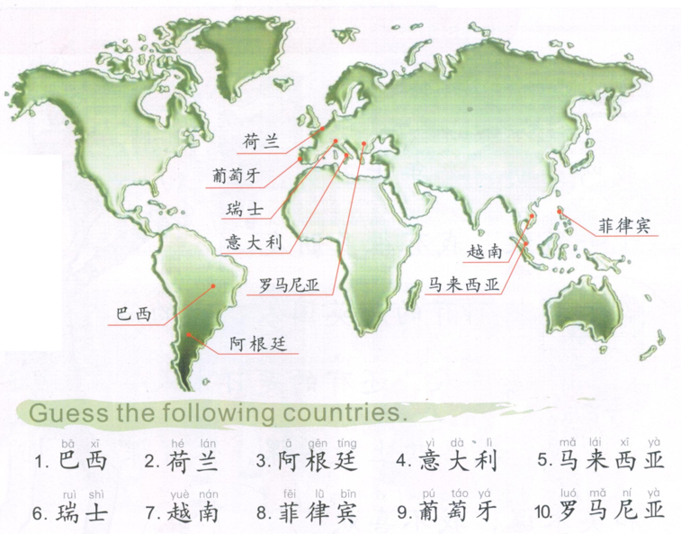
TASK 6: BONUS

Slide 15
我叫小天。我是北京人。我今年十二岁，上七年级。我们一家人现在住在香港。我家有三口人：爸爸，妈妈和我。我爸爸每天九点上班。他坐公共汽车上班。他喜欢穿衬衫和长裤。我妈妈不工作。她喜欢穿裙子。我每天八点上学，下午四点放学。妈妈不开车，所以(so) 我每天坐校车。我喜欢穿汗衫和牛仔裤。

