Slide 1
DO NOW Write the characters down twice each on your own paper.
Characters | Pin yin | English | Characters | Characters | Characters
打 | da | Play
踢 | ti | Play (soccer)
篮球 | Lan qiu | Basket ball
足球 | Zu qiu | soccer
棒球 | Bang qiu | baseball
网球 | Wang qiu | tennis
跑步 | Pao bu | run
骑车 | Qi che | cycling
橄榄球 | Gan lan qiu | football
兵乓球 | Bing pang qiu | Ping pong
运动 | Yun dong | sports

Slide 2
Asking if someone likes a certain sport
Do you like swimming?
You like swimming + ma?
Ni xi huan you yong ma?
你喜欢游泳吗?
Yes.
No.
(Wo) xi huan.
(Wo) bu xi huan.
我喜欢。
我不喜欢。

Slide 3
Qi che
To ride a bike/cycle
骑车

Slide 4
Zui – goes after the subject
The most
最
I like that cat the most.
I + the most + like + that + MW + cat.
Wo zui xi huan na zhi mao.
我最喜欢那只猫。

Slide 5
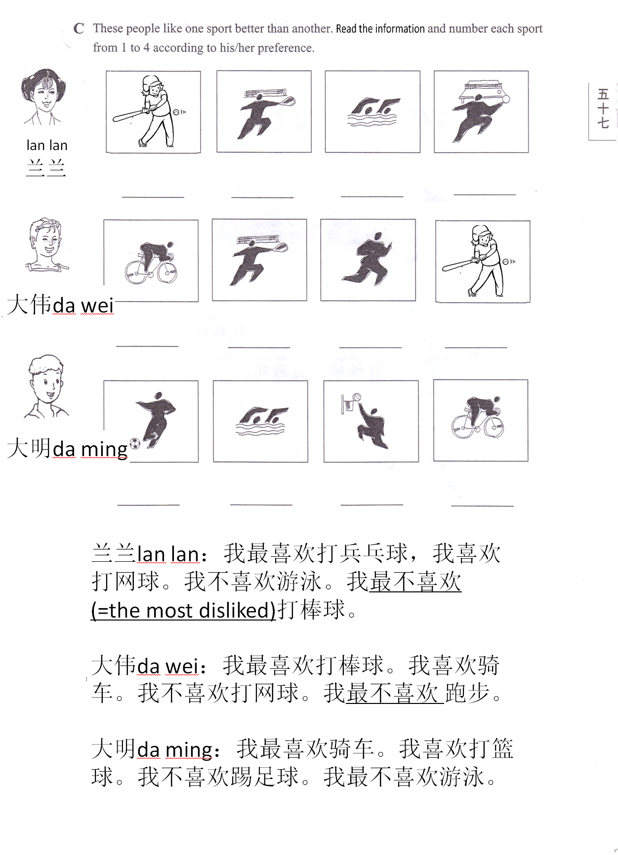
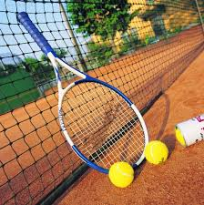
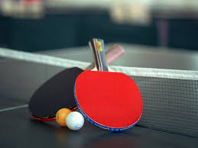
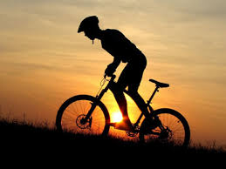
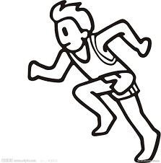
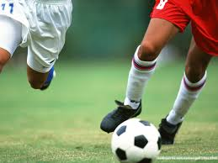
Listening Task: go to http://jfeng1.wix.com/chinese , click Level 1, find the listening material. Please ask Ms. Feng to unblock your Ipad if it is blocked.
最喜欢4 喜欢3 不喜欢2 最不喜欢1
10%
10%
10%

Slide 6
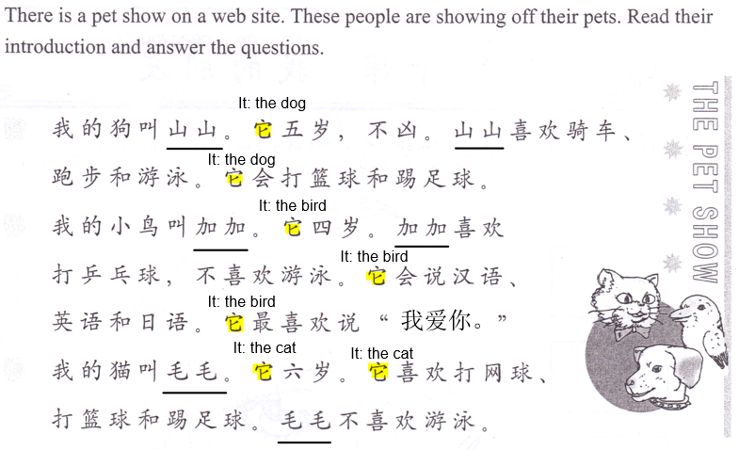
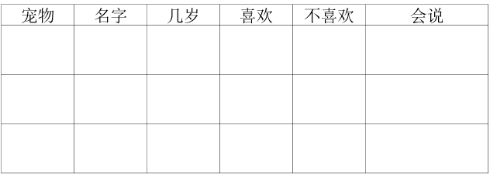

Slide 7
DO NOW: On your own paper
Fan yi: (characters)
1 to 10-
12-
29-
31-
20-

Slide 8
To tell dates
Big element small element
Number + year + number + month + number + day
1987/05/31
Year: State the 4 single-digit number
一九八七年五月三十一日

Slide 9
jin tian
zuo tian
Ming tian
yesterday
today
tomorrow
昨天
今天
明天
Monday-星期一 Tuesday-星期二 Wednesday-星期三Thursday-星期四 Friday-星期五 Saturday-星期六
Sunday-星期日 or Sunday-星期天

Slide 10
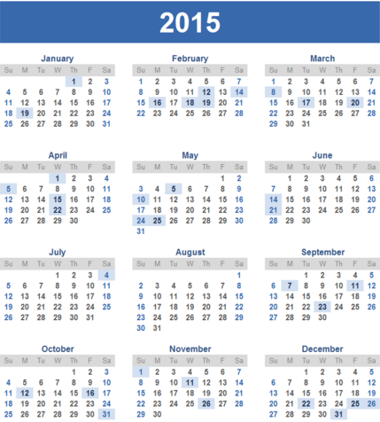
Task 1: Choose your birthday month this year to make a calendar on the chart paper:
You need to cover:
The year
The month
The days of the week
The days
Circle your birthday and write down:
“Date is my birthday (生日)。”
Example:
二零一五年
三月
星期日 | … | … | … | … | … | 星期六
一 | … | … | … | … | … | …
… | … | … | … | … | … | …
… | … | … | … | … | … | …
… | 三十 | …
三月三十日是我的生日。

Slide 11
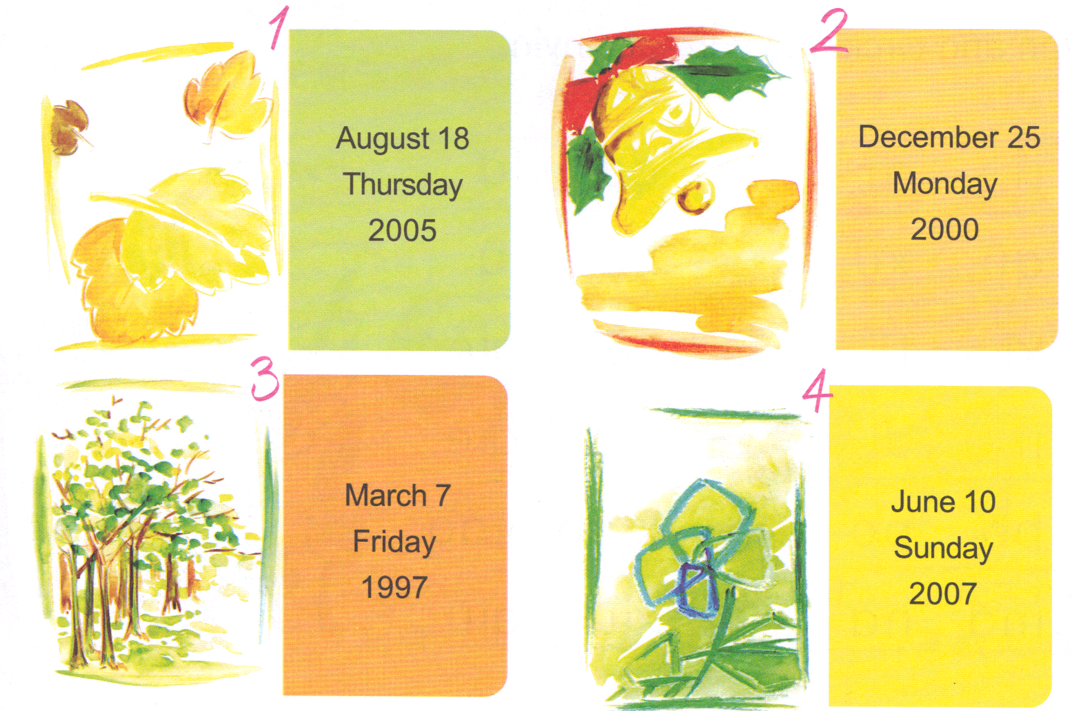
Task 2: Write 4 sentences to tell the dates.
Order for 1: Today is 2 0 0 5 year 8 month 18 day Thursday.
今天
明天
昨天
今天

Slide 12
Today is Sunday, March 27th 2000.
Jin tian shi er ling ling ling nian san yue er shi qi ri xing qi tian.
今天是二零零零年三月二十七日星期天/星期日。

Slide 13
Video www.youtube.com/watch?v=D2EzpteYuoM
The history of Chinese paper cutting.__________
In what occasions that mentioned in the video would Chinese people use paper cutting to decorate their houses?
What animals represent good luck or prosperity in Chinese culture?
How many characters are in the famous paper cutting piece mentioned in the documentary? How many women are on it?

Slide 14
你好：
我叫…。
我是…人。
我是…,我今年…岁。
我家有…口人。他们是…。
我爸爸是…。
我妈妈是…。
我家有一只…。
它很…很…。
我有两个好朋友。他们是…和…。
他们都是…人。
他们都说…。
我会说…和…。
我…说得很好。
我…说得不好。
我最喜欢…。
我也喜欢…。
我最不喜欢…。
18-20 Choose/Write 3 questions to ask:
你叫什么名字？今年几岁？你家有几口人？你有宠物吗？你喜欢宠物吗？你喜欢什么运动？你打篮球吗？
Paragraph 1:
1-3
Paragraph 2:
4-6
Paragraph 3:
7-8
Paragraph 4:
9-11
Paragraph 5:
12-14
Paragraph 6:
15-17
Paragraph 7:
18-20
此致
敬礼
Your name: (the same as 1)
Date: 2015 year 11 month 2 day
2+0+1+5+年+11+月+2+日

Slide 15
The history of Chinese paper cutting.__________
In what occasions that mentioned in the video would Chinese people use paper cutting to decorate their houses?
What animals represent good luck or prosperity in Chinese culture?
How many characters are in the famous paper cutting piece mentioned in the documentary? How many women are on it?
Your class assignment today is to write a letter to talk about “yourself”. You will use the structures provided on the other side of your paper and you will need to fill in the information below:
1.麦克 2.美国 3.学生，16
4.五，dad, mom, 2 older brothers and me。
5.老师 6.律师
7.dog 8 .big，cute。
9.小刘，小王 10. 中国 11. Chinese (language)
12.French(language) ，Chinese(language)
13. English (language) 14.French(language)
15. football 16. baseball 17. ski
18-20: Choose your 3 questions.
Everything on your letter needs to be in CHARACTERS!!!

Slide 16
The history of Chinese paper cutting.__________
In what occasions that mentioned in the video would Chinese people use paper cutting to decorate their houses?
What animals represent good luck or prosperity in Chinese culture?
How many characters are in the famous paper cutting piece mentioned in the documentary? How many women are on it?
Your class assignment today is to write a letter to talk about “yourself”. You will use the structures provided on the other side of your paper and you will need to fill in the information below:
Everything on your letter needs to be in CHARACTERS!!!
1.兰兰 2.中国 3.高中生，15
4.三，dad, mom and me。 5.医生 6.工人
7.Cat 8. small，cute。
9.小明，杰克 10. 美国 11. English (language)
12.English (language)，Chinese (language)
13. Chinese(language) 14.English (language)
15. Basketball 16. tennis 17. swim
18-20: Choose your 3 questions.

Slide 17
中国
日本
中文
美国
加拿大
澳大利亚
小
大
人
小学
初中
爸爸

