Slide 1
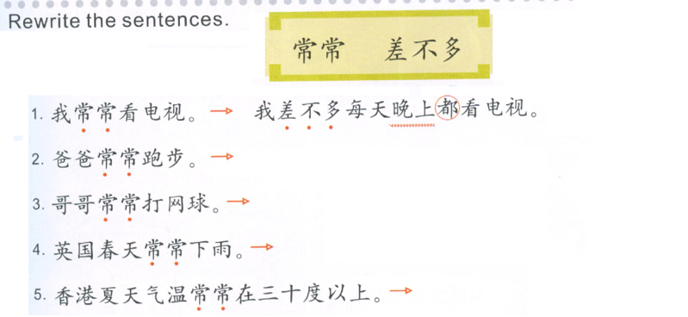
Task 1
Write down 4 sentences using “很喜欢-喜欢-不太喜欢-不喜欢”.
1
2
3
4
Do Now: Translate the paragraph.
Task 2: Write 4 差不多sentences, use the structure provided.
Subject + 差不多 + frequency + 都 + do something.
Frequency:每星期
Frequency:每天
Frequency:每星期二和五
Frequency:每天

Slide 2
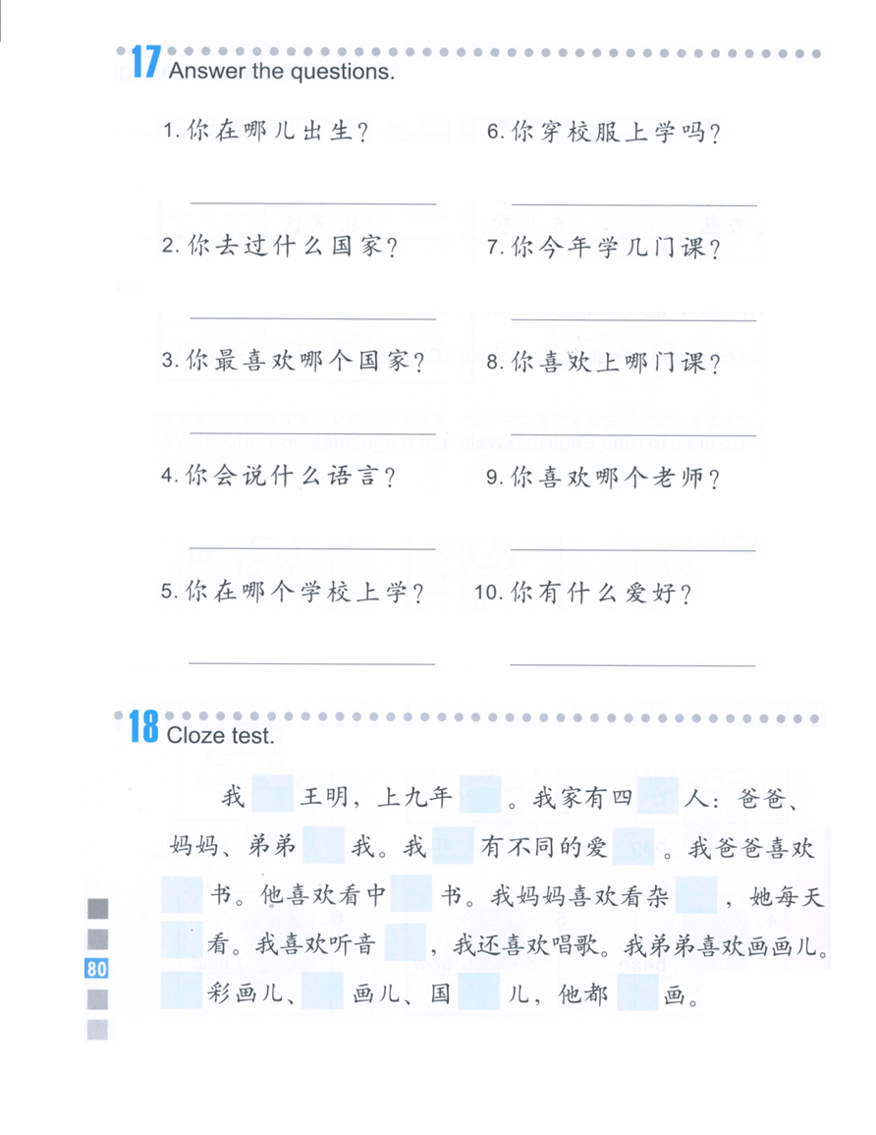
TASK 3
Answer the questions based on the small paper.
Sentence structures:
1. Change 你 to 我，change 哪儿 to the place you were born.
2. Change你 to 我，change什么国家 to the countries you have been to.
3. Change 你 to 我，change 哪个国家 to the countries you like the most.
叫
级
口
4. Change 你 to 我，change 什么语言 to the languages you can speak.
和
们
好
5. Change 你 to 我，change 哪个学校 to the school you go to.
6. Change you to I, take out MA..
看/读
文
志
7. Change 你 to 我，change 几 to the number of the classes you take this year.
都
乐
8. Change 你 to 我，change 哪门课 to the name of the classes you like.
油
画
会
9. Change 你 to 我，change 哪个 to the name of the teacher you like.
水
10. Change 你 to 我，change 有to 喜欢，change 什么爱好 to the hobbies you have.

Slide 3
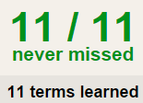
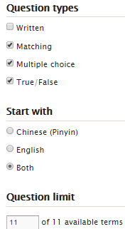
4 QUIZLET Measure Words 1 each section is 20%
Learn-Make sure you finish 100%
Speller-Make sure you finish 100%
Scatter-The time needs to be within 35 seconds.
Test- Create New Test after you change the settings to:
NOTES:
10/10
This number has to be 100
This number doesn’t matter.
10/10
The comment doesn’t matter.
10
This number has to be 12
This number has to be less than 40
10 of 10

