Slide 1
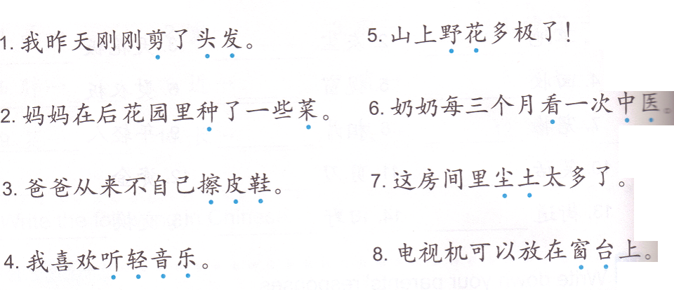
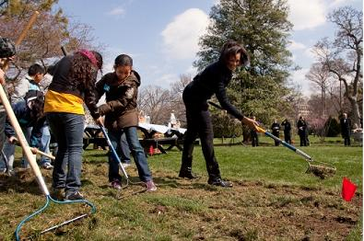
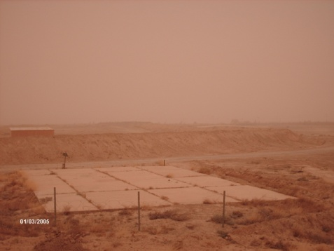
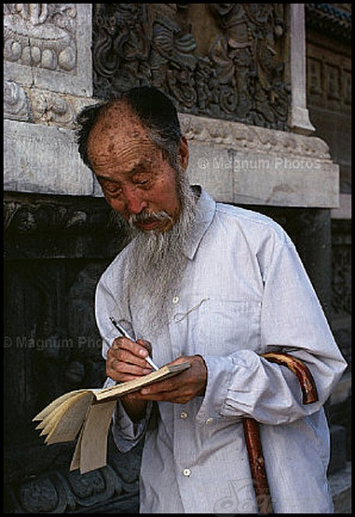
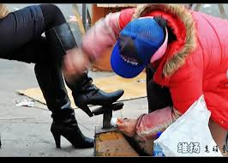
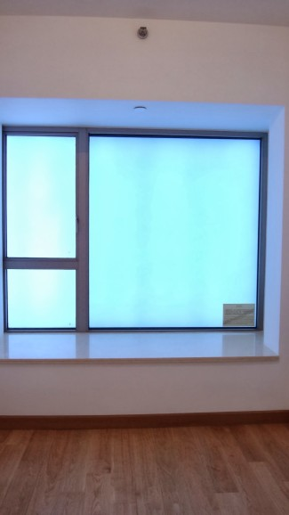
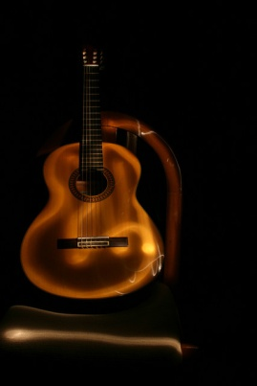
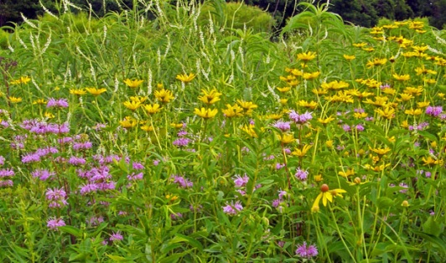
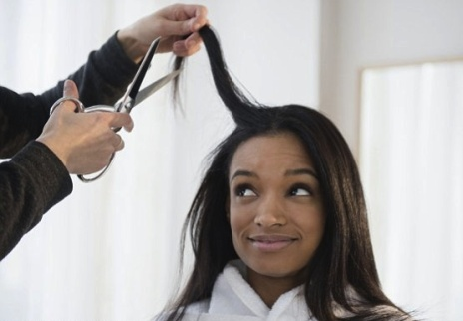
DO NOW: Match the pictures based on the dotted words.

Slide 2
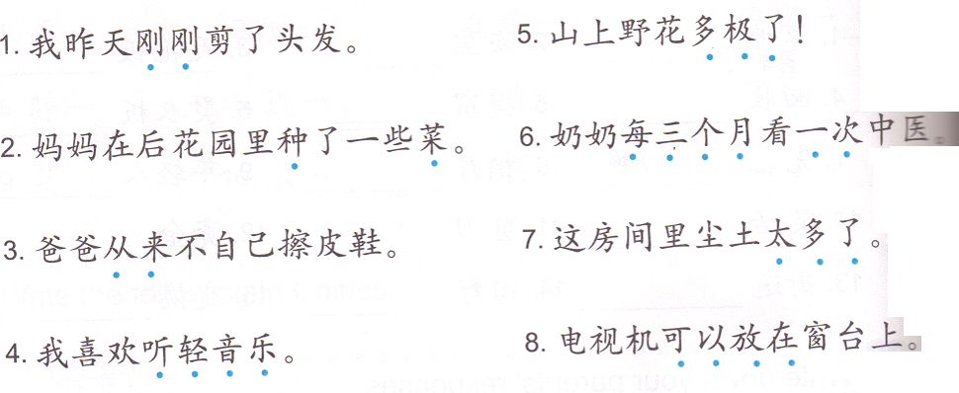
Task 1: Make your own sentences using the sample sentences.
I just cut my hair yesterday.
Mom planted some vegetables in the back yard.
Dad never wipe his own shoes.
I like listening light music.
There are some many wild flowers on the mountain!
Grandma sees the Chinese traditional doctor once every 3 month.
It is too dusty in this room.
TV can be put on the windowsill.

Slide 3
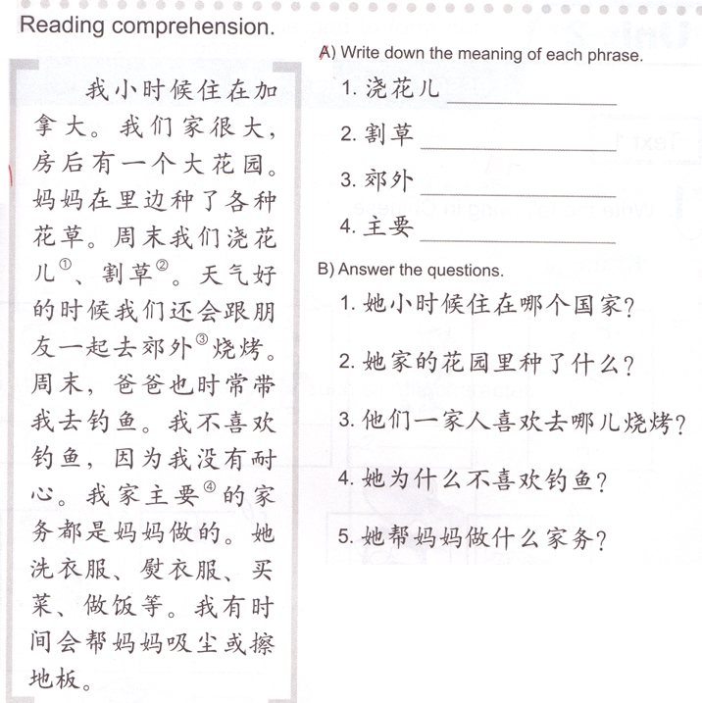
TASK 2
country
plants
place
因为
House chores

Slide 4

Task 3: Oral activity
Agree or disagree with 3 and say:
我也喜欢1。
Or
我不喜欢1。
Choose a chore and say: 我喜欢….
Choose a personality or quality to match 1 and say: 我特别+ 有爱心/有耐心/细心/爱干净/勤劳。
Example:
我喜欢做家务。
Example:
我也喜欢做家务。
1
4
2
3
Combine 1&2 and say:
我喜欢…,因为我…。
Example:
我喜欢做家务，因为我特别爱干净。
Example:
我特别爱干净。

Slide 5
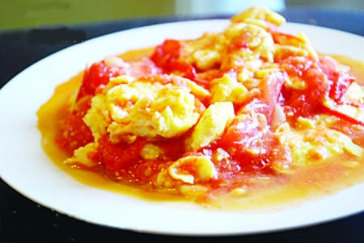
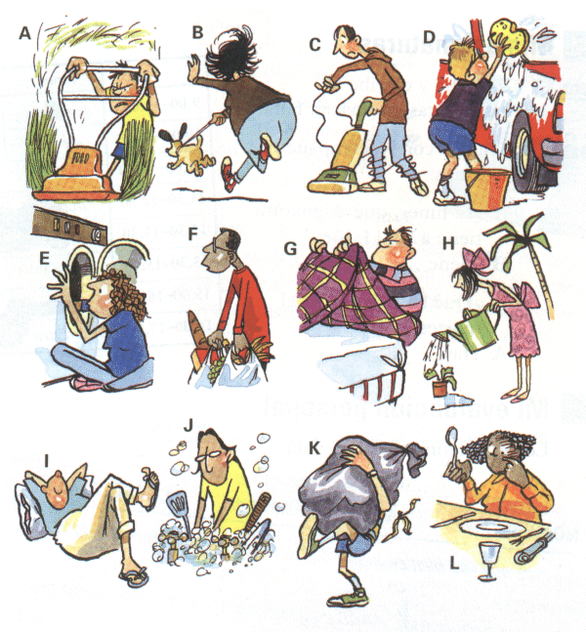
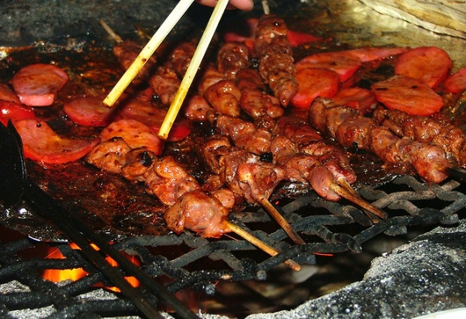
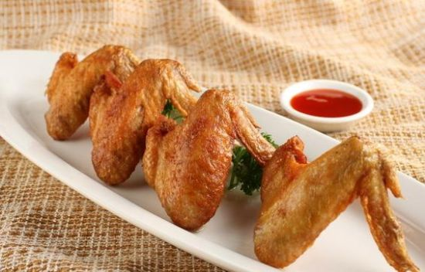
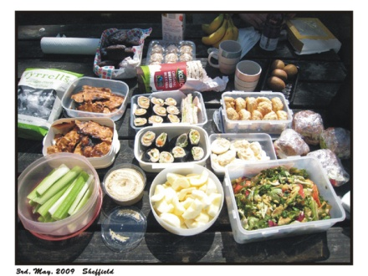
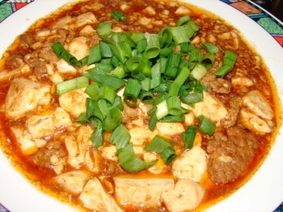
家务
野餐
烧烤
炸鸡翅
西红柿炒鸡蛋
麻婆豆腐

Slide 6

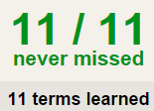

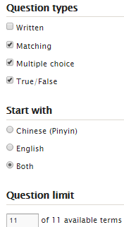
TASK1 QUIZLET instructions – 宠物 each section/20%
Flashcard-Go over all the words
Learn-Make sure you finish 100%
Speller-Make sure you finish 100%
Scatter-The time needs to be within 40 seconds.
Test- Create New Test after you change the settings to:
Task 2:
Translate from Chinese to English.
我在北京住过。
我吃过这个零食。
我看过这个电影。
爸爸也学过法语。
我用过这个手机。
妈妈在这个学校工作过。
我养过猫和狗。
我没有喝过可口可乐。
我没有开过车。
我没有上过中文课。
This number doesn’t matter.
20/20
This number has to be 100
过:Have done
20/20
The comment doesn’t matter.
20
This number has to be 11
This number has to be less than 40
20 of 20

Slide 7
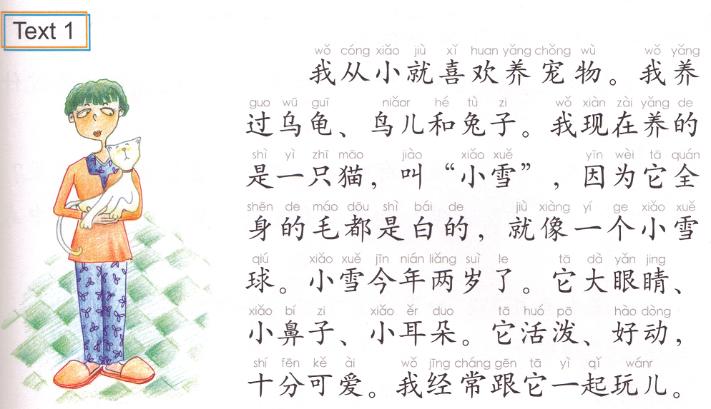
从小就… Since someone was little…
养宠物 Raise pets
（养）过 Have raised
我现在养的是…Now I am raising ….
Appearance: big eyes, small nose, small ears.
Task 3: Make up your own paragraph. You MUST use the following structures:
Like/dislike raising pets.
我从小就…
我养过…
我现在养的是…
它叫…
它有…,…和…。
它又personality 1又 personality 2.
Quizlet (REFERENCE PETS PERSONALITIES)
我们都很/非常/特别/喜欢它。
Pet 1 & pet 2.
a MW pet (cat/dog/snake…)
A Chinese name
Adj.1 BP1, Adj.2 BP2 & Adj.3 BP3

Slide 8
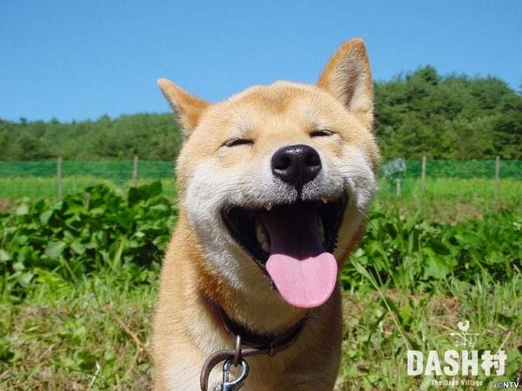
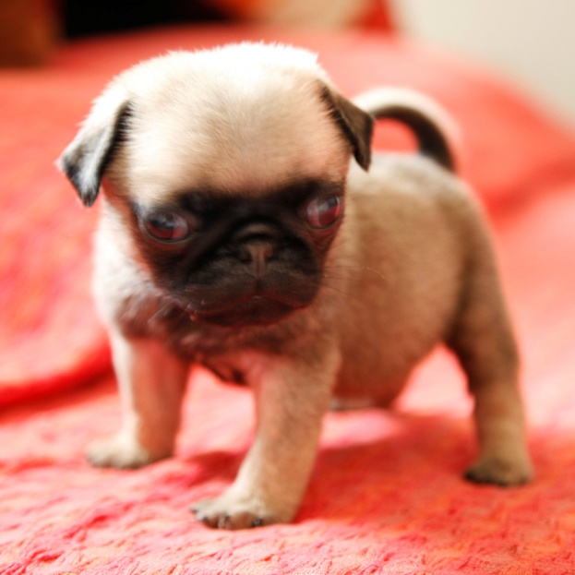
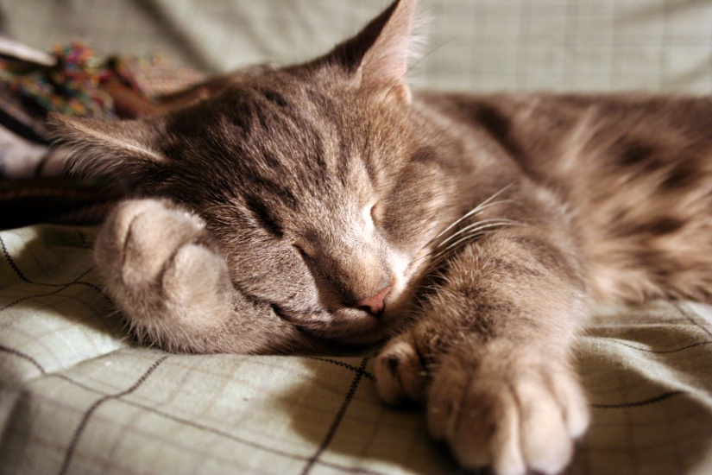
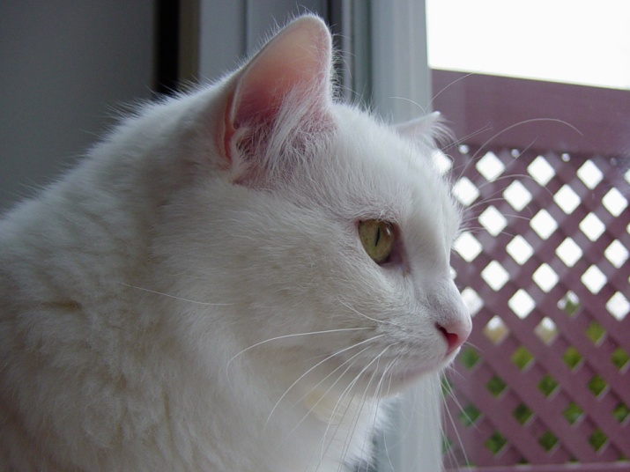
写作

Slide 9
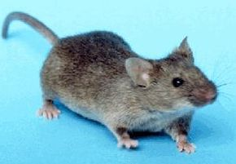
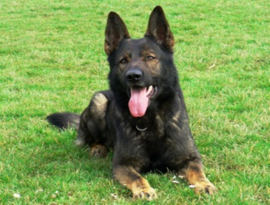
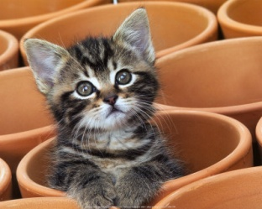
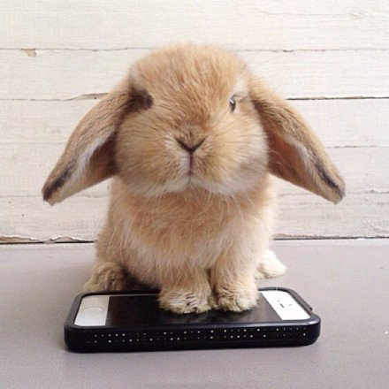
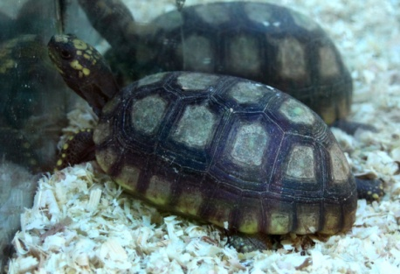
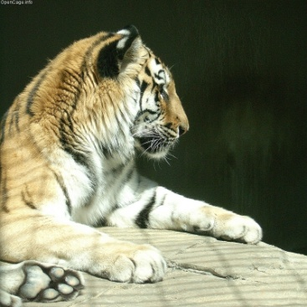
老鼠
狗
猫
兔子
乌龟
老虎

