Slide 1
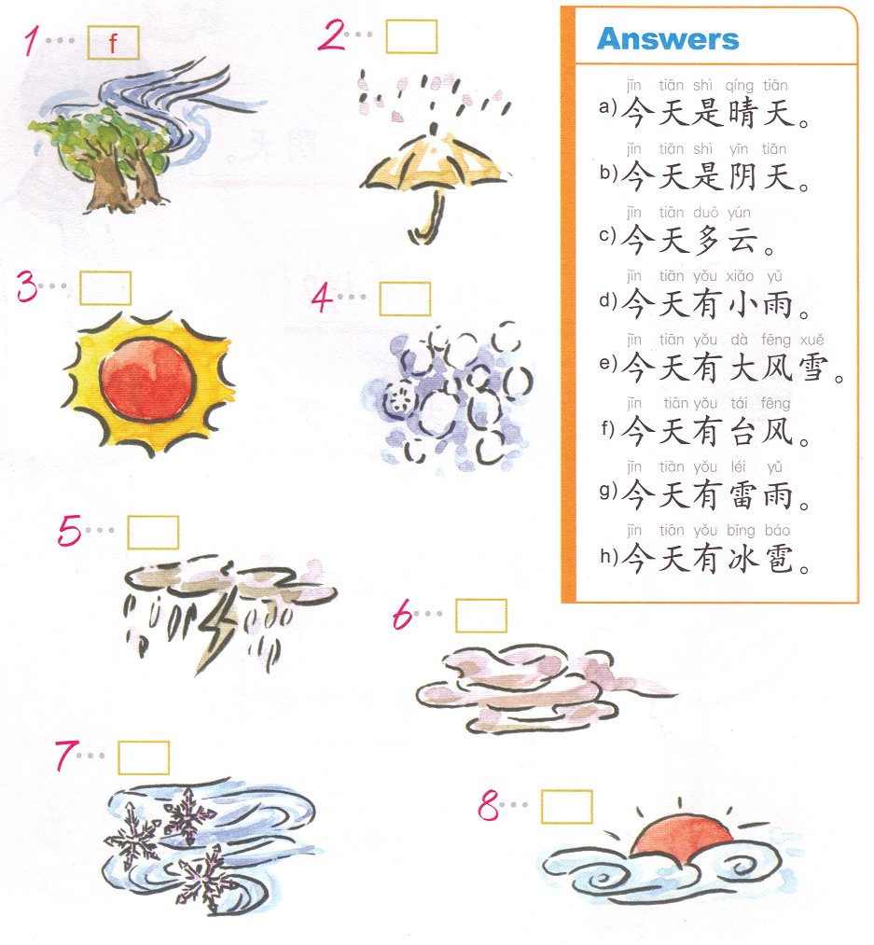
DO NOW
F
D
A
H-hail
G-thunderstorm
B
E
C

Slide 2
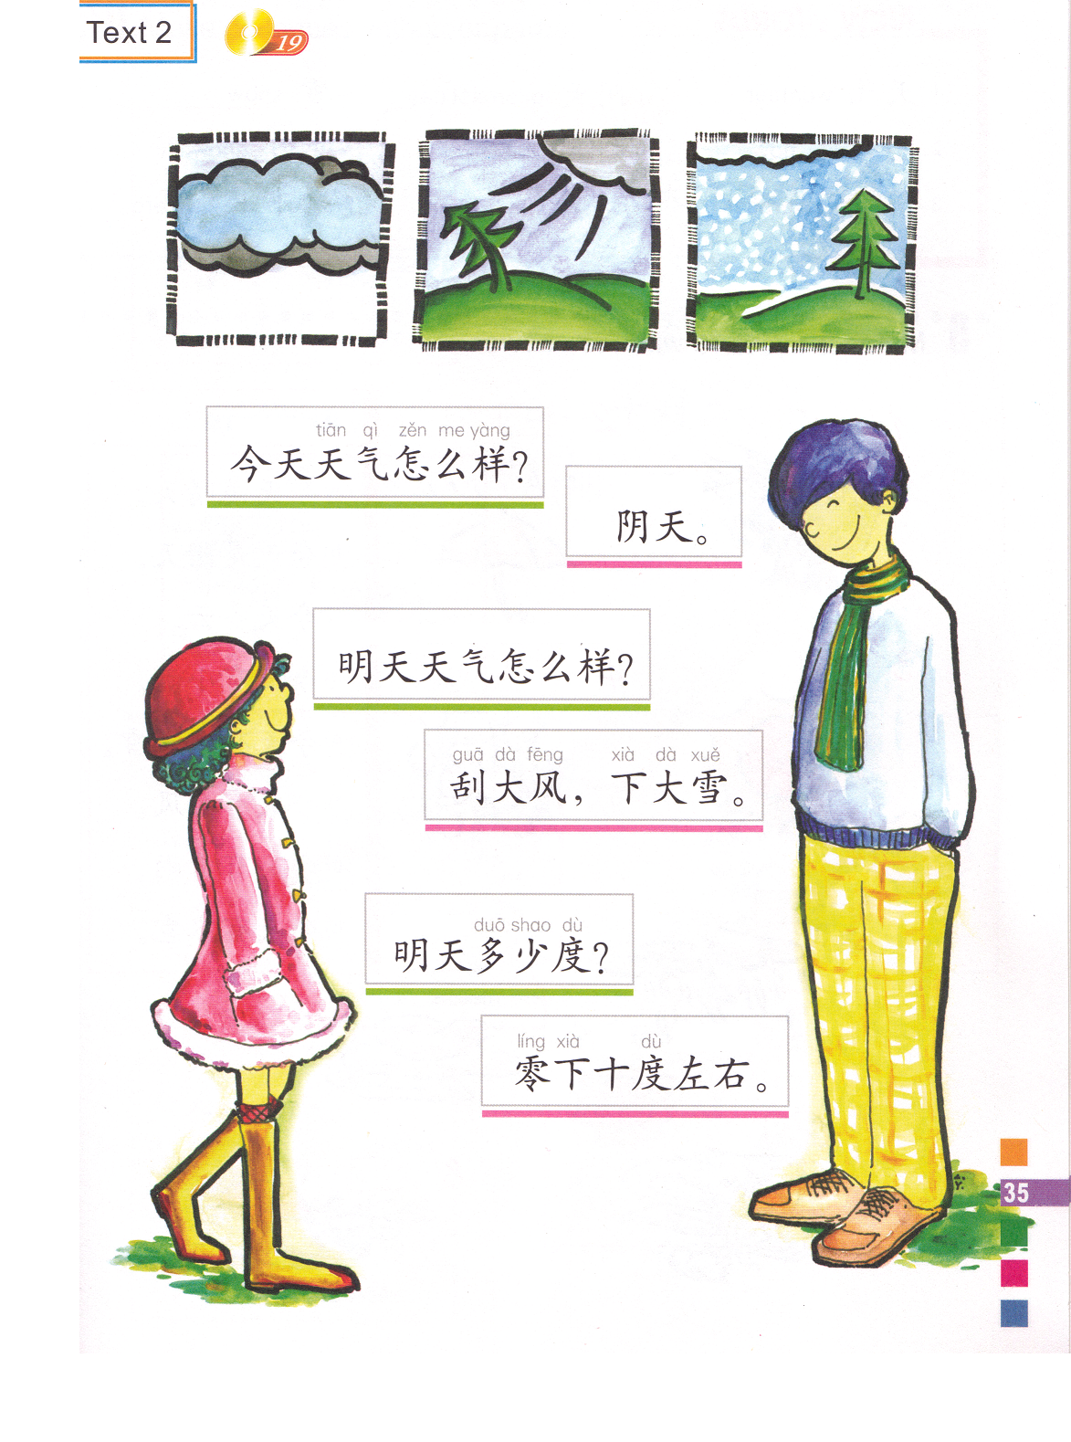
看纸的背面，标号。
What’s the temperature tomorrow?
What’s the weather like today?
Overcast.
Around -10 degrees.
Very windy and heavy snow.
What’s the weather like tomorrow?
今天
明天
左右-zuo you-around
零下-ling xia-below zero

Slide 3
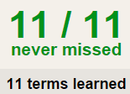
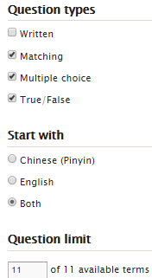
TASK 1 QUIZLET instructions – 天气1 & 天气2 each section is 20%
Learn-Make sure you finish 100%
Speller-Make sure you finish 100%
Scatter-The time needs to be within 35 seconds.
Test- Create New Test after you change the settings to:
笔记notes:
10/10
This number has to be 100
This number doesn’t matter.
10/10
The comment doesn’t matter.
10
This number has to be 12
This number has to be less than 40
10 of 10

Slide 4
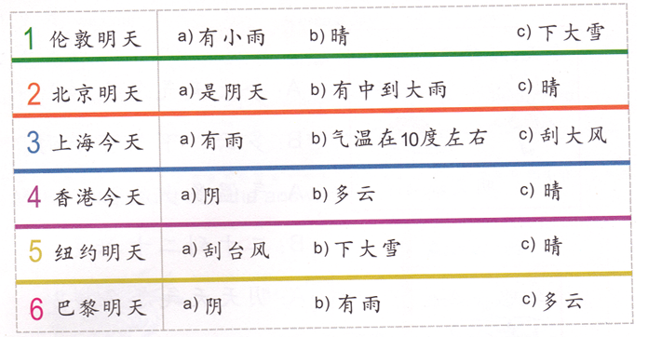

Slide 5
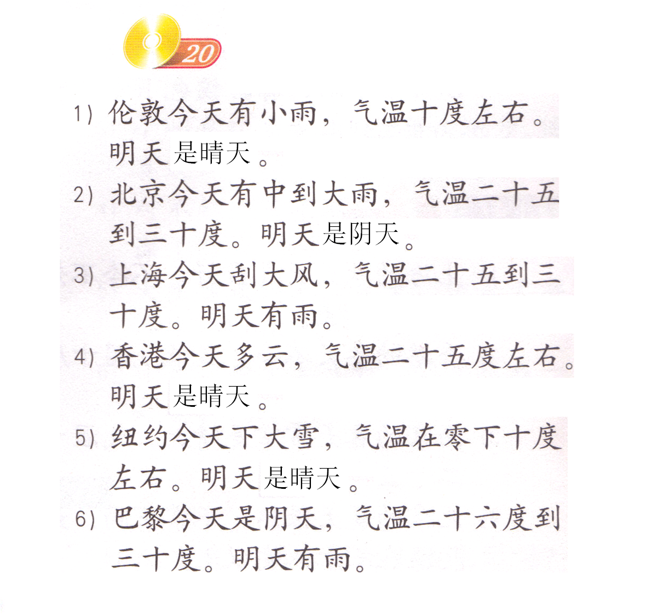

Slide 8
Find:
What’s the weather like…?
What’s the temperature…?
What’s the weather like today?
今天
Overcast.
What’s the weather like tomorrow?
56 degrees below zero
Very windy and heavy snow.
明天
Below zero + 56 degrees
What’s the temperature tomorrow?
零下五十六度
左右-zuo you-around
零下-ling xia-below zero
Around -10 degrees.

Slide 9
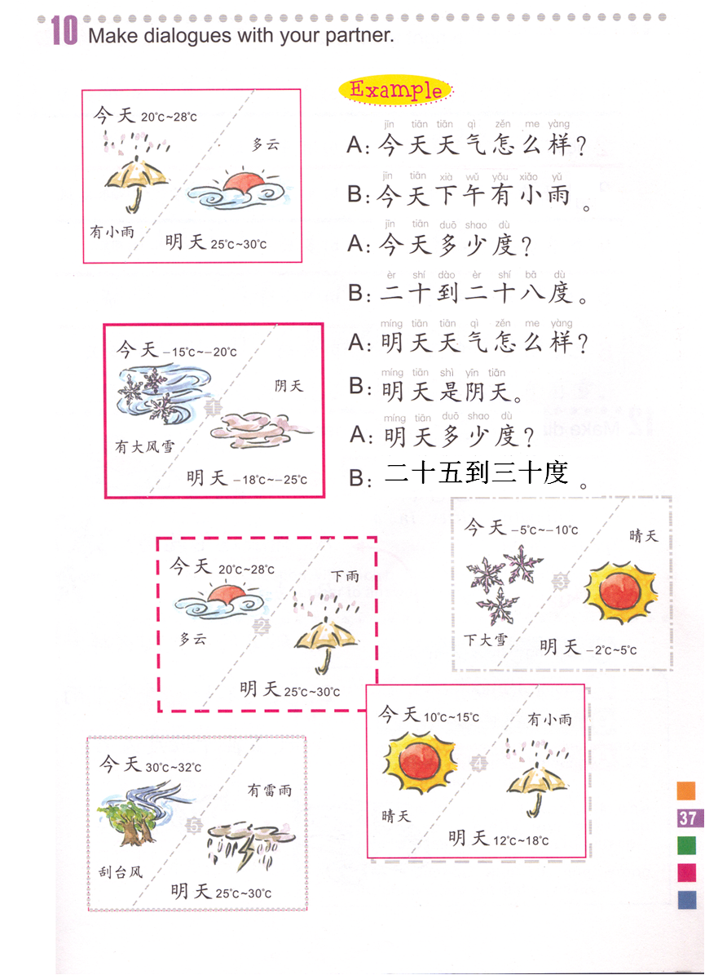
Use 8 sentences (As the example shown) to describe each picture. You MUST put the time of day for the . Today/Tomorrow + TOD + weather condition.
Words for reference:
早上-上午-中午-下午-晚上 一1，二2，三3，四4， 五5，六6，七7，八8，九9，十10
If the temperature is below zero, add 零下 in front of the number. Example:
-15degrees=零下十五度
I picked __.
A:
B:
A:
B:
A:
B:
A:
B:
1
3
I picked __.
A:
B:
A:
B:
A:
B:
A:
B:
2
4
5

Slide 10
你：今天天气怎么样？
冯老师：今天
冯老师：今天天气怎么样？
你：今天
1.是晴天。
2.阴天。
3.多云。
4.下雨。
5.刮风。
6. 下雪。

Slide 11
热身
Find your DO NOW paper on your desk.
Each group only has 1 sheet.
You need to write the answers on your own paper.
You have 5 minutes to finish your DO NOW.

Slide 12
DO NOW
https://quizlet.com/40701452/flash-cards/

Slide 13
Nagee 的作业

Slide 14
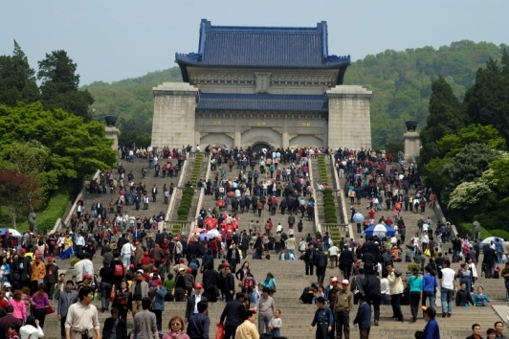
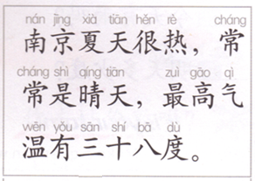
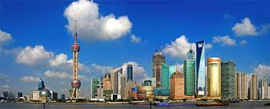
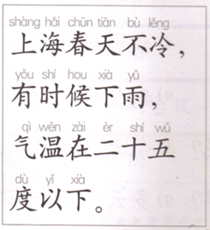
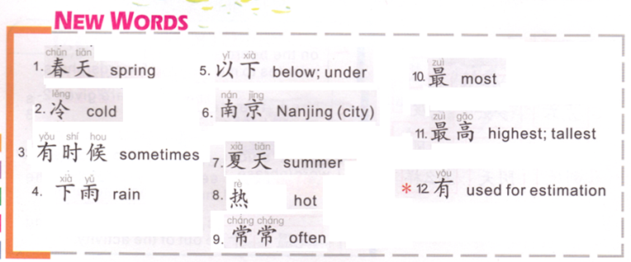
Place + season + hen很 + adj.
Nanjing + summer + hen很 + hot.
Summer in Nanjing is hot.
It’s often sunny.
The highest temperature is around 38 degrees.
最高:highest 最低:lowest
A:（最高/最低）气温是__度 （左右）。
B: （最高/最低）气温在__度（左右）。
C: （最高/最低）气温有__度（左右）。
Place + season + not + adj.
Shanghai + spring + not + cold.
Spring in Shanghai is not cold.
Sometimes,(it) rains.
气温在…以下。
Air temperature is below…
Air temperature is below 25 degrees.
Air temperature

Slide 15
很冷，
最低气温
有时候
阴天，
纽约
在
零下
二十度
冬天
左右。
Each group will:
Cut out the words.
Put them in the order to show the weather condition in each city and the temperature in each city.
Please use your notes as the reference.

Slide 16
纽约冬天很冷，有时候阴天，最低气温在零下二十度左右。

Slide 17
北京春天不冷，常常刮风，气温在十八度左右。

Slide 18
亚特兰大夏天很热，有时候下雨，最高气温有四十五度。

Slide 19
Atlanta’s winter is not cold. The highest temperature is around 62 degrees, the lowest temperature is around 25 degrees. It’s windy sometimes. I like Atlanta.
Atlanta’s summer is hot. The lowest temperature is around 70 degrees, the highest temperature is around 98 degrees. It rains sometimes. I like Atlanta.
City + season + not + cold.
City + season + 很 + hot.
亚特兰大
亚特兰大
Highest air temperature + 是/在/有 + 62 degrees + around.
lowest air temperature + 是/在/有 + 70 degrees + around.
lowest air temperature + 是/在/有 + 25 degrees + around.
highest air temperature + 是/在/有 + 95 degrees + around.
Sometimes + windy.
Sometimes + rains.
I like Atlanta.
I like Atlanta.

Slide 20
Oral Task: Each student will be called to say 5 sentences. You can change the information if you wan to. This is your class assignment GRADE.
北京
这是…。
…的…很…。
最高/最低气温…度。
有时候/经常…。
我（不）喜欢…的…。
北京
冬天
冷
零下十
下大雪
北京
冬天

Slide 21
Atlanta’s winter is not cold. The highest temperature is around 62 degrees, the lowest temperature is around 25 degrees. It’s windy sometimes. I like Atlanta.
City + season + not + cold.
亚特兰大冬天不冷。
Highest air temperature + 是/在/有 + 62 degrees + around.
最高气温是/在/有六十二度左右。
lowest air temperature + 是/在/有 + 25 degrees + around.
最低气温是/在/有二十五度左右。
Sometimes + windy.
有时候有/刮风。
I like Atlanta.
我喜欢亚特兰大。

Slide 22
Atlanta’s summer is hot. The lowest temperature is around 70 degrees, the highest temperature is around 98 degrees. It rains sometimes. I like Atlanta.
City + season + 很 + hot.
亚特兰大夏天很热。
lowest air temperature + 是/在/有 + 70 degrees + around.
最低气温是/在/有七十度左右。
highest air temperature + 是/在/有 + 95 degrees + around.
最高气温是/在/有九十五度左右。
Sometimes + rains.
有时候下雨。
I like Atlanta.
我喜欢亚特兰大。

Slide 23
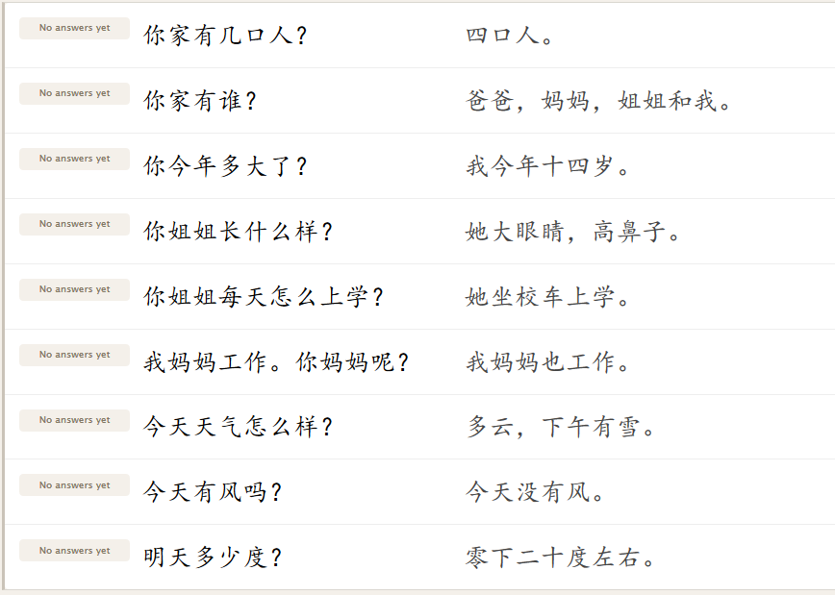
http://quizlet.com/40698056/flashcards
DO NOW: MAKE NOTES. YOU WILL BE CALLED TO TAKE THIS MATCHING ON QUIZLET TO GET A
QUIZ GRADE.

Slide 24
他春天去悉尼（澳大利亚），
悉尼的春天经常是晴天。
白先生今年七十二岁。
他是英国人。
他夏天去亚特兰大，
亚特兰大的夏天很热。
他秋天去纽约，
纽约的秋天不冷也不热。
他是老师。
他冬天去曼谷（泰国），
曼谷的冬天很暖和。
Task 1

Slide 25
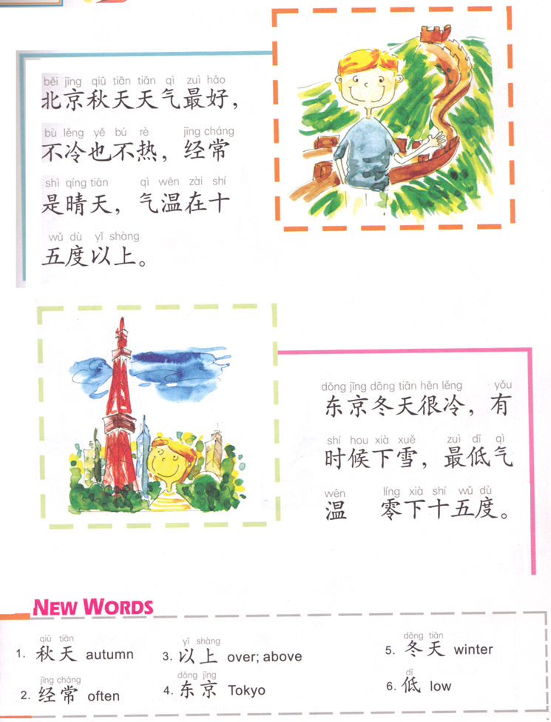
City + season + (weather) + zui hao.（最好）
Beijing’s fall is the best.
不冷也不热。
It’s not cold or hot.
Often is sunny.
气温在…度以上。
Temperature is above 15 degrees.
City + season + 很 + adj.
Tokyo’s winter is cold.
Sometimes snows.
最低气温是零下…度。
是
The lowest temperature is below 15 degrees below zero.

Slide 26
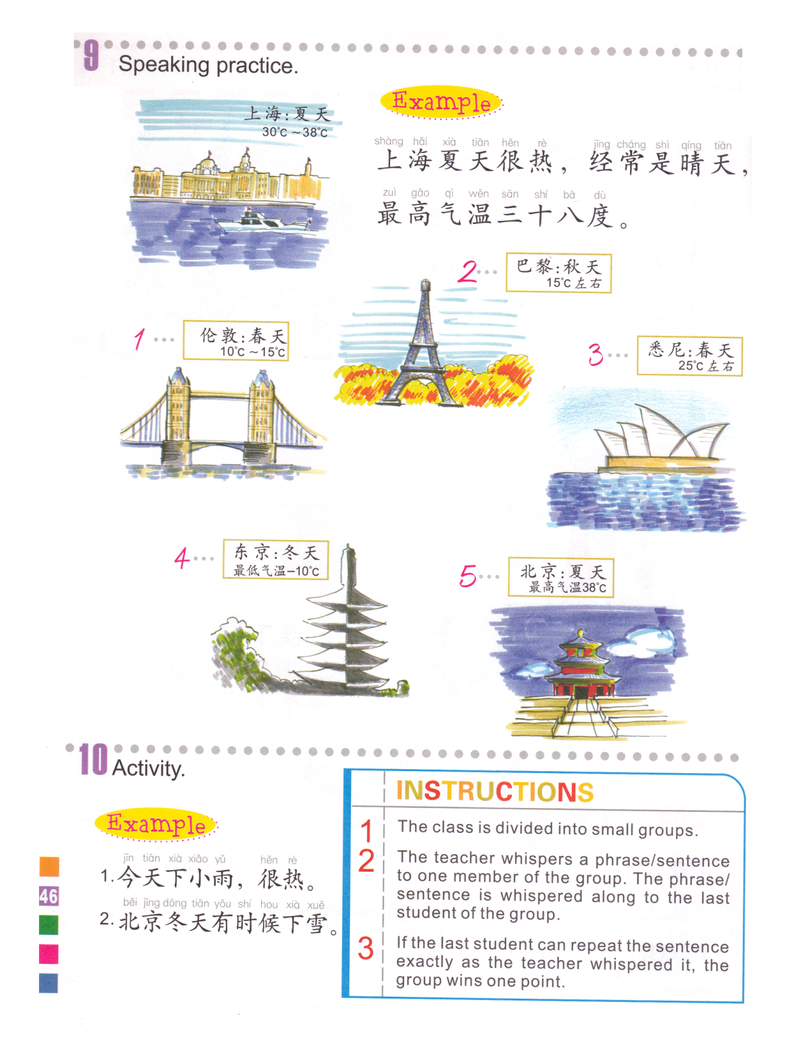
1. 伦敦 春天
2. 巴黎 秋天
3. 悉尼 春天
4. 东京 冬天
5. 北京 夏天
TASK 2
2. Cool 凉快
Not often 不常
Rains 下雨
Is around 15 degrees
1. Warm 暖和
Often Cloudy 多云
Is around 10 to 15 degrees
从…到
3. Warm
Often sunny
Is around 25 degrees
4. Cold
Often snows(light)下小雪
Lowest 最低 temperature is 10 degrees below zero 零下 .
5. Hot
Often sunny
Highest temperature is 38 degrees.
1. City + season + 很 + warm, often cloudy，temperature 是/在/有10 到 15 degrees around 左右。
2. City + season + 很 + cool, not often 下/有雨，temperature是/在/有15 degrees around。
Task 2
3. City + season + 很 + warm, often 是 sunny，temperature是/在/有25 degrees around。
4. City + season + 很 + cold, often snows (light)，lowest temperature是/在/有 below zero 10 degrees。
5. City + season + 很 + hot, often是 sunny ，highest temperature是/在/有 38 degrees.

Slide 27
TASK 3 QUIZLET instructions – 天气 3 (21 terms) each section is 20%
Learn-Make sure you finish 100%
Speller-Make sure you finish 100%
Scatter-The time needs to be within 35 seconds.
Test- Create New Test after you change the settings to:
笔记notes:
21/21
This number has to be 100
This number doesn’t matter.
21/21
The comment doesn’t matter.
21
This number has to be 12
This number has to be less than 40
If you are do this on your cellphone or ipad, DON’T use the app, do it on safari, firefox, chrone or IE.
21 of 21

Slide 28
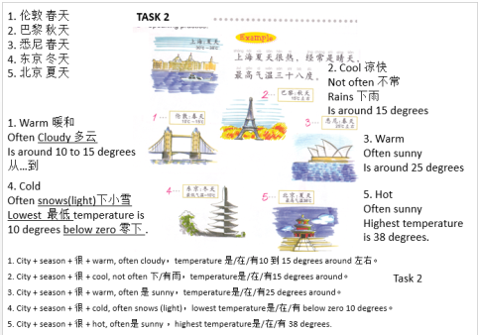
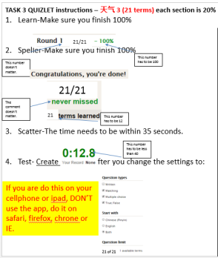
08/14 Chinese Level 2 TO DO LIST:
TASK 1 CHART PAPER ACTIVITY.
TASK 2 Describe the pictures on your own paper. (due 08/14)
Task 3 Quizlet on your cellphone (due 08/14, ask for permission to extend the due day to next Tuesday)
In between Task 2&3, you will be called to take your DO NOW matching quiz, you will have 1 chance ONLY in class.
If you are do this on your cellphone or ipad, DON’T use the app, do it on safari, firefox, chrone or IE.

