Slide 1
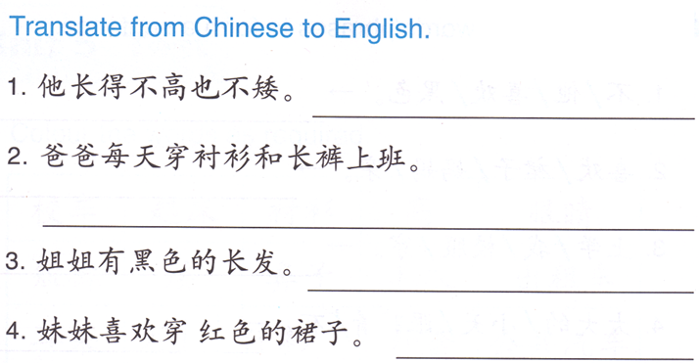
DO NOW-
On a worksheet paper, you will only need to write down the English meaning of each sentence.
You have 5 minutes after the ring of the bell.
You will need to TURN IN your paper.
Go to work
长头发。
Today’s tasks:
1st: PROJECT (cups, demonstration and the paper) DUE: TODAY
2nd: Task 1 (QUIZLET-国家和语言) DUE: Monday (03/07)
3rd: Task 2 (Oral Presentation) DUE: Monday (03/07)
4th: Bonus DUE: Whenever you finish (optional)

Slide 2
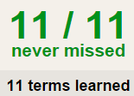
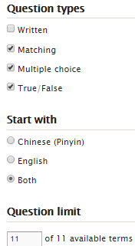
Task 1 QUIZLET 国家和语言
Learn-Make sure you finish 100%
Speller-Make sure you finish 100%
Scatter-The time needs to be within 35 seconds.
Test- Create New Test after you change the settings to:
Task 2
Oral Task – Tell Ms. Feng about your birth place, country you have been to, country you are living in and languages you can speak.
You are NOT allowed to read off your paper.
You must present it no later than next Monday. (03/07)
C. Reference-
quizlet (reference 03/02 Task 2)
D. The information you are providing doesn’t have to be true.
This number doesn’t matter.
20/20
This number has to be 100
20/20
The comment doesn’t matter.
20
This number has to be 12
This number has to be less than 40
1.我在…出生。
2. 我去过…。
3.我住在…。
4.我会说…和…。
Grab a BONUS paper when you FINISH tasks 1 & 2 !!!!
20 of 20

Slide 3
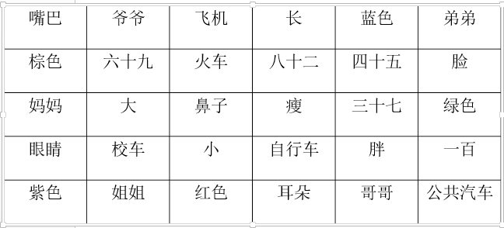
Task 3 Bonus :
find 5 words for each category. You can cut them out and glue them or write them down.
Task 3 Bonus :
find 5 words for each category. You can cut them out and glue them or write them down.

Slide 4
Research based mini project:中国新年 (Chinese New Year)
Format: Mini poster on construction paper
Grade: will be a TEST grade (35% of your overall grade)
You must finish the project TODAY in class and turn it in at the end of the period.
Why is 中国新年 also called Spring Festival ?
How many days do Chinese people celebrate 中国新年?
When is 中国新年 this year? (date)
List at least 1 tradition that Chinese people do on each day of the 中国新年celebration.
List 3 中国新年 traditional food.
Choose 3 of the following 中国新年 traditions to explain : (At least 150 words each)
You will need to draw some pictures to match what you write
A: 守岁(shou sui) B: 红包(hong bao)/压岁钱(ya sui qian) C: 年夜饭(nian ye fan)
D: 春运(chun yun) E: 春联(chun lian) F: 年画(nian hua)
G: 爆竹(bao zhu)
7. You will each get 1 sheet of construction paper, you can decide how you will use it.

Slide 5
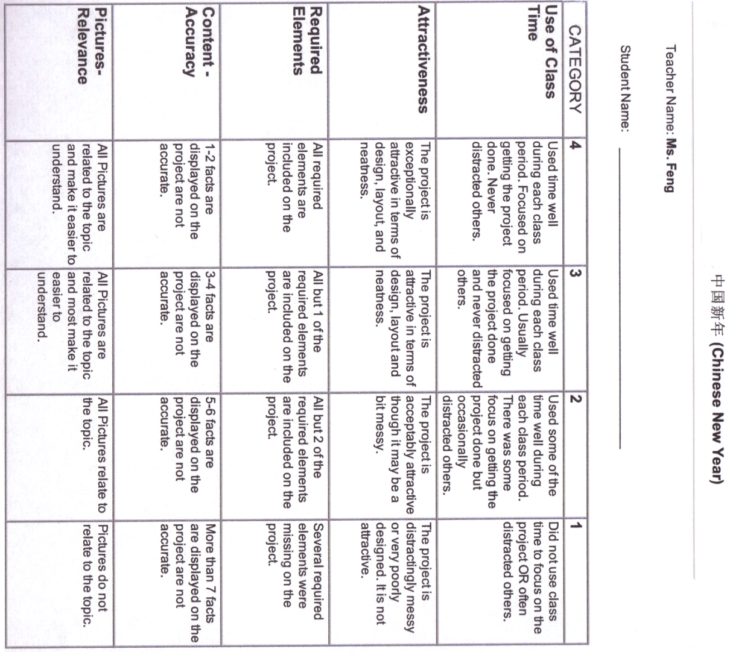
If you finish your project early, you are allowed to work on you missing assignments.

