Slide 1
DO NOW：
A. 是
B. 很/非常/特别/十分
C. 还有
D. 的
E.不是&没(有)
我从来_养过猪。
我爱妈妈，_我爱中国。
美国是一个_美丽的国家。
我有一件红色_毛衣。
中国_世界第三大的国家。

Slide 2
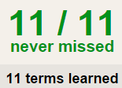
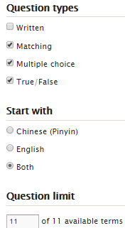
TASK 1 QUIZLET instructions – 学校 each section/20% Flashcard-Go over all the words
Learn-Make sure you finish 100%
Speller-Make sure you finish 100%
Scatter-The time needs to be within 40 seconds.
Test- Create New Test after you change the settings to:
笔记notes:
15/15
This number has to be 100
This number doesn’t matter.
15/15
The comment doesn’t matter.
15
This number has to be 9
This number has to be less than 40
15 of 15

Slide 3
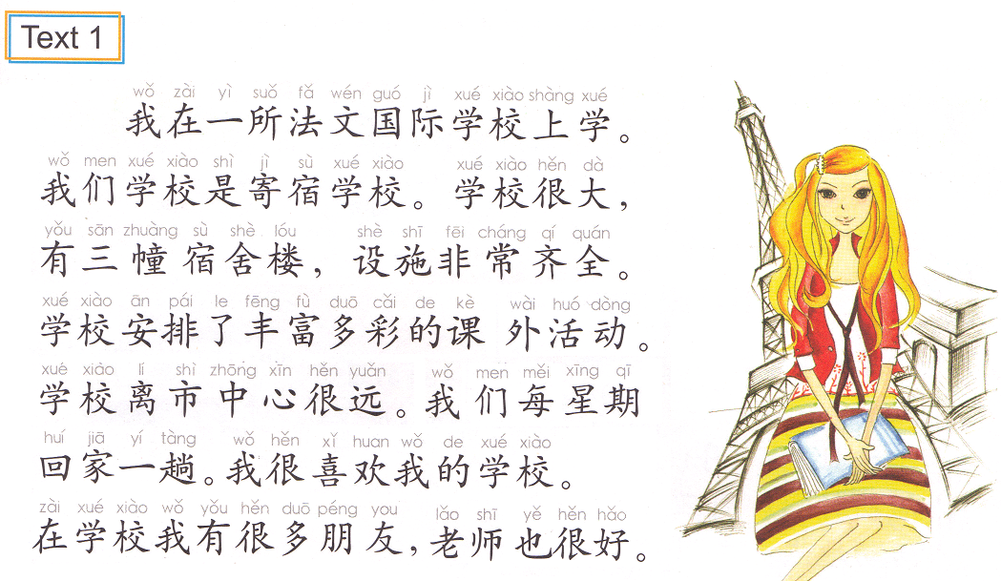
Task 2
Use this as reference to write about your school.
You must use at least 10 words in Task 1 and your sentences should match your school.

Slide 4
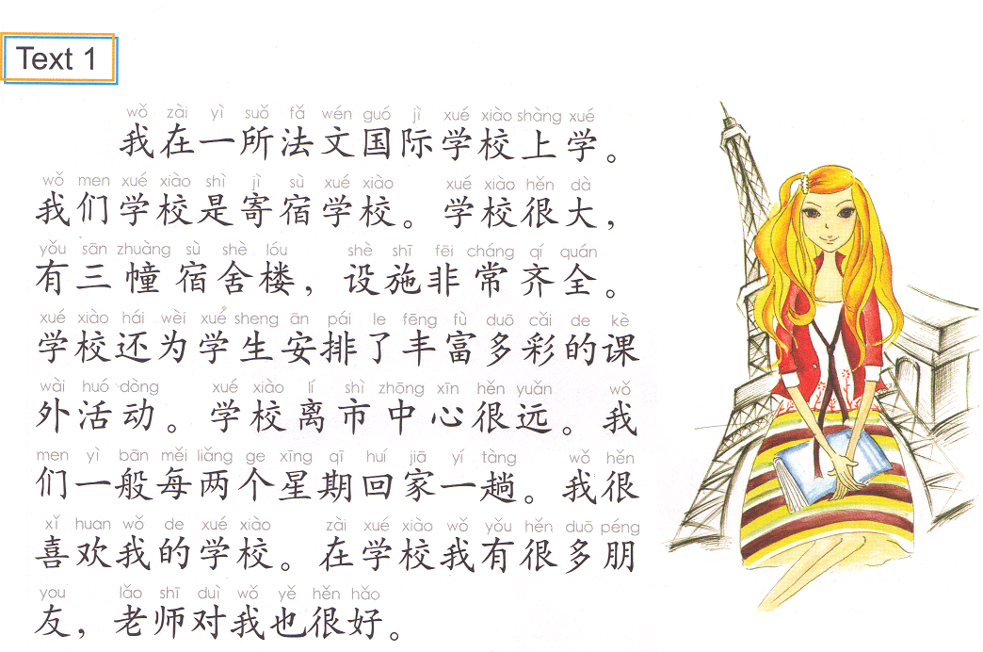
Task 2
Use this as reference to write about your school.
You must use at least 12 words in Task 1 and your sentences should match your school.

Slide 5
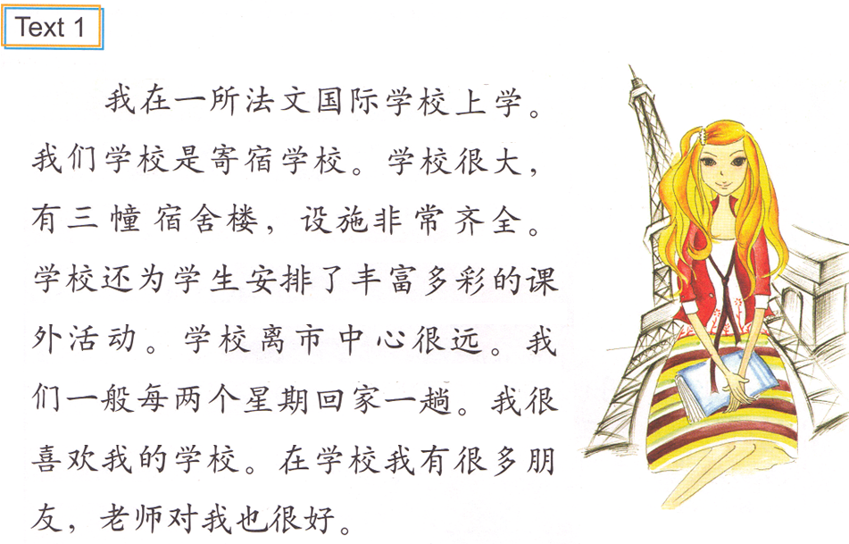
Task 2
Use this as reference to write about your school.
You must use ALL the words in Task 1 and your sentences should match your school.

Slide 6
Task 3
prepare an oral introduction:
Which school you go to.
Cover as least 3 aspects:
type B. size C. facilities D. teachers E. Students. F. location
IB students, you are NOT allowed to read off your notes.
You will present this either today or Thursday.

Slide 7
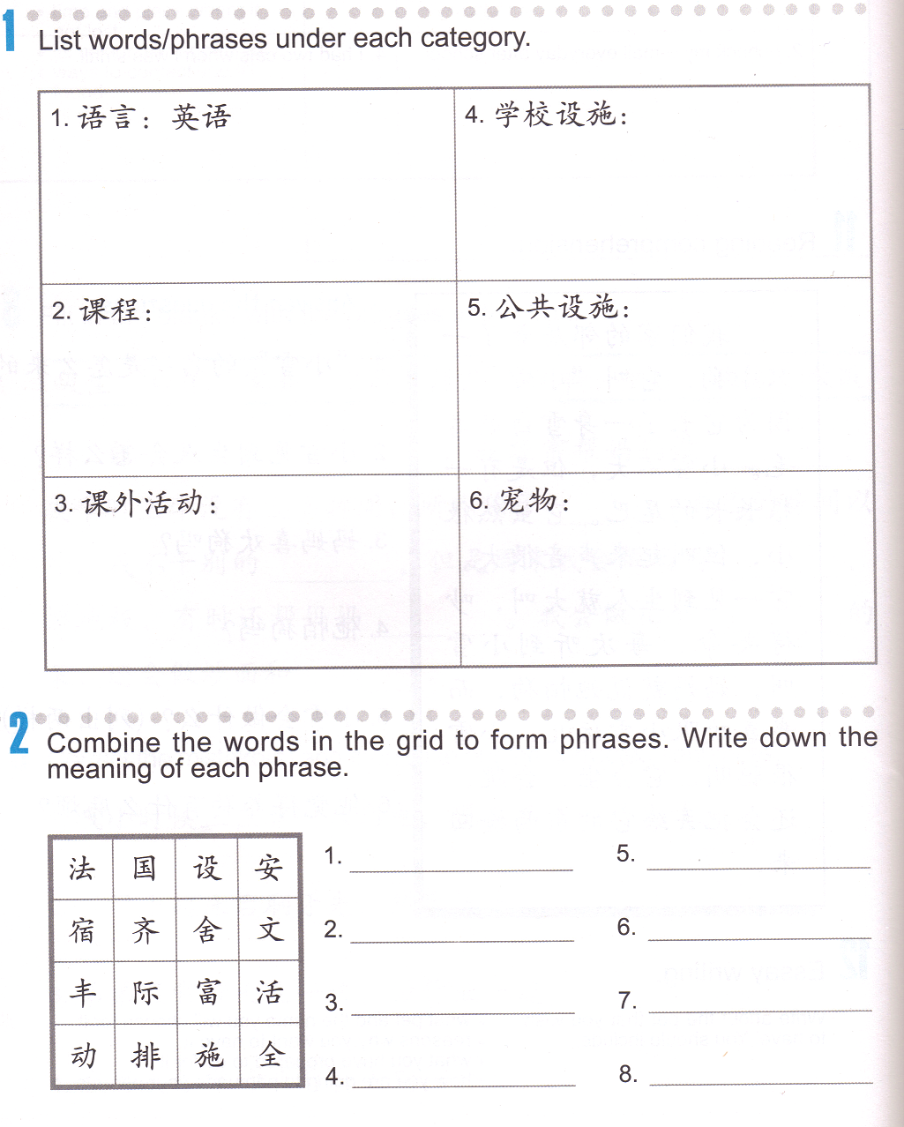
Task 4: List 3 words/phrases under each category.
英语
中文
日语
Task 5：combine the words in the grid to form phrases. Write down the words and the meanings on the lines.
法国、France

Slide 8
DO NOW:
一___楼
一___狗
一___学校
一___衣服
一___老师
只
所
位
幢
件
幢
只
所
件
位

Slide 9
Task 1
Present the 5-minute oral introduction:
Talk about your school.
Cover as least 3 aspects:
type B. size C. facilities D. teacher E. Students. F. location
You are NOT allowed to read off your notes.
You will present this Thursday, you don’t get a second chance for this task.

Slide 10
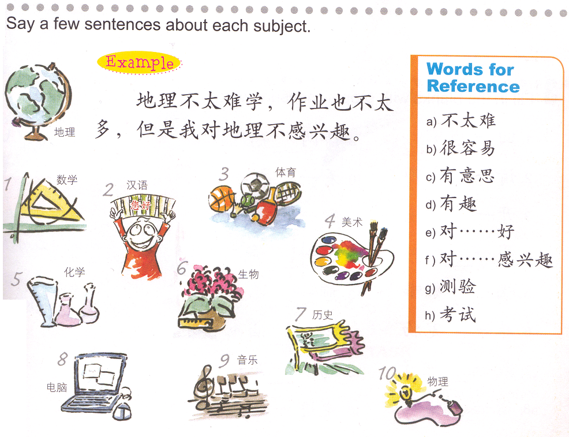
Task 2:
Choose 5 classes and 5 words for reference to form 5 sentences.
QUIZLET : Reference 03/03 Task 2

Slide 11
Task 3 groups of 2 students :
Find the matching Measure Words.
Draw a paper slip from each bag.
Figure out the matching measure word.
Write down your answers on a sheet of paper.
Staple all of your paper slips.
Put both of your names on it.
Turn it in~~~~~
吃了一___鱼
趟： trips/places
杯 means cups/classes
只：pets/small to medium size animals
张： paper product
条: fish/snake/lower body clothes
有一___狗
买了一___水
读了两___报纸
去了一___美国

Slide 12
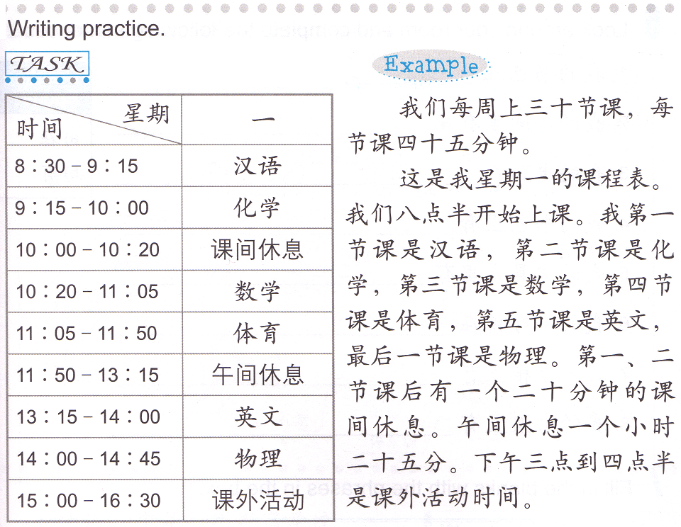
Task 4: write about your own schedule using the following as the reference:
30 classes/week
45 minutes/class
Monday’s schedule
Class starts @8:30
Chinese
Chemistry
Math
Physics
学
每
10 minutes break
1 hour 25 minutes lunch
3:00-4:30 extracurricular activity

Slide 13
True or false
一只乌龟
两幢咖啡
去三个中国
四个人

Slide 14
回一___家
去两___中国
去三___亚特兰大
去一___奶奶家
回一___家
去两___中国
去三___亚特兰大
去一___奶奶家
回一___家
去两___中国
去三___亚特兰大
去一___奶奶家
回一___家
去两___中国
去三___亚特兰大
去一___奶奶家
回一___家
去两___中国
去三___亚特兰大
去一___奶奶家
回一___家
去两___中国
去三___亚特兰大
去一___奶奶家
回一___家
去两___中国
去三___亚特兰大
去一___奶奶家
回一___家
去两___中国
去三___亚特兰大
去一___奶奶家
回一___家
去两___中国
去三___亚特兰大
去一___奶奶家

Slide 15
买一___咖啡
卖三___可乐
喝了两___水
想买一___雪碧
买一___咖啡
卖三___可乐
喝了两___水
想买一___雪碧
买一___咖啡
卖三___可乐
喝了两___水
想买一___雪碧
买一___咖啡
卖三___可乐
喝了两___水
想买一___雪碧
买一___咖啡
卖三___可乐
喝了两___水
想买一___雪碧
买一___咖啡
卖三___可乐
喝了两___水
想买一___雪碧
买一___咖啡
卖三___可乐
喝了两___水
想买一___雪碧
买一___咖啡
卖三___可乐
喝了两___水
想买一___雪碧
买一___咖啡
卖三___可乐
喝了两___水
想买一___雪碧

Slide 16
看了四___报纸
买了六___篮球票(ticket)
养了___条鱼
穿了两___裤子
有三___狗
想要一___猫
养五___猪
看了四___报纸
买了六___篮球票(ticket)
养了___条鱼
穿了两___裤子
有三___狗
想要一___猫
养五___猪
看了四___报纸
买了六___篮球票(ticket)
养了___条鱼
穿了两___裤子
看了四___报纸
买了六___篮球票(ticket)
养了___条鱼
穿了两___裤子
有三___狗
想要一___猫
养五___猪
看了四___报纸
买了六___篮球票(ticket)
养了___条鱼
穿了两___裤子
3

Slide 17
下次的考试
1.鱼__猫__。
2.数学__英文__。
3. __我有时间，我__去你家。
4.__今天下雨，__我没有去上学。
5. __中文很难，__我特别喜欢中文。
A.因为…所以…。
B.虽然…但是…。
C.…比…难。
D. 如果…会…。
E.…被…吃了。

