Slide 1
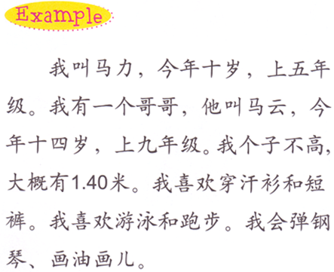
DO NOW
Find the following information:
1.名字
2.年龄（岁）
3.年级
4.身高（个子）
5.Clothes preference (color + 的 + clothes)
6.运动
7.爱好

Slide 2
Write a dialog and make a matching lost and found sign to go with it.
MISSING PET
寻狗/猫启事 (missing pet)
You are looking for your missing dog or cat, this dialog happens when you are looking. Make sure you change the words accordingly.
You are making a sign to find your missing cat or dog.
On the sign, you need to cover:
1. Your pet’s name:
我的狗/猫叫…。
2. The appearance of your pet:
我的狗/猫…斤重。
它有…毛，是…色的。
3. When and where you lose your pet:
我的狗/猫是when在where不见的。
4. Your contact information:
Your name-我是…。
Telephone number-我的电话是…。
Address-我家住在…。(…街…楼…号)
5. I would like to pay you…if you find my pet:
如果您找到…, 我会给您…元作为感谢。
6. draw/doodle a picture of your pet on your sign.
A:你在找什么？
B:我在找手机。
A:别着急，我帮你找。
B:谢谢。
A:你的手机长什么样？
B:它是红色的，不大也不小。
A:它是什么时候不见的？
B:我吃午饭的时候。
A;我们应该去饭店找。
B :好。

Slide 3
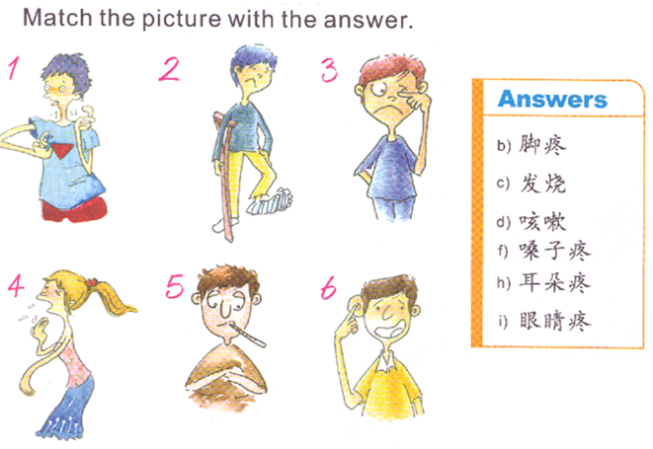
DO NOW-match the numbers with letters

Slide 4
Task 1: class assignment due TODAY!
Match the boxes to form words or phrases.
Glue the words on the construction paper.

Slide 5
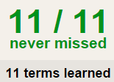
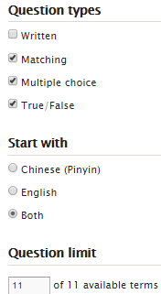
TASK2 QUIZLET instructions – 生病 each section/20%
Flashcard-Go over all the words
Learn-Make sure you finish 100%
Speller-Make sure you finish 100%
Scatter-The time needs to be within 40 seconds.
Test- Create New Test after you change the settings to:
笔记notes:
This number doesn’t matter.
20/20
This number has to be 100
20/20
The comment doesn’t matter.
20
This number has to be 11
This number has to be less than 40
20/20

Slide 6
TASK 3: translate the conversation between a patient and a doctor
医生：你好，你哪儿不舒服？
病人：我头疼咳嗽还流鼻涕。
医生：你发烧吗？
病人：我今天早上量了体温，没有发烧。
医生：你现在量一下体温。
病人：好。我四十度， 发烧了。
医生：我给你开点儿药。
病人：你开什么药？
医生：发烧药和咳嗽药。
病人：谢谢。
医生：你明天不要去上学，你要在家休息一天。
病人：好，谢谢医生。
医生：不客气。

Slide 7
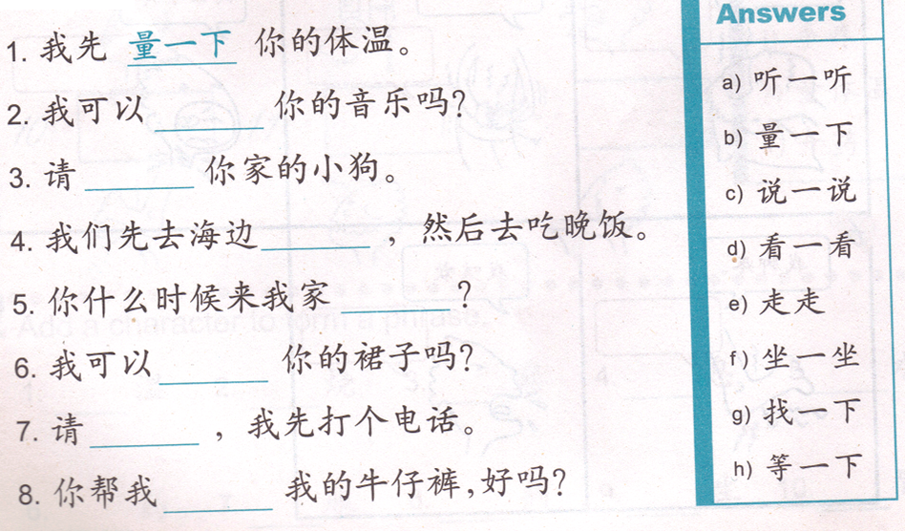
Task 4:
V. + 一下
V.+ V.
V.一V.
Reference:
reference 03/10 Task 4
Do something for a second
1. 我量一下你的体温。
I will measure your temperature for a second.

Slide 8
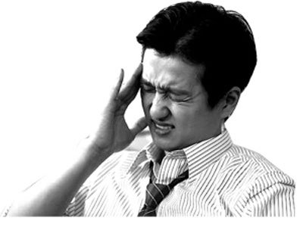
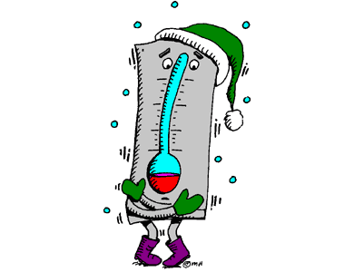
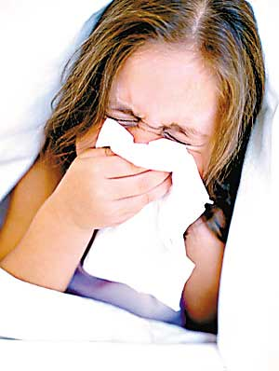
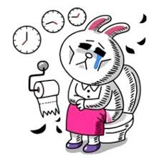
发烧
流鼻涕
咳嗽
医生
拉肚子
头疼

Slide 9
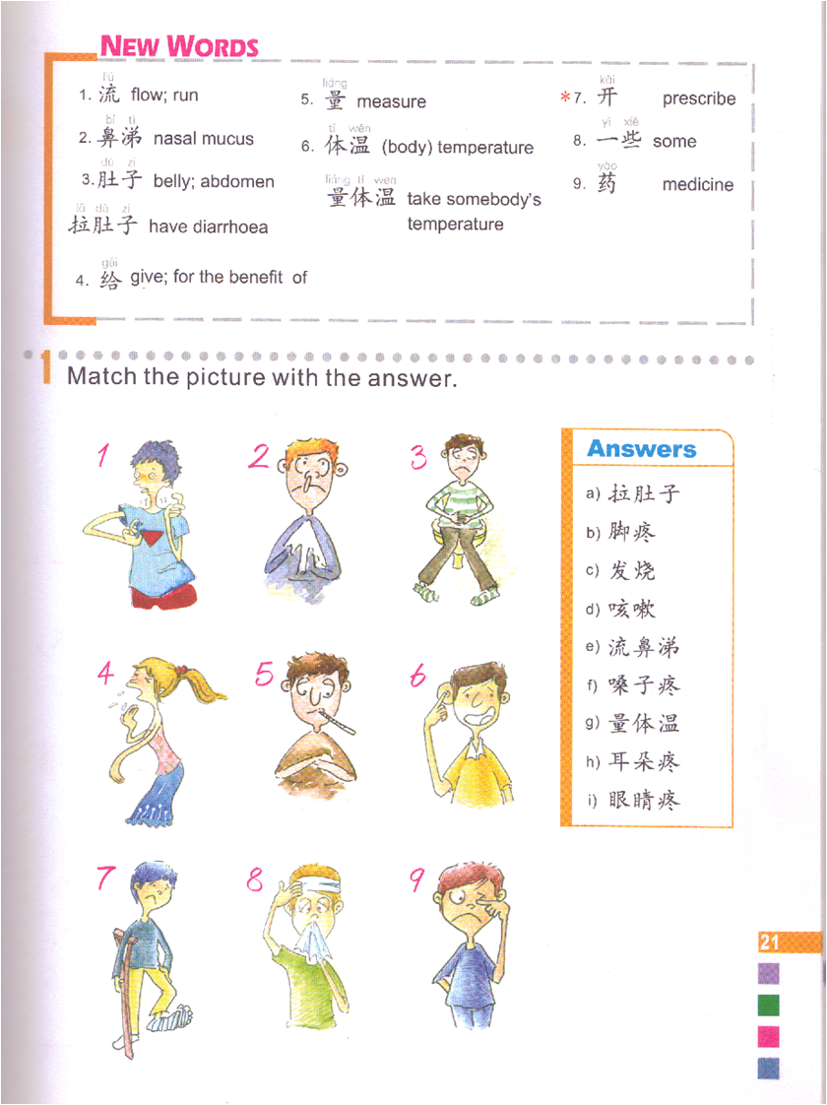
DO NOW
E
A
F
D
H
G
B
I
C

Slide 10
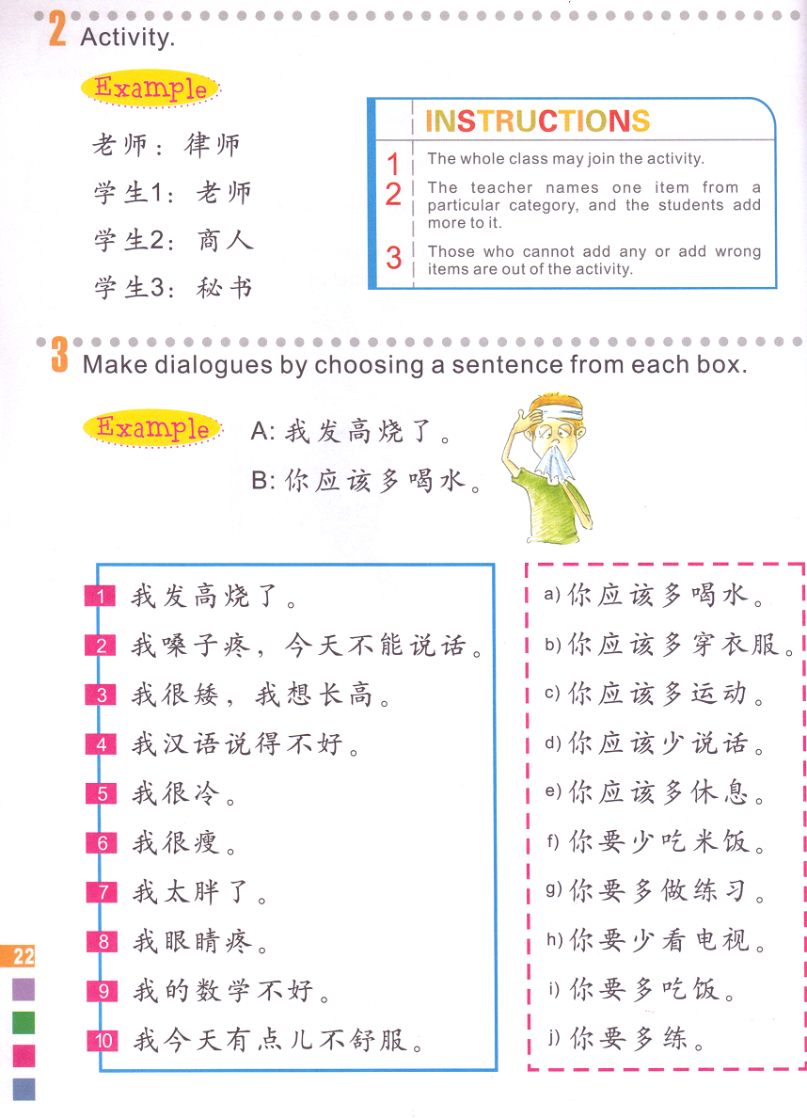
Task 1 : Match the suggestions with the situations.
应该=要=should
多 do something = do something more
少 do something = do something less
数学题。
说汉语。

Slide 11
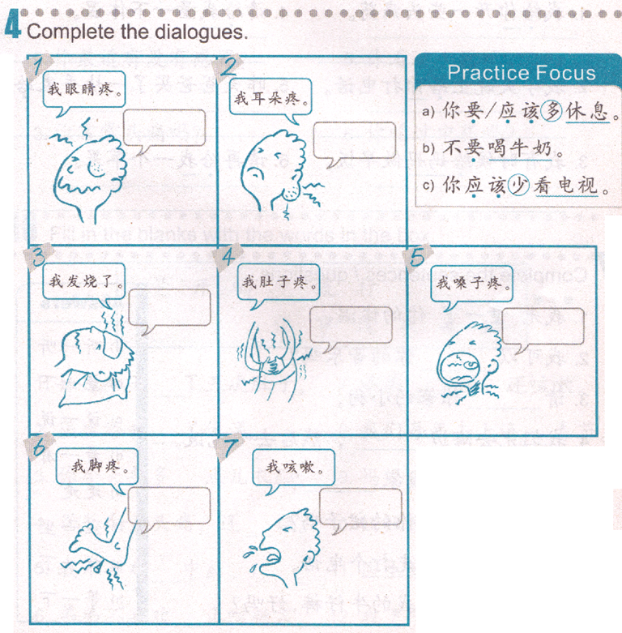
Task 2
Finish your own sentences.
Reference:
Task 1
你应该少…。
你要去…。
你应该多…。
你要…。
你应该少…。
你要少…。
你应该喝…。

Slide 12
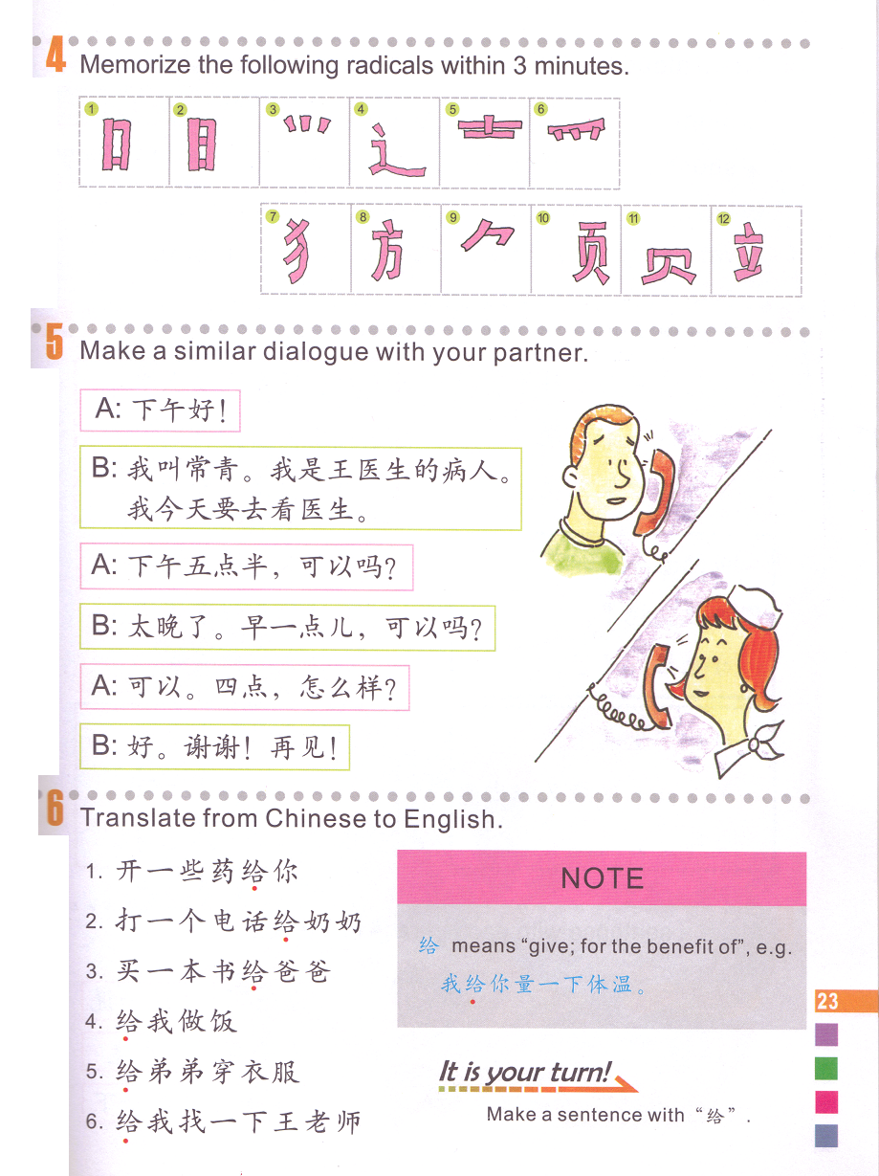
Task 3: Translate the sentences to English.
我
我
我
你
给：give/for/to…
Find the subject.
Find the verb.
Subject does something for another person.
我
你
I prescribe you some medicines.

Slide 13
发烧
流鼻涕
咳嗽
医生
拉肚子
头疼

Slide 14
Task 1 : Match the suggestions with the situations.
应该=要=should
多 do something = do something more
少 do something = do something less
A
D
C
J
B
I
F
数学题。
H
G
E
说汉语。

