Slide 1
Yun dong
Sport(s)
运动
Yun dong yuan
Yun dong chang
Athlete(s)/players
field
运动员
运动场

Slide 2
网球 wǎngqiú
乒乓球 pīngpāngqiú
篮球 lánqiú
羽毛球 yǔmáoqiú
足球 zúqiú
游泳 yóuyǒng
滑冰 huábīng
滑雪 huáxuě
跑步 pǎobù
tennis
Ping pong
basketball
badminton
soccer
To swim
To ice skate
To ski
To jog

Slide 3
Gan lan qiu
football
橄榄球

Slide 4
Bang qiu
baseball
棒球

Slide 5
我叫兰兰，今年十五岁，我是一个学生。我家有五口人。我有一个姐姐和一个弟弟。我的妈妈是英语老师。我是中国人，我会说汉语，和一点儿英文，我不会说日语。我家有一只猫和一只狗。我的猫很小，很可爱，我的狗很大，很凶。
Group of 2 students:
Answer the questions in complete sentences on the big paper.
What is her name?
2. How old is she?
3. How many people are their in her family?
4. How many younger brothers does she have?
5. What job does her mom have?
6. What is her nationality?
7. What language does she NOT speak?
8. What pets does she have?
9. What kind of 猫 does she have?
10. What kind of 狗 does she have?
EXAMPLE:
她叫兰兰。
Both of your names

Slide 6
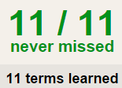
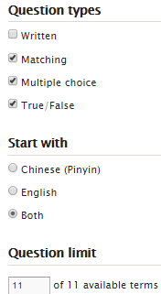
Task 1 QUIZLET instructions – sports 1 each section is 20%
Learn-Make sure you finish 100%
Speller-Make sure you finish 100%
Scatter-The time needs to be within 35 seconds.
Test- Create New Test after you change the settings to:
Task 2:
Make sure you write down the answers on your Unit Test Study Guide and study!!!
Your test in on Wednesday (10/21)
12/12
This number has to be 100
This number doesn’t matter.
Vocabulary:
运动-yun dong-sports
12/12
The comment doesn’t matter.
网球 wǎngqiú
乒乓球 pīngpāngqiú
篮球 lánqiú
羽毛球 yǔmáoqiú
足球 zúqiú
游泳 yóuyǒng
滑冰 huábīng
滑雪 huáxuě
跑步 pǎobù
橄榄球 gan lan qiu
棒球 bang qiu
12
This number has to be 12
This number has to be less than 40
12 of 12

Slide 7
da
ti
Xi huan
Play (for ball games except soccer)
Play (for soccer)
like
打
踢
喜欢

Slide 8
Sports & verbs.
Name:
Date:
12:10-1:15
Sports & verbs
1:20-1:54
Unit Test
If you finish your test before the ring of the bell.
Leave your test on your desk and put your head down.
You can’t talk, walk around or use bathroom.
Tennis 网球 wǎngqiú
Ping pong
basketball
badminton
football
Baseball
soccer
Da
Play
打
English
Pin yin
Characters
Ti
Play
踢
swim
Ice skate
Ski
Run
Xi huan
Like
喜欢
Sentences:
1.打：
2.踢:
3.喜欢:
English
Characters

Slide 9
Fill in the blanks.
是 今年 打 踢 喜欢
我____三十五岁。
爸爸____篮球。
弟弟____足球。
我____妈妈。
她____我的朋友。

Slide 10
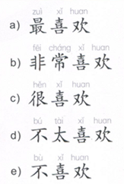
I like you the most.
I + 最喜欢 + you.
我最喜欢你。
Like the most
I like you very much.
Like very much
I + 非常喜欢+ you.
我非常喜欢你。
I really like you.
Really like
我很喜欢你。
I + 很喜欢 + you.
Don’t/ doesn’t really like
I don’t really like you.
我不太喜欢你。
I +不太喜欢d+ you.
Don’t/ doesn’t like
I don’t like you.
I + 不喜欢 + you.
我不喜欢你。

Slide 11
2:15-2:50
Choose 5 sports to write about.
Write 1 sentence on each color in Chinese.
red
orange
pink
green
yellow
I 最喜欢 sport1.
I 非常喜欢 sport2.
I 很喜欢 sport3.
I 不太喜欢 sport4.
I 不喜欢 sport5.
Make sure you put your first name on all of them.
Walk around and glue your paper on the matching sport.
篮球
Example:
John
John
我最喜欢篮球。
我最喜欢篮球。

Slide 12
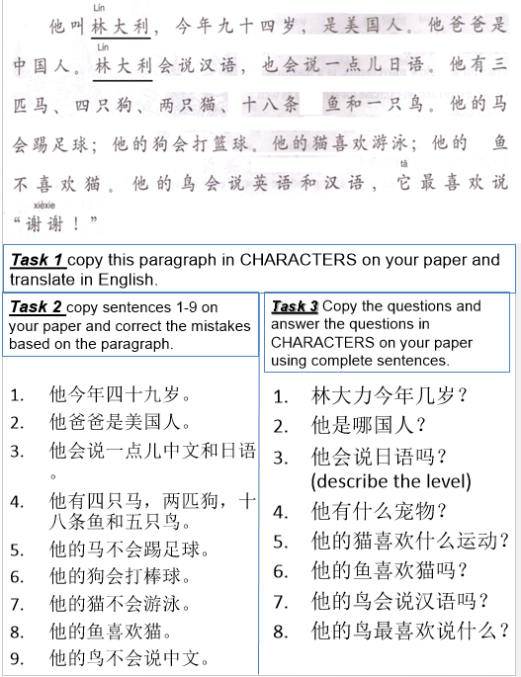
2:50-3:30
Choose 1 out of 3 tasks to work on.

Slide 13
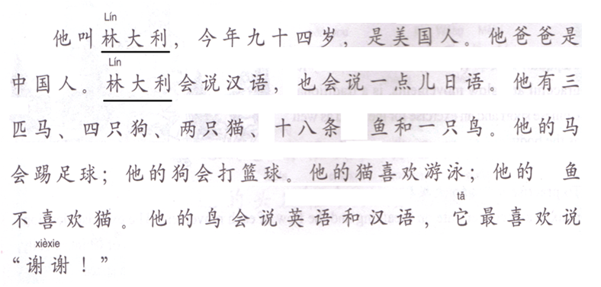
Task 1 copy this paragraph in CHARACTERS on your paper and translate in English.

Slide 14
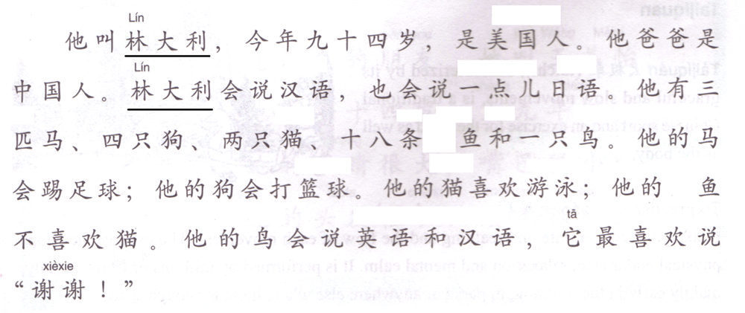
Task 2 copy sentences 1-9 on your paper and correct the mistakes based on the paragraph.
九十四
他今年四十九岁。
他爸爸是美国人。
他会说一点儿中文和日语。
他有四只马，两匹狗，十八条鱼和五只鸟。
他的马不会踢足球。
他的狗会打棒球。
他的猫不会游泳。
他的鱼喜欢猫。
他的鸟不会说中文。

Slide 15
Task 3 Copy the questions and answer the questions in CHARACTERS on your paper using complete sentences.
林大力今年几岁？
他是哪国人？
他会说日语吗？(describe the level)
他有什么宠物？
他的猫喜欢什么运动？
他的鱼喜欢猫吗？
他的鸟会说汉语吗？
他的鸟最喜欢说什么？

