Slide 1

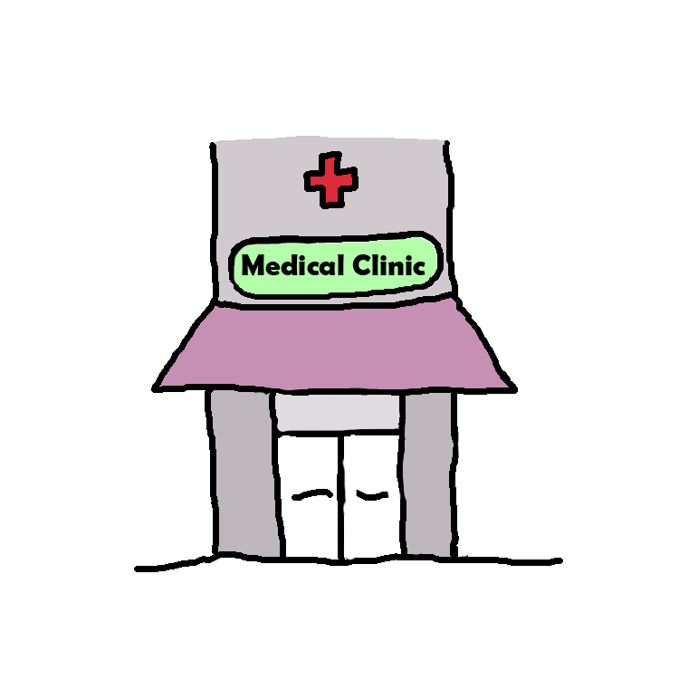

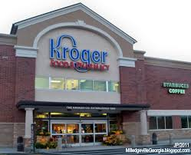
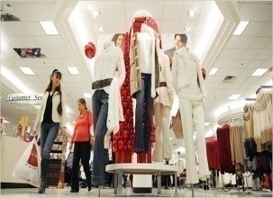
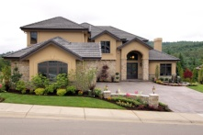
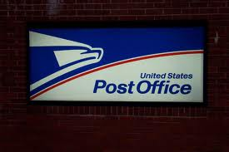

Name: Name:
邮局离我家不远。
Place 1 离 Place 2 远/很远/非常远/特别远/不远。
超级市场在邮局对面。
Place 1 在 Place2 对面。
邮局的左边是诊所，邮局的右边是银行。
Place 1 的左边是 Place2 。
Place 1 的右边是 Place2 。
市政大楼在百货公司的前面。
教堂的后面是一个小学
Place 1 在 Place2 的前面 。
Place 1 在 Place2 的后面 。
我家附近还有一个教堂。
Place 1 附近有 Place 2。
Place 1 附近没有 Place 2。
教堂的旁边是一个公园。
Place 1 的旁边是 Place 2。
Cut out the places and glue them on your paper based on the descriptions. (2 students)
邮局离我家不远。
超级市场在邮局对面。
邮局的左边是诊所，邮局的右边是银行。
市政大楼在百货公司的前面。
我家附近还有一个教堂。
教堂的后面是一个小学，教堂的旁边是一个公园。

Slide 2

Describe a neighborhood using ALL the following sentence structures and at least 10 places.
Draw your neighborhood based on your descriptions.
Place 1 离 Place 2 远 (far)/很远/非常远/特别远/不远。
Place 1 离 Place 2 近(close)/很近/非常近/特别近/不近。
Place 1 在 Place2 对面。
(across the street from each other)
Place 1 的左边是 Place2 。
(Place 2 is to the left of Place 1)
Place 1 的右边是 Place2 。
(Place 2 is to the left of Place 1)
Place 1 在 Place2 的前面 。
(Place 1 is in front of Place 2)
Place 1 在 Place2 的后面 。
(Place 1 is behind Place 2)
Place 1 附近有 Place 2。
(Place 2 is nearby Place 1)
Place 1 附近没有 Place 2。
(Place 2 is not nearby Place 1)
Place 1 的旁边是 Place 2。
(Place 2 is next to Place 1)
QUIZLET GRADE
2 students/each group
Example:
Sentences:
__________________________________________________________
_______________________________________________________________________________________

Slide 3
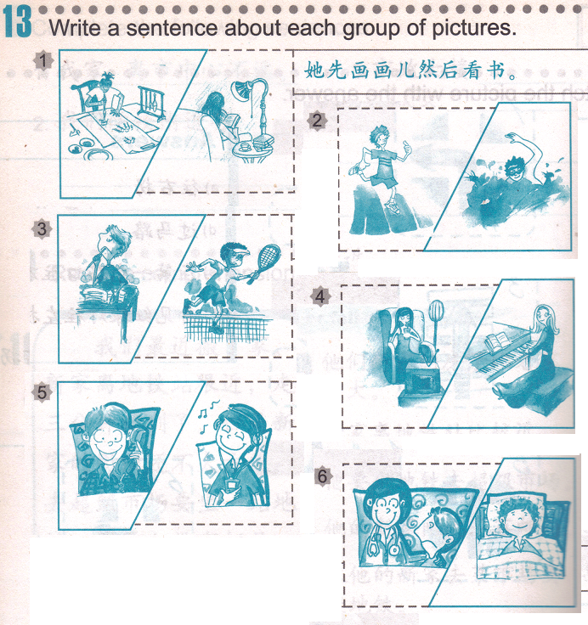
Independent Assignment: QUIZLET reference (09/22 Independent Assignment)
Subject + 先 + do thing 1,然后 + do thing 2。
Class Assignment GRADE
ON YOUR
OWN
PAPER

Slide 4

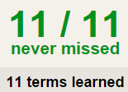

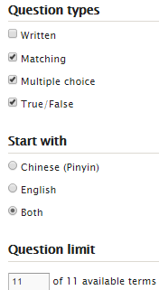
HOMEWORK QUIZLET instructions – Places 3 (directions) each section is 20%
Learn-Make sure you finish 100%
Speller-Make sure you finish 100%
Scatter-The time needs to be within 35 seconds.
Test- Create New Test after you change the settings to:
笔记notes:
10/10
This number has to be 100
Homework GRADE
This number doesn’t matter.
10/10
The comment doesn’t matter.
10
This number has to be 12
This number has to be less than 40
10 of 10

Slide 5
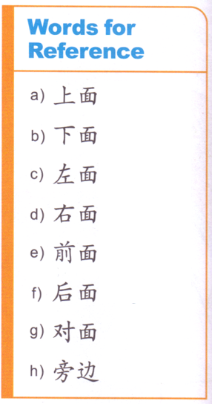
DO NOW

Slide 6
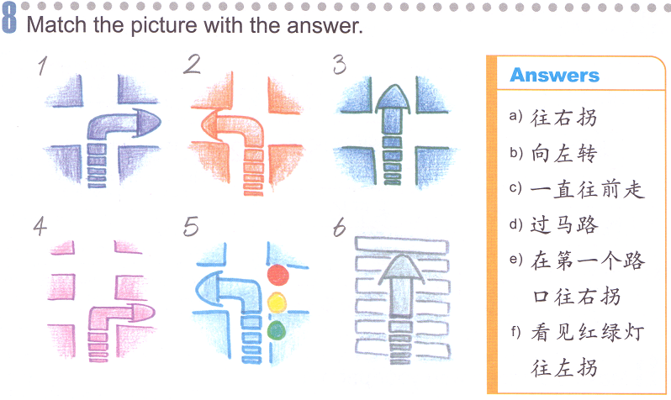
往左拐

Slide 7
Sample:
http://www.classtools.net/connect/
http://www.classtools.net/connect/201509_6Aidcc

Slide 8
May I please ask, Where is the school?
A:请问，学校在哪儿？
B:你先过马路，然后往前走。你走五分钟（就）到（了）。
A: 请问，去银行怎么走？
B: （一直）往前走，看到红绿灯往左拐。你走十分钟到。
A: 请问，附近有医院吗？
B:你在前面的第一个路口过马路，然后往右拐。 医院在你的左手边。
You cross the street first, then walk straight. It takes you (only) 5 minutes to get there.
May I please ask, how do I get to the bank?
Walk straight all the way, make a left turn when you see the red light. It takes you 10 minutes to get there.
Is there a hospital nearby?
You cross the street at the 1st intersection in the front, then make a right turn. The hospital is on your left hand side.

Slide 9

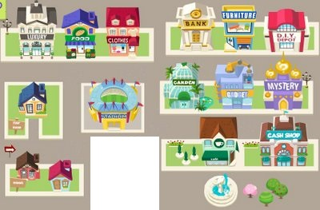

Each group will be assigned 2 places. You all start at the same spot. You will need to write 2 short conversations to describe how to get to your 2 places on the construction paper.
青青家具店
中国银行
山山百货公司
小红诊所
上海饭店
乐乐超市
非非电影院
市政大楼
第五中学
第一教堂
游乐场
图书馆
前
星巴克咖啡馆
右
左
我家
后
我外婆家
中心公园

Slide 10
HOMEWORK QUIZLET instructions – Places 3 (directions) each section is 20%
Learn-Make sure you finish 100%
Speller-Make sure you finish 100%
Scatter-The time needs to be within 35 seconds.
Test- Create New Test after you change the settings to:
笔记notes:
10/10
This number has to be 100
Make sure you finish Places 1,2&3
This number doesn’t matter.
10/10
The comment doesn’t matter.
10
This number has to be 12
This number has to be less than 40
10 of 10

Slide 11
Kahoot it

