Slide 1
Do Now: Which ones are most likely females?
舅舅
姑姑
舅妈
婶婶
妈妈
弟弟
姨妈
姥爷
姥姥
爷爷
奶奶
叔叔

Slide 2
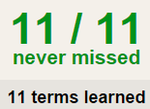
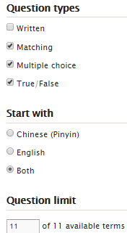
Task 1 QUIZLET relatives each section is 20%
Learn-Make sure you finish 100%
Speller-Make sure you finish 100%
Scatter-The time needs to be within 35 seconds.
Test- Create New Test after you change the settings to:
NOTES:
10/10
This number has to be 100
This number doesn’t matter.
10/10
The comment doesn’t matter.
10
This number has to be 12
This number has to be less than 40
10 of 10

Slide 3
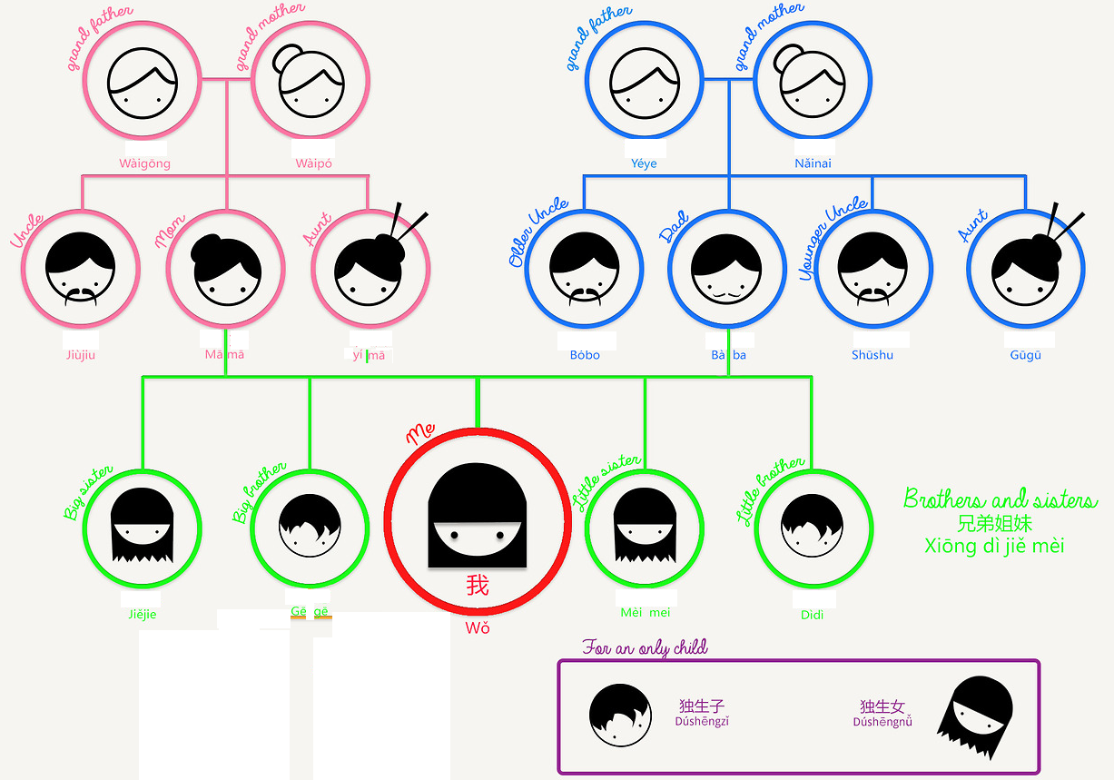
Task 2: Each group of 2 students will make a chart like this.

Slide 4
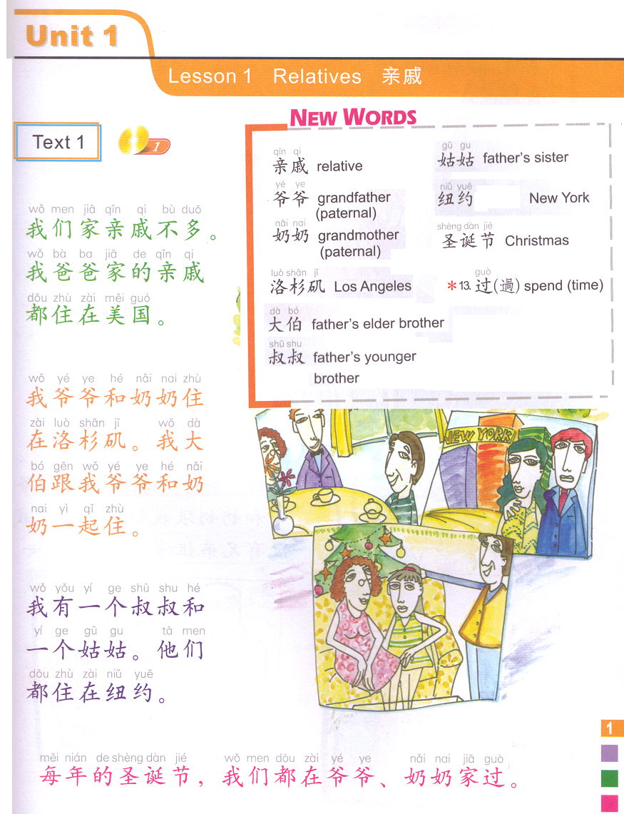
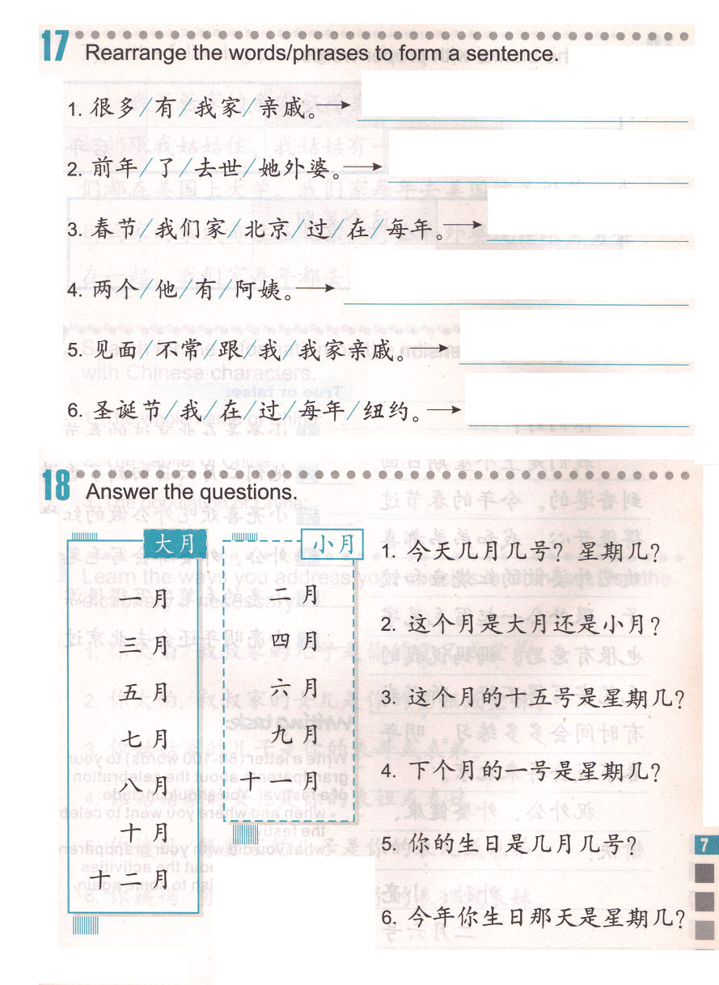
TASK3&4 are on a separate sheet of paper!!!!!!
TASK 3
Reference: Text 1
Subject + year + V. + 了。
Not many/much
Pass away
Reference: Text 1
Spring festival
伯伯 dad’s older brother
我不常…
Meet/see
Reference: Text 1
Write down the hints on the hand out.
伯
TASK 4
A & B live together.
We spend time at grandma and grandpa’s house for Christmas every year.
我们每年都在爷爷，奶奶家过圣诞节。
Subject + adverb + 都 + 在 + place + 过 + holiday.

Slide 5
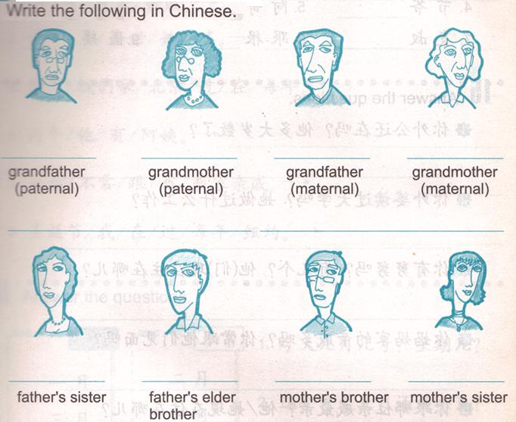
DO NOW
爷爷
奶奶
姥爷
姥姥
姑姑
伯伯
舅舅
姨妈

Slide 6
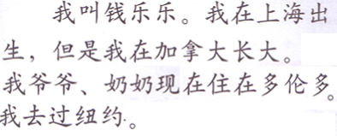
Task 1: Describe your family, choose the information and say it to Fenglaoshi.
Reference – QUIZLET (reference 02/03 Task1)
名字：小红，大明，天天，欢欢
出生地：北京，亚特兰大，伦敦，上海
长大：日本，英国，澳大利亚，德国
亲戚：外公和外婆，姑姑和伯伯，舅舅和姨妈，哥哥和姐姐
亲戚住在：北京，亚特兰大，伦敦，上海
我去过：美国，英国，澳大利亚，德国

Slide 7
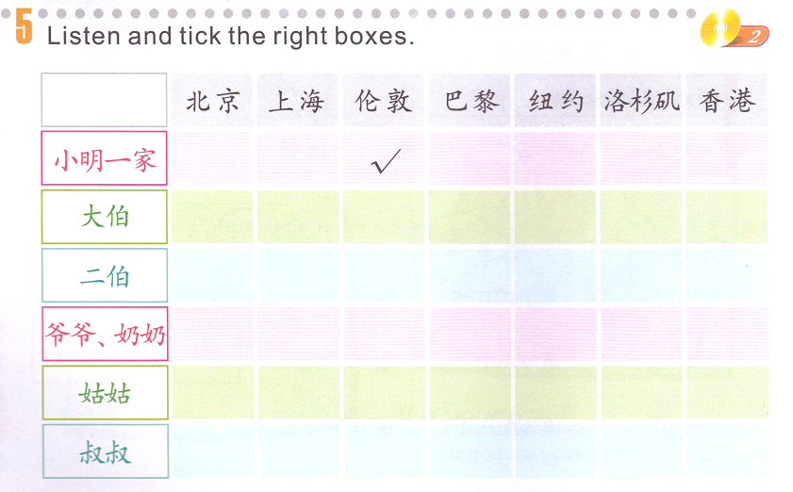
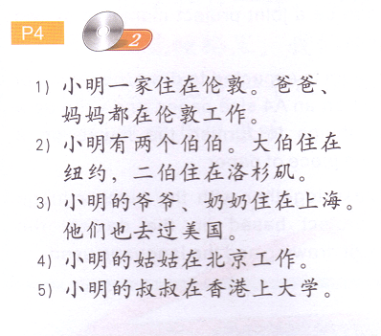
Task 2: Read the sentences about 小明’s family and put a check mark for the place each relative lives in.

Slide 8
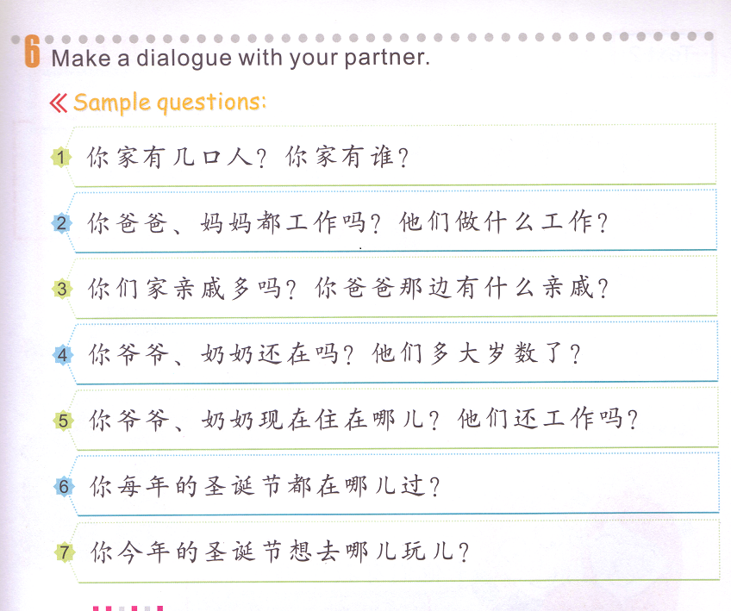
Task 3 : Answer the questions in complete sentences.
Change all 你 to 我。
Change 几 to a number. Change 谁 to your family members.
Yes: take out 吗. No: take our 吗，add 不 in front of 工作. Describe their jobs, using “he/she is …”
Yes: Take out 吗. No: Take out 吗，add 不 in front of 多。Chang 什么亲戚 to the family members on your dad’s side.
妈妈 or 爸爸
Change 哪儿 to the place your mom or dad lives in. Yes: Take out 吗. / No: take out吗，change 还 to 不。
Change 哪儿 to a place.
Change 哪儿to another place.

Slide 9
Task 2: Each group of 2 students will make a chart like this.

Slide 10
Task 3: Translate from Chinese to English.
Reference:
Quizlet: 12/09 Task 1
Have done
Do something with someone

Slide 11
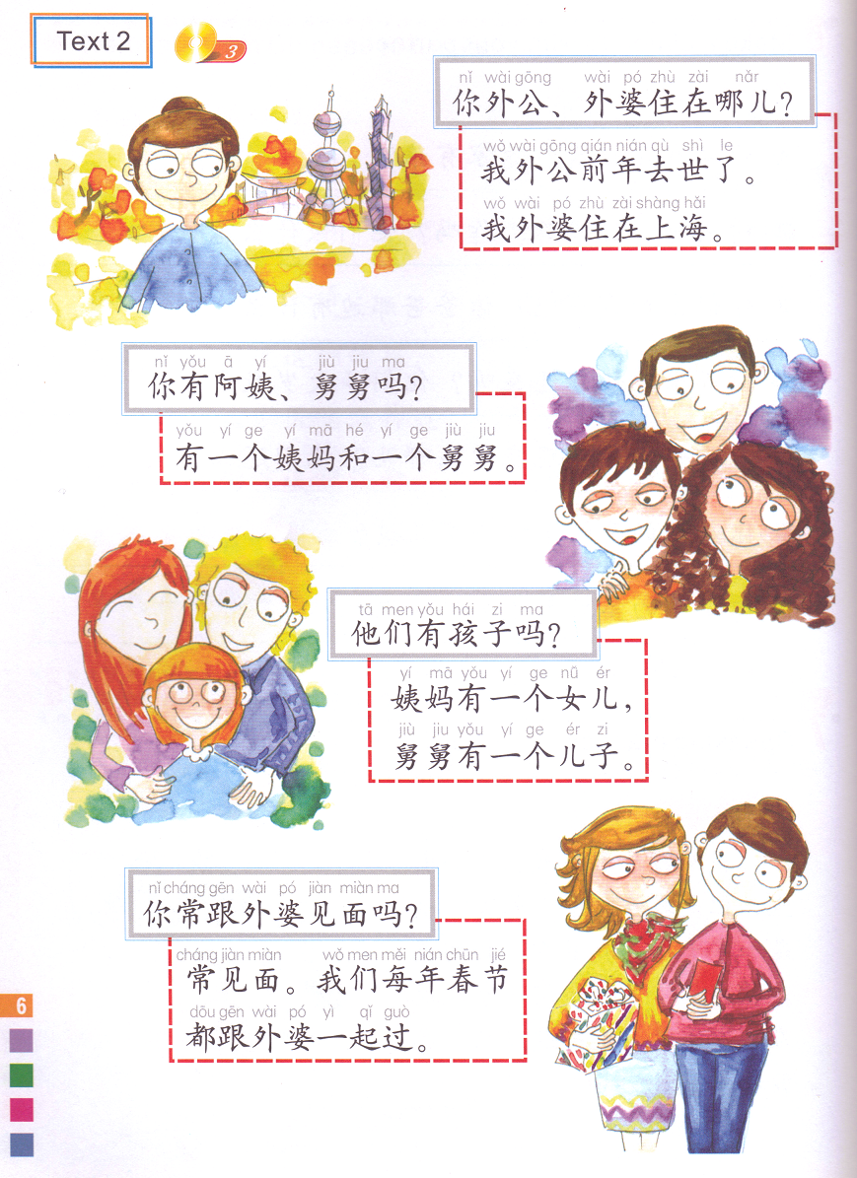
Where do your grandpa and grand ma live?
My grandpa passed away 2 years ago, My grandma lives in SH.
Do you have aunts and uncles?
I have 1 aunt and 1 uncle.
Do they have kids?
My aunt has 1 daughter. My uncle has 1 son.
A 跟 B 常/不常 见面。
Do you see your grandma often?
Yes. We spend Chinese New Year with my grandma every year.

Slide 12
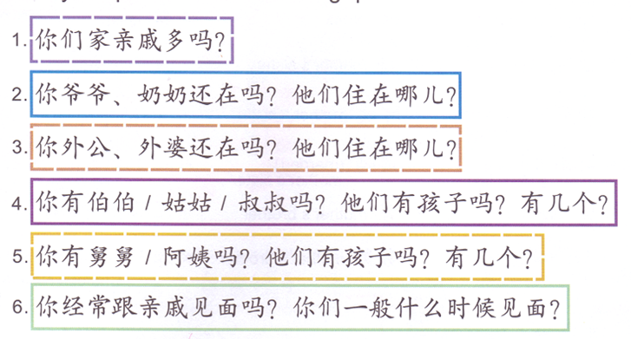
TASK 3: Answer the questions in complete sentences.
Replace all the 你 to 我。
1. Yes: take out 吗. No: take out 吗, add 不 before 多。
2. 1st question: take out 吗. 2nd question: change 哪儿 to a place.
3. 1st question: take out 吗. 2nd question: change 哪儿 to a place.
4 & 5. 1st question: choose 1 relative, take out 吗.
2nd question: take out 吗.
3rd question: change 几 to a number.
6. 1st question- Yes: take out 吗. No: take out 吗, add 不 before 经常。
2nd question-change 什么时候 to a frequency word, like: every weekend, every month est.

Slide 13
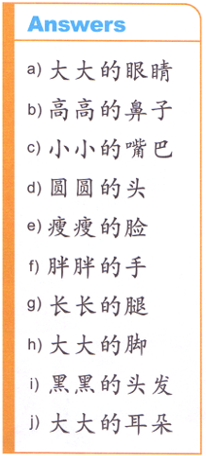
TASK 2- draw the following body parts based on the descriptions. reference: quizlet - body parts
adjectives
J

Slide 14
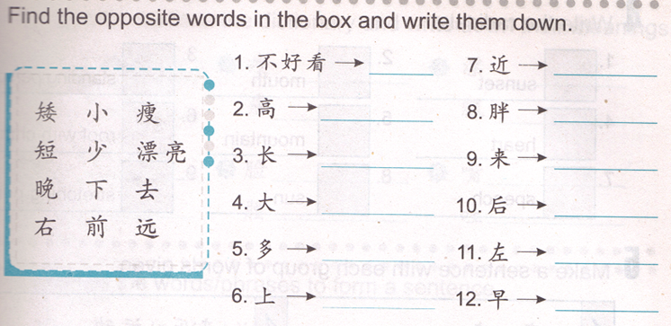
TASK 3
reference: quizlet- adjectives

Slide 15
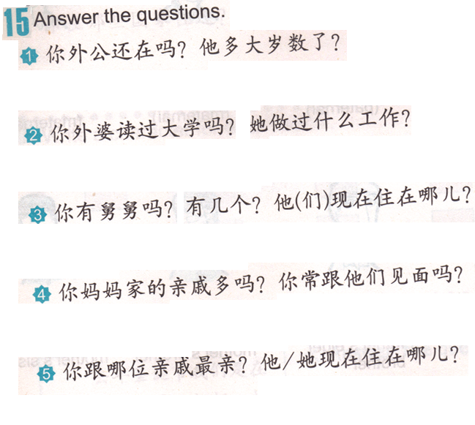
Task 4
Change all the 你 to 我.
65
Yes
Take out 吗. He + 65 + 岁了.
teacher
Yes
Take out 吗. Change 什么工作 to teacher.
Beijing
Yes
2
Take out 吗. Change 几 to 两. Change 哪儿 to Beijing.
Yes
No
Take out 吗, add 不 before 多. Take out 吗.
Atlanta
Grandma
Change 哪位亲戚 to grandma (wai po). Change 哪儿 to Atlanta, take out 他.

