Slide 1
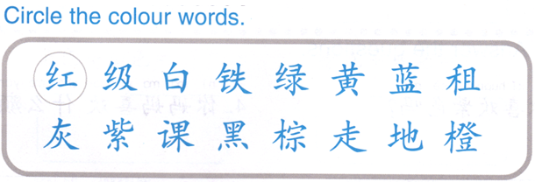
DO NOW 10% of your grade!!

Slide 2
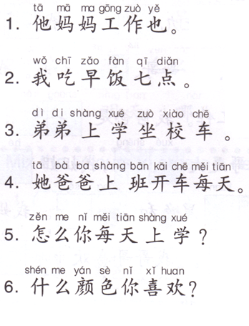
Group Assignment: Each group will cut out the words to put them in the correct order and glue them on the paper.
Structure references:
Subject + adverb (everyday) + how to + do something?
Subject + adverb (everyday) + TOD + time + do something.
Subject + like + what + color?
QUIZLET references: routines, transportations, time, family
1.__________________________________________
2.__________________________________________
3.__________________________________________
4.__________________________________________
5.__________________________________________
6.__________________________________________

Slide 3
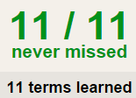
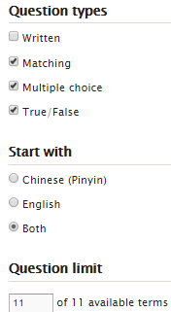
Task 1 QUIZLET Unit Test Vocab 1
Learn-Make sure you finish 100%
Speller-Make sure you finish 100%
Scatter-The time needs to be within 35 seconds.
Test- Create New Test after you change the settings to:
IMPORTANT NOTES:
MS. FENG WILL CHECK YOU QUIZLET COMPLETING NEXT FRIDAY. YOU WILL GET 1 HOMEWORK GRADE. MAKE SURE YOU FINISH EVERYTHING BY NEXT FRIDAY (01/29)
20/20
This number has to be 100
This number doesn’t matter.
20/20
The comment doesn’t matter.
20
This number has to be 12
This number has to be less than 40
20 of 20

Slide 4
Kahoot it.
12:50

Slide 5
Group Assignment: Each group will cut out the words to put them in the correct order and glue them on the paper.
I + time + eat breakfast.
Subject + ride + school bus + go to school.
Subject + everyday + drive + car + go to work.
You + everyday + how + go to school?
You + like + what + color?

Slide 6
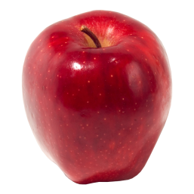
颜色
红色
绿色
黄色
蓝色
黑色

Slide 7
Do Now: What do they indicate?
车
吃
色
人
女
火

Slide 8
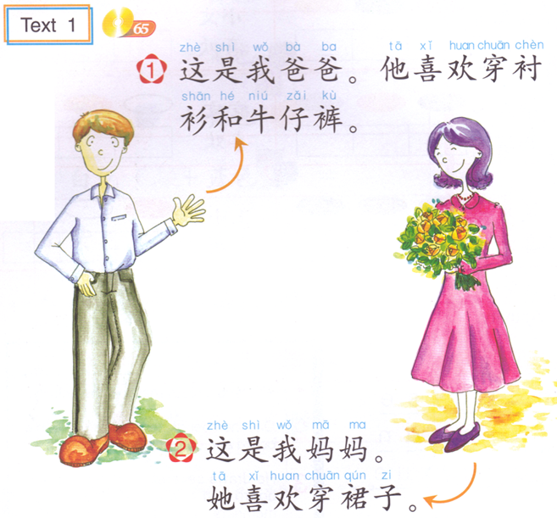
1. This is my dad. He likes wearing shirt and Jeans.
2. This is my mom. She likes wearing skirt.

Slide 9
TASK1 QUIZLET instructions – clothes 1 each section is 20%
Flashcard-Go over all the words
Learn-Make sure you finish 100%
Speller-Make sure you finish 100%
Scatter-The time needs to be within 40 seconds.
Test- Create New Test after you change the settings to:
笔记notes:
This number doesn’t matter.
11/11
This number has to be 100
11/11
The comment doesn’t matter.
MS. FENG WILL CHECK YOU QUIZLET COMPLETING NEXT FRIDAY. YOU WILL GET 1 HOMEWORK GRADE. MAKE SURE YOU FINISH EVERYTHING BY NEXT FRIDAY (01/29)
This number has to be 11
This number has to be less than 40

Slide 10
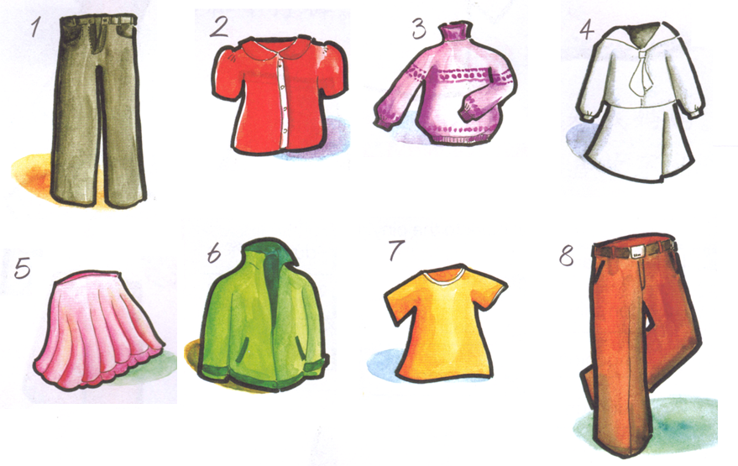
TASK 2：
Speaking task: 说
Choose 3 clothes to describe to Fenglaoshi.
Color + 的 + clothes
Reference: QUIZLET colors & clothes 1
Writing task: 写
Write 5 sentences using the clothes you didn’t choose.
Subject + 喜欢穿+ color + 的 + clothes。
1.
2.
3.
4.
5.
TASK3：
Summarize the story of Nian:
https://www.youtube.com/watch?v=P1AKwg7Ng2s

Slide 11
颜色
红色
绿色
黄色
蓝色
黑色

Slide 12
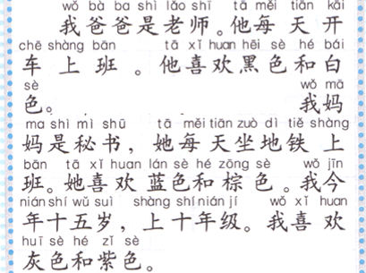
DO NOW: Under line the answers. (10%)
你爸爸喜欢什么颜色？
妈妈呢？
你喜欢绿色吗？

Slide 13
Task 1: Divide the words into 3 categories (20%).
Clothes:
Routines:
Transportations:

Slide 14
TASK 2: listen to the items and match the colors with the words. (24%)

Slide 15
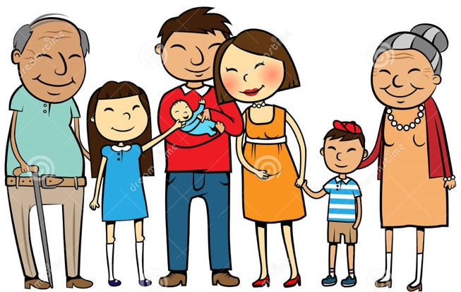
TASK 3
Choose 1 adult in the picture to describe using the following sentences: (46%)
这是…。
This is…
她/他…岁。
Age
她/他是一个…。
job
她/他每天…上班。
How to get to work
她/他喜欢穿color1 的clothes 1 和…的clothes 2。
*You can get up 10% bonus to write down any other information about the family. *
1.
2.
3.
4.
5.

Slide 16
TASK1 QUIZLET instructions – Unit Test Vocab 2
each section/20%
Flashcard-Go over all the words
Learn-Make sure you finish 100%
Speller-Make sure you finish 100%
Scatter-The time needs to be within 40 seconds.
Test- Create New Test after you change the settings to:
笔记notes:
This number doesn’t matter.
20/20
This number has to be 100
20/20
20
The comment doesn’t matter.
This number has to be 11
This number has to be less than 40
20

Slide 17
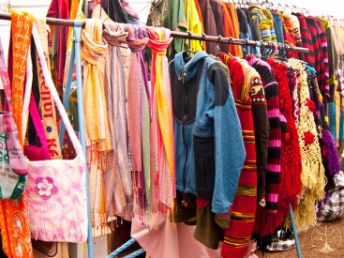
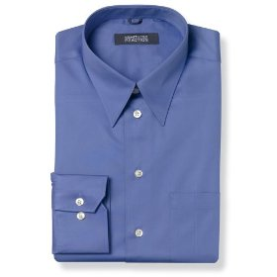
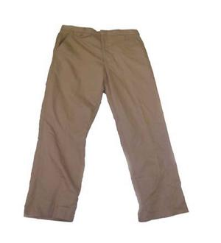
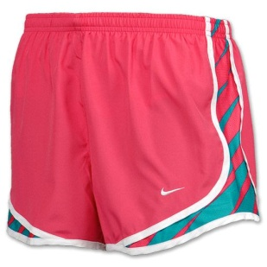
衣服
衬衫
汗衫
长裤
短裤
裙子

