Slide 1
Pronounce these words. You will be asked to say 5 words to Ms. Feng later today to get a quiz grade.
family/ home 家
My mom 我的妈妈
Your dad 你的爸爸
3 Older sisters 三个姐姐
4 Older brothers 四个哥哥
10 Younger sisters 十个妹妹
8 Younger brothers 八个弟弟
His grandpa 他的爷爷
Her grandma 她的奶奶

Slide 2
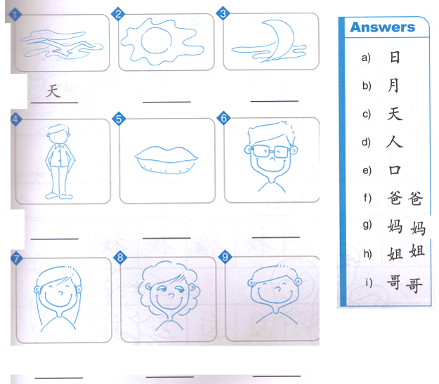
Re shen: matching

Slide 3
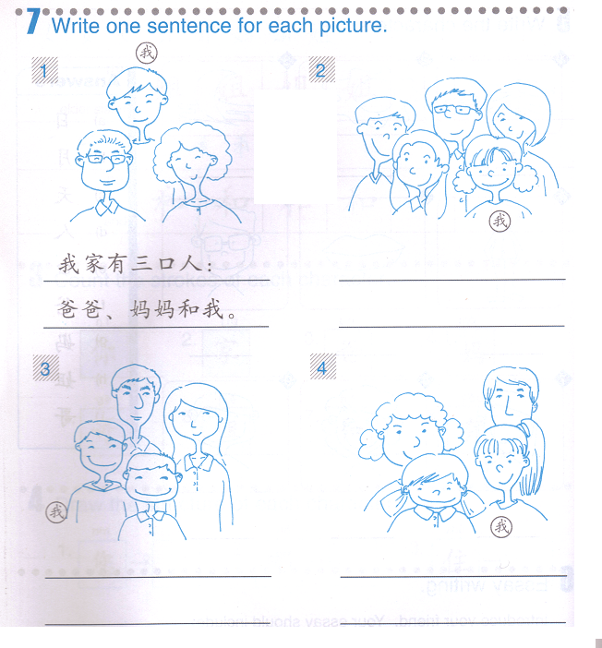
Example:
我的家有三个人。
他们是爸爸妈妈和(and)我。

Slide 4
liang
Two
两
二 (èr) and 两 (liǎng) both mean “two,” but they differ in usage.
两 (liǎng) is used in front of common measure words to express a quantity, e.g., 两个人 (liǎng ge rén, two persons).
In counting, one uses 二 (èr): “一， 二， 三， 四…” (yī, èr, sān, sì; one, two, three, four...).
In compound numbers, 二 (èr) is always used for the 2 on the last two digits, e.g.,二十二 (èrshí’èr, 22); 一百二十五 (yìbǎi èrshí’wǔ, 125). But 二百二十二 (èrbǎi èrshí’èr, 222) can also be said as 两百二十二 (liǎngbǎi èrshí’èr, 222).

Slide 5
2 people
2 + measure word + people
Liang + ge + ren
两个人

Slide 6
There are 2 people in your family.
Translate the sentence into pin yin and character.
Your family has 2 people.
Ni de jia you liang ge ren.
你的家有两个人。

Slide 7
Shei de
whose
谁的

Slide 8
Asking who owns an object: To ask…
Whose book is this?
This is whose book?
zhè shì shéi de shū ?
这是谁的书？

Slide 9
Asking who owns an object: To answer this question, replace the question word 谁的 with the owner.
This is my book.
This is mine.
OR
zhè shì wǒ de shū .
zhè shì wǒ de.
这是我的(书)。

Slide 10
Lian xi （练习）-practice：
Whose ruler is this?
This is (the) teacher’s.
zhe shì shéi de chǐ zi?
Zhe shi lao shi de.
这是谁的尺子？
这是老师的。

Slide 11
Asking who owns an object: To ask…
Whose writing brush is that?
That is whose writing brush?
Nà shì shéi de máo bǐ ?
那是谁的毛笔？

Slide 12
Asking who owns an object: To answer this question, replace the question word 谁的 with the owner.
That is his writing brush.
nà shì tā de máo bǐ .
那是他的毛笔。

Slide 13
Homework: Translate the sentences in Characters on your own paper. Purple: Order needs to be changed. Red: Possessive 的
You will have these words as your quiz next class, you will need to study and memorize them:
This:这
That:那
Am/is/are:是
My:我的
Her/hers:她的
Student’s: 学生的
Teacher’s:老师的
1-This is my teacher.
2-Whose knife is that? That is my knife.
3-Whose writing brush is this? This is hers.
4-Whose pen (writing utensil) is that?
That is my student’s pen.
5-Whose is that? That is my teacher’s.

Slide 14
Categorize the words on the construction paper, you will have to use at least 6 categories, 50 words. Any more category will get you 1 extra point. Any more word will get you 1 extra point.
School supplies Family members More than 1 person 1 digit numbers 2 digit numbers
Question words Possessive words Males Females People who are older than “I” People who are younger than “ I”
Nature words Characters share the same parts
妈妈 | 你 | 书包 | 那 | 剪刀 | 姐姐 | 我们
三十六 | 月 | 老师 | 一 | 三 | 九 | 六
他们 | 爸爸 | 谁 | 人 | 毛笔 | 木 | 我的
二 | 七 | 我 | 八 | 哥哥 | 是 | 两
爷爷 (grandpa) | 火 | 妹妹 | 水 | 十 | 橡皮 | 她
你的 | 几岁 | 零 | 你们 | 谁的 | 他的 | 十一
五 | 尺子 | 这 | 四 | 五十六 | 他 | 弟弟
书 | 日 | 山 | 奶奶 (grandma) | 笔 | 九十 | 七十四

