Slide 1
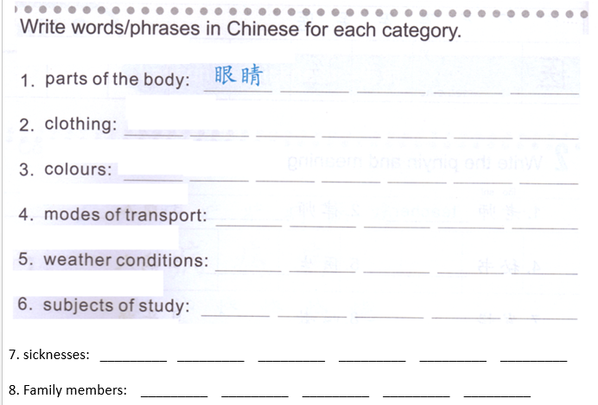
Turn in your homework
Last time’s paper

Slide 2
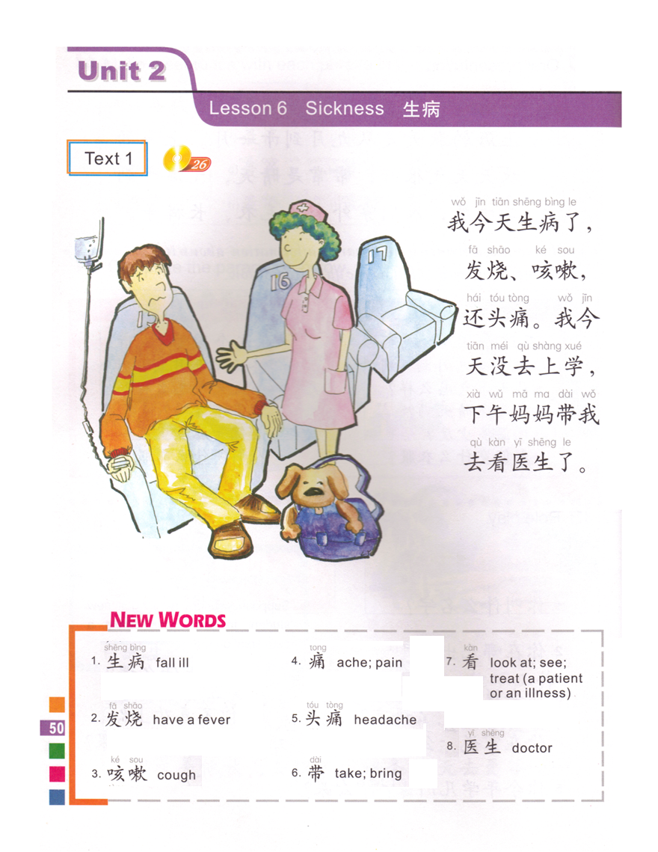
I got sick today,
还-hai :also, even more; indicates an increase from a certain level or a supplement.
I have a fever, I cough and I also have a headache.
没=没有
Didn’t
I didn’t go to school today
Mom took me to see doctor in the afternoon.
A 带 B 去 do something
A =妈妈 B=我
Do something=看医生
了 changes “take” to “took”

Slide 3
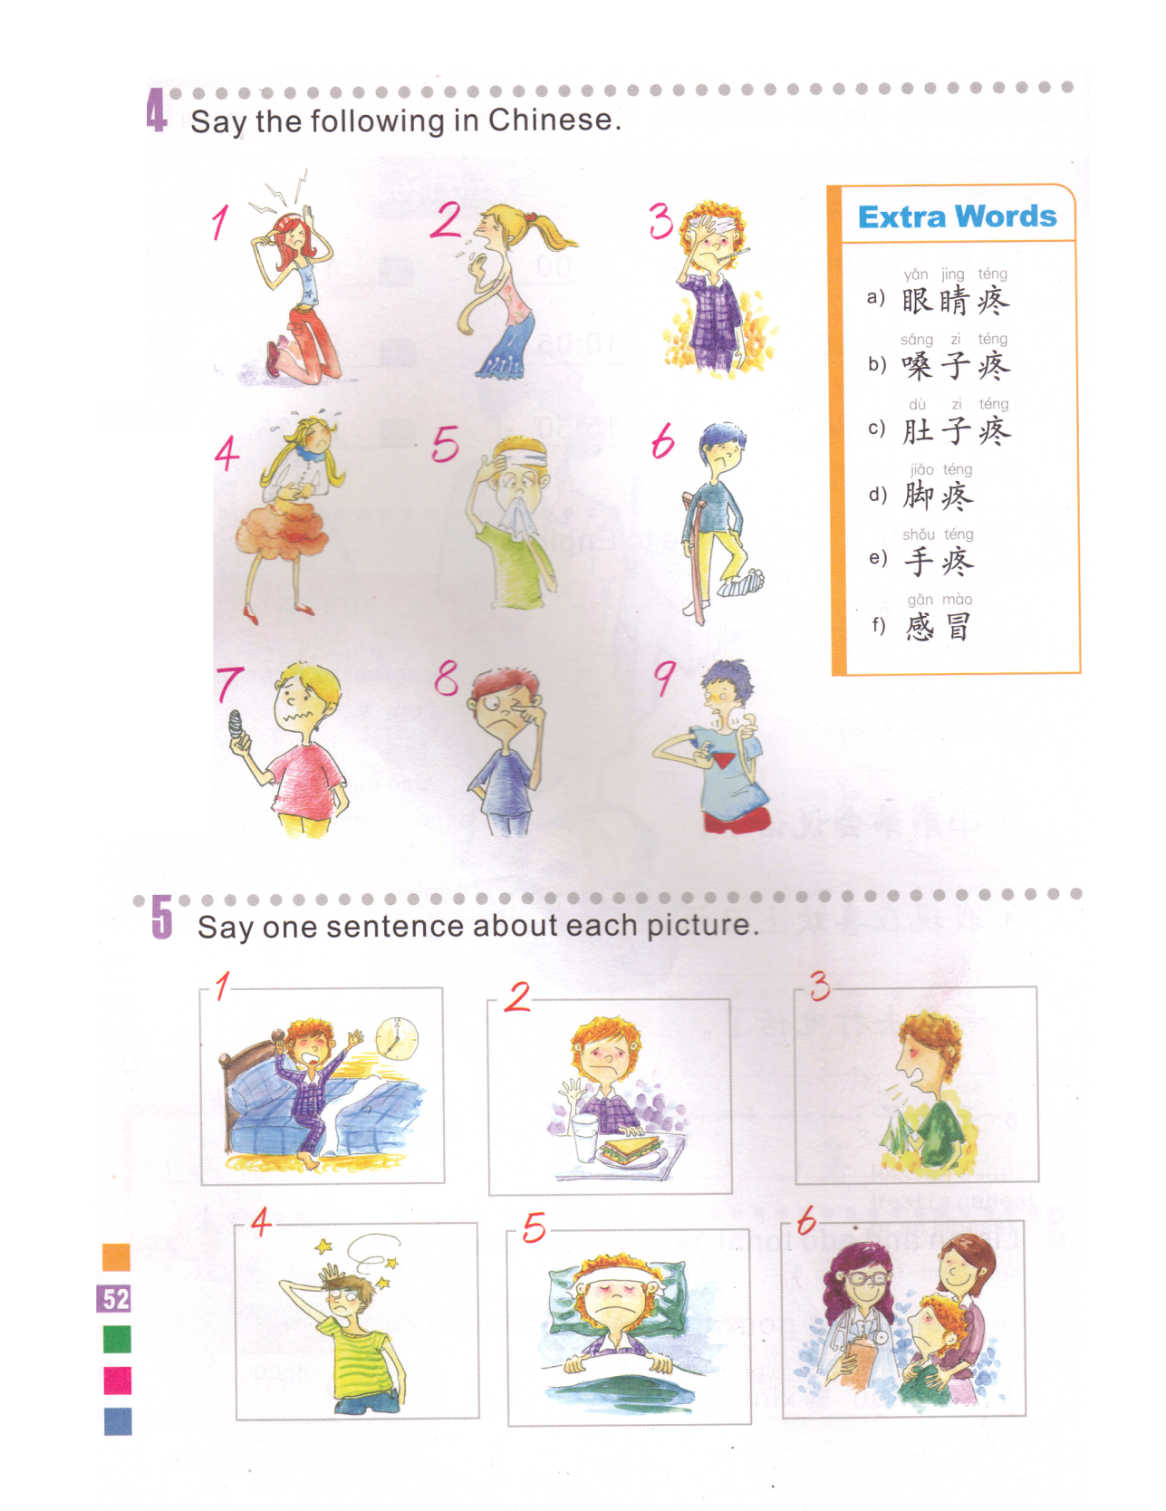
Task 1: Use quizlet-生病 1 words to describe the pictures ON YOUR OWN PAPER.
Task 2: write 1 sentence to describe each picture ON YOUR OWN PAPER. (structures are provided)
You can use any subject:
He/I/his brother/my friend…
1 &2 Sentence structure is:
Subject + time of day/time + do something.
Examples:
He + early morning + get up.
He + 8:00 + eat breakfast.
6. Sentence structure is:
Mom + take + him + go to + see doctor + 了。
3.4. and 5 sentence structure is:
Subject + cough/have a headache/have a fever.

Slide 4
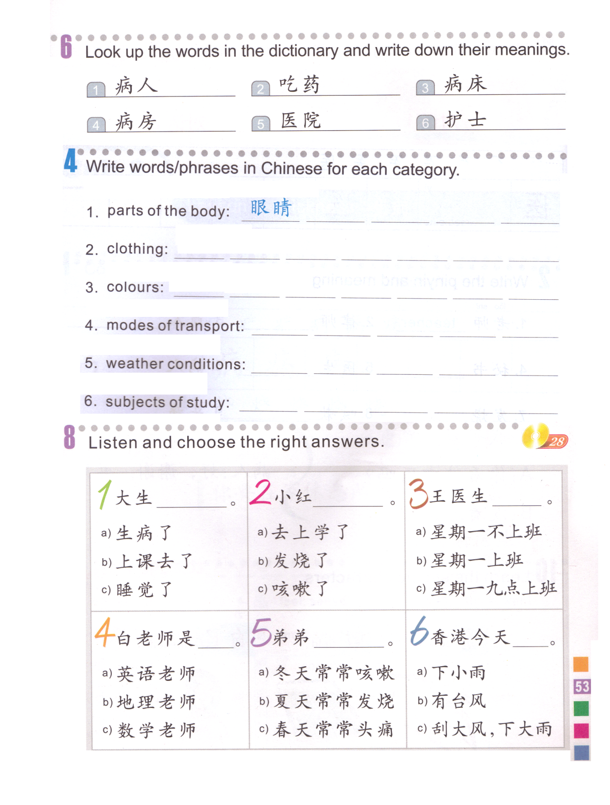
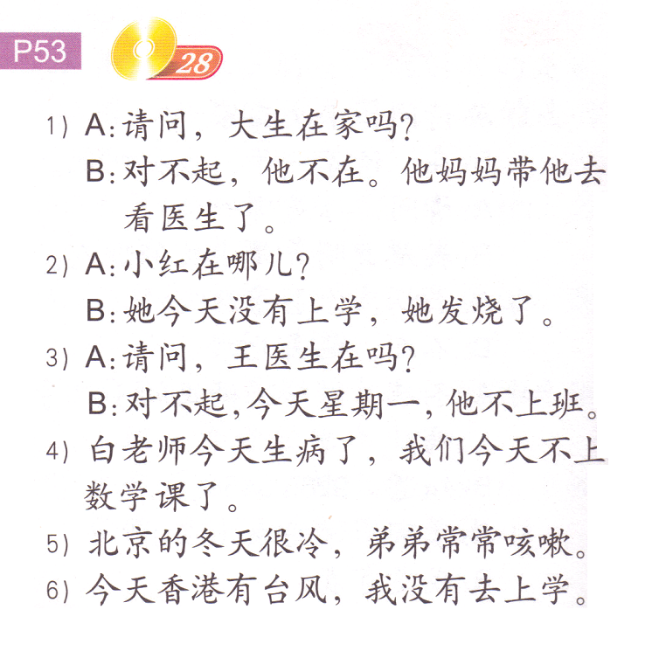
Task 3: Read the conversations and choose the answers based on what you read.

Slide 5

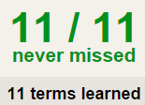

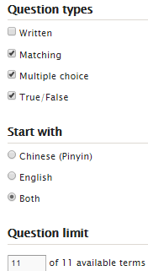
TASK 4 Homework QUIZLET instructions – 生病 2 each section is 20%
Learn-Make sure you finish 100%
Speller-Make sure you finish 100%
Scatter-The time needs to be within 35 seconds.
Test- Create New Test after you change the settings to:
笔记notes:
10/10
This number has to be 100
This number doesn’t matter.
10/10
The comment doesn’t matter.
10
This number has to be 12
This number has to be less than 40
10 of 10

Slide 6


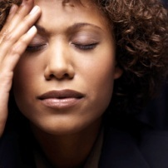
生病
生病
看医生
没有
头痛
发烧
咳嗽

Slide 7
TASK 4 Homework QUIZLET instructions – 生病 3 each section is 20%
Learn-Make sure you finish 100%
Speller-Make sure you finish 100%
Scatter-The time needs to be within 35 seconds.
Test- Create New Test after you change the settings to:
笔记notes:
10/10
This number has to be 100
This number doesn’t matter.
10/10
The comment doesn’t matter.
10
This number has to be 12
This number has to be less than 40
10 of 10

