Slide 1
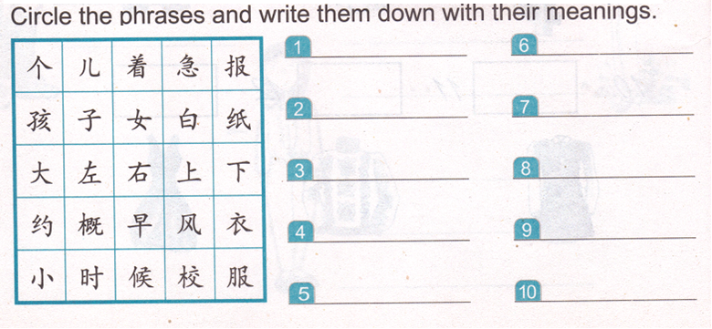
DO NOW

Slide 2
Task 1: http://jfeng1.wix.com/chinese
裙子
姥姥，姥爷

Slide 3
Task 2- group of 2 students:
find 5 words for each category. You can cut them out and glue them or write them down.
胳膊 | 舅舅 | 飞机 | 方 | 蓝色 | 姥爷
棕色 | 汉堡包 | 火车 | 三明治 | 热狗 | 脖子
姑姑 | 浓眉大眼 | 鼻子 | 难看 | 可乐 | 绿色
腿 | 船 | 圆 | 自行车 | 眉清目秀 | 咖啡
紫色 | 姥姥 | 红色 | 胡子 | 姨妈 | 公共汽车

Slide 4
Task 3: Talk about yourself. You must cover 4 aspects. You can present today or Thursday.
Use this paragraph about my little sister as the reference.
zhangde
yuan
长
Zhi fa
Piao liang
Ke ai
Qun zi
Fen hong se
Zi se
Chang ge
Tiao wu
Age body parts(2) | Clothes colors (2)
3. Languages (2) | 4. Hobbies (2)

Slide 5
Task 4
When…
When?
sometimes

Slide 6
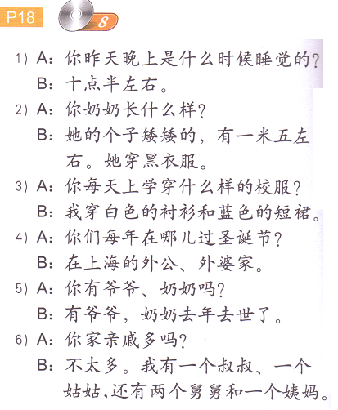

Slide 7
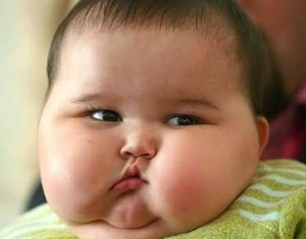
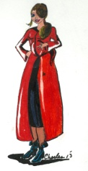
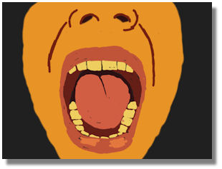
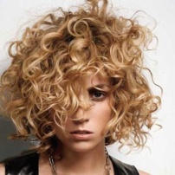
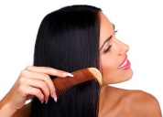
长得…
高个子
直发
卷发
胖
瘦
大嘴巴

Slide 8
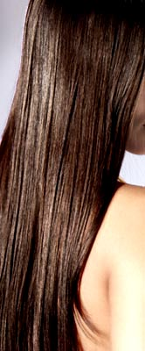
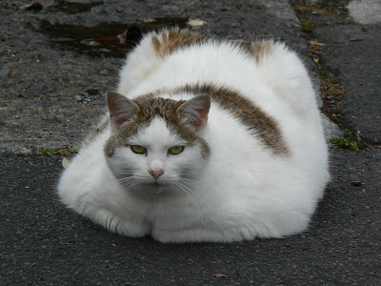
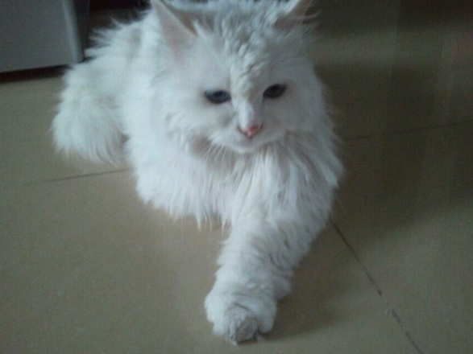
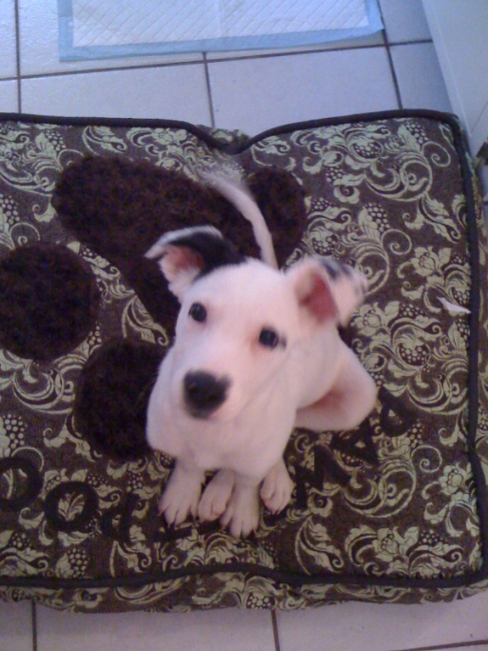
DO NOW
卷发。
又瘦又可爱。
黄色
白色和黑色

Slide 9
LAST TIME’s PAPER, you can do this before lunch today or next Monday due to the Unit Test.
Task 3: Talk about yourself. You must cover 4 aspects. You can present today or Thursday.
Use this paragraph about my little sister as the reference.
zhangde
yuan
长
Zhi fa
Piao liang
Ke ai
Qun zi
Fen hong se
Zi se
Chang ge
Tiao wu
Age body parts(2) | Clothes colors (2)
3. Languages (2) | 4. Hobbies (2)

Slide 10
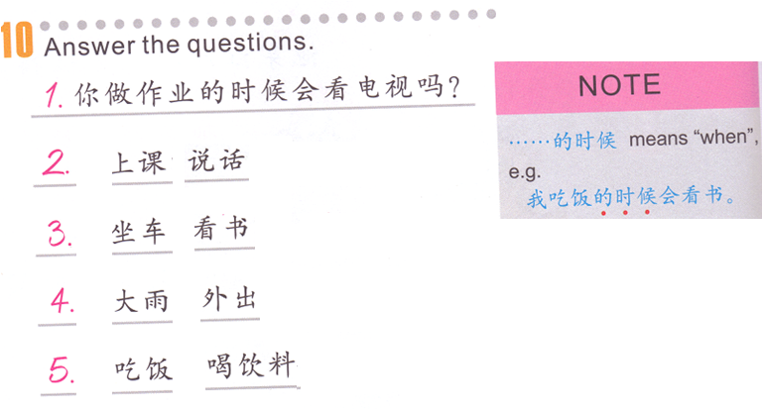
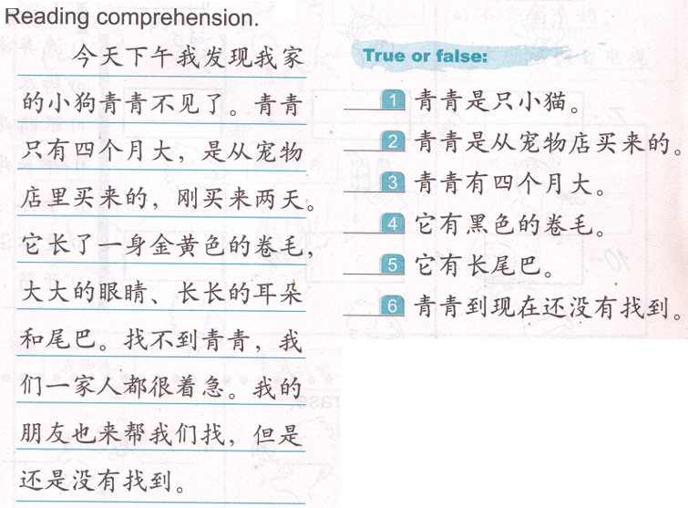
Unit Test
Task 1
Would you watch TV when you do your homework?
Follow the steps when you answer:
Step 1:我
Step 2:我 + 1st word
Step 3:我 + 1st word + 的时候
Step 4:我 + 1st word + 的时候 + （不）会
Step 5:我 + 1st word + 的时候 + （不）会 + 2nd word.
Task 3

Slide 11
长得…
高个子
直发
卷发
胖
瘦
大嘴巴

