Slide 1
Do NOW:
What are they?
头
头发
眼睛
耳朵
鼻子
嘴巴

Slide 2
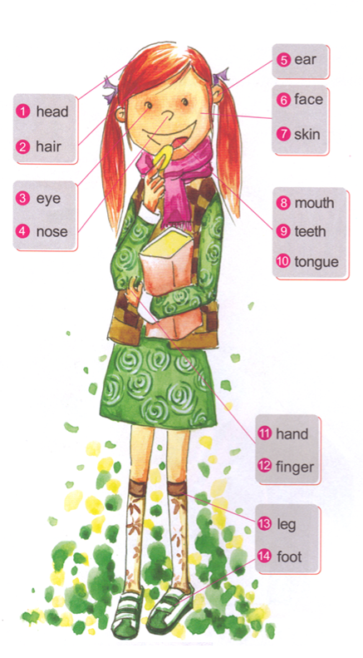
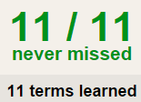
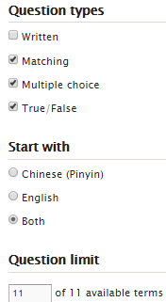
TASK1 QUIZLET instructions – Facial Features & Adjectives 2 each section/20%
Flashcard-Go over all the words
Learn-Make sure you finish 100%
Speller-Make sure you finish 100%
Scatter-The time needs to be within 40 seconds.
Test- Create New Test after you change the settings to:
Task 2: Write down the words.
This number doesn’t matter.
15/15
This number has to be 100
15/15
The comment doesn’t matter.
15
This number has to be 13
This number has to be less than 40
Toe
Please also use Facial Features & Adjectives 1 as the reference.
15/15

Slide 3
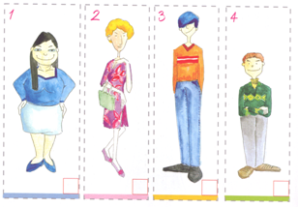
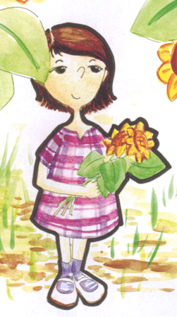
1.“长得很”sentence: appearance
Task 3:
Choose 2 peopleto describe. You have to use:
1 appearance
(Red structure.)
3 have/has
(Purple structures.)
1 not…or…
(Green structure.)
Subject + 长得 + 很 + adj.。
Someone is short/tall/small/skinny/fat…
She is short.
Ta + zhang de + hen + ai.
她长得很矮。
2. “有” sentence: have/has
Subject + has + adj. + body part.
Adj.:
高tall 长long 大big 胖fat
矮short(H) 短short(L) 小small 瘦skinny
Subject has big/small/long/short/high/low body part.
She has big eyes.
EXAMPLE:
Ta + you + da + yan jing.
1 她长得很矮。
她有大眼睛。
3 她有短头发。
3. “不…也不…” sentence: not…or…
她有…。
Subject + bu + adj1 + ye + bu + adj2
她有…。
Subject am/is/are not adj1 or adj2.
1 她不胖也不瘦。
Her hair is not long or short.
她的头发不长也不短。

Slide 4
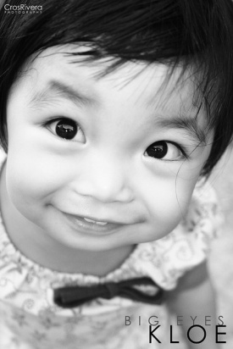
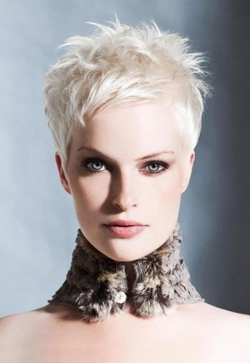
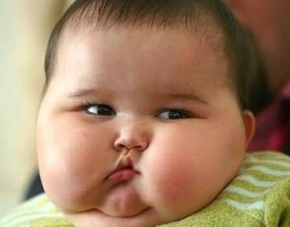
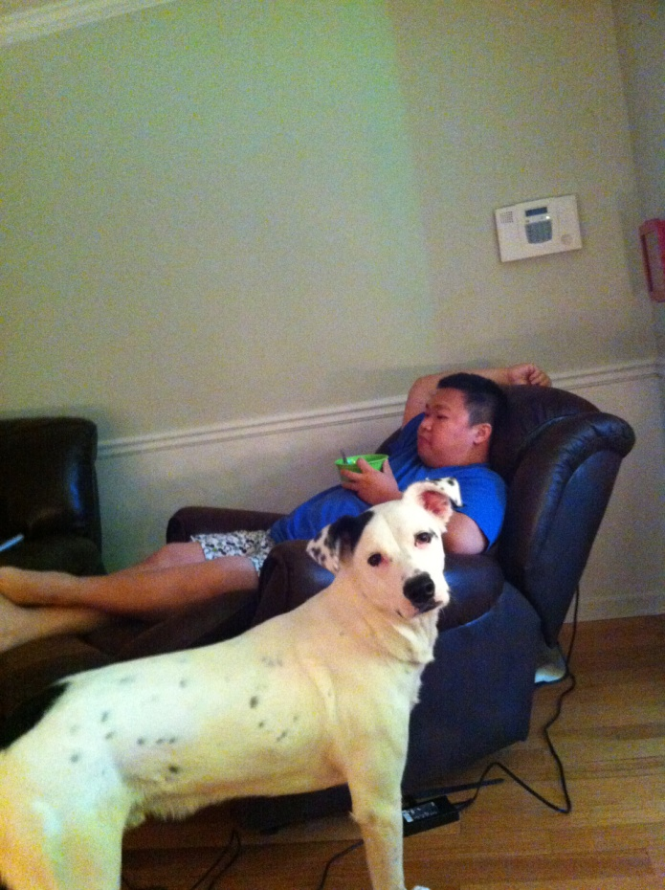
DO NOW:
1. 她有大眼睛。
2. 她有长头发。
3. 他长得很瘦。
4. 冯(Feng)老师的狗不大也不小。

Slide 5
Task 1:
Mark down the words using different signs.
T恤
自行车

Slide 6
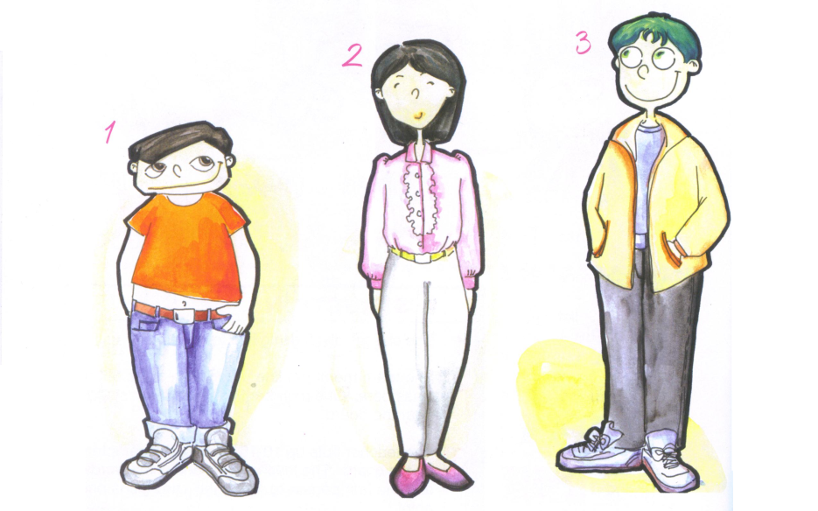
Task 2: Can you find 2 sentences to match each person?
我的朋友长得不高也不矮。
他长得很矮。
她的头发不长也不短。
她弟弟有大大的眼睛。
她哥哥有大大的嘴。
他长得很高。

Slide 7
Task 3: Can you rearrange the characters to form sentences.
You are tall.
His face is not big nor small.
My teacher has fat hands.
你，很，长，高，得。
1.________________。
2.我的，有，胖，手，老师。
2.________________。
3. 脸，他，的，大，也，不，小，不。
3.________________。

Slide 8
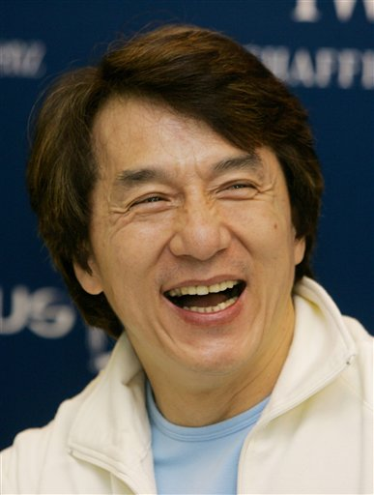
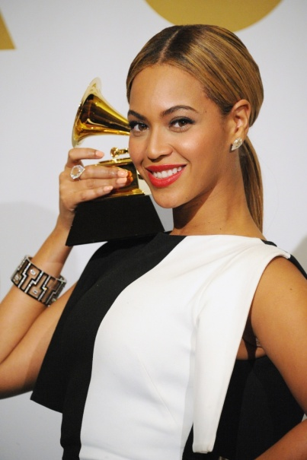
Task 4: Choose 1 celebrity to describe.
Jackie Chan
成龙
Cheng long
Beyonce
碧昂斯
Bi ang si
Jackie Chan is not short or tall. He has small eyes, (a) big nose and (a) long face. He is Chinese. He lives in Beijing.
Beyonce is tall. She has big eyes, (a) tall nose and (a) big mouth. She is not skinny or fat. She is American. She lives in New York.
成龙不…也不…。
碧昂斯长得很…。
他有adj.1+body part1， adj.2+body part2和 adj.3+body part3 。
她有adj.1+body part1， adj.2+body part2和 adj.3+body part3 。
他是…。
她不…也不…。
他住在…。
她是…，住在…。

Slide 9
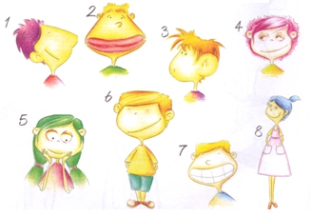
Oral activity:Describe the pictures in Chinese.
You need to memorize your number 4, and say it to Ms. Feng to get an oral quiz grade.
Choose a subject, like: 弟弟 妹妹 她的眼睛 他的头发… Say it in Chinese | Say the complete sentence And memorize it.
Choose a sentence structure: | Say the adjective and the body part (if it applies) in Chinese, like: 长 短 大 小…
1
4
2
3
Subject + 长得 + 很 + adj。
Subject + has + adj + body part.
Subject + bu + adj1 + ye + bu + adj2

