Slide 1
I marked 4 students “cheated” last week on IC.
If you are caught cheating, here is what you can do:
Come to my tutorial, redo the work.
or
2. Take a quiz on the work you cheated on and pass it.
I will take off “cheated” on IC only if you do 1 or 2.
If you don’t do 1 or 2, that comment will be your record on IC.
If you are getting your answers from online translate tool, the highest grade you will get for that assignment will be 60%, because:
You don’t know what you put on your paper, you are not leaning anything.
That is cheating.
You don’t need to do that, you have all the words you need on your notes.
Next week, you will have your sickness Unit Test, if you are still copying all the time, you most likely will fail your test again, which will make passing this class very hard! So stop cheating and use your notes.

Slide 2
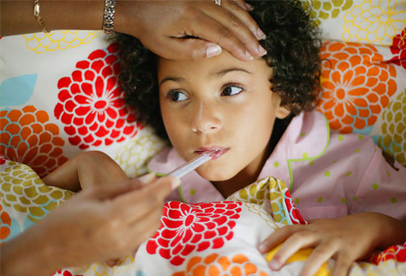


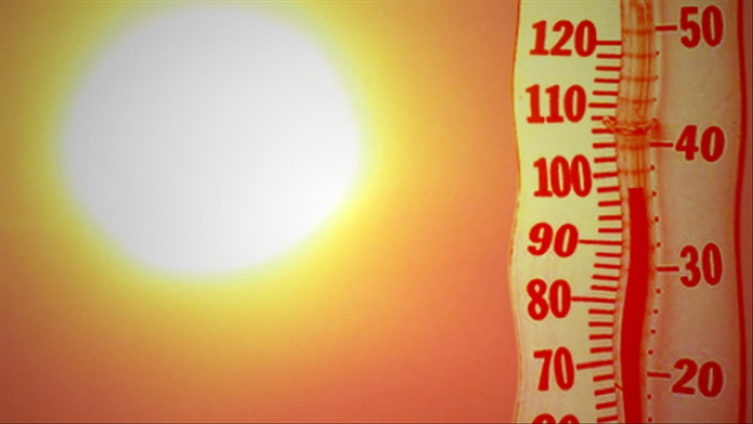
TASK 1
Someone went to the doctor/hospital…
The doctor asked/advise 叫 her to…
Someone got sick yesterday/last Friday…
She was having a fever/ coughing…
Some of the sentences that you can make are given on this page, however, you are encouraged to write at least 2 sentences to describe each picture.
Please describe the pictures in CHARACTERS. 105%
Today/tomorrow… is hot.
The highest temperature is 36 degrees. / The temperature is around 36.
We don’t have class today.
I am not going to school today.

Slide 3

TASK 2
My teacher went to see her doctor today.
老师，看医生。
2. The doctor asked/advise 叫 her to rest at home.
叫，在家休息。
My little sister got sick yesterday.
生病，昨天，了。
2. She was having a fever. Her temperature was 40 degrees.
发烧，了，体温，度。
You need to translate the sentences provided. Key words are provides by Ms. Feng. Make sure you use them. You need to write down 2 complete sentences to describe each picture.
Sentence structures are provided. 103%
This morning (today+morning) is hot.
早上，热。
2. The highest temperature is 36 degrees.
最高，气温，度。
We don’t have class today.
没有，课。
2. I am not going to school today.
不，上学。
Sentence structures
My little sister + yesterday + get sick + 了。
She + have a fever + 了。Her temperature + 是/在 + 40 + degrees.
1. Today morning + 很 + hot.
2. Highest temperature is 36 degrees.
My teacher + today + go to + see doctor +了.
Doctor + 叫 + she + at home + rest.
1. We + today + don’t have class.
2. I + today + not + go to school.

Slide 4
TASK 3
A：她生病了，昨天去医院了。
B:她没有发烧，没有去看医生。
C:她爸爸带她去看医生了。
A.我爸爸今天生病了。
B.她妹妹昨天生病了。
C.我的朋友明天生病了。
You need to :
1. Pick one sentence to describe each picture.
2. Explain in English why the other 2 sentences are wrong.
3. Copy the 4 sentences you picked to in Characters on your paper.
100%
A.星期五很冷，最低气温是三度。
B.三月很热，气温在三十六度左右。
C.今天天气很热，最高气温是三十六度。
A: 我今天上中文课，数学课，英语课和地理课。
B: 我们今天不上课。
C: 我明天没有上课。

Slide 5
If you didn’t do these 2 tasks last Thursday, please work on them today. You DO get a grade on them.
Task 1
Copy 1,2,3 & 4 on a separate sheet of paper in CHARACTERS and translate in English.
1.北京现在是春天，常常刮大风，气温在十度左右。
去北京你要带外套和裤子。
2.妈妈今天生病了。她头痛，咳嗽，嗓子疼，还发烧。
她要去看医生。
3. 今天是晴天，很热，气温在三十五度以上。
你出去要穿衬衫和短裤。
4. 现在晚上十一点半。
不要读书了。
Task 2
Copy 1,2,3 & 4 on a separate sheet of paper in English and translate in CHARACTERS.
1. She likes red.
You should wear (穿) a (一件) red sweater. (red + 的 + sweater)
2. I often eat rice (米饭).
You should cook rice for dinner tonight.
You + today + evening + should + cook (做) + rice.
3. New York’s winter is cold.
You should take your coat and
(和) sweater when you go to New York.
4. My friend (朋友) got the flu (重感冒) yesterday.
My friend + yesterday + 重感冒 + 了。
He should take medicines and see doctor.

Slide 6
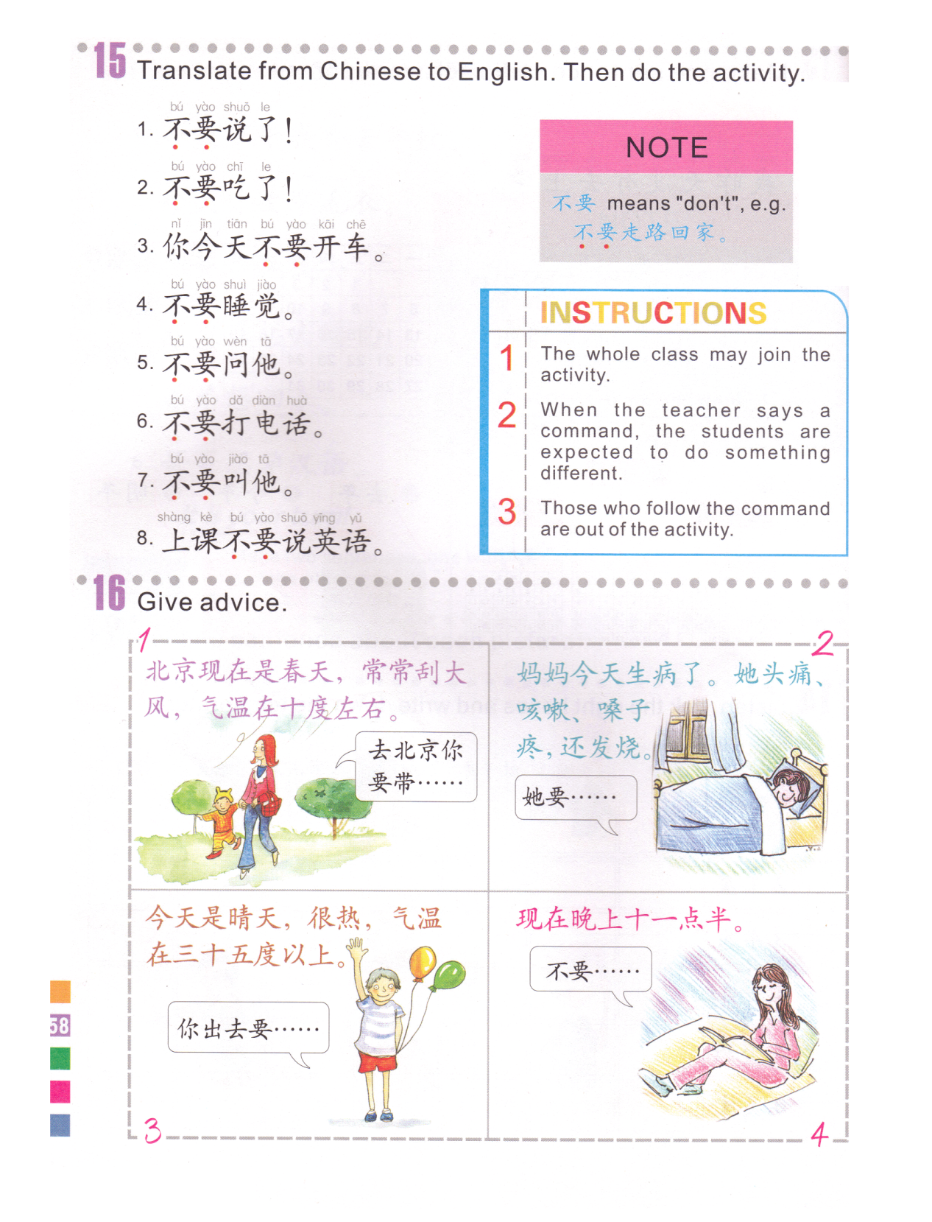
1. It’s spring in BJ now, it’s often windy, the temperature is around 10 degrees.
Yao- should
要
Don’t talk./Stop talking.
Bu Yao- don’t
不要
Don’t eat./Stop eating.
去北京你要带…
Don’t drive today.
2. Mom got sick today. She is having a headache, sore throat, she is coughing and having a fever.
You should take…when you go to Beijing.
Don’t sleep.
Don’t ask him.
2. A在家休息。Rest at home.
外套coat,裤子pants.
Don’t call.
Don’t ask him.
2. B.去看医生。 See doctor.
Don’t speak in class.
2. C. 吃药。Take medicine.
3. Today is sunny, hot, the temperature is above 35 degrees.
4. Now it’s 11:30 in the evening.
你出去要…
You should…when you go out.
不要…
Don’t…
穿衬衫和短裤。
Wear shirt and shorts.
不要读书了。
Don’t read books./ Stop reading books.
Notes:
子

Slide 7
Cut your paper to form A,B,C,D. Please use the left side as the reference.
一天两次
Twice every day
A. Once every day, 2 pills every time.
两
一
天 次
B. 3 times per day, 3 pills every time.
Once every 2 days
一次两粒(MW for pills)
2 pills every time
C. Once every 2 month,
10 people every time.
一
四
次 粒
4 pills every time
D. 3 times each week,
2 hours every time.

Slide 8
Vocab Quiz 09/17
Study guide was provided 09/08
Name:
1.Rest
2. Cough
3. Where
4. Have a sore throat
5. Have a cold
6. Get sick
7. Patient
8. See a doctor
9. Comfortable
10. Also (hai)
Vocab Quiz 09/17
Study guide was provided 09/08
Name:
1.Rest
2. Cough
3. Where
4. Have a sore throat
5. Have a cold
6. Get sick
7. Patient
8. See a doctor
9. Comfortable
10. Also (hai)
Vocab Quiz 09/17
Study guide was provided 09/08
Name:
1.Rest
2. Cough
3. Where
4. Have a sore throat
5. Have a cold
6. Get sick
7. Patient
8. See a doctor
9. Comfortable
10. Also (hai)

Slide 9
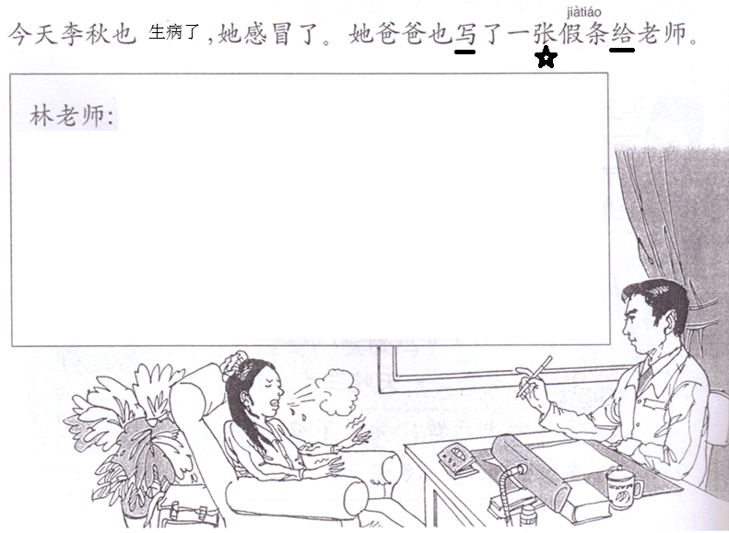
Translate the note in Characters on a separate sheet of paper, using the sentences provided by Ms. Feng.
100%
假条
Li qiu got a headache last night. She is coughing and having a sore throat. We took her to the hospital this morning . Her doctor asked her to stay at home for 3 days.
Thank you.
Li qiu’s dad：li ming李明
Sep 16th 2015
Li qiu (李秋) + yesterday evening + get sick + 了。
She + cough + 还 + have a sore throat.
We + today + morning + take her to the hospital 带她去看病 + 了.
Her doctor + 叫 + she + at home + rest + 3 days.
Thank you 谢谢您
March 5th 2013=2013年3月5日

