Slide 1
DO NOW: 10 minutes. Make sure you write down the DO NOW, because you will have a POP QUIZ right after this.
1. Tall nose
2. Big mouth
3. Big ears
4. Round face
5. Long hair
6. Big head
7. Small nose
8. Thin legs
9.Small eyes
10. Short (height)
高鼻子
大嘴（巴）
大耳朵
圆脸
长头发
大头
小鼻子
瘦腿
小眼睛
矮

Slide 2
True or false: 10 minutes. Make sure you write down the DO NOW, because you will have a POP QUIZ right after this.
1.
2.
3.
4.
5.
6.
7.
8.
9.
10.
高鼻子
Tall nose
Small eyes
Long hair
Round face
Long hair
Small face
Small nose
Thin legs
big eyes
Short (length)
大嘴（巴）
大耳朵
圆脸
长头发
大头
小鼻子
瘦腿
小眼睛
矮

Slide 3
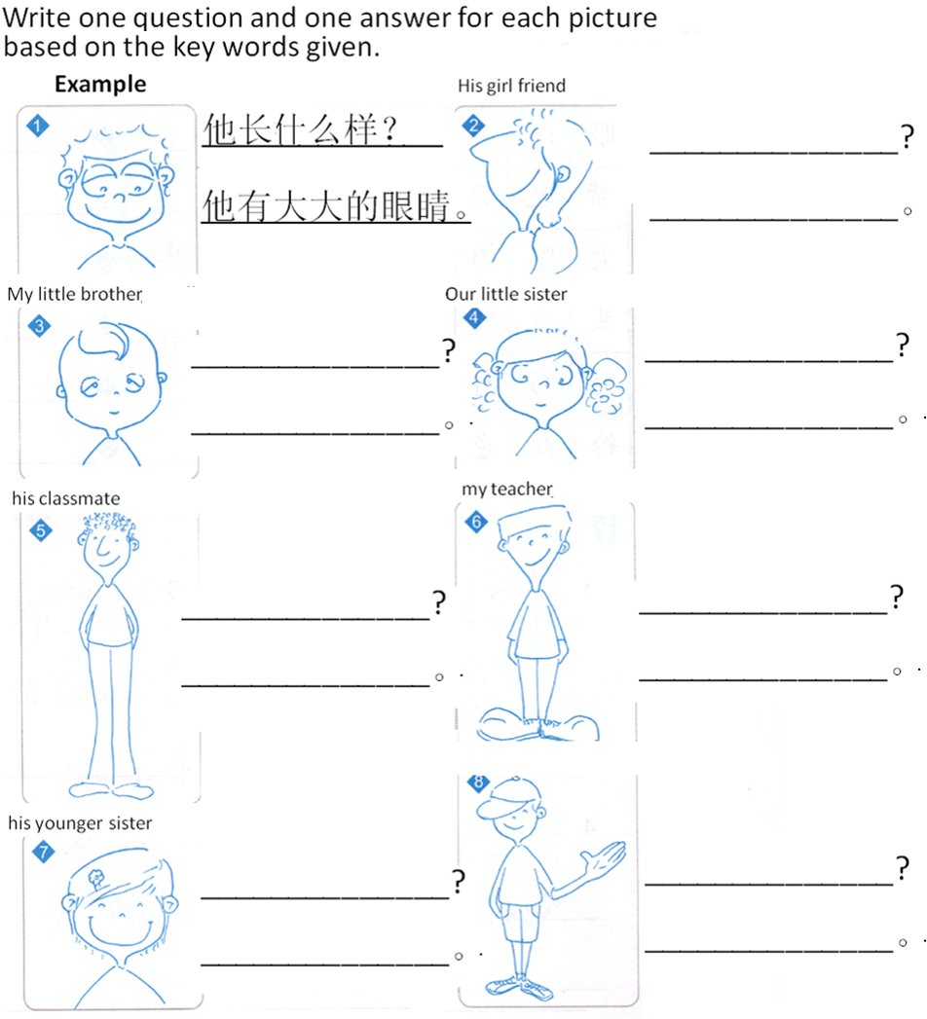
What does someone look like ?
Someone + 长什么样？
TASK 1
Zhang (look)
chang (long)
All the questions :
The subject given + 长什么样？
His girl friend/my little brother…
All the answers:
You MUST use at least 1 of each structure.
1.Subject + 长得很 + adj.
Subject is tall/short/fat/skinny…
2.Subject + 有 + adj. + body part.
Subject has big head/ short hair…
3. He/she 不 adj.1 也不 adj.2。
He is not short or tall…
4. His/her body part 不 adj.1 也不 adj.2。
Her hair is not short or long…
他有大眼睛。
you

Slide 4
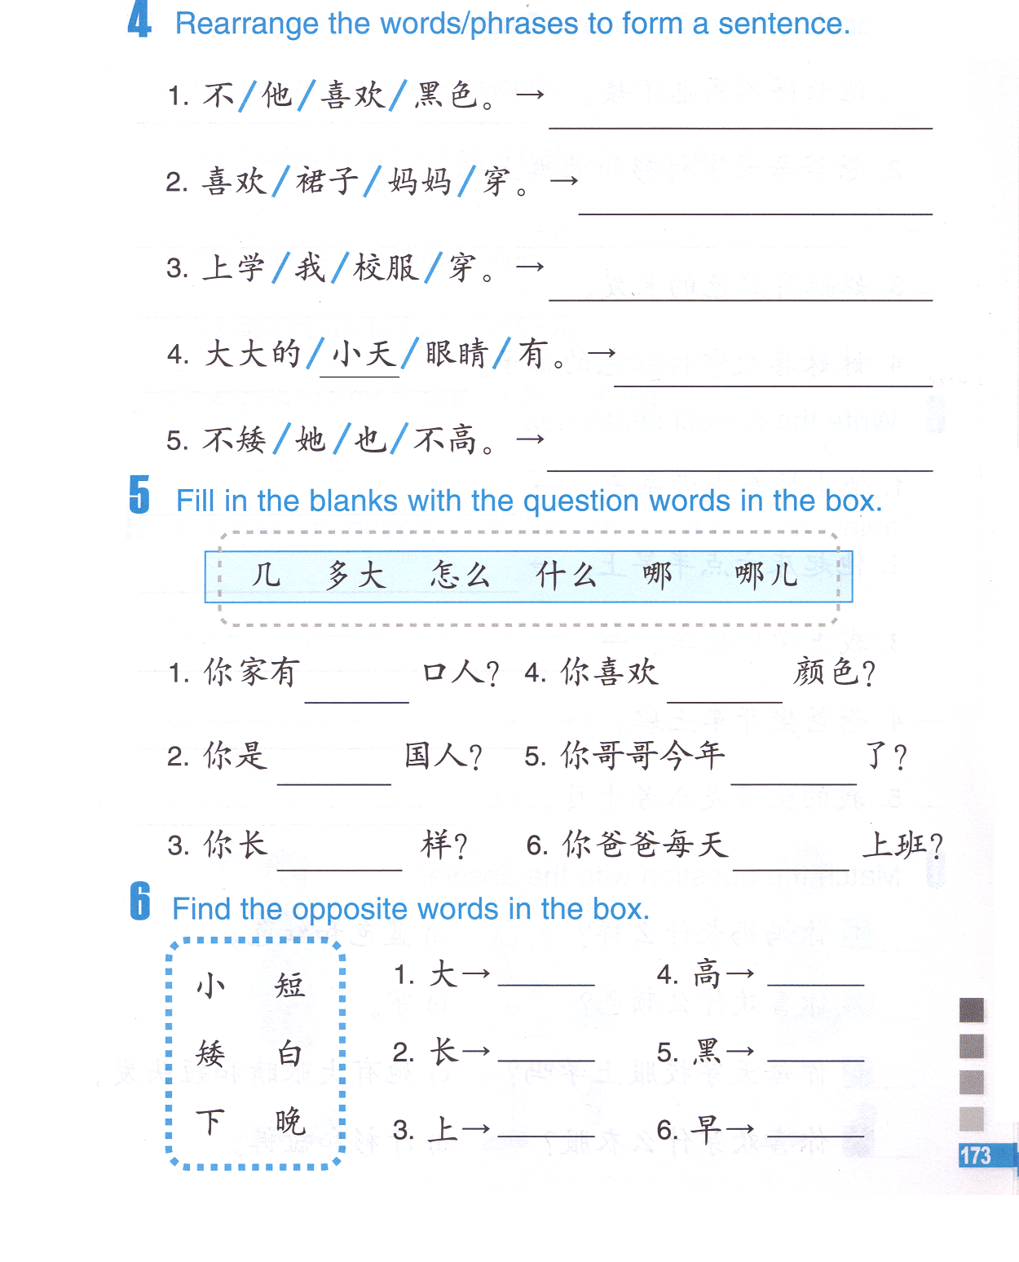
TASK 2
他不喜欢黑色。
大
TASK 3
几
TASK 4
小

Slide 5
长
短
大
小
高
矮

Slide 6
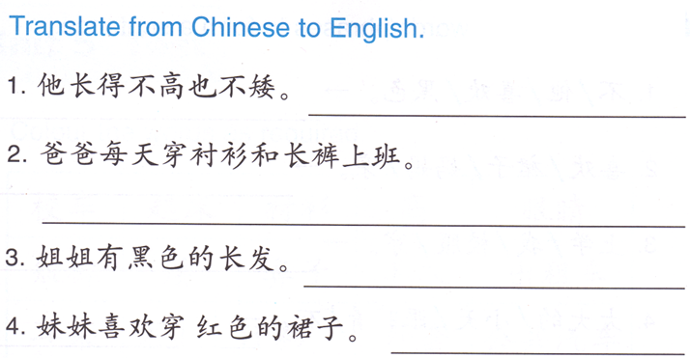
DO NOW

Slide 7
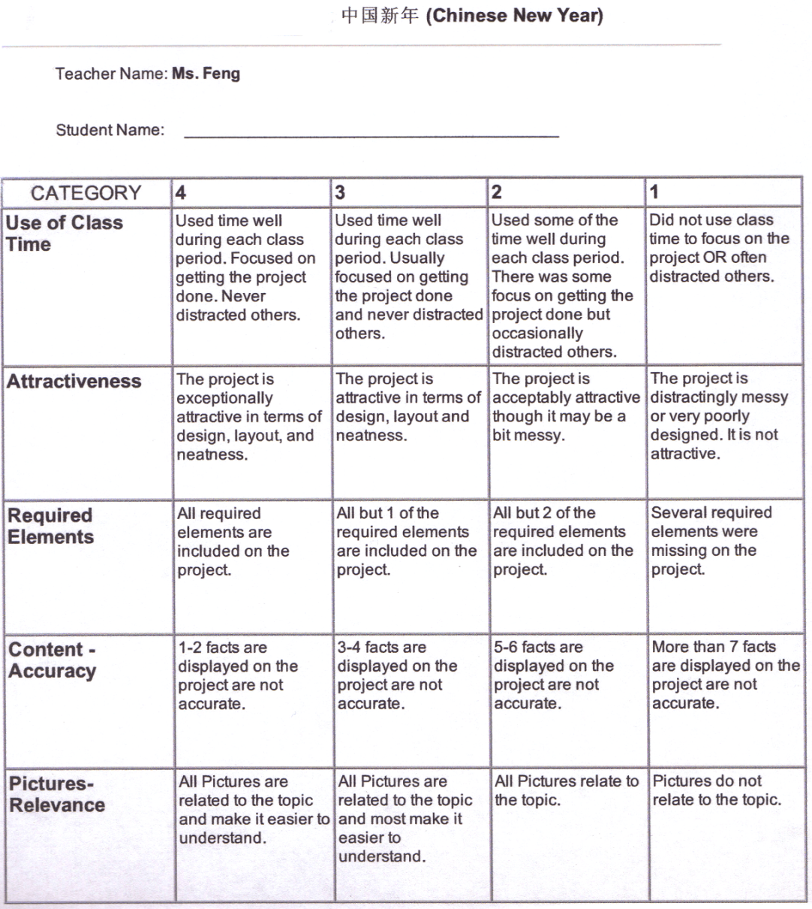
Name of the project: 中国新年 (Chinese New Year)
Assigned date: 02/23 (Monday) Due date: 03/05 (Thursday)
Format of the project: PPT presentation / poster/ brochure/ booklet
Content of the project:
What is中国新年 (Chinese New Year)?
How many days do people celebrate 中国新年 (Chinese New Year)?
When is 中国新年 (Chinese New Year) this year?
List at least 1 thing that Chinese people do on each day of the中国新年 (Chinese New Year) celebration.
List 3 中国新年 (Chinese New Year) traditional food.
Choose 3 of the following 中国新年 (Chinese New Year) traditions to explain/ talk about: (At least 200 words each)
A: 守岁(shou sui) B: 红包(hong bao) C: 年夜饭(nian ye fan)
D: 春运(chun yun) E: 春联(chun lian) F: 年画(nian hua)
G:爆竹(bao zhu)
You will be randomly assigned to present a portion of your project on 03/05 to your class and get an oral activity grade.
8. No matter what format you choose to work on, for content 4-6, you will have to include pictures or your own drawings/doodles to match your words.
9. The name of the project has to be in Chinese, which is:
中国新年

