Slide 1
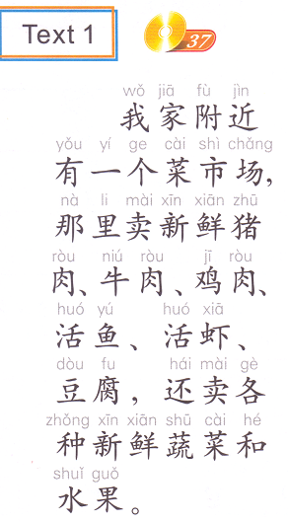
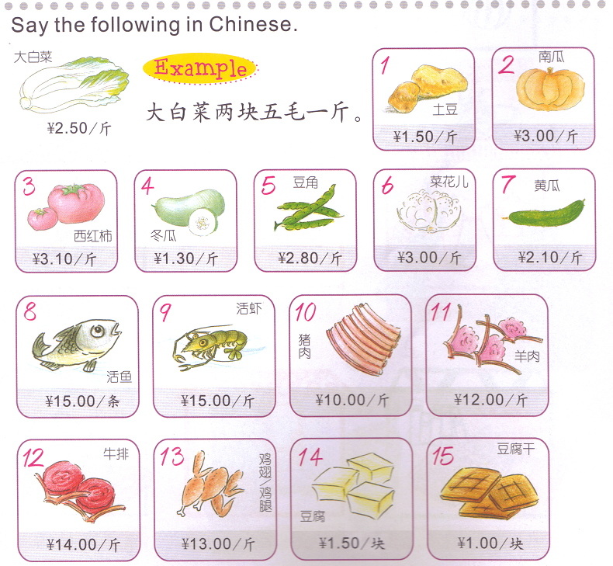
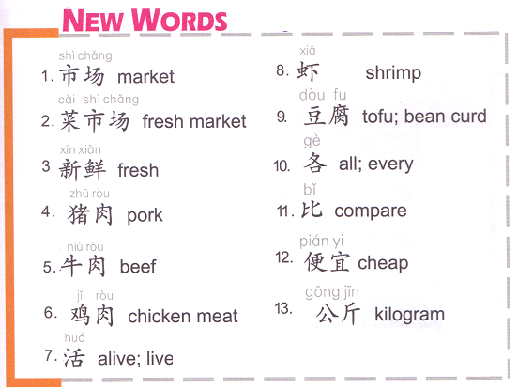
TASK 1: Choose 8 to describe ON YOUR OWN PAPER.
There is a
nearby
They sell….over there.
1 + MW + Item + price
Item + Price + 1 + MW
3.00
三块
14.00
十四块
1.50
一块五毛
2.80
两块八毛

Slide 2
Find vegetables and write them down on your notebook.
牛肉
白菜
生菜
鱼
虾
豆腐
苹果
香蕉
书包
红色
黄瓜

Slide 3
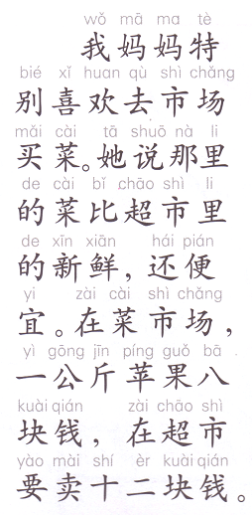
There is a
nearby

Slide 4
Task 1: Oral Task
Reference: QUIZLET 08/20 TASK 2
A: 你每天午饭吃什么？
B: 我每天吃____还有____。
A: 你在学校吃午饭吗？
B: 在，我有时候从家里带饭。
A:学校的饭贵吗？
B:不贵，三块钱。
A: 你喜欢学校的饭吗？
B:一般。
Task 2 Writing task:
There is a _____nearby my house.
They sell (3 items) over there, they also sell (another item).
I like going there （那里）buying 1 item. Because 因为
那里的 1 item 比______(another place) 的+adj.
Options:
…书店/饭店/超市
adj.:新鲜, 便宜，贵，大，小，漂亮，难看…
Higher level sentences:
Describe if the place is big or small. (not big or small)
Describe if the place is far or close. (not far or close)
C. Describe how often you visit that place.
D. Describe your last visit. (When, with whom, what you bought 买到了)

Slide 5
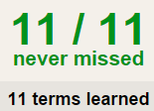
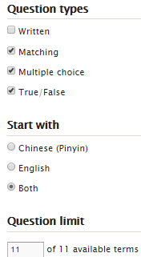
TASK 3 QUIZLET instructions – school food 1 each section is 20%
Learn-Make sure you finish 100%
Speller-Make sure you finish 100%
Scatter-The time needs to be within 35 seconds.
Test- Create New Test after you change the settings to:
笔记notes:
10/10
This number has to be 100
This number doesn’t matter.
10/10
The comment doesn’t matter.
10
This number has to be 12
This number has to be less than 40
10 of 10

Slide 6
猪肉
鸡肉
牛肉
牛奶
苹果
香蕉
草莓
鱼
贵
便宜
大
买

