Slide 1
Copy the notes on your paper.
English (language)
ying wen
ying yu
英文
英语
language
language
Chinese (language)
Zhong wen
Han yu
中文
汉语
language
language

Slide 2
can
speak/say/talk
hui
shuo
会
说

Slide 3
Countries In English | Countries In pin yin | Countries In Characters
China | zhong guo | 中国
United States | Mei guo
Great Britain | Ying guo
Germany | De guo
France | Fa guo
Japan | Ri ben
South Korea | Han guo
Mexico | Mo xi ge
Canada | Jia na da
Australia | Ao da li ya
Language spoken in the country In English
Chinese
English
English
German
French
Japanese
Korean
Spanish
English
English
Language spoken in the country In pin yin
zhong wen/han yu
Ying wen/ying yu
ying wen/ying yu
De wen/de yu
Fa wen/fa yu
Ri wen/ri yu
Han wen/han yu
Xi ban ya wen/ xi ban ya yu
Ying wen/ying yu
Ying wen/ying yu
Language spoken in the country In characters
中文/汉语
西班牙文/西班牙语
Countries:
澳大利亚/英国/美国/韩国/德国/加拿大/法国/日本/墨西哥
英文/韩文/德语/日文/英语/韩语/法语/德文/日语/法文
Languages:

Slide 4
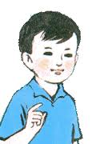
Introduce 小明
1. 他叫小明。
2. 他五岁。
3. 他是中国人。
Xiao ming 小明
5 years old
Chinese
Speaks Chinese & English
4.他会说汉语和英语。

Slide 5
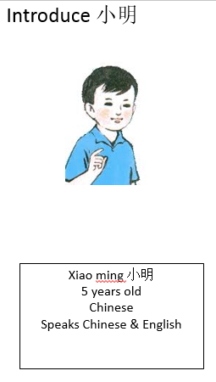
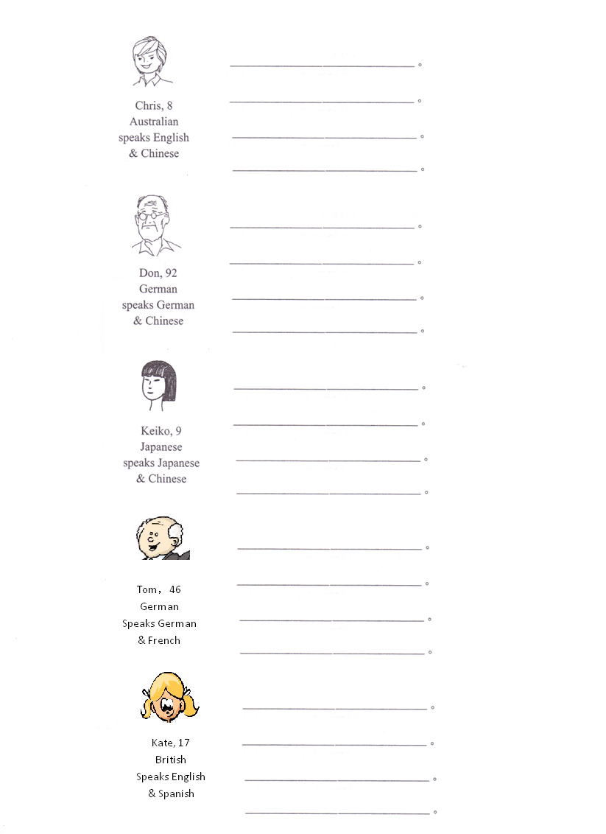
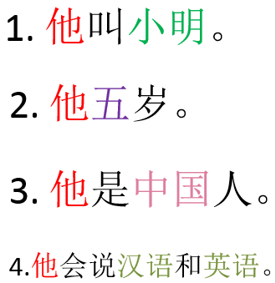
Use 4 sentences to introduce the following people in CHARACTERS .
Hints:
He=他 she=她
Don’t use 是 for age.
Nationality= country + 人
For language, you can use 文 or 语.
“And” is 和
姓名：
Date:
Example:

Slide 6
http://www.purposegames.com/game/pick-the-country-game

Slide 7
Use the 4 sentences that shown in the previous slide to finish this work sheet.
You need to introduce the following people in CHARACTERS .
Hints:
He=他 she=她
Don’t use 是 for age.
Nationality= country + 人
For language, you can use 文 or 语.
“And” is 和

Slide 8
中国
日本
韩国
美国
加拿大
墨西哥
小
大
美
小学
初中
高中

Slide 9
DO NOW (translate to characters)
I am American, I speak English.
我是美国人，我说英文。
Her friend is Australian, he can speak English and Chinese.
她的朋友是澳大利亚人，他会说英语和汉语。

Slide 10
To answer “ yes.”
Yes, I can speak Chinese.
Hui.
会。
我会。
Wo hui.
Wo hui shuo yi dian er.
我会说一点儿。
A little bit
Wo hui shuo yi dian er zhong wen.
我会说一点儿中文。
会，我会说一点儿中文。
Hui, wo hui shuo yi dian er zhong wen.

Slide 11
To answer “no”
No, I can’t speak Chinese.
Bu hui.
不会。
我不会。
Wo bu hui.
Wo bu hui shuo zhong wen.
我不会说中文。
不会，我不会说中文。
Bu hui, wo bu hui shuo zhong wen.

Slide 12
Use 得 (de) to describing language ability (express compliments)
You speak Chinese very well.
You + Chinese + speak + de + very well/good.
Ni + zhong wen + shuo + de + hen hao.
你中文说得不好。
Chinese use de 得 after a verb to lead to the degree or result of the action of this verb.

Slide 13
very
really
hen
zhen
很
真
She speaks English really fast!
She + English + speak + de + really + fast!
Ta + ying wen/ying yu + shuo + de + zhen + kuai!
她英文/英语说得真快！

Slide 14
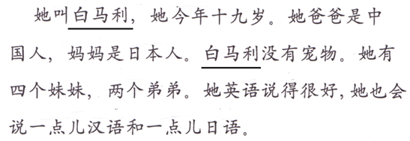
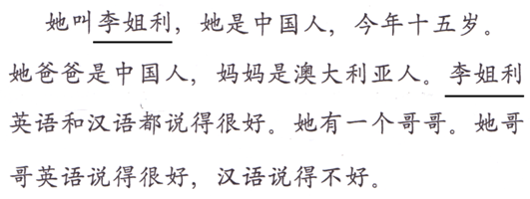
Task 1 Translate 2 paragraphs in English and A, B, C in CHARACTERS.
Task 2 Translate 2 paragraphs in English and A, B, C in CHARACTERS.
His girl friend does not speak Chinese well.
B. Both of my mom and dad can speak German and French.
C. Can you guys speak English? (会不会)
He speaks Chinese very well.
My little brother can speak Spanish and French.
Can you speak Japanese?

