Slide 1
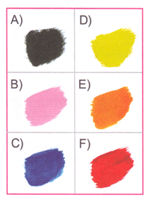
Do Now:
Match the colors with the words:
红色
黄色
黑色
蓝色
橙色
粉色

Slide 2
1. You + like + what + color(s)?
1.What color(s) do you like?
2. I like orange, purple, brown and green.
3. Do you like gray?
4. No.
5.ye-too/also/either: after the subject
5. I don’t like gray either.

Slide 3
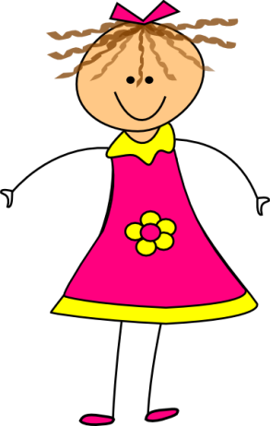
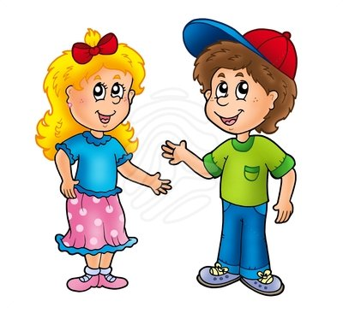
Task 1 Oral activity:Describe the pictures in Chinese.
After 4 rounds, you need to memorize your 4th sentence, and say it to Ms. Feng and get a quiz grade.
Choose a person. | Make a sentence using 喜欢 to connect 2 and 3, like: 弟弟喜欢红色和绿色。
Choose a role, like: 弟弟 妹妹… | Choose 2 colors the person is wearing, like: 红色和绿色
You have to take the Quiz before :
2:45
1
4
2
3

Slide 4
Task 2- Group activity:
Due:3:30
Name1: Name:2
Grade level

Slide 5
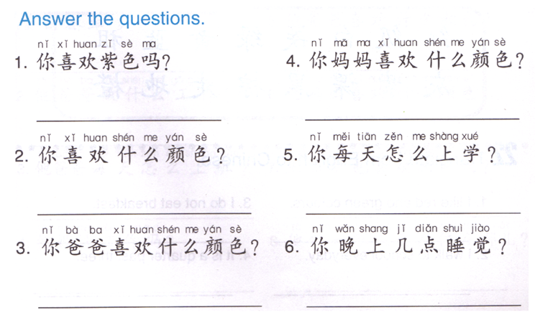
Task 3
Change all the 你 to 我。
Yes: take out 吗，keep everything else.
No: Yes: take out 吗，add 不 before 喜欢，
keep everything else.
4. Chang 什么颜色 to the actual color(s) your mom likes, add 和 in between last 2 colors.
Chang 什么颜色 to the actual color(s) you like, add 和 in between last 2 colors.
5. Change 怎么 to drive/ride transportation, keep everything else.
6. Change 几点 to the time you go to bed, keep everything else.
3. Chang 什么颜色 to the actual color(s) your dad likes, add 和 in between last 2 colors.

Slide 6
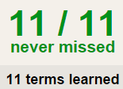
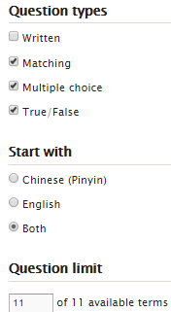
Task 4 QUIZLET Review Vocab 01/19 & 01/20
Learn-Make sure you finish 100%
Speller-Make sure you finish 100%
Scatter-The time needs to be within 35 seconds.
Test- Create New Test after you change the settings to:
NOTES:
11/11
This number has to be 100
This number doesn’t matter.
11/11
The comment doesn’t matter.
11
This number has to be 12
This number has to be less than 40
11 of 11

Slide 7
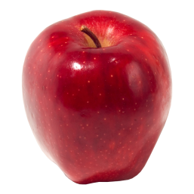
颜色
红色
绿色
黄色
蓝色
黑色

Slide 8
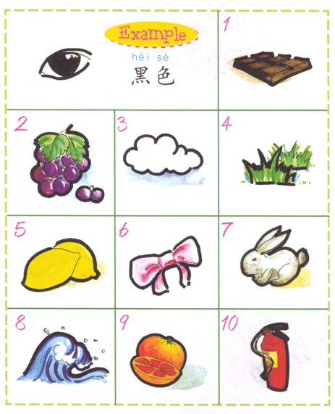
DO NOW:
A 红色
B 黄色
C 白色
D 灰色
E 紫色
F 粉色
G 橙色
H 绿色
I 蓝色
J 棕色

Slide 9
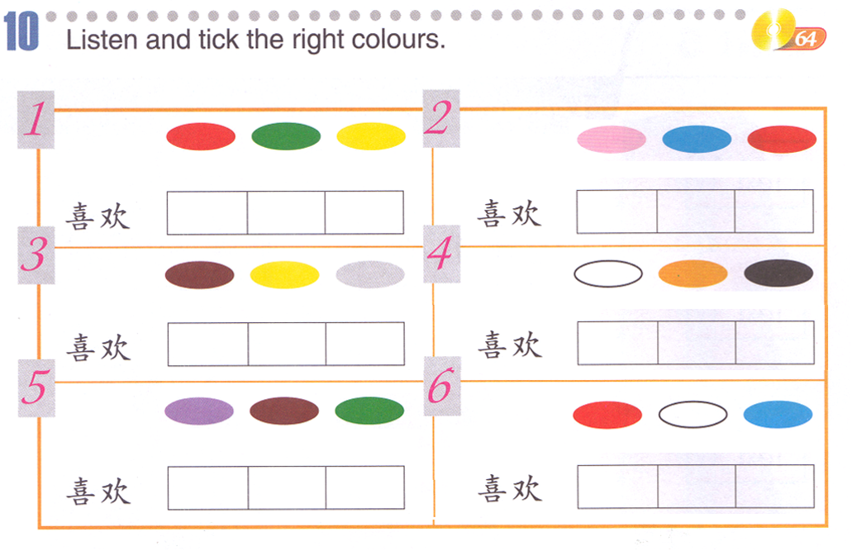
Task 1: write down pin yin for the colors, listen to the sentences and chose the matching colors.
x
x
x
x
x
x
x
x

Slide 10
Task 2：You will be assigned a partner, you and your partner will practice the conversation, MEMORIZE it and present it to Ms. Feng in 20 minutes.
Here is a QUIZLET (01/21 TASK 2) set that can help you with the pronunciation, for the colors, you can use the QUIZLET (颜色colors), feel free to use the FLASHCARDS to play it and listen to it. If you are talking instead of practicing, it will cause you a BAD/FAILING grade.
A：你叫什么名字？
B：我叫…
A：你喜欢什么颜色？
B：我喜欢…,你呢？
A: 我也喜欢…。

Slide 11
Task 3
喜欢
和
I + 不 + eat breakfast.
I + everyday + walk + go to school.
现在 3: 15.
Task 4 (LAST TIME’s paper, if you lost it, here it is:
Change all the 你 to 我。
Yes: take out 吗，keep everything else.
No: Yes: take out 吗，add 不 before 喜欢，
keep everything else.
4. Chang 什么颜色 to the actual color(s) your mom likes, add 和 in between last 2 colors.
Chang 什么颜色 to the actual color(s) you like, add 和 in between last 2 colors.
5. Change 怎么 to drive/ride transportation, keep everything else.
6. Change 几点 to the time you go to bed, keep everything else.
3. Chang 什么颜色 to the actual color(s) your dad likes, add 和 in between last 2 colors.

Slide 12
Task 5 QUIZLET all the precious sets
Learn-Make sure you finish 100%
Speller-Make sure you finish 100%
Scatter-The time needs to be within 35 seconds.
Test- Create New Test after you change the settings to:
IMPORTANT NOTES:
MS. FENG WILL CHECK YOU QUIZLET COMPLETING NEXT FRIDAY. YOU WILL GET 1 HOMEWORK GRADE. MAKE SURE YOU FINISH EVERYTHING BY NEXT FRIDAY (01/29)
11/11
This number has to be 100
This number doesn’t matter.
11/11
The comment doesn’t matter.
11
This number has to be 12
This number has to be less than 40
11 of 11

Slide 13
颜色
红色
绿色
黄色
蓝色
黑色

