Slide 1
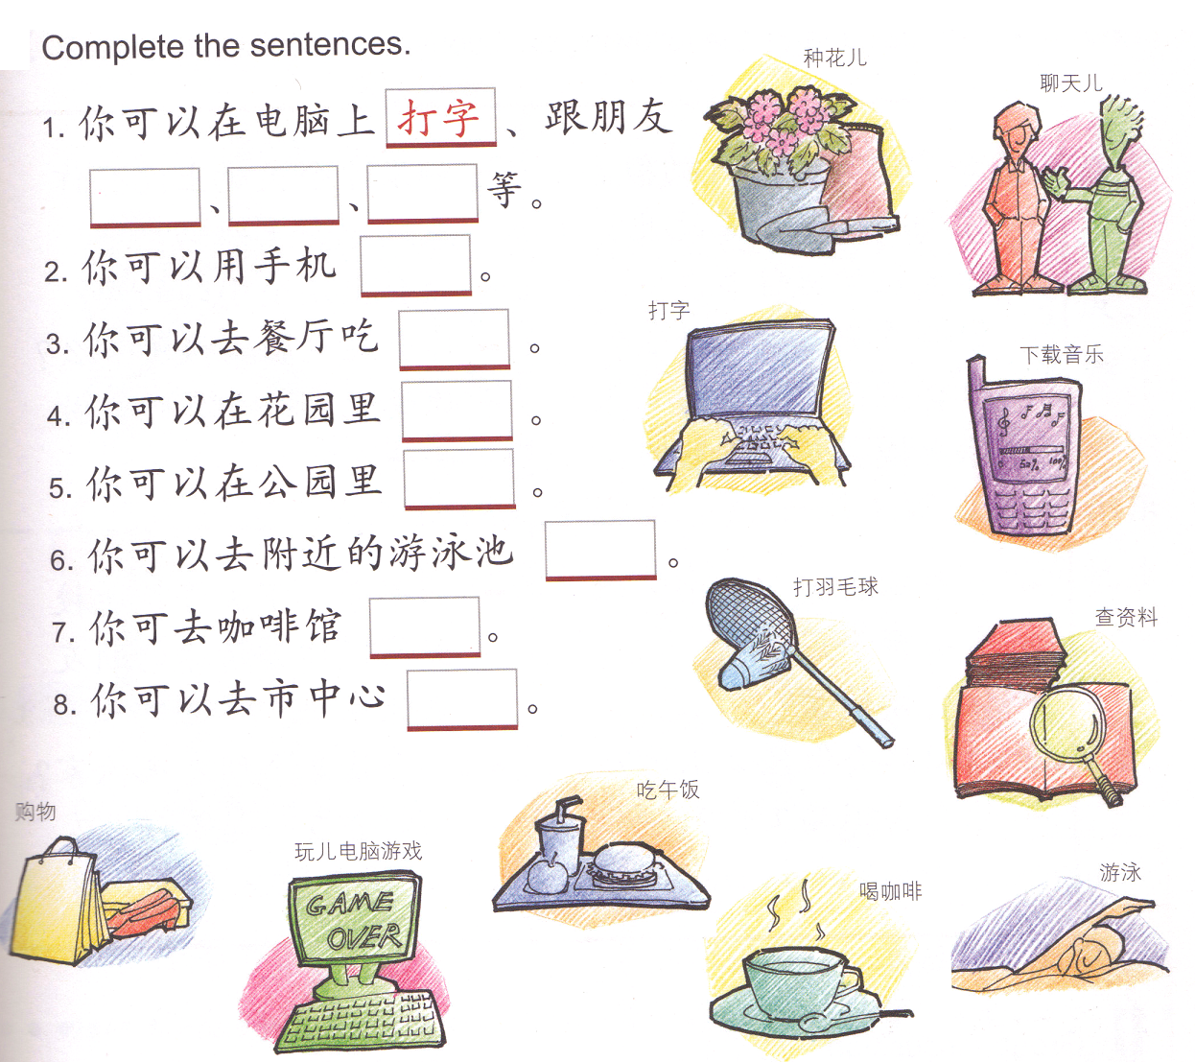
DONOW: Fill in the blanks using the words provided. This will be your next time’s QUIZ study guide. PLEASE STUDY!
DONOW: Fill in the blanks using the words provided. This will be your next time’s QUIZ study guide. PLEASE STUDY!
种花儿 游泳
聊天儿 玩儿电脑游戏
打字 购物
下载音乐
打羽毛球
查资料
吃午饭
喝咖啡
种花儿 游泳
聊天儿 玩儿电脑游戏
打字 购物
下载音乐
打羽毛球
查资料
吃午饭
喝咖啡

Slide 2
Task 1: QUIZLET household chores 1
Task 1: QUIZLET household chores 1
TASK 2 Each person will write 4 sentences to talk about how frequent someone does house chores using 4 colors of the frequency words and 4 house chores.
TASK 2 Each person will write 4 sentences to talk about how frequent someone does house chores using 4 colors of the frequency words and 4 house chores.
a.从来不 b. 有时候 c.平时 d. 通常 e. 常常/经常 f.总是
a.从来不 b. 有时候 c.平时 d. 通常 e. 常常/经常 f.总是
我从来不去菜市场买菜。我喜欢去超市
买菜。
我从来不去菜市场买菜。我喜欢去超市
买菜。
我总是做作业,从星期一到星期五。
我总是做作业,从星期一到星期五。

