Slide 1
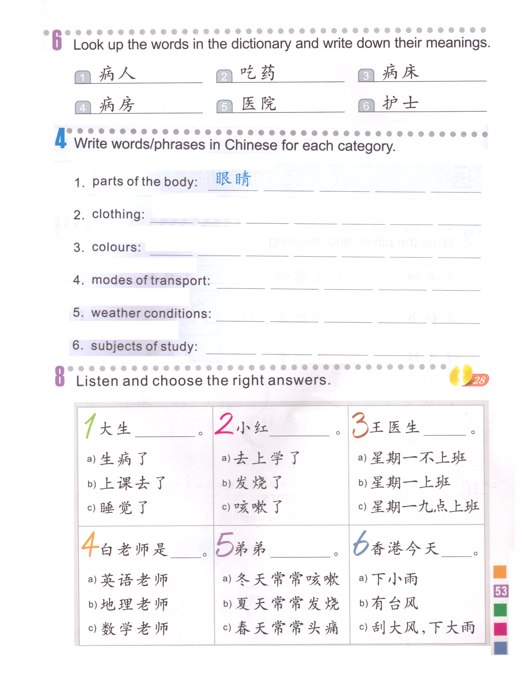
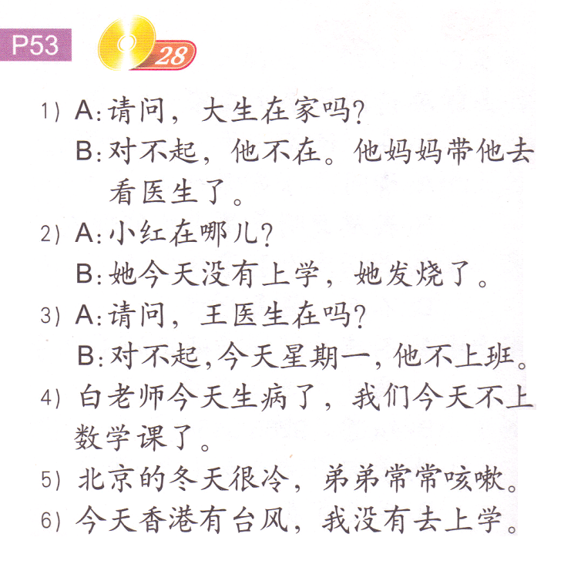
DO NOW: Read the conversations and choose the answers based on what you read.
LAST TIME’s paper.
Get ready.
This will be on your UNIT TEST!!!

Slide 2
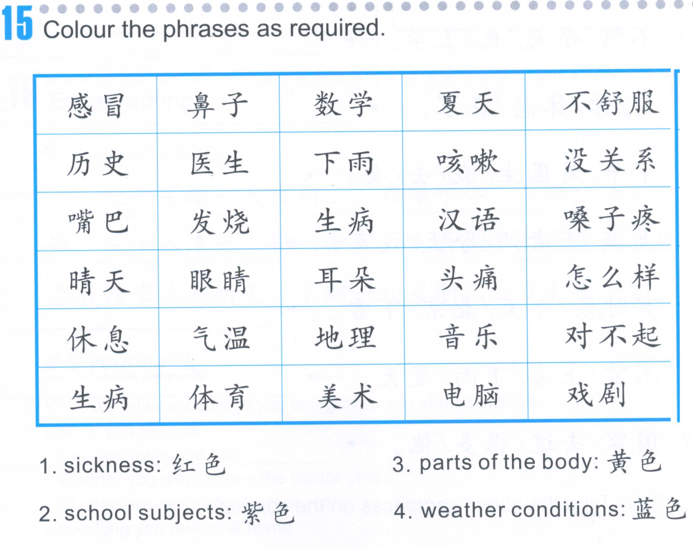
TASK 1

Slide 3
TASK 2
39.2
39度2
三十九度二
36.8
37.5
38.9
39.2
40.1

Slide 4
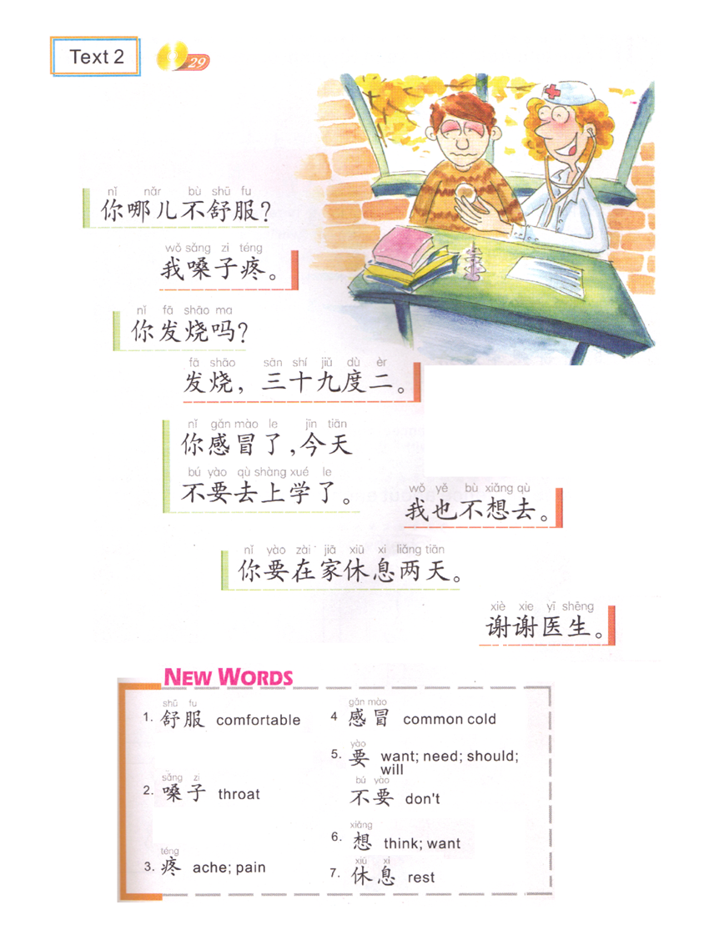
You + where + not comfortable?
哪儿=哪里 where
What’s wrong with you? (doctor-patient)
I am having sore throat.
Are you having a fever?
Yes, 39.2. (102.6)
I don’t want to go either.
You got a cold, don’t go to school today.
You should rest for 2 days at home.
Thank you doctor.
Catch the cold

Slide 5
Reference:
病人: Hello, is Doctor Wang there?
医生：This is Doctor Wang. (I am Doctor Wang)
病人: I got sick yesterday, I want to go to see you .
医生：What’s wrong with you?
病人：I think I caught the cold.
医生：Are you coughing?
病人: Yes.
医生: Are you having a fever?
病人: Yes, 39.8C.
医生: Is it ok that you come to see me at 2:00 in the afternoon?
病人：Ok. bye.
医生: Bye.
病人: Hello, Wang 王 Doctor + 在吗?
医生：I am Wang Doctor.
病人: I + yesterday + fall ill + 了, I + want to 想 + go to + see you 看病.
医生：What’s wrong with you?
病人：I think 想 I catch the cold + 了.
医生：You + cough + 吗?
病人: Yes.= cough.
医生: You + have a fever + 吗?
病人: Yes = have, 39.8C. (39 degrees 8)
医生: You + afternoon + 2:00 + come to see me 来看病, 好吗?
病人：Ok. bye.
医生: Bye.

Slide 6
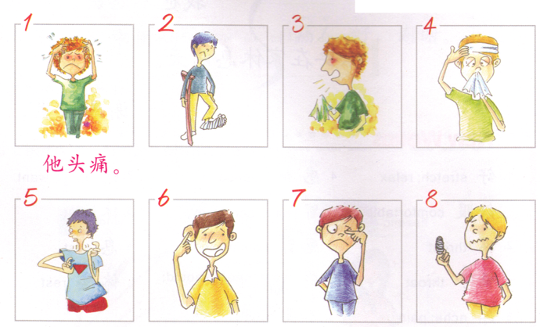
脚疼
嗓子疼
手疼
耳朵疼
咳嗽
发烧
眼睛疼

Slide 7
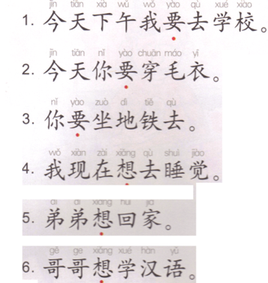
要: need to
想：want to, miss

Slide 8
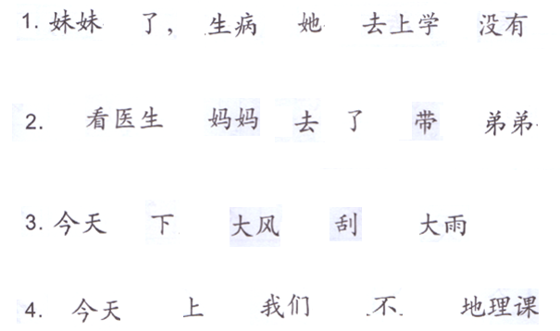

Slide 9
You have to cover:
When you felt sick
The symptoms you had
Whether you went to see the doctor or not
Whether you went to school or not
How long you rested at home
You have to use the structures:
last Monday I get sick 了。
I ……, ….., 还…。
Mom 带 I (go) see doctor 了。
Doctor 叫 I at home rest 3 days.
… and … I 没有 go to school.
上个星期一我生病了。 我嗓子疼，头痛，咳嗽，还发烧，三十八度六。 妈妈带我去看医生了。医生说我感冒了， 要我在家休息两天。星期一和星期二我没有去上学。

