Slide 1
Re shen （热身）Class room phrases
re shen 热身
bi ji 笔记
lian xi 练习
ce yan 测验
kao shi 考试
zuo ye 作业
wen ti 问题
warm up
notes
practice
quiz
test/exam
homework
question

Slide 2
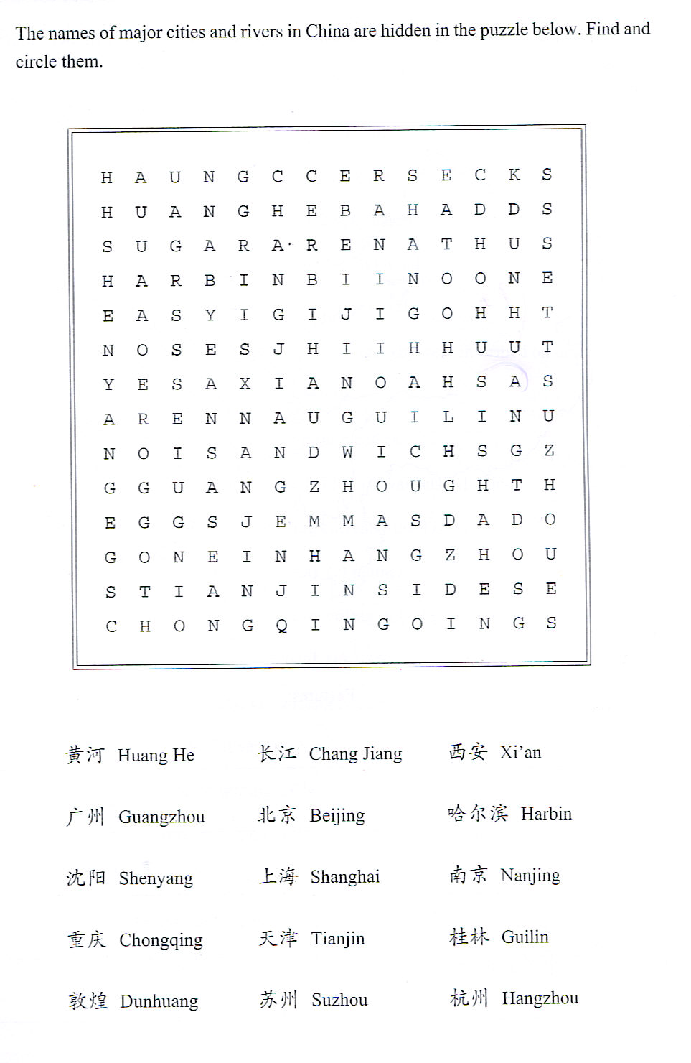
Yellow River
Yangtze River

Slide 3
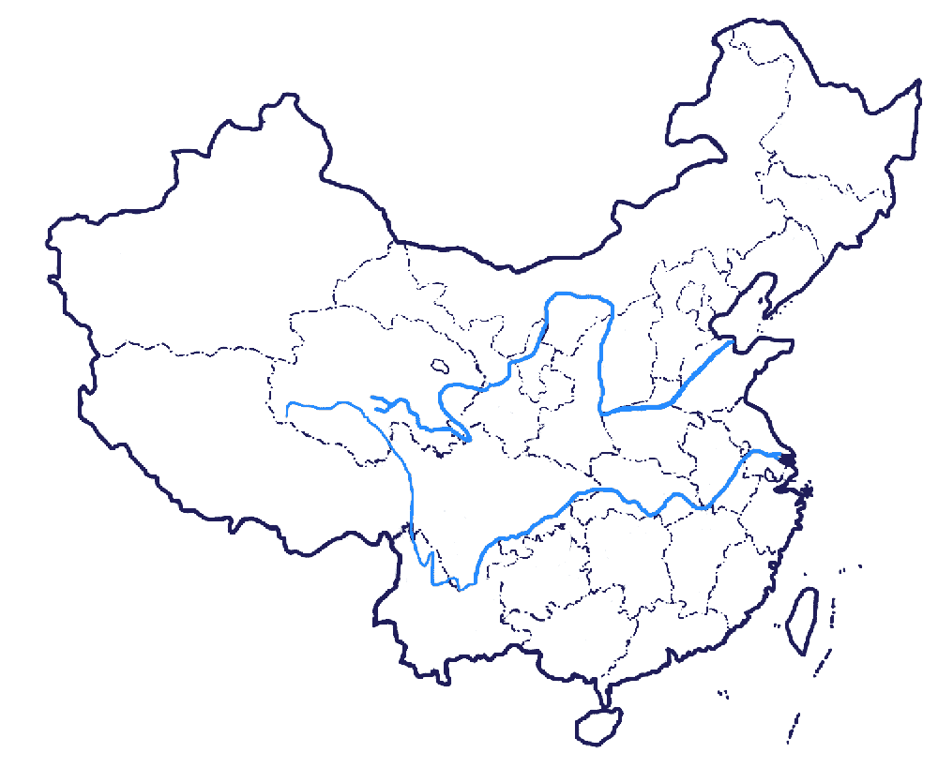

Slide 4
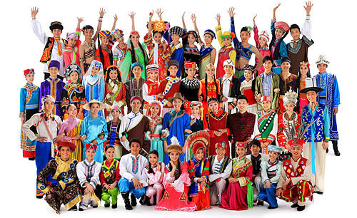

Slide 5
Ni hao
hello
你好

Slide 6
zhong guo
China
中国

Slide 7
mei guo
United States
美国

Slide 8
The top 5 largest countries
e luo si 俄罗斯
Russia
jia na da 加拿大
Canada
zhong guo 中国
China
mei guo 美国
U.S
ba xi 巴西
Brazil

Slide 9
口 日 水 山 木 火 人 月

Slide 12
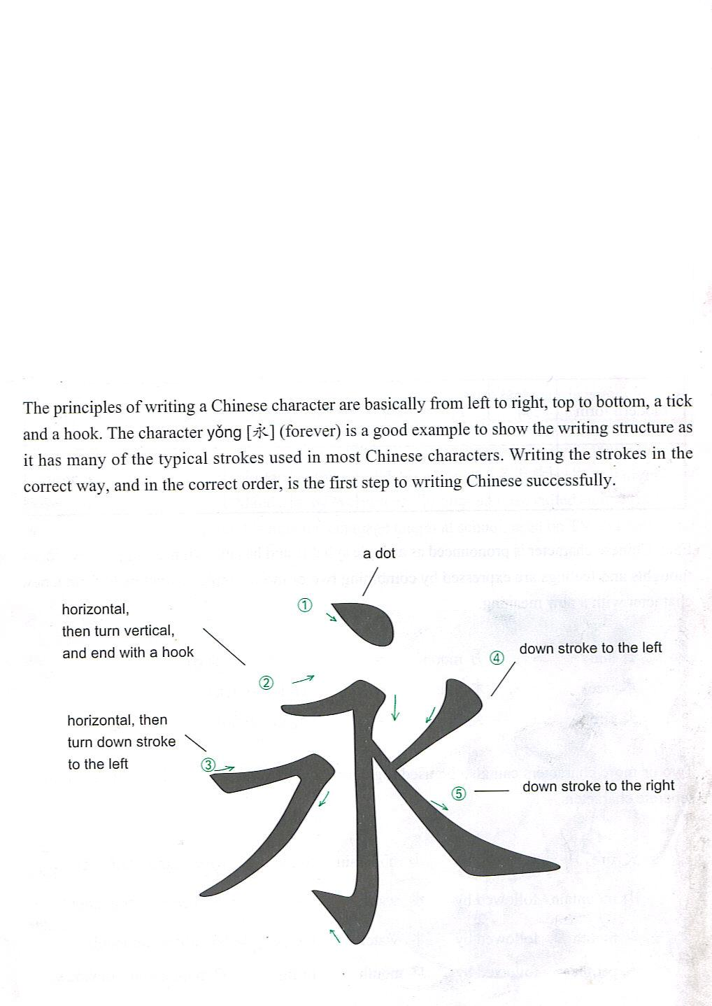

Slide 13
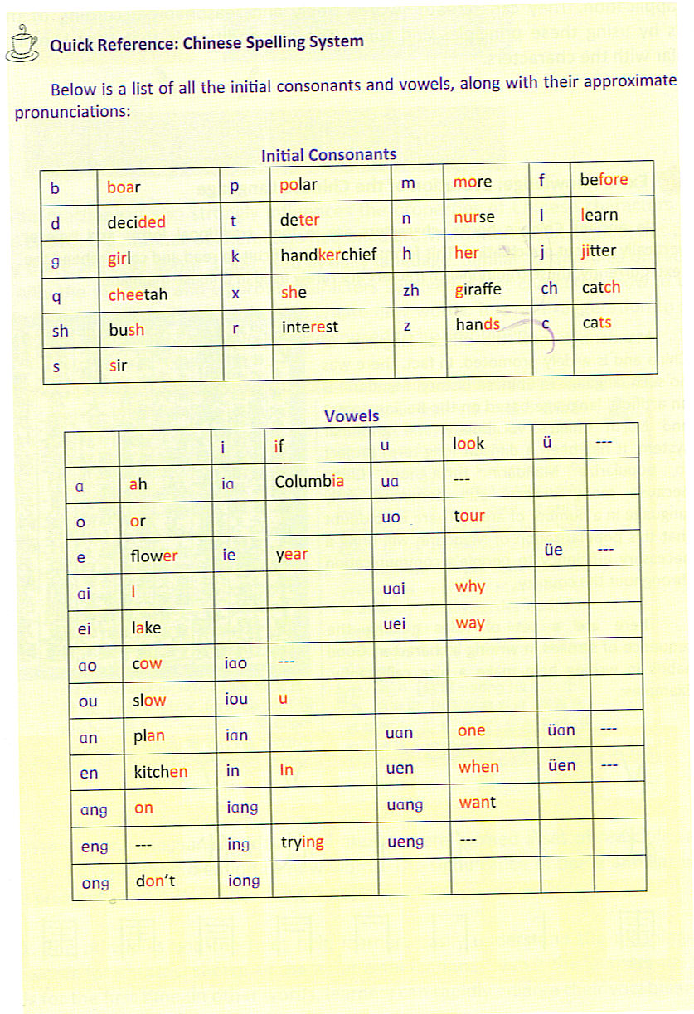

Slide 14
shi
am/is/are
是

Slide 15
Ni
you
你

Slide 16
wo
I/me
我

Slide 17
ta
ta
He/him
She/her
他
她

Slide 18
You – 你
你是
You are
我是
I/me – 我
I am
Am/is/are – 是
He/him – 他
他是
He is
She/her – 她
她是
She is

Slide 19
我是
冯老师

Slide 20
http://www.mandarintools.com/chinesename.html

Slide 21
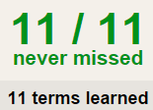
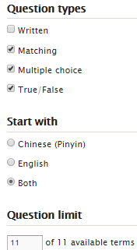
TASK 1 QUIZLET instructions – 08/10 新词 each section is 20%
Learn-Make sure you finish 100%
Speller-Make sure you finish 100%
Scatter-The time needs to be within 35 seconds.
Test- Create New Test after you change the settings to:
笔记notes:
16/16
This number has to be 100
This number doesn’t matter.
16/16
The comment doesn’t matter.
16
This number has to be 12
This number has to be less than 40
16 of 16

Slide 22
测验提醒！！！QUIZ-Matching
QUIZ study guide:
A Day: Wednesday (08/12) B Day: Thursday (08/13)
口 mountain
山 am/is/are
人 water
火 sun
水 moon
我 I/am
你 mouth
月 you
日 fire
是 tree/wood

Slide 23
热身
1. Where is China located? (Which continent?)
2. What is the most common greeting word in Chinese?
3. How many ethnic groups are there in China?
4. What is the name of the pronunciation system in Chinese?
5. How many tones are there in Chinese?
6. What is “China” and “”USA” in Chinese?
7. Do you know any Chinese character?
8. What are the 2 main rivers in China?
CLASS

Slide 24
测验 08/12 Level 1 4 B
NAME:
Matching:
测验 08/12 Level 1 4 B
NAME:
Matching:
CLASS
A. Am/is/are
B. Sun
C. Mouth
D. Fire
E. Water
F. I/me
G. You
H. Mountain
I. Moon
J. person
A. Am/is/are
B. Sun
C. Mouth
D. Fire
E. Water
F. I/me
G. You
H. Mountain
I. Moon
J. person
口 ( )
山 ( )
人 ( )
火 ( )
水 ( )
我 ( )
你 ( )
月 ( )
日 ( )
是 ( )
口 ( )
山 ( )
人 ( )
火 ( )
水 ( )
我 ( )
你 ( )
月 ( )
日 ( )
是 ( )
测验 08/12 Level 1 4 B
NAME:
Matching:
测验 08/12 Level 1 4 B
NAME:
Matching:
A. Am/is/are
B. Sun
C. Mouth
D. Fire
E. Water
F. I/me
G. You
H. Mountain
I. Moon
J. person
A. Am/is/are
B. Sun
C. Mouth
D. Fire
E. Water
F. I/me
G. You
H. Mountain
I. Moon
J. person
口 ( )
山 ( )
人 ( )
火 ( )
水 ( )
我 ( )
你 ( )
月 ( )
日 ( )
是 ( )
口 ( )
山 ( )
人 ( )
火 ( )
水 ( )
我 ( )
你 ( )
月 ( )
日 ( )
是 ( )

Slide 25
CLASS
You wen ti ma?
有问题吗
You / mei you 有/没有
Any question?
Yes / no.

Slide 26
Re shen （热身）Class room phrases
re shen 热身
bi ji 笔记
lian xi 练习
ce yan 测验
kao shi 考试
zuo ye 作业
wen ti 问题
warm up
notes
practice
quiz
test/exam
homework
question

Slide 27
Pin Yin

Slide 28
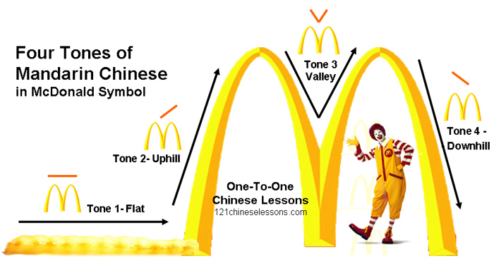

Slide 29
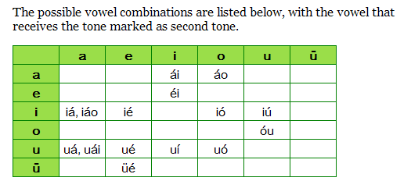
http://www.chinese-tools.com/tools/converter-pinyin-unicode.html
Where to mark the tones:
1. A and e trump all other vowels and always take the tone mark. There are no Mandarin syllables in Pinyin that contain both a and e.
2.In the combination ou, o takes the mark.
3.In all other cases, the final vowel takes the mark.
4. Ong & iong

Slide 30
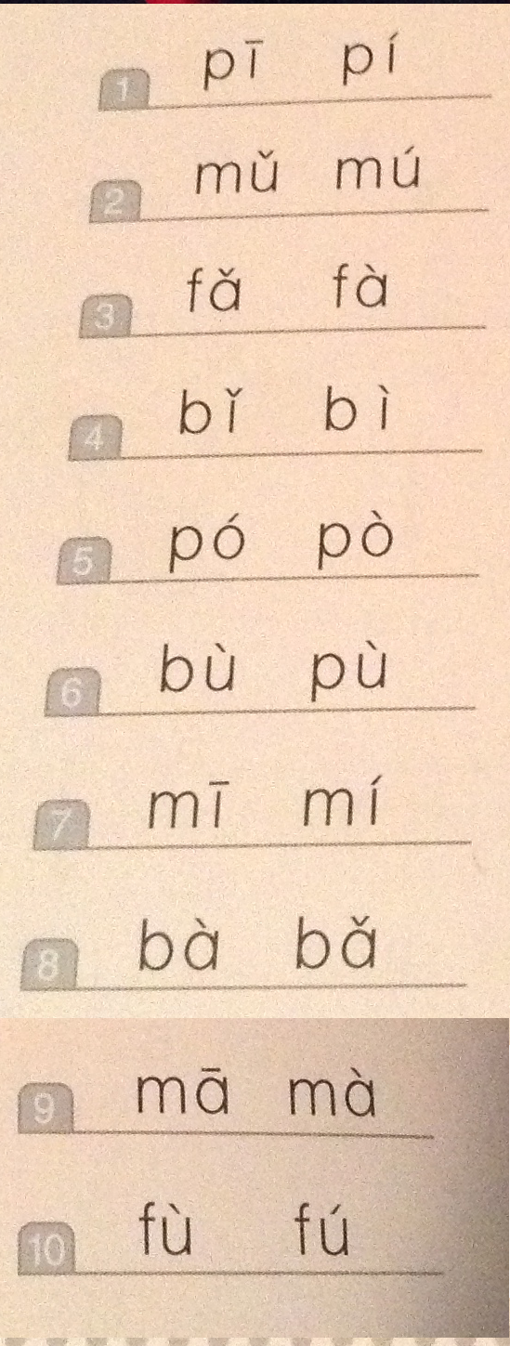
Track 3

Slide 31
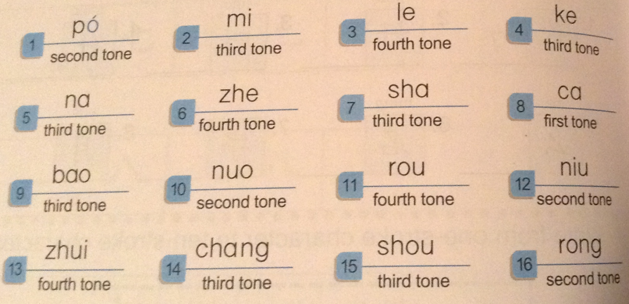

Slide 32
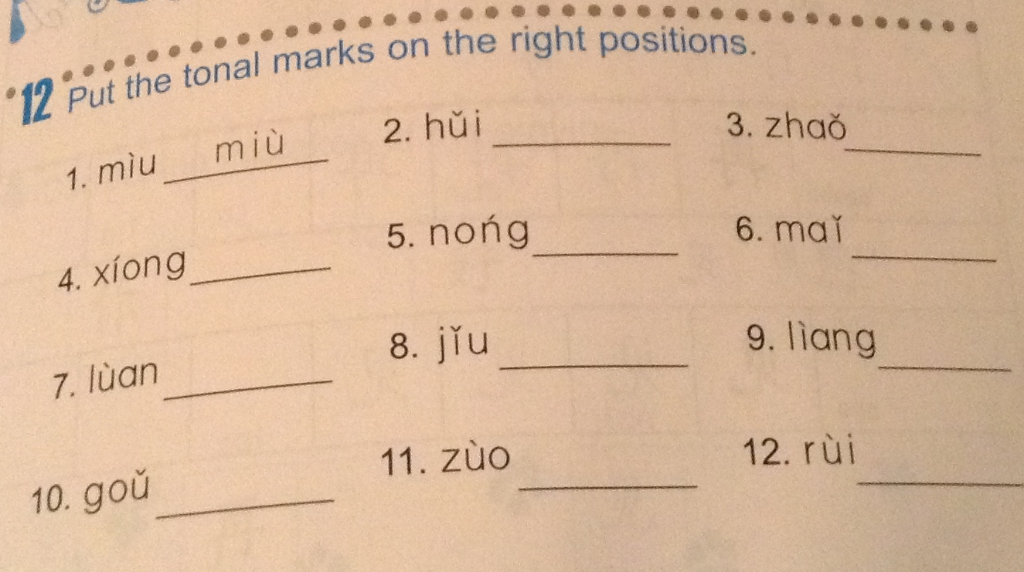

Slide 33
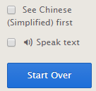
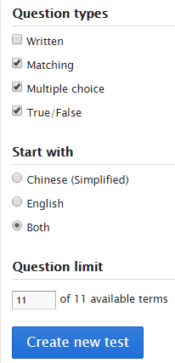
certain students will be assigned to work on QUIZLET Class: Ms. Feng 2015-2016 Chinese Level 1 (4 B Class periods) Set: Numbers (11 words)
Go over the words and make notes when needed.
MUST be 100%!
X
V
V
V
MUST be with in 25 seconds
MUST get 100
both
CREAT NEW TEST

Slide 34
one
yi
一

Slide 35
two
er
二

Slide 36
three
san
三

Slide 37
four
si
四

Slide 38
five
wu
五

Slide 39
six
liu
六

Slide 40
seven
qi
七

Slide 41
eight
ba
八

Slide 42
nine
jiu
九

Slide 43
ten
shi
十

Slide 44
zero
ling
零

Slide 45
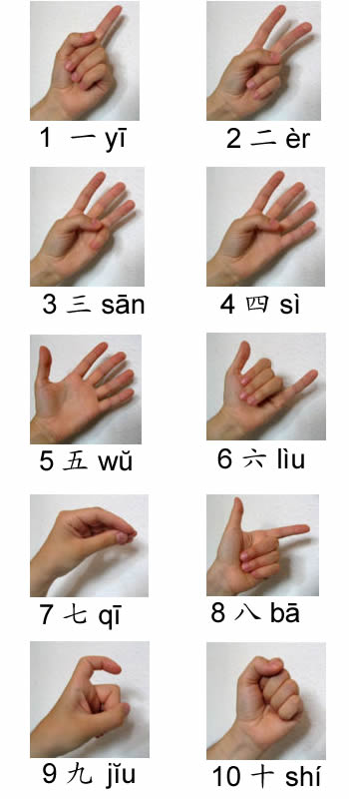
shu zi
Number(s)

Slide 46
A tongue twister
三是三， 山是山；
四是四，十是十。

Slide 48
C. Here are five telephone numbers. Rewrite the Chinese numbers in English and the English numbers in Chinese.
1. 六 八 五 二 九 七 二
1. 6852972
2. 四 五 八 九 七 六 三
2. 4589763
3. 三 八 一 七 四 三 六
3. 3817436
4. 1542109
4.一 五 四 二 一 零 九
5. 7810563
5.七 八 一 零 五 六 三

Slide 49
零
零

Slide 50
2-digit numbers
11-19
10 + the second digit
18
10+8
十八

Slide 51
Lian xi (pin yin & han zi)
19
15
16
13

Slide 52
2-digit numbers
20,30,40…90 (the second digit is 0)
The first digit + 10
80
8+10
八十

Slide 53
Lian xi (pin yin & han zi)
90
50
60
30

Slide 54
2-digit numbers
The rest of the numbers
The first digit + 10 + the second digit
87
8+10+7
八十七

Slide 55
Lian xi (pin yin & han zi)
23
46
75
99

Slide 56
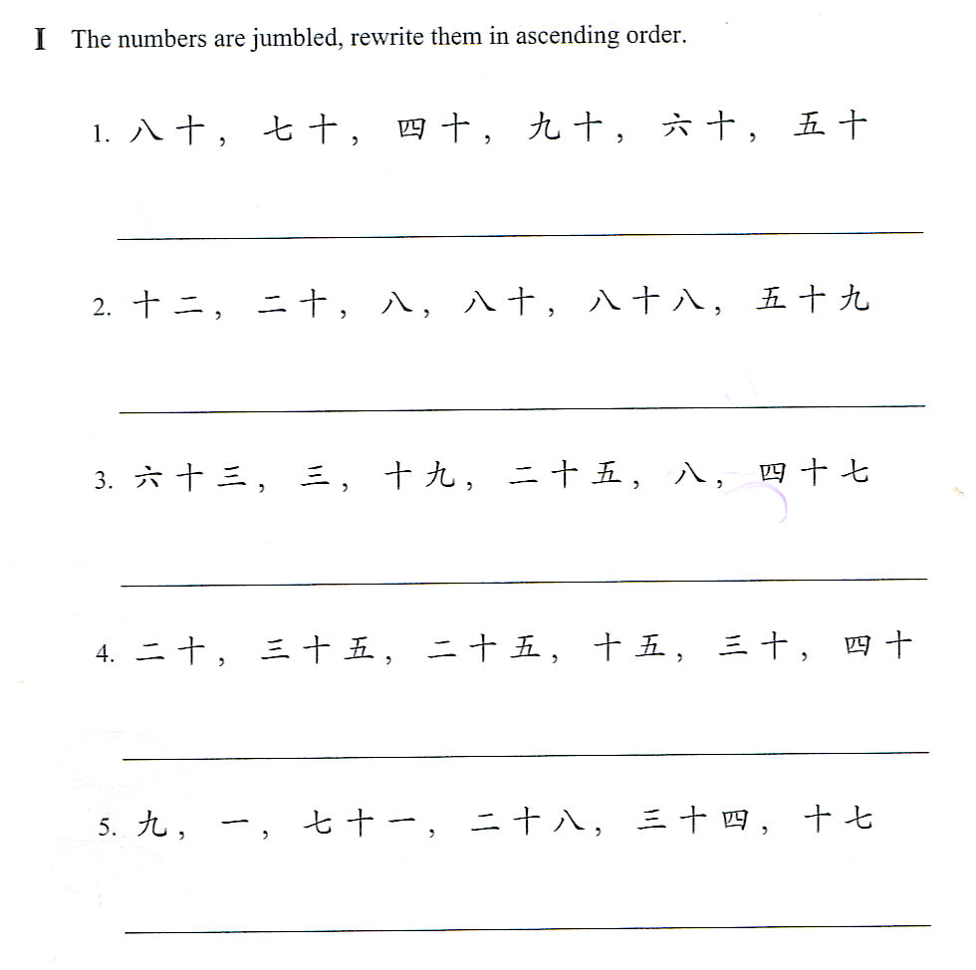
P19

Slide 57
http://www.digitaldialects.com/Chinese/numbers_1I_KS.htm

Slide 58
姓名：
班级：中文一
冯老师
日期：
数字
Pin Yin | character | What does the Pin Yin sound like to me? (example) | What does the character look like to me?
0 Ling | 零 | linguistic | T, half of a box, 4 dots, person, dot, 7 with a dot at the end.
1
2
3
4
5
6
7
8
9
10

Slide 59
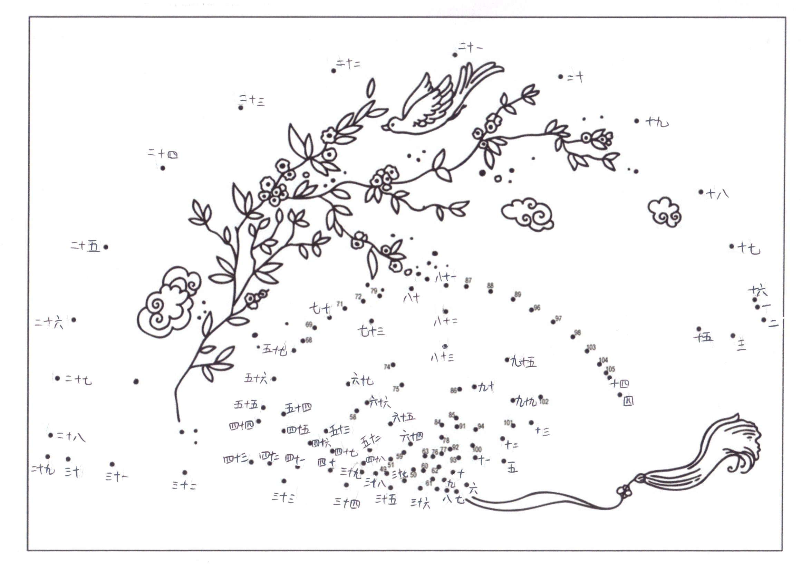

Slide 60
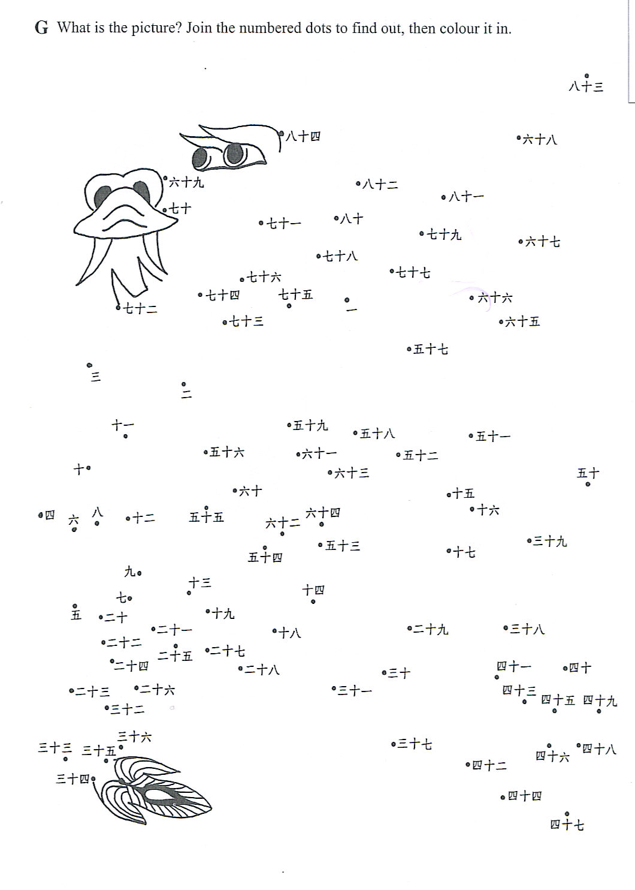

Slide 61
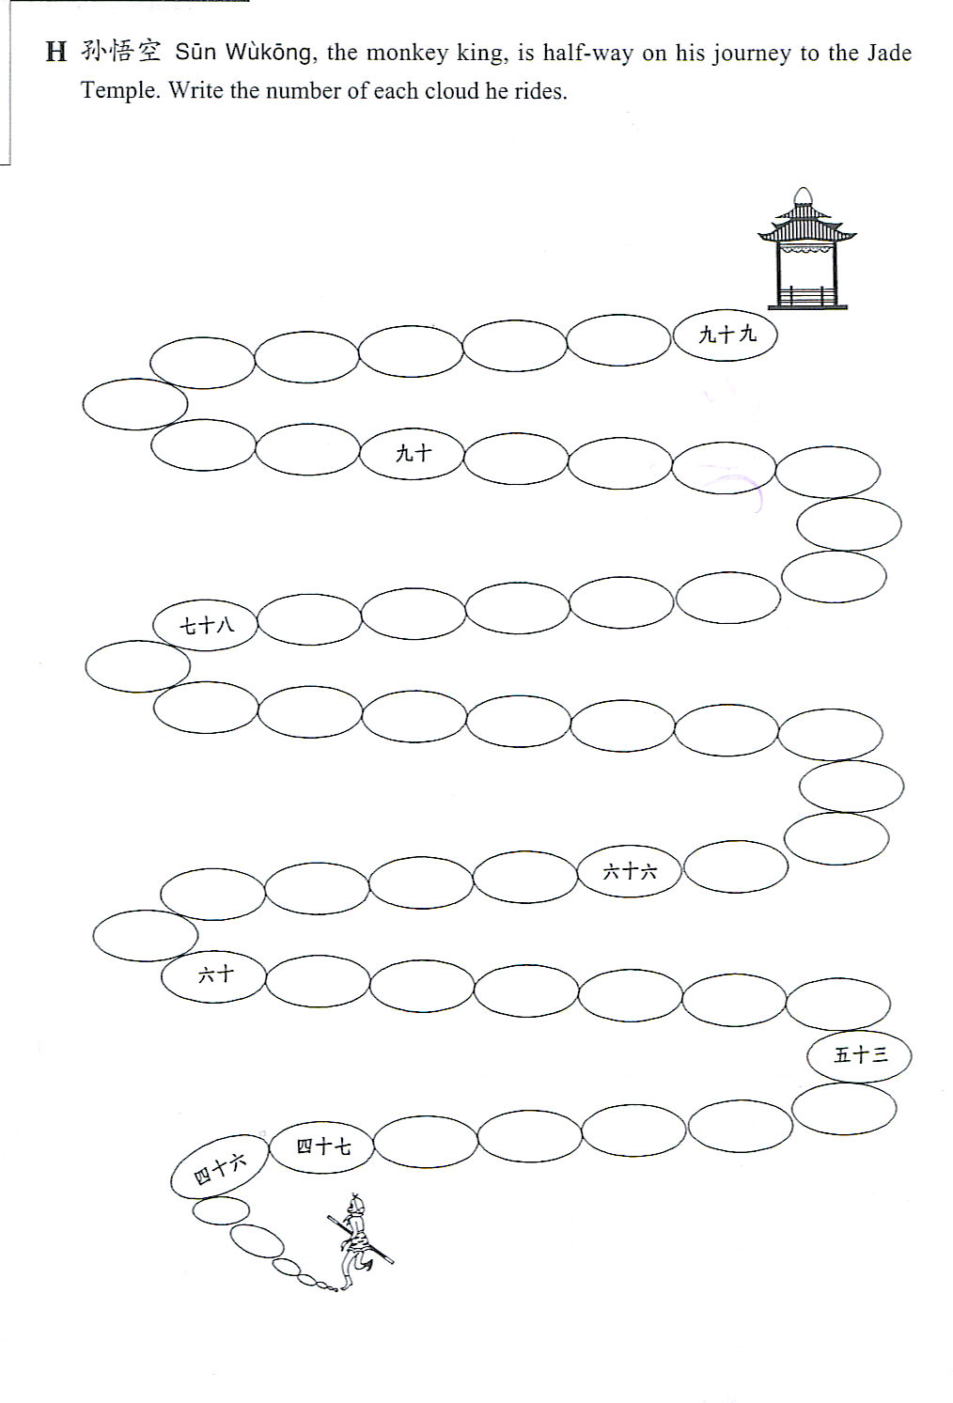

Slide 62
Reorder the following numbers: (small to big) on your handout.
热身：
零
二十三
六十八
三
十四
十一
九
七十九
九十七

Slide 63
Vocabulary:
谁
您
几岁
岁
Sentence structures for questions:
Who are you?
YOU ARE WHO?
Ni shi shei?
你是谁？
When you do “who is she/he?”
SHE/HE IS WHO?
Ta/ta shi shei?
她/他是谁？
Sentence structures for answers:
The same as English:
I AM/SHE IS/HE IS…
Wo shi/ta shi/ta shi…
我是/她是/他是…。
Sentence structures for questions:
How old are you?
You + how old?
Ni + ji sui?
你几岁？
When you do “How old is she/he?”
SHE/HE + HOW OLD?
Ta/ta ji sui?
她/他几岁？
Sentence structures for answers:
I am 9 years old.
I + 9 + YEARS OLD.
Wo + jiu + sui.
我九岁。
He/she is 9 years old.
He/she + 9 + YEARS OLD.
Ta/ta + jiu + sui.
她/他九岁。

Slide 64
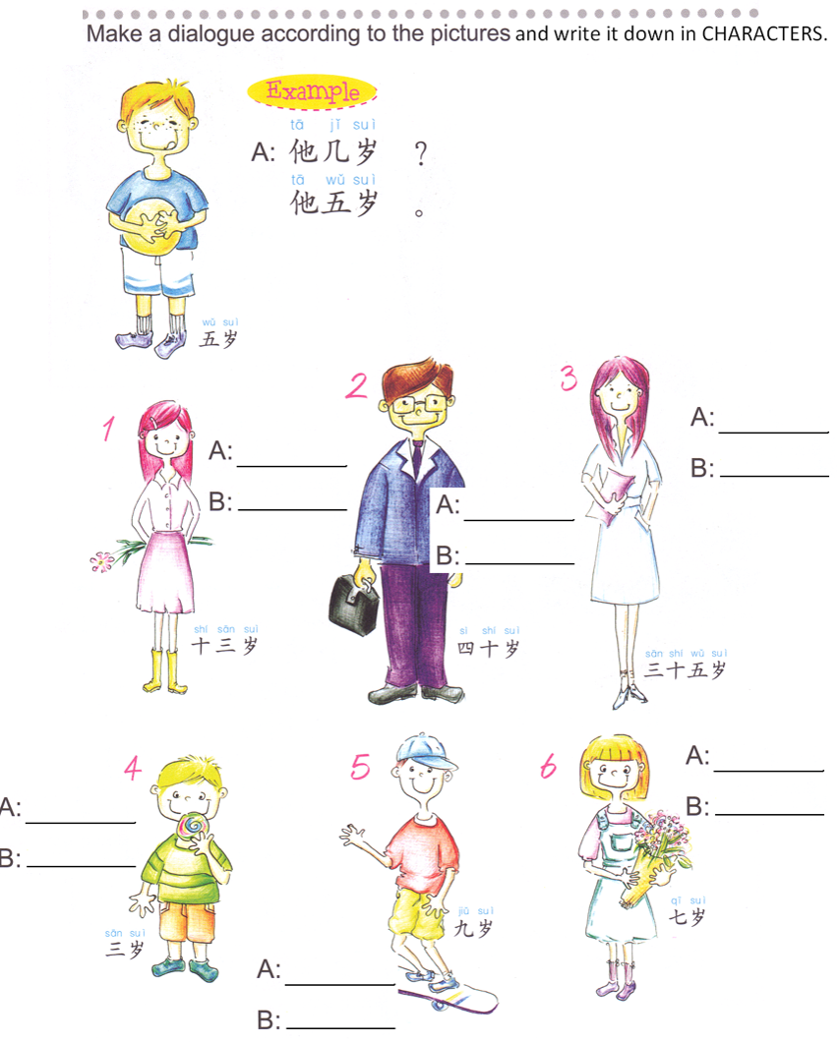
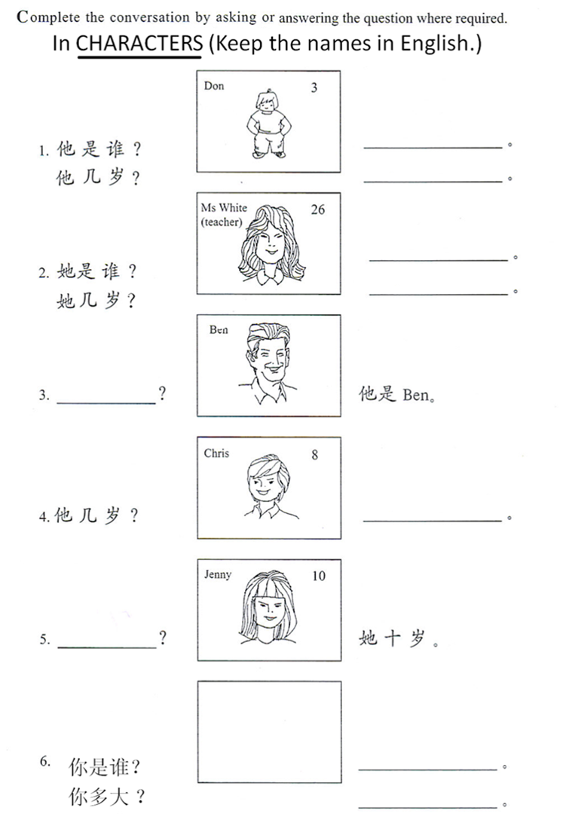
NAME： DATE：

Slide 65
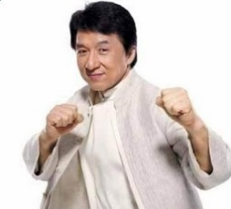
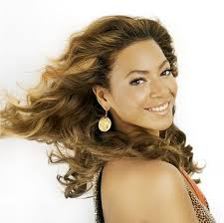
Group activity：Translate the conversation in CHARACTERS for your group using 谁 & 几岁 sentences and read it in Chinese.
Person 1: Hello.
Person 2&3: Hello.
Person 1: Who are you?
Person 2: I am _______. Who is he?
Person 3: He is_______. Who is she?
Person 1: She is ________.
Person 3: Thank you. How old are you?
Person 2: I am ____ years old. How old is she?
Person 1: She is ____ years old. How old are you?
Person 3: I am ____ years old.
Person 1 is: person 2 is: person 3 is:

