Slide 1
Make Turns
向左拐
向右拐
往左拐
往右拐
向左转
向右转
往左转
往右转

Slide 2
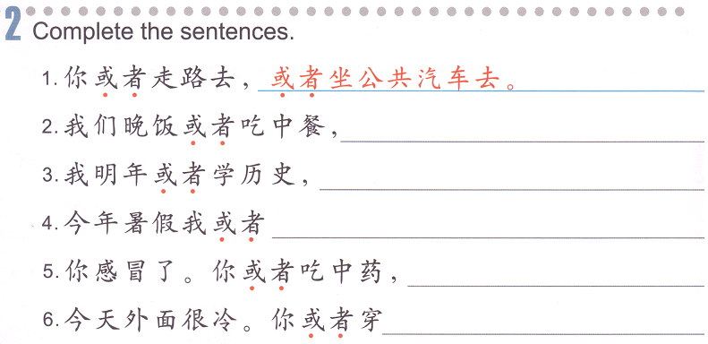
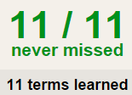
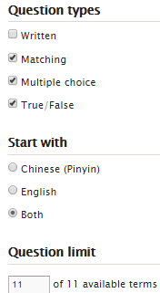
Task 2 QUIZLET instructions – Places 4 each section is 20%
Learn-Make sure you finish 100%
Speller-Make sure you finish 100%
Scatter-The time needs to be within 35 seconds.
Test- Create New Test after you change the settings to:
11/11
Task 1
This number has to be 100
This number doesn’t matter.
Reference: QUIZLET
Task 1 或者...或者...
11/11
The comment doesn’t matter.
11
This number has to be 12
This number has to be less than 40
或者…或者…
Either…or…
11 of 11

Slide 3
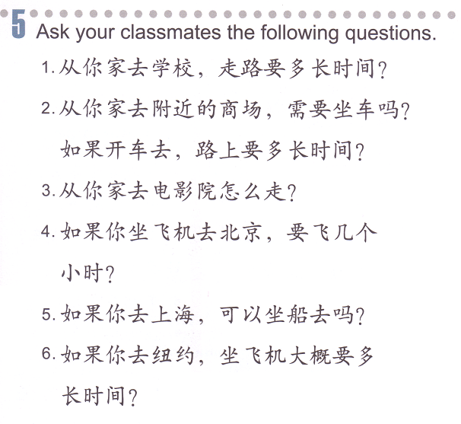
Task 3: Based on the conversation, draw the bus stops and the destination.
TASK 4: Answer the questions using the hints.
A:请问，去购物广场怎么走？
B:你或者骑自行车，或者坐公共汽车。
A:我坐几路公共汽车？
B:坐25路或坐97路都可以。
A:车站在哪儿？
B:车站在一座庙的对面。
A:我要坐几站？
B:大概坐五六站。
你在购物广场那站下车。
1.
2.
3.
4.
5.
6.

Slide 4
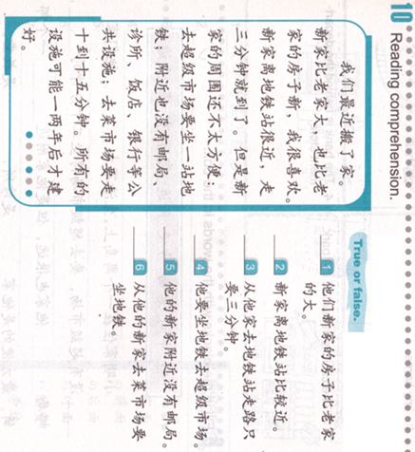
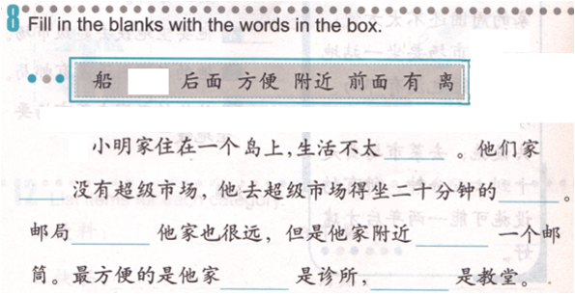

Slide 5
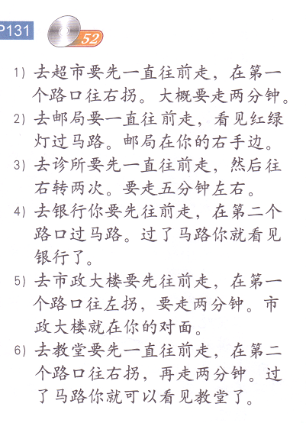
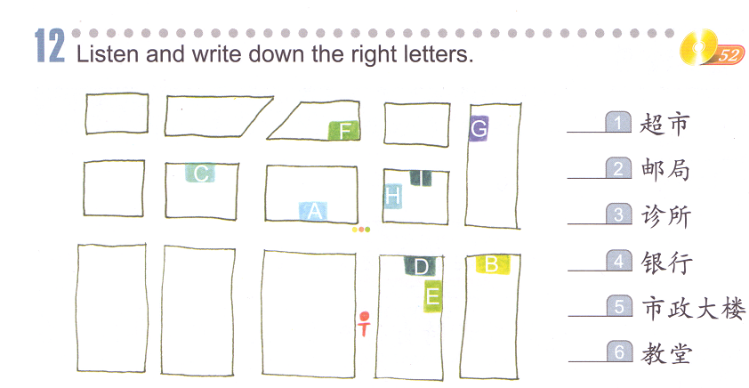

Slide 6
D
H
E
F
A
G

Slide 7
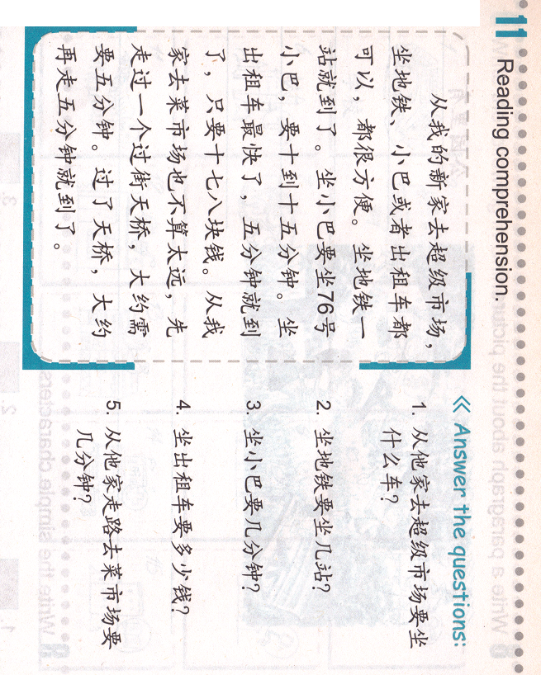
Task 2: QUIZLET Reference 09/30 Task 2
Name 1:__________ Name2:___________ Name3:__________
Task 1
因为，所以 如果 一，就
一边，一边 又，又 跟，一起
除了，以外 先，然后
_______学校离我家很远，_______我每天坐公共汽车上学。
我每天_______回家________吃饭。
我每星期天都_______爸爸_______打篮球。
________汉语_______,我还会说英文。
她喜欢_______唱歌________弹钢琴。
我的老师_______高_______瘦。
_______我去北京，我要坐飞机。
你_______往左拐，_______往前走。

Slide 8
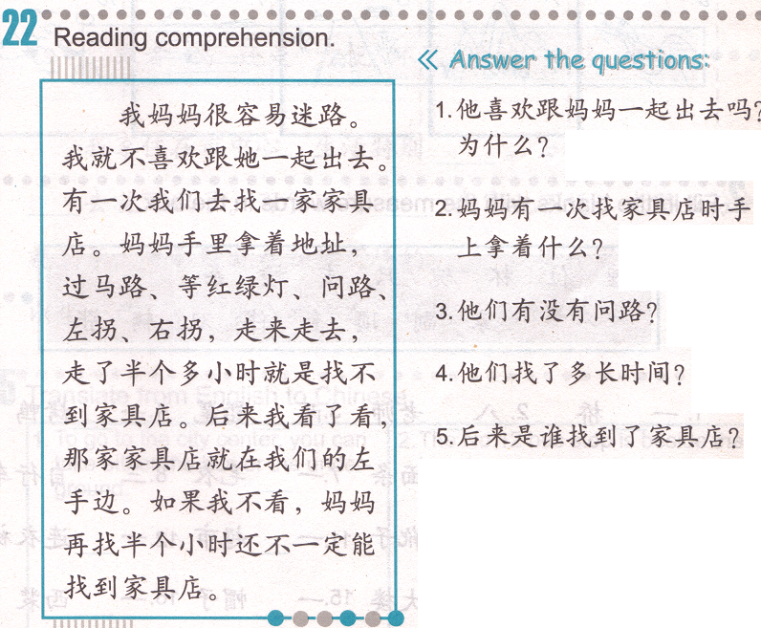

Slide 9
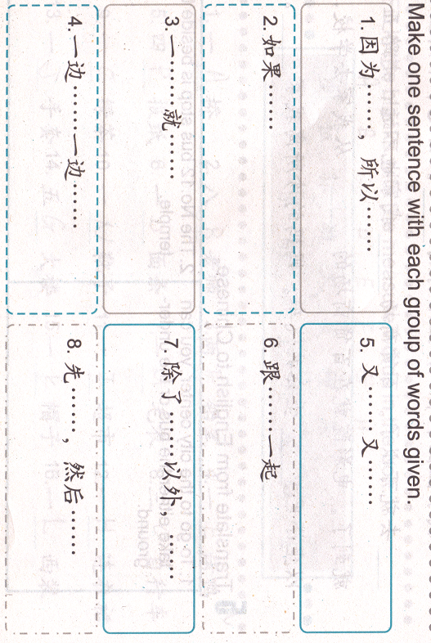
妈妈让我在家休息一个星期
我还会说中文和西班牙语
我有九千块钱 ,我会买一辆车
进学校大门
我昨天跑步的时候脚受伤了
可以看见校长办公室
英语
听音乐
高
瘦
写作业
洗手
吃饭

Slide 10
Task 1: Study the MW, take your quiz when your are ready.
http://www.purposegames.com/game/please-click-the-matching-words-game

Slide 11
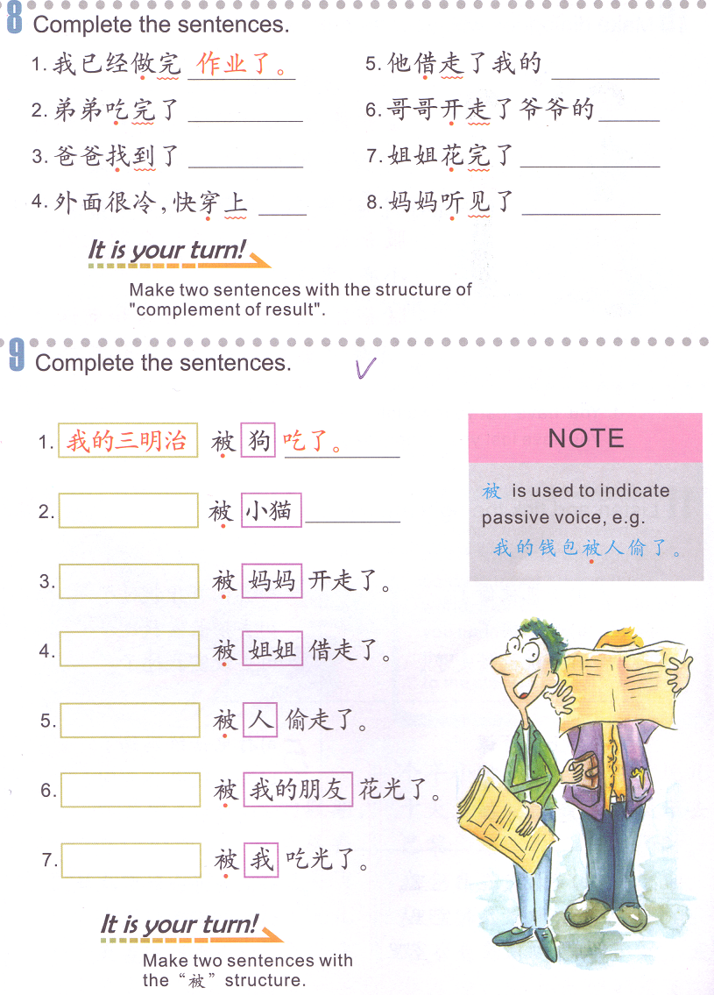
Task 2: Find the Object for each sentence and rewrite the sentences on your paper.
Object + 被 + someone + V. + 了
match
My sandwich is eaten by the dog.
吃了。
钱
车
书
热狗
我的书包
鱼

Slide 12
Task 3:

Slide 13
Task 4 QUIZLET instructions – Personal Items each section is 20%
Learn-Make sure you finish 100%
Speller-Make sure you finish 100%
Scatter-The time needs to be within 35 seconds.
Test- Create New Test after you change the settings to:
10/10
This number has to be 100
This number doesn’t matter.
10/10
The comment doesn’t matter.
10
This number has to be 12
This number has to be less than 40
10 of 10

