Slide 1
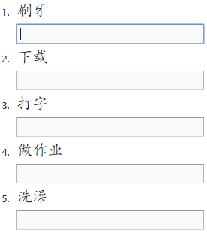
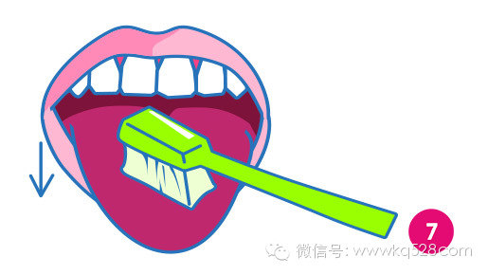
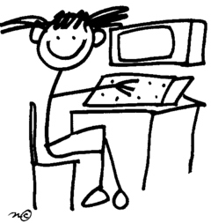
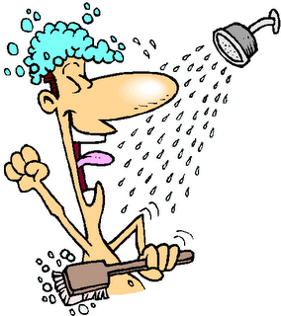
DO NOW
A
B
C
D
E

Slide 2
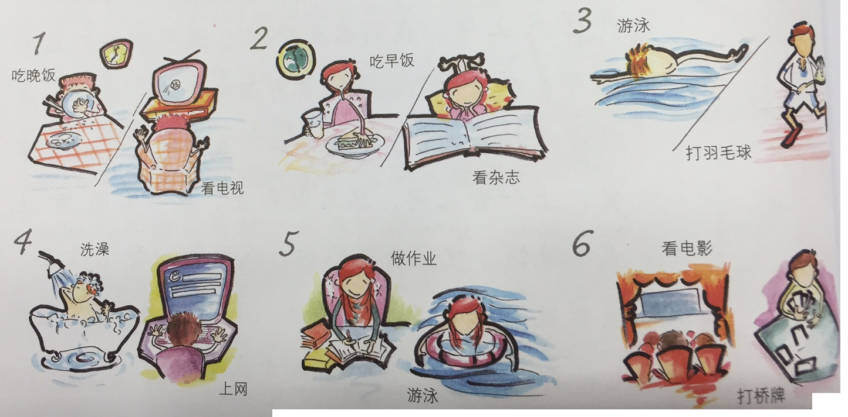
Task 1: Choose 3 out of 6 pictures to write about using:
做作业
玩电脑游戏
他做完作业以后玩一会儿电脑游戏。
He plays a little bit computer games after he finishes doing homework.
He V. a little bit N. after he V. N. .
他V.完N.以后V.一会儿N.。
The 1st character in each word is the V., the rest is the N.

Slide 3
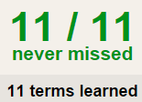
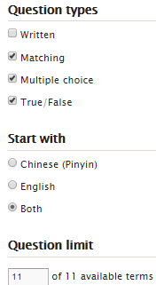
Task 2 QUIZLET Routines 16 each section is 20%
Learn-Make sure you finish 100%
Speller-Make sure you finish 100%
Scatter-The time needs to be within 35 seconds.
Test- Create New Test after you change the settings to:
NOTES:
16/16
This number has to be 100
This number doesn’t matter.
16/16
The comment doesn’t matter.
16
This number has to be 12
This number has to be less than 40
16 of 16

Slide 4
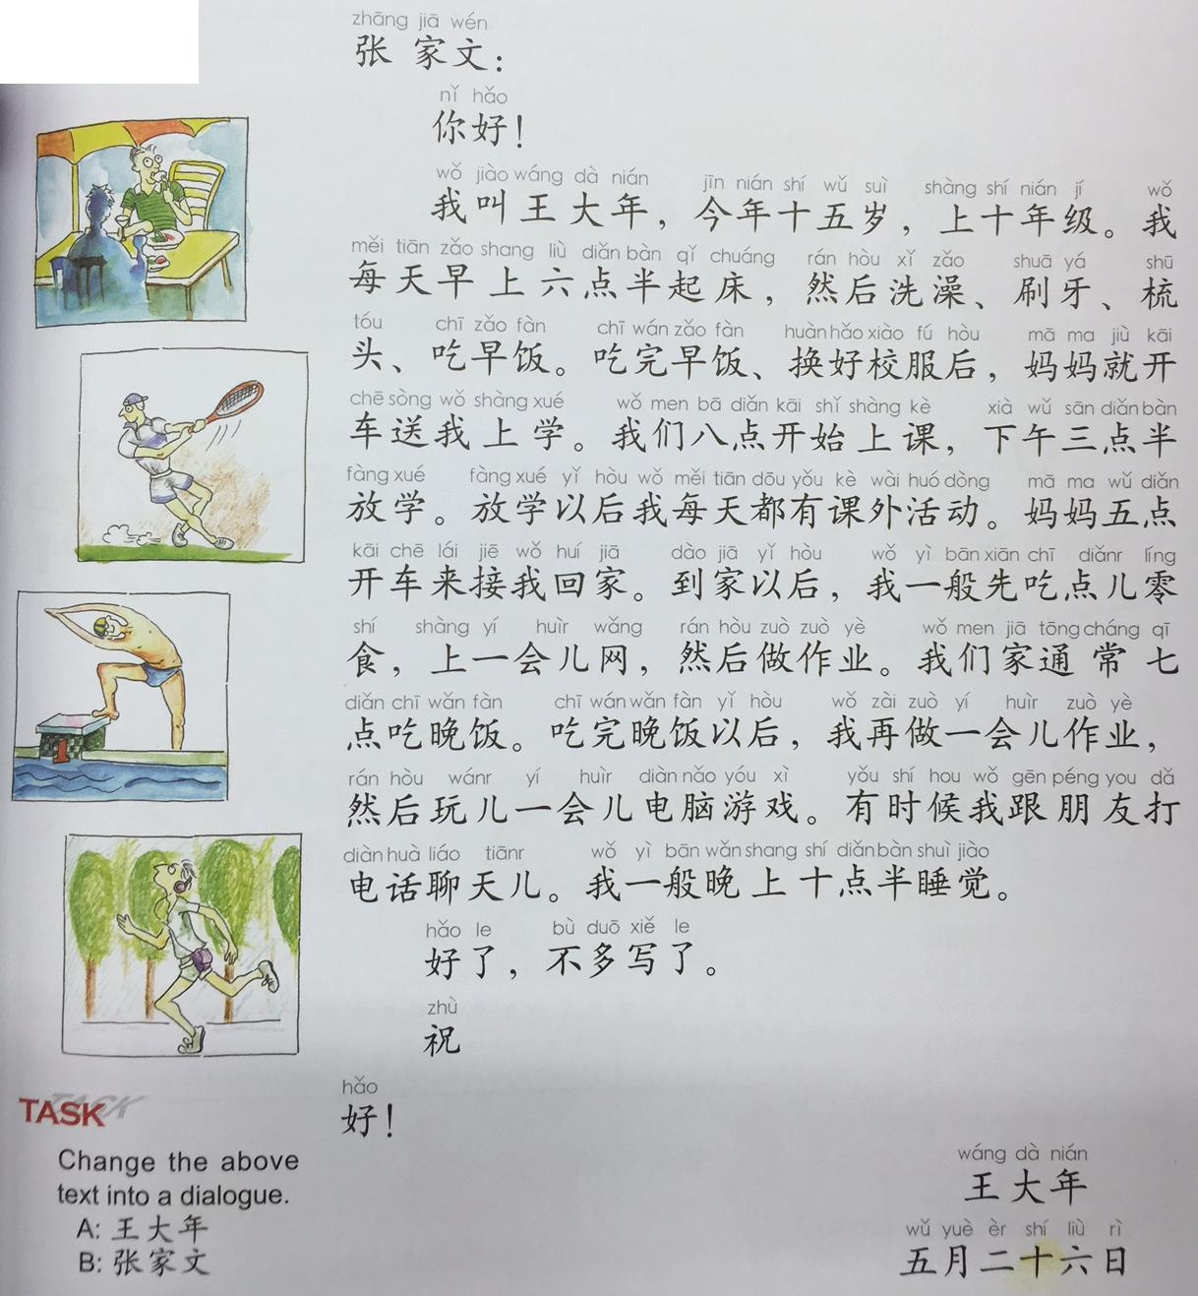
Task 3 – Groups of 2 students
Change the letter into a dialog.
You need to at least cover the following question types:
Name: 我叫王大年。 （1）
Age: 我今年十五岁。（1）
几点: 我每天早上六点半起床。（3）
谁: 妈妈开车送我上学。 （2）
吗: 我每天回家先吃一点儿零食。 （2）
什么: 我每天八点开始上课。… (3)

Slide 5
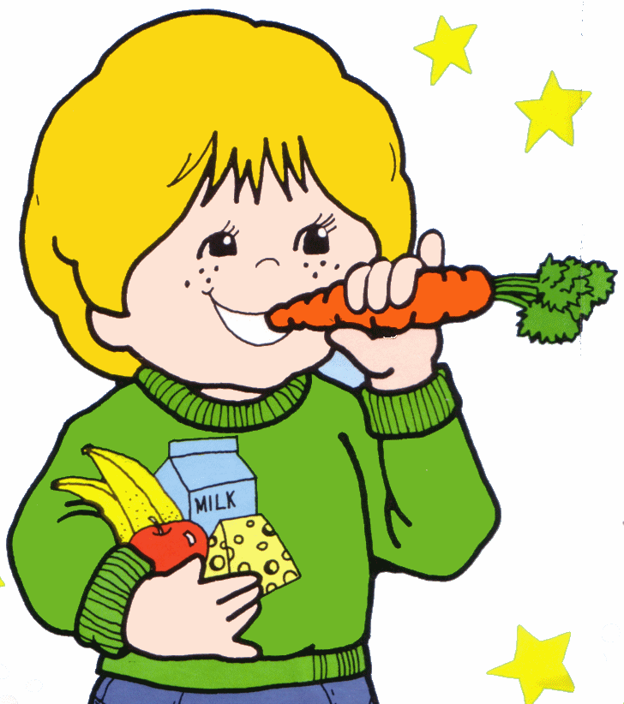
吃零食
写作业
下载
打字
洗澡
刷牙

