Slide 1
Find the furniture words and write them down on your paper.
椅子
草莓
床
米饭
历史书
鸡肉
汉堡包
热狗
薯条
小说
杂志
西瓜
香蕉
尺子
鱼肉
笔
桌子
书本

Slide 2

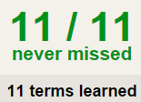

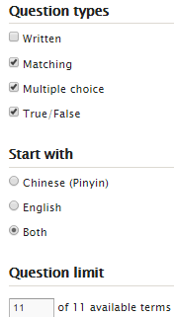
TASK 1 QUIZLET instructions – school food 1 each section is 20%
Learn-Make sure you finish 100%
Speller-Make sure you finish 100%
Scatter-The time needs to be within 35 seconds.
Test- Create New Test after you change the settings to:
笔记notes:
10/10
This number has to be 100
This number doesn’t matter.
10/10
The comment doesn’t matter.
10
This number has to be 12
This number has to be less than 40
10 of 10

Slide 3
Task 2: Group activity
Categorize the words
You can name your own categories, as long as they make sense.
杂志
西瓜
香蕉
尺子
鱼肉
笔
桌子
书本
椅子
草莓
床
米饭
历史书
鸡肉
汉堡包
热狗
薯条
小说

Slide 4
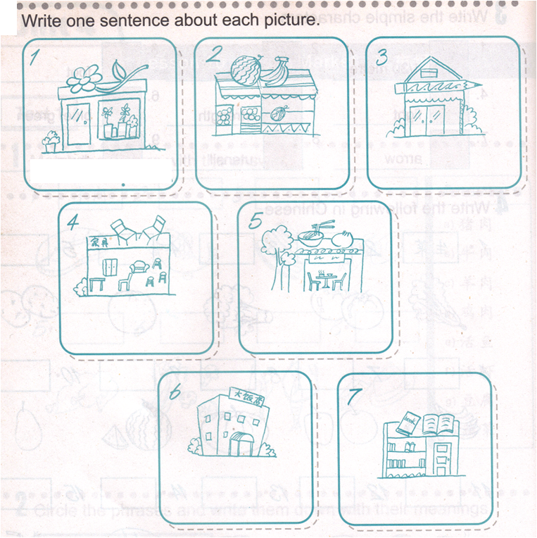
Task 3:
这家…卖各种…,比如…(3 examples)等。
1.花店卖各种花，比如玫瑰花，百合花和郁金香等。
花店
水果店
文具店
家具店
中餐馆
西餐厅
书店

Slide 5
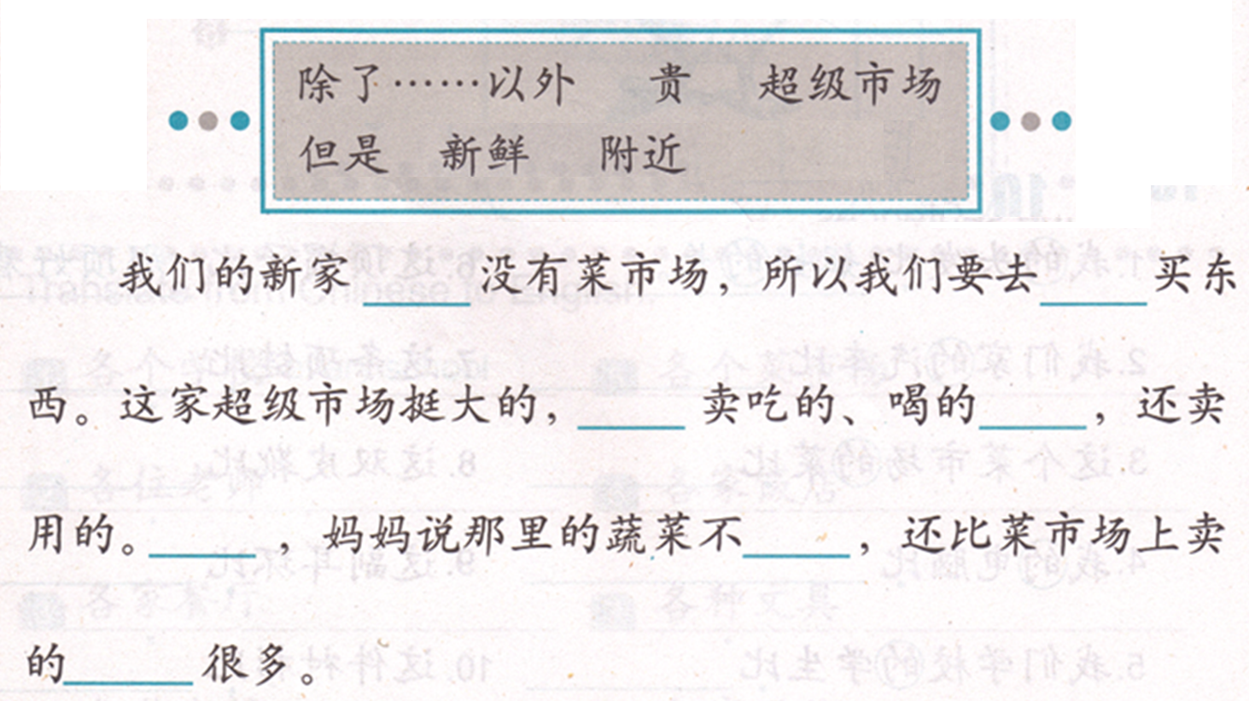
Task 4:
Reference-QUIZLET 08/24 Task4

Slide 6
杂志
西瓜
香蕉
尺子
鱼肉
笔
桌子
书本
椅子
草莓
床
米饭
历史书
鸡肉
汉堡包
热狗
薯条
小说
书本
椅子
草莓
床
米饭
历史书
鸡肉
杂志
西瓜
香蕉
尺子
鱼肉
笔
桌子
汉堡包
热狗
薯条
小说
桌子
书本
椅子
草莓
杂志
西瓜
香蕉
尺子
鱼肉
笔
床
米饭
历史书
鸡肉
汉堡包
热狗
薯条
小说
杂志
西瓜
椅子
草莓
床
米饭
历史书
香蕉
尺子
鱼肉
笔
桌子
书本
鸡肉
汉堡包
热狗
薯条
小说
草莓
床
米饭
历史书
鸡肉
汉堡包
热狗
薯条
杂志
西瓜
香蕉
尺子
鱼肉
笔
桌子
书本
椅子
小说
尺子
鱼肉
笔
桌子
书本
椅子
草莓
床
米饭
历史书
鸡肉
汉堡包
热狗
薯条
小说
杂志
西瓜
香蕉

Slide 7
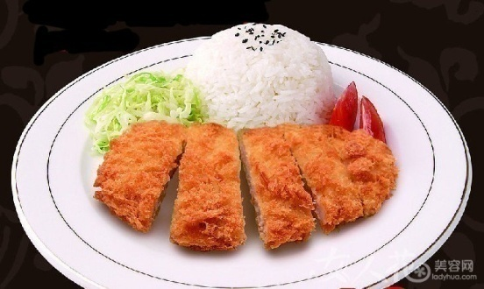
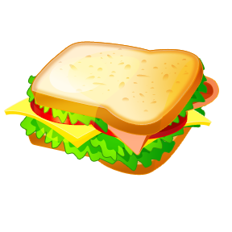
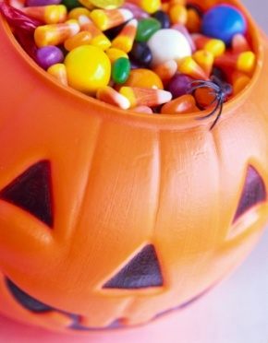
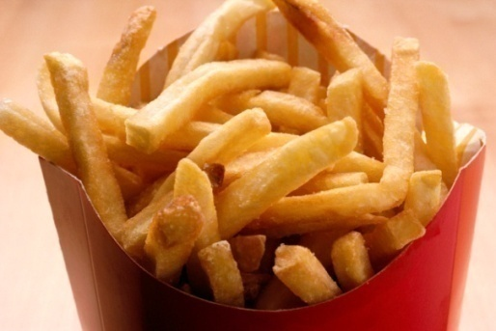
汉堡包
三明治
猪排饭
薯条
薯片
糖果

Slide 8
Last time’s tasks 3&4

Slide 9
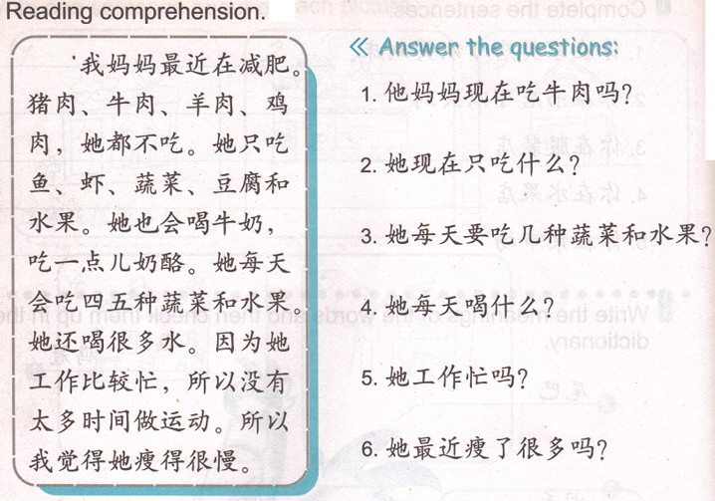
DO NOW: mark down the question words.
slow
Has she been losing a lot of weight recently?
think

Slide 10
TASK 1 QUIZLET instructions – school food 2 each section is 20%
Learn-Make sure you finish 100%
Speller-Make sure you finish 100%
Scatter-The time needs to be within 35 seconds.
Test- Create New Test after you change the settings to:
Task 2 Oral activity:
Reference - Quizlet 08/26 Task 2
A:你早饭吃什么？
B:我吃麦片加牛奶，有时候吃面包和鸡蛋。
B:你午饭吃什么？
A:我吃沙拉，有时候喝汤。
A: 你们家晚饭吃什么？
B: 我们有时候吃中餐，有时候吃西餐。
B: 你们家平时谁做饭？
A: 妈妈，我有时候吃完晚饭以后帮妈妈洗碗。
10/10
This number has to be 100
This number doesn’t matter.
10/10
The comment doesn’t matter.
10
This number has to be 12
This number has to be less than 40
10 of 10

Slide 11
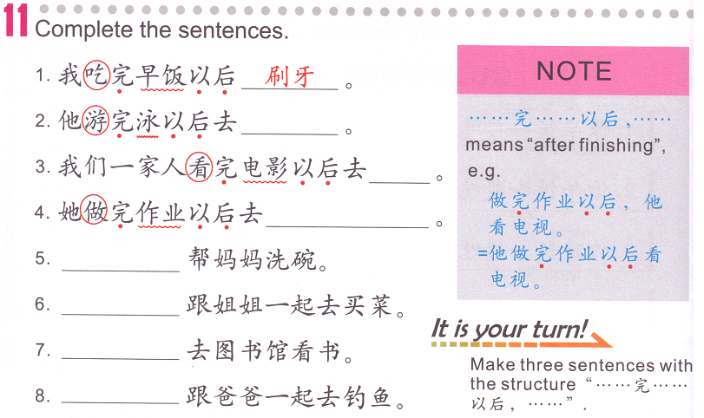
Task 3: Write 8 sentences on your paper.
Reference: QUIZLET 08/26 Task 3
I + eat (V.) 完 breakfast (N.) 以后 brush teeth.
I brush teeth after I eat breakfast.
Subject + V. 完 N. 以后
Subject + V. 完 N. 以后
Subject + V. 完 N. 以后
Subject + V. 完 N. 以后

Slide 12
Homework: Answer the questions on your paper.

Slide 13
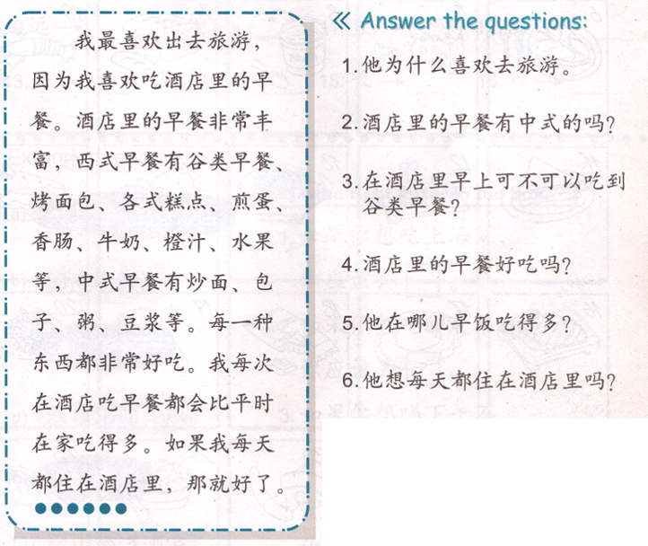
Task 1
QUIZLET
Reference
08/28 Task 1
DO NOW: Mark down the question words.
IB Students, your task 1 is NOT to answer the questions, your task if to write:
I like going to…the most, because ... has plenty of food, like…,… and … etc.
Everything is good.
Every time I eat there, I eat more than what I would eat at home.
That would be great if I can eat there everyday!
(Use the paragraph as reference, YOU WON’T SEE THE PARAGRAH WHEN YOU TAKE THE TEST IN 2WEEKS)
You will need to memorize all the characters and take a test (write from memory) in 2 weeks.
Your testing date is marked on Ms. Feng’s website. Your TASK 1 is due 09/01)

Slide 14
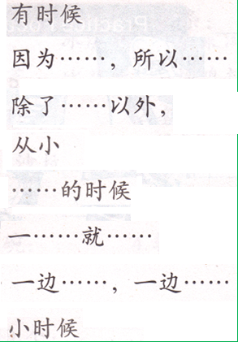
Task 2
Sometimes
Because…so…
Besides …
Since…was little
…when
2 right after 1
Do 2 things at the same time
When…was little
…
我家周末______去饭店吃饭。
妈妈______在中国上小学。
每年冬天______，我都会滑雪。
妹妹______就喜欢英文。
他______起床______看电视。
______英文______, 我还会说中文和日语。
我喜欢和我的好朋友______看电视, ______说话。
______爸爸不吃肉，______他很瘦。
…
1
2

Slide 15
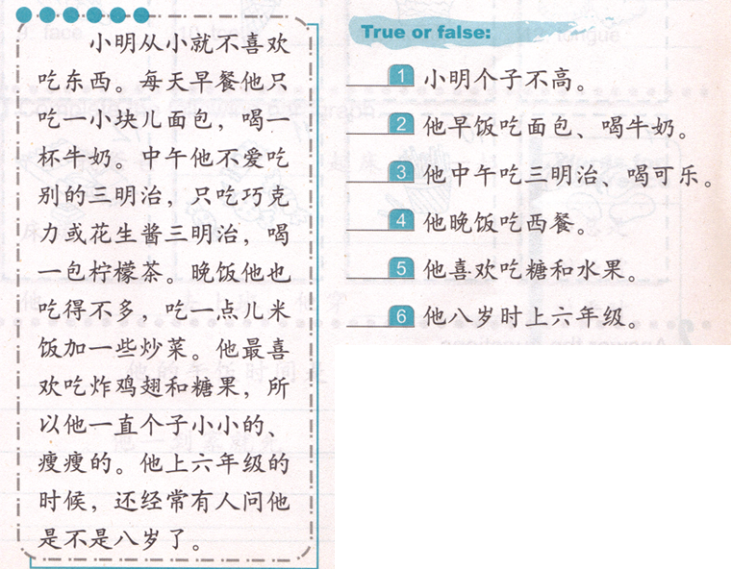
Task 3

Slide 16
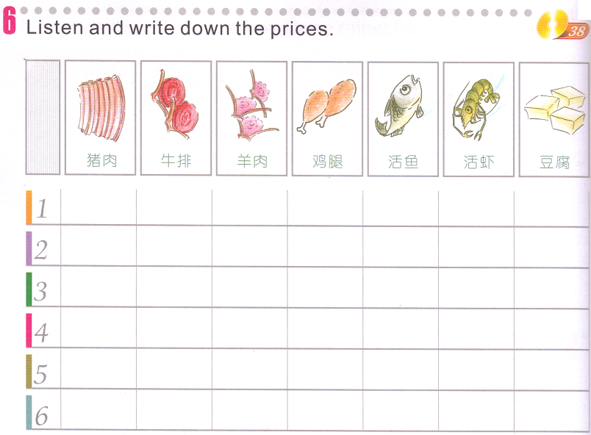
Task 4
http://jfeng1.wix.com/chinese
听力练习

