Slide 1
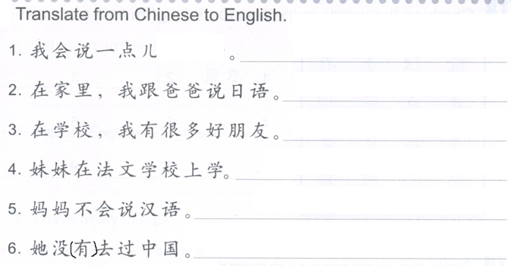
DO NOW:
汉语

Slide 2
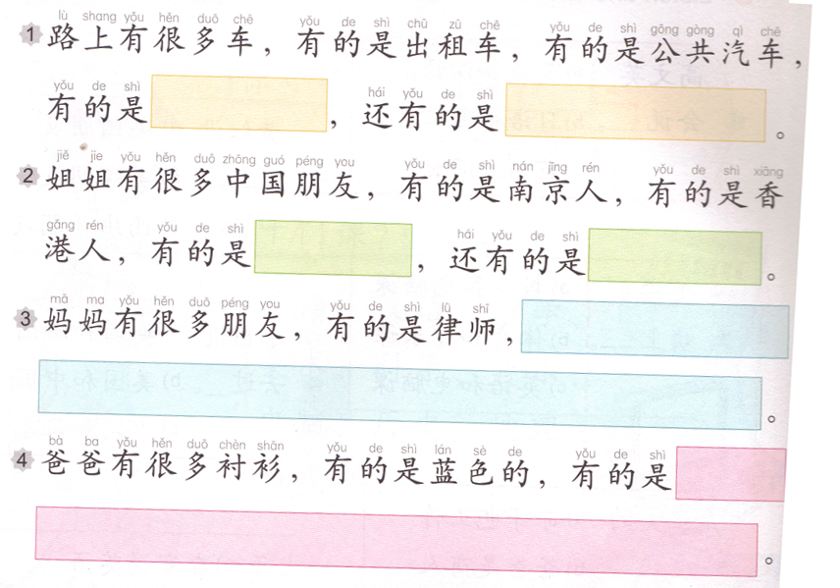
Task 1: Fill in the blanks.
Reference: 有的…,有的…,还有的…

Slide 3
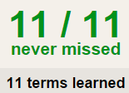
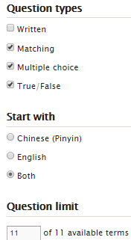
TASK 2 QUIZLET instructions – 课 1 each section is 20%
Learn-Make sure you finish 100%
Speller-Make sure you finish 100%
Scatter-The time needs to be within 40 seconds.
Test- Create New Test after you change the settings to:
笔记notes:
13/13
This number has to be 100
This number doesn’t matter.
13/13
The comment doesn’t matter.
13
This number has to be 12
This number has to be less than 40
13 of 13

Slide 4
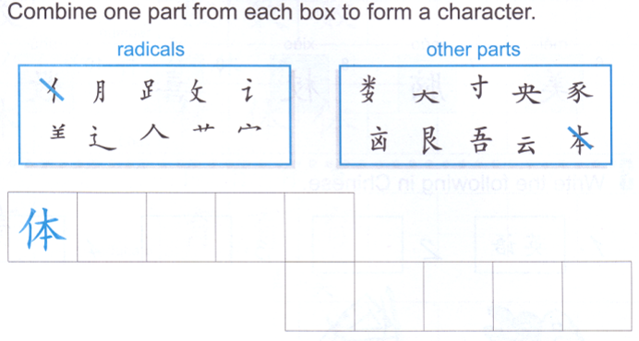
Task 3
美

Slide 5
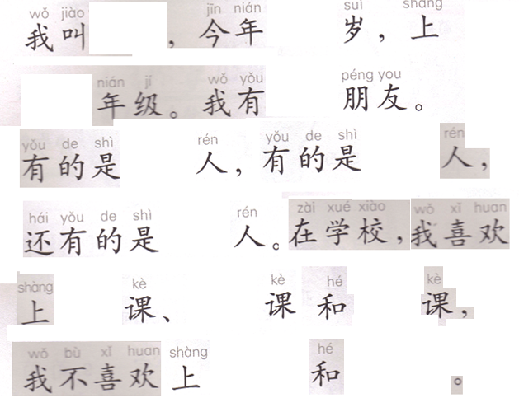
Task 4: Write a paragraph using the words from Task 2.

Slide 6
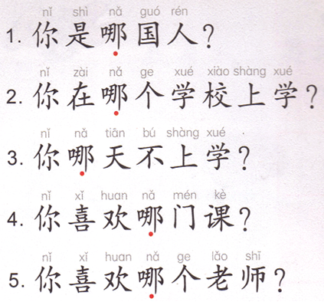
DO NOW: What are the questions asking you?
哪=which

Slide 7
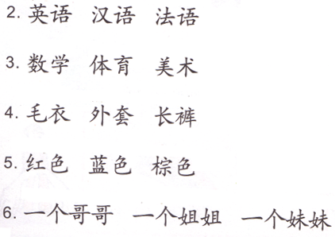
Task 1: Think about a verb and write a sentence for each number using all the words provided.
Subject + V. + A 和 B, 还 + V. + C.
A
B
C
speak
take
wear
like
have

Slide 8
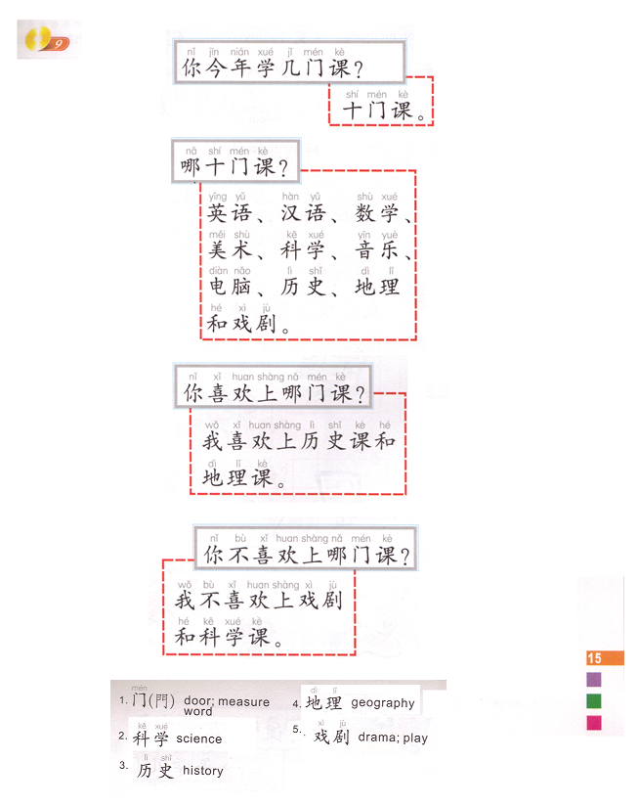
You + this year + learn + how many + MW + classes?
Men: measure word for classes
Task 2: Oral Task
Make a dialog similar to this one, talk about 4 classes you take on A day. Choose 1 class you like and 1 class you don’t like.
You will practice the dialog TWICE. Ms. Feng will decide who will ask the questions, who will answer them.
Reference:
QUIZLET:
课 1 (pronunciation for classes)
&
03/24 Task 2
(pronunciation for the dialog)
Ni + jin nian + xue + ji + men + ke?
10 classes
Which 10 classes?
You + like + take + which + MW + classes?
Which classes do you like to take?
You + not like + take + which + MW + classes?
Which classes don’t you like to take?

Slide 9
Task 3
弹钢琴吗？
弹钢琴。
Hints for 8 reading comprehension
She + number (age) + years old.
Change 几 to the number of the classes.
Change 什么课 to the classes she likes.
Change 什么课 to the classes she dislikes.
弹钢琴=play piano
Yes answer: take out 吗。
No answer: take out 吗, add 不 after 她。

Slide 10
Task 4: Choose 2 words under each category.
颜色 车 课 动物 家人
紫色
猪
狗
数学
火车
红色
出租车
爷爷
蛇
紫色
妹妹
弟弟
汉语
自行车
电脑
淡粉色
淡粉色

Slide 11
DO NOW
Chinese class
Foreign language class
A little bit

Slide 12
Task 1: Speaking task
You will be asked to answer Ms. Feng’s 5 questions.
You may NOT use your notes.
You must provide your name, age, nationality, 1 class (YOU LEARNED) you like and 1 class (YOU LEARNED) you don’t like.
You have 20 minutes to prepare.
Your grade will be posted right away.
wǒ jiào…
你叫什么名字？
你是哪国人？
你今年几岁？
你喜欢上哪门课？
你不喜欢上哪门课？
wǒ shì…
wǒ jīn nián…suì.
wǒ xǐ huan shǎng…
wǒ bù xǐ huan shǎng…

Slide 13
Task 2: Listening
http: //jfeng1.wix.com/chinese
Write down pin yin for the words as the example shown.
Ke xue ke
Shi men ke

Slide 14
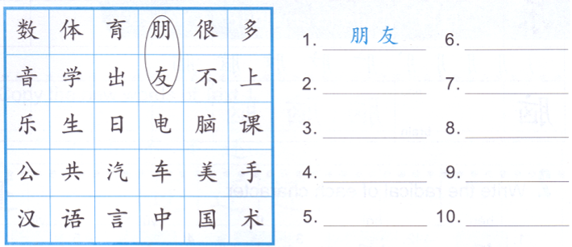
Task 3
friend

Slide 15
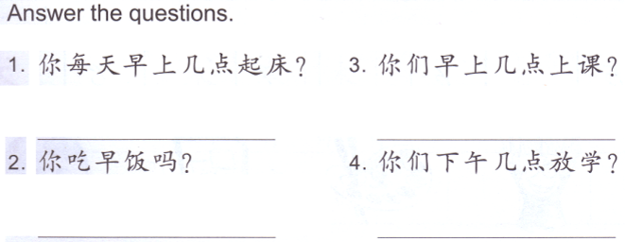
Task 4:
Step 1- mark down the question words, find out what the question is asking.
Step 2- change 你 to 我
Step 3- change the questions words to the actual answers.
Step 4- keep everything else.
6:00-六点
5. 你今年上几门课？
______________________
我
每天早上六点起床。
6. 你喜欢上哪门课？
______________________

Slide 16
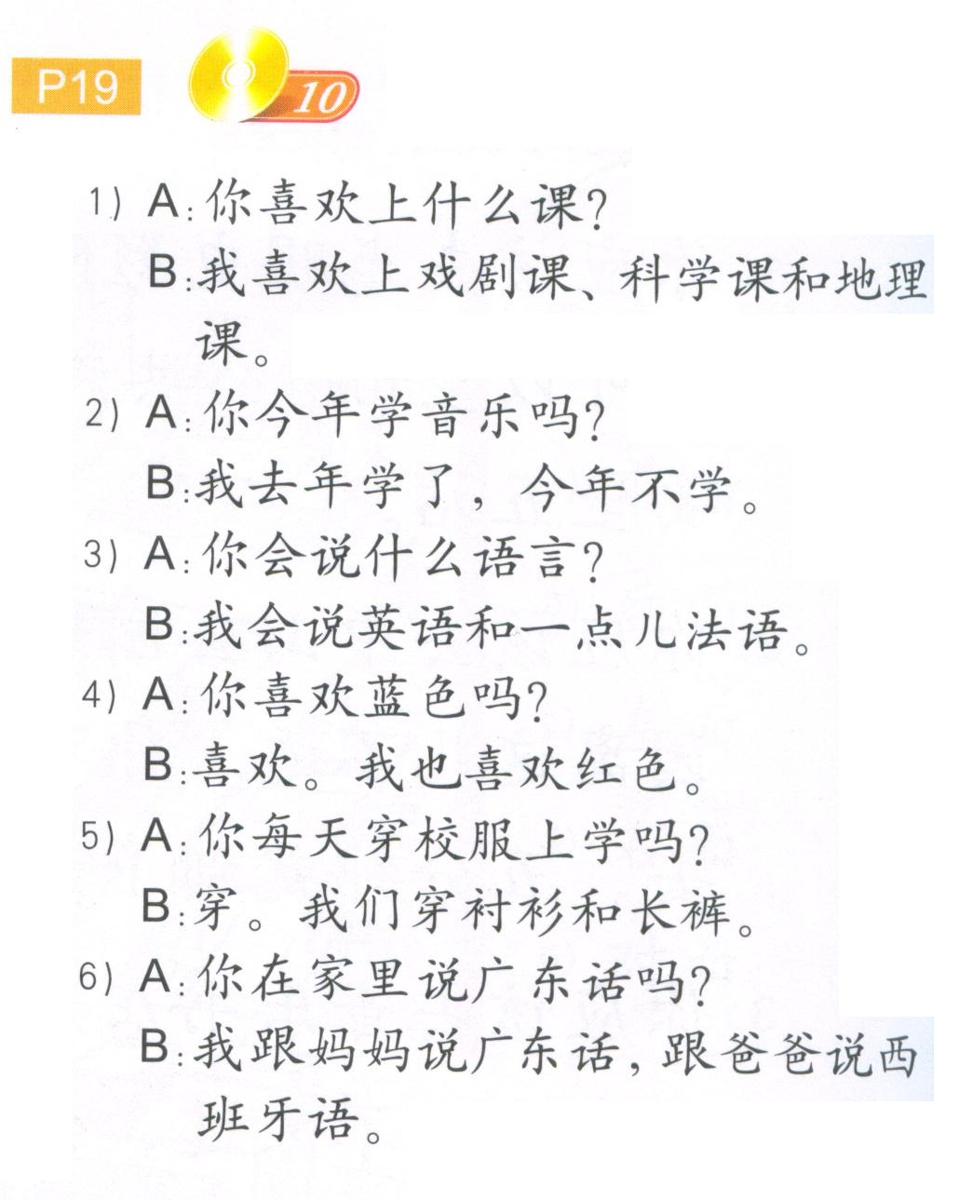
A: ni xi huan shang shen me ke?
B: wo xi huan shang xi ju ke, ke xue ke he di li ke.
2. A: ni ji nian xue yin yue ma?
B: wo qu nian xue le, jin nian bu xue,
3. A: ni hui shuo shen me yu yan?
B:wo hui shuo ying yu he yi dian fa yu.
4. A: ni xi huan lan se ma?
B:xi huan. Wo ye xi huan hong se.
A: ni mei tian chuan xiao fu shang xue ma?
B:Chuan. Wo men chuan chen shan he chang ku.
6. A: ni zai jia li shuo guang dong hua ma?
B:wo gen ma ma shuo guang dong hua, gen ba ba shuo xi ban ya yu.

