Slide 1
Name of the project: 我的社区 (My Neighborhood)
Assigned:01/19 or 01/20 Due:02/04 or 02/05
Materials you might need:
Cardboard
Poster board
Colored boxes like shoe box, cereal box, milk box, Toothpaste boxes etc.
Foam Board
Wood
Thread spools
Toothpicks
Paper clips
Colored paper
Tape or glue
and any materials that are appropriate to make a neighborhood.

Slide 2
You can work in a group of 2 or 3 students. You can decide your own group, however make sure you know that your group will get the same grade.
Your group will get 3 grades for this project, these 3 grades will count 25 % of your semester grade:
The project/ model neighborhood: 10%
The writing part/Descriptions/2 paragraphs: 10%
Oral presentation: 5%

Slide 3
You must label the 10 places, the bus stop and the subway station/train station .
Your neighborhood must include:
10 different places (including your house, a school, a restaurant and 7 other places)
2 intersections
1 bus stop
1 subway station or 1 train station

Slide 4
You must label all the rooms (including yard/garden and garage) and all the items in the room in Chinese.
Your house must at least include:
2 floors
1 bedroom, 1 bathroom, 1 living room, 1 study room, 1 kitchen, 1 dining room.
1 yard/garden and 1 garage.

Slide 5
Your bedroom(s) must at least have:
1 bed
1 nightstand
1 wardrobe

Slide 6
Your bathroom(s) must at least have:
1 toilet
1 sink (洗手池)
1 shower (淋浴间) or 1 tub (洗澡盆)

Slide 7
Your living room(s) must at least have:
1 sofa
1 tea table or 1 coffee table
1 TV

Slide 8
Your study room(s) must at least have:
1 writing desk
1 computer
1 chair
1 bookshelf
2 books

Slide 9
Your kitchen(s) must at least have:
1 stove
1 oven
1 cupboard (柜子)
Your dining room(s) must at least have:
1 dining table
1 dining chair

Slide 10
Your yard/garden(s) must at least have:
2 kinds of vegetables
2 kinds of fruits
1 pet
Your garage(s) must at least have:
1 car

Slide 11
You need to write 1 paragraph to describe the neighborhood using the following sentence structures.
This is my neighborhood.
There are place 1, place 2 and place 3 nearby my house.
我家附近有place 1, place 2 and place 3。
Place 4 is quite far from my house.
我家离 place 4 quite far.
Place 5 is not close to my house.
我家离 place 5 not close.
To get to place 6 from my house, I need to first … then …
从 my house 到 place 6, 我要先…(example: ride a car),然后…(example: walk)。
It takes 5 minutes to drive/walk to place 7 from my house.
从 place 7 开车/走路 5 minutes 就到了。
Many of my friends live in this neighborhood.
我有many friends 住在这个社区。

Slide 12
You need to write 1 paragraph to describe your house using the following sentence structures.
This is my house.
这是我的房子。
My house is … (color).
我的家是…(color) 的。
3. Person 1, person 2 and I live in this house.
Person 1, person 2 and I 住在这个房子 inside.
4. My house has 2/3 floors, 1 yard and 1 garage.
My house has 两/三层，一个yard 和一个garage.
5. Upstairs has room1, room2 and ….., downstairs has room1, room2 and …
楼上有room1, room2 和…,楼下有room1, room2 和…。
6. The capacity of the garage.
我家的车库可以停 number + 辆 + car.
7. Choose 1 room to describe in details. Your descriptions have to cover:
Size : 我的room 很大/小。
Furniture : 我的room里面有…,…和…。
Describe 2 pieces of furniture using: furniture 1 在 furniture 2 （的）proposition.
What you usually do in this room. : 我一般在room里面do something.

Slide 13
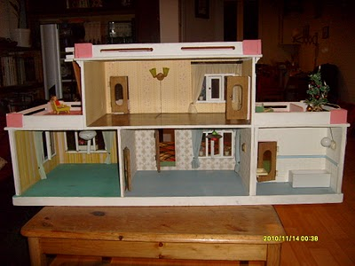
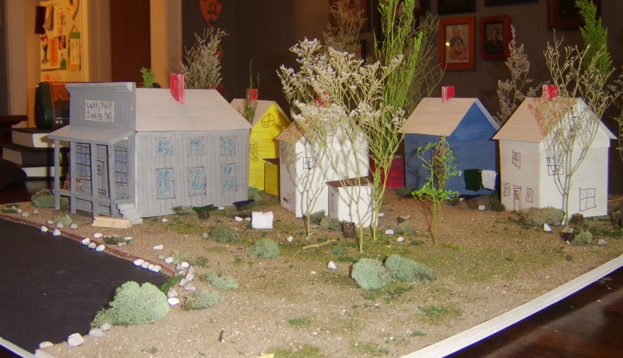
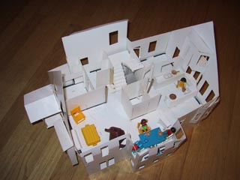
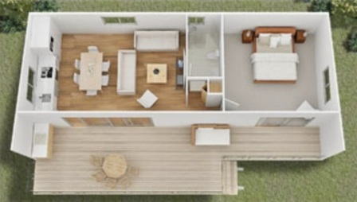
How to Build a Model House for a School Project Read more: http://www.ehow.com/how_5664445_build-model-house-school-project.html#ixzz2f0gsiguK

