Slide 1
Re Shen:
How many people?
Who are they?
“他”叫小明
一岁
三姐
六岁
三姐
两岁
哥哥
三岁
二姐
四岁
妈妈叫小美
三十岁
老师
爸爸
三十四岁
律师

Slide 2
Do you have younger sisters?
You have younger sister + ma?
Ni you mei mei ma?
你有妹妹吗？

Slide 3
When the question is “Does someone have…?”
If the answer is “YES”:
you , someone + you + something.
有，someone有…
If the answer is “NO”:
Mei you, someone + mei you + something.
没有，someone没有…

Slide 4
Yes, I have 3 younger sisters.
You, wo you san ge mei mei.
有，我有三个妹妹。
No, I do not have younger sisters.
Mei you, wo mei you mei mei.
没有，我没有妹妹。

Slide 5
Xing
ming
Last name
First name
姓
名

Slide 6
Xing ming
Ming zi
FORMAL – forms/interviews/formal conversation
Full name
Full name
Regular – daily life/ informal conversation
姓名
名字

Slide 7
To ask what someone’s name is
What is your name?
Who are you asking?
You – ni – 你
Ni + jiao + shen me + ming zi?
你叫什么名字？

Slide 8
To answer what someone’s name is
My name is Mary.
I/me – wo – 我
wo + jiao + Mary.
我叫mary。

Slide 9
To ask what someone’s name is
What is her friend’s name?
Her friend – ta de peng you
Ta de peng you + jiao + shen me + ming zi?
她的朋友叫什么名字？

Slide 10
To answer what someone’s name is
His younger sister’s name is Lily.
His younger sister – ta (de) mei mei
Ta (de) mei mei + jiao + Lily.
他妹妹叫Lily。

Slide 11
Practice the game with class

Slide 12
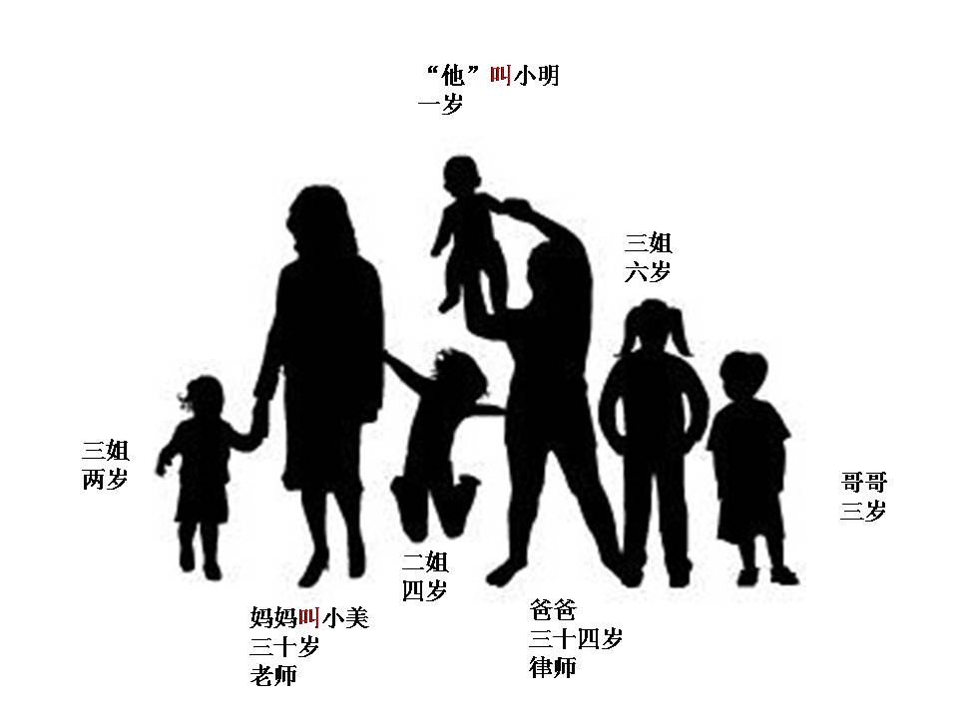
Sit with your partner, go to: www.purposegames.com/game/ad3f718549
Finish 10 questions. You can redo as many times as you need, your goal is 100%.
Show Ms. Feng your grade when you get 100%, you will get a QUIZ grade for this activity.

Slide 13
http://www.purposegames.com/game/basic-characters-game

Slide 14
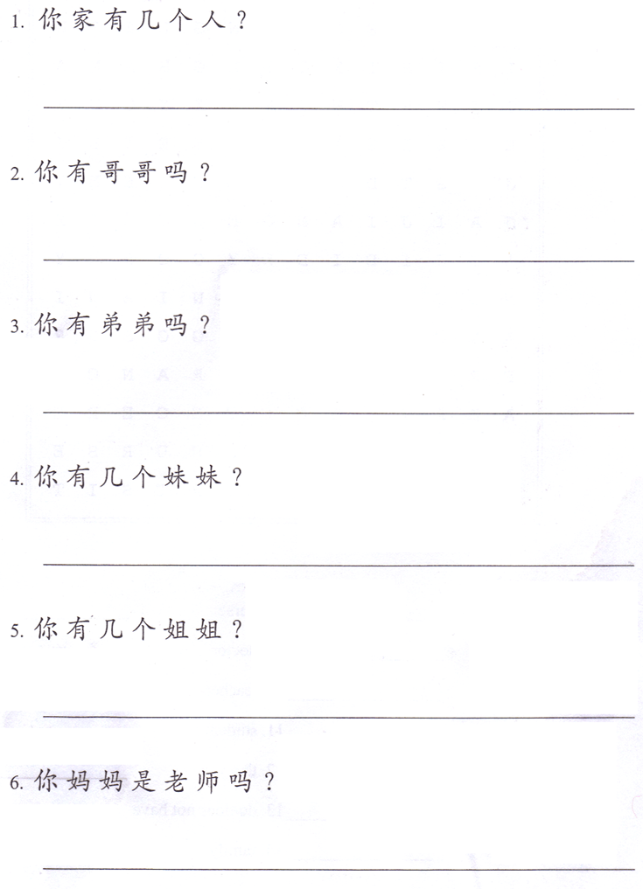
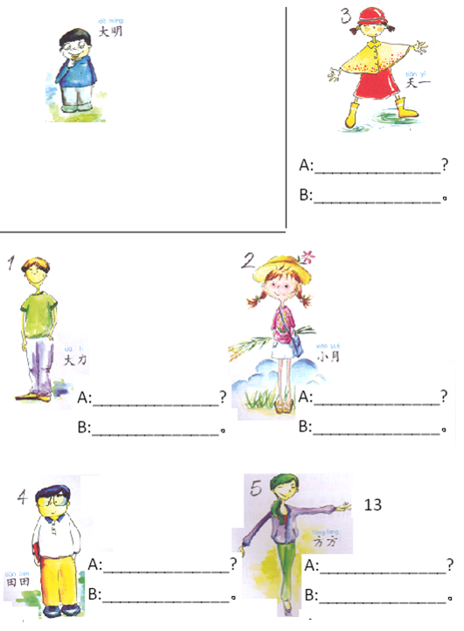
Task 1: Answer the questions based on your real life.
Follow the structures.
Task 2: A-Write 她/他叫什么名字？
B-Write 她/他叫…。
ON YOUR OWN PAPER
JUST THE ANSWERS.
ON YOUR OWN PAPER
Questions and answers.
Change 你 to 我，change 几 to the number.
If you finish Tasks 1&2, do QUIZLET 有没有 吗 名字 (09/14-09/15) all 5 tasks
天一
Yes: Change 你 to 我，take out 吗
No: Change 你 to 我，take out 吗, change 有 to 没有
Example:
On your own paper
A：他叫什么名字？
B：他叫大明。
Yes: Change 你 to 我，take out 吗
No: Change 你 to 我，take out 吗, change 有 to 没有
Yes: Change 你 to 我，change 几 to the number
No: Change 你 to 我，change 有 to 没有，take out 几个
大力
小月
On your own paper
On your own paper
Yes: Change 你 to 我，change 几 to the number
No: Change 你 to 我，change 有 to 没有，take out 几个
芳芳
On your own paper
On your own paper
Yes: Change 你 to 我，take out 吗
No: Change 你 to 我，take out 吗，change 是 to 不是
天天

Slide 15
“他”叫小明
一岁
三姐
六岁
三姐
两岁
哥哥
三岁
二姐
四岁
妈妈叫小美
三十岁
老师
爸爸
三十四岁
律师

Slide 16
Take out your cellphone
Go to:
Kahoot.it Game PIN:
Nickname: Your first name
If you don’t provide your real name, you will be deleted by Ms. Feng

Slide 17
Materials needed:
Pencil or Pen (draft)
Color pencils or sharpies (Yours & Feng)
Construction paper or poster board (Yours & Feng)
Glue sticks (Yours & Feng)
Scissors (Yours & Feng)
Photos of at least 4 family members (including yourself)
Any other decorative materials that you want to use on your project. (Yours)

Slide 18
4th period Chinese 1
Work on your project. Your project is due next Thursday and today will be the ONLY period I provide for the project.
2. You can use my supplies on the round table, but make sure you SHARE.
3. If you need the poster board, ask MS. Feng. Don’t just take it.
4. NO CELLPHONE.

Slide 19
Project Instructions
Name: 我的家
Format: Booklet or Poster. ( everything has to be hand written, can not be typed.)
Language: Everything on your project has to be in Chinese CHARACTERS, the only thing can be written in English is name.
Sentences:
There are 4 people in my family. 我家有四口人。
They are member 1, member 2, member 3 and me. 他们是妈妈，爸爸，妹妹和我。
Each family member:
A. This is my ___.(relationship)
B. She/he is ___. (name)
C. She/he is __ (number of age) years old.
D. She/he is a ___. (profession)
E .She/he works in/at a ___. (work place)
A. 这是我妈妈。
B. 她是Mary Smith。
C. 她四十一岁。
D. 她是老师。
E. 她在一家学校工作。
a. If you want to put more family member(s) on your project, you will get up to 5 extra points.
b. If the family members, professions or the work places are the words that you haven’t learned in Chinese class, please ask Ms. Feng for help.
c. If the family member is a student, his/her profession should be “student” and his/her work place should be “school”. D. 她/他是一个学生。 E. 她/他在一家学校上学。
d. Project is due 09/24 Thursday.

Slide 20
Project Instructions
Name: 我的家
Format: Booklet or Poster. ( everything has to be hand written, can not be typed.)
Language: Everything on your project has to be in Chinese CHARACTERS, the only thing can be written in English is name.
Sentences:
There are 4 people in my family. 我家有四口人。
They are member 1, member 2, member 3 and me. 他们是妈妈，爸爸，妹妹和我。
Each family member:
A. This is my ___.(relationship)
B. She/he is ___. (name)
C. She/he is __ (number of age) years old.
D. She/he is a ___. (profession)
E .She/he works in/at a ___. (work place)
A. 这是我妈妈。
B. 她是Mary Smith。
C. 她四十一岁。
D. 她是老师。
E. 她在一家学校工作。
a. If you want to put more family member(s) on your project, you will get up to 5 extra points.
b. If the family members, professions or the work places are the words that you haven’t learned in Chinese class, please ask Ms. Feng for help.
c. If the family member is a student, his/her profession should be “student” and his/her work place should be “school”. D. 她/他是一个学生。 E. 她/他在一家学校上学。
d. Project is due 09/25 Friday.

Slide 21
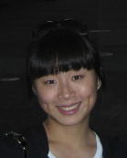
PROJECT EXAMPLE
Mom’s photo here
这是我妈妈。
她是Guo.
她五十七岁。
她是一个警察。
她在一家警察局工作。
这是我。
我是Jia Feng.
我三十岁。
我是一个老师。
我在一家学校工作。
我的家
Dad’s photo here
我家有四口人。他们是我老公 (husband)，我妈妈，爸爸和我。
这是我老公(husband)。
他是 Yi peng Wang.
他三十岁。
他是一个老师。
他在一家学校工作。
这是我爸爸。
他是Feng.
他五十九岁。
他是一个销售员。
他在一家公司工作。

Slide 22
Do Now：
Is this her pen?
Yes, this is her pen.
是
吗
她的
这
笔
？
是
吗
她的
这
笔
？
是
她的
这
笔
。
，
是

