Slide 1
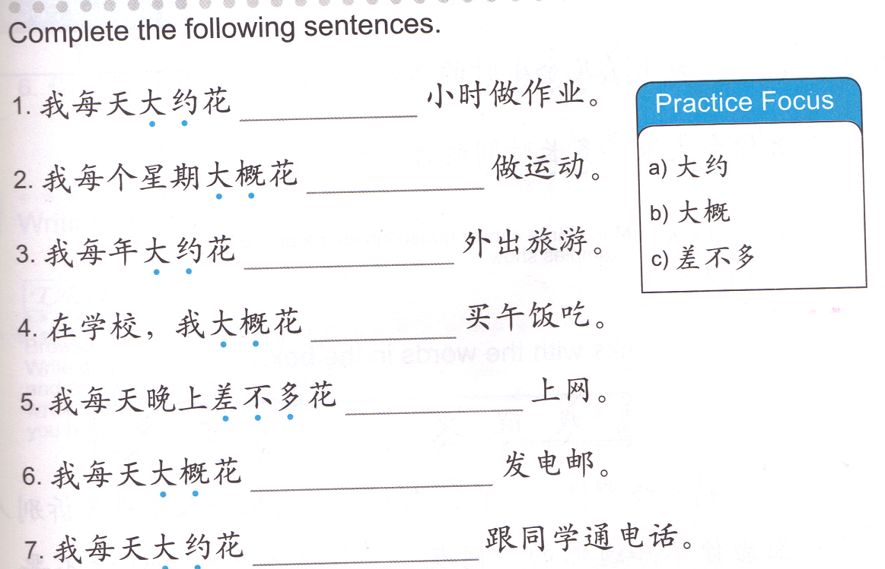
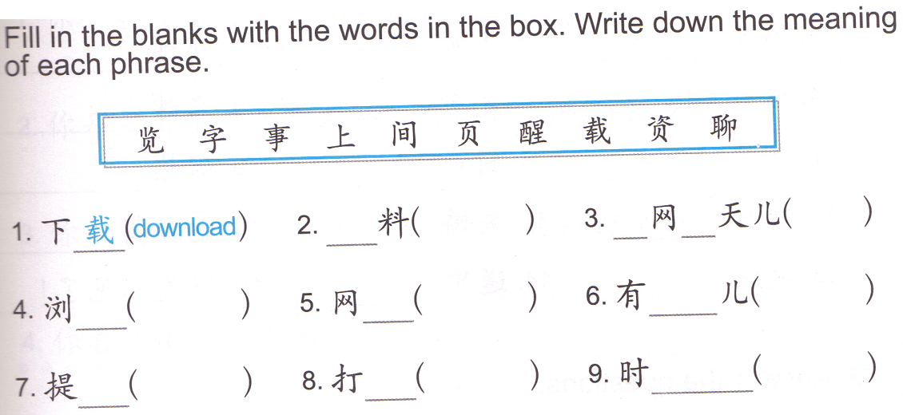
DO NOW
Task 1: Rewrite the sentences with the missing parts filled in.
QUIZLET: reference 01/15 Task 1

Slide 2
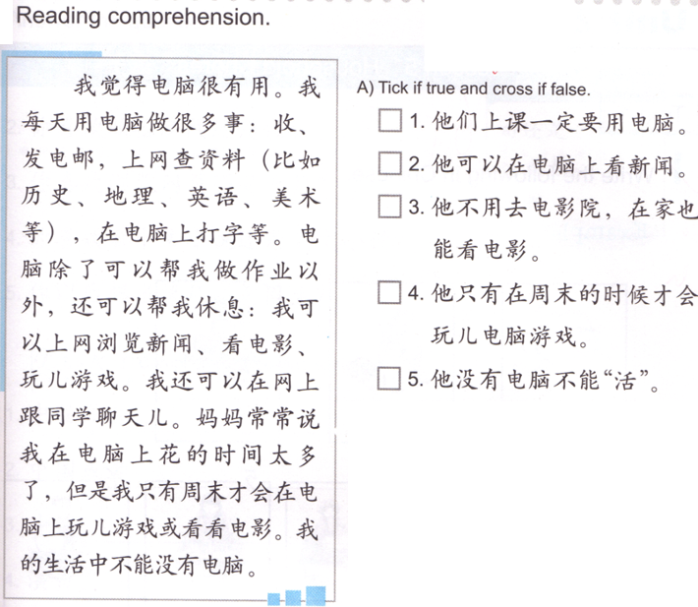
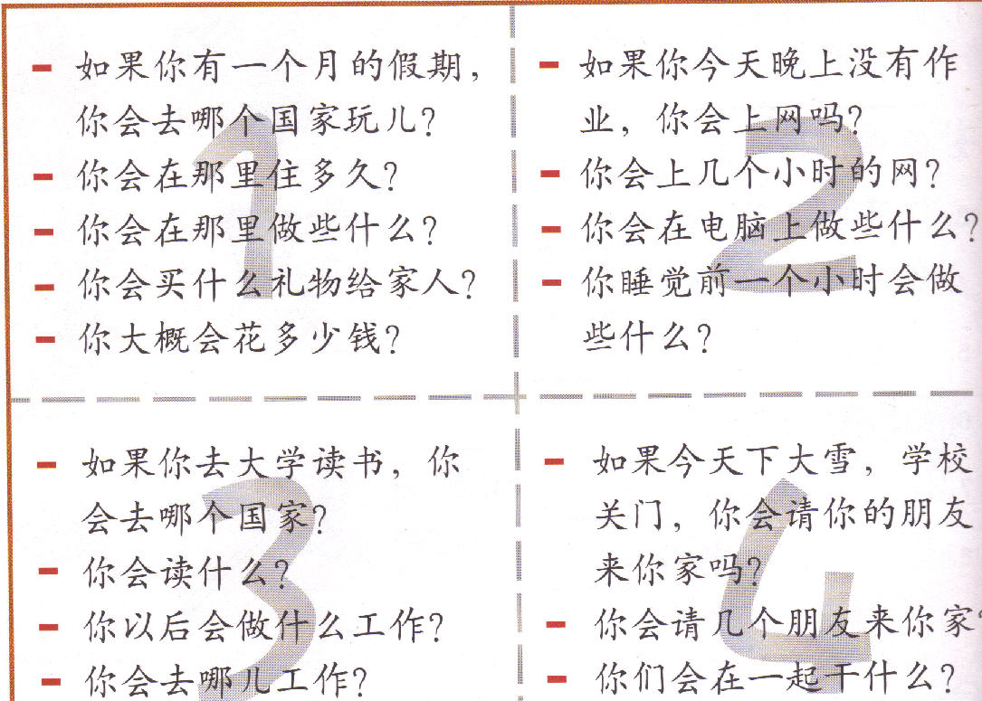
Task 3
Task 2: Group of 2 Choose a box to present to Ms. Feng (questions & answers)
QUIZLET reference: 01/15 Task 2 Oral Task
Task 4 QUIZLET internet 10
Live/survive

Slide 3
DO NOW

Slide 4
Task 1: Rewrite the sentences with the missing parts filled in.
QUIZLET: reference 01/15 Task 1
about
approximately
almost

Slide 5
Task 2: Group of 2 Choose a box to present to Ms. Feng (questions & answers)
QUIZLET reference: 01/15 Task 2 Oral Task

Slide 6
Task 3
Live/survive

Slide 7

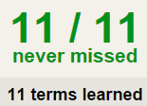

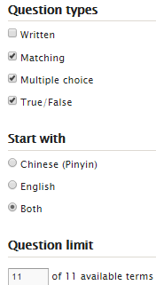
Task 4 QUIZLET internet 10 each section is 20%
Learn-Make sure you finish 100%
Speller-Make sure you finish 100%
Scatter-The time needs to be within 35 seconds.
Test- Create New Test after you change the settings to:
NOTES:
10/10
This number has to be 100
This number doesn’t matter.
10/1
The comment doesn’t matter.
10
This number has to be 12
This number has to be less than 40
10 of 10

Slide 8
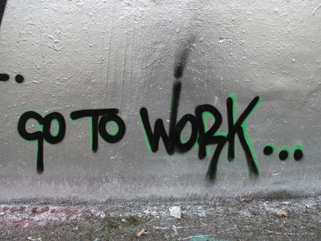
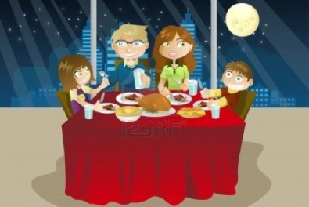
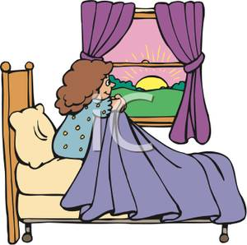
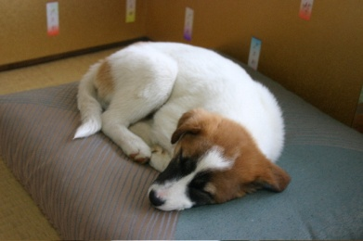

吃饭
起床
睡觉
上课
上学
上班

Slide 9
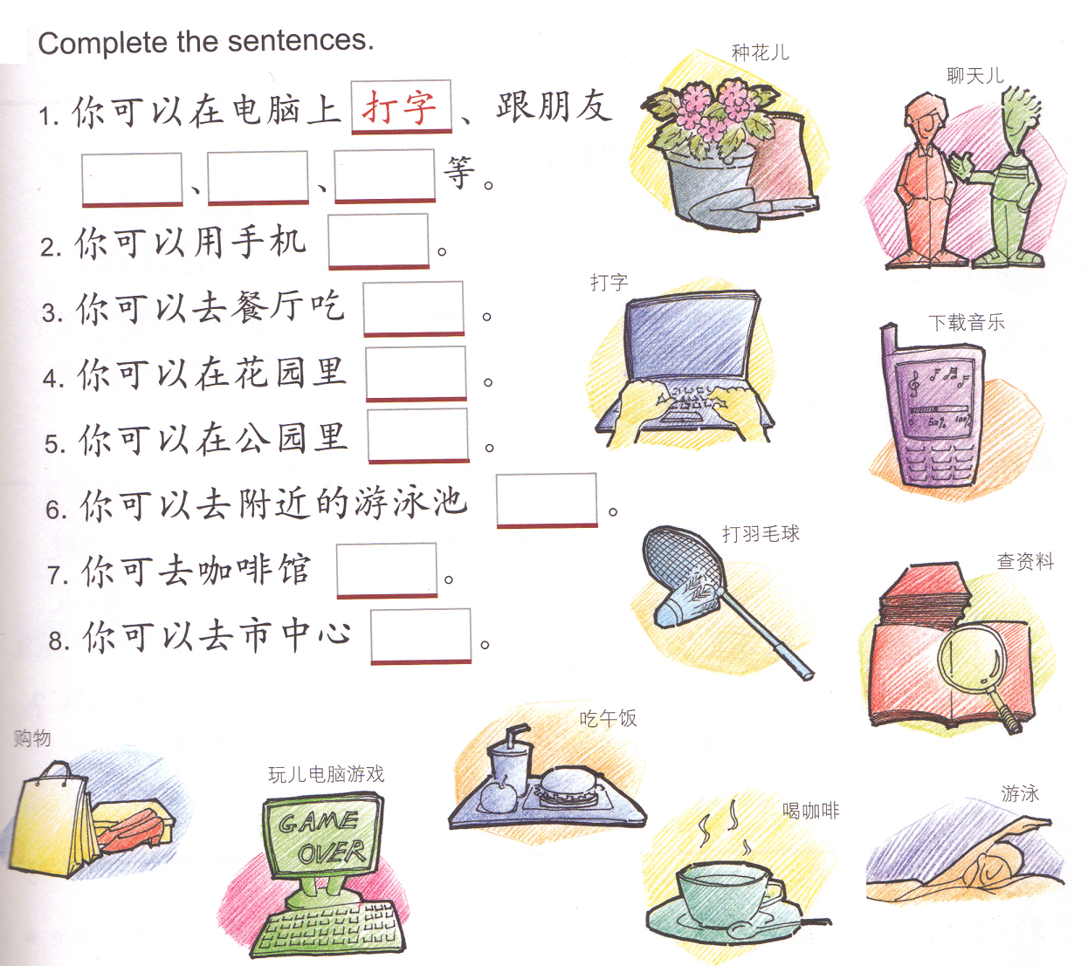
DONOW:
Fill in the blanks using the words provided.
聊天儿
example
Black paper means NO SITTING
Brianna
Mykesia
Sullivan
Dasia
Drone
Walker
Phillip
Jamario
Lorenzo
Unique

Slide 10
a.从来不 b. 有时候 c.平时 d. 通常 e. 常常/经常 f.总是
TASK 2 (During Task 1) each person will write 4 sentences to talk about how frequent someone does house chores using 4 colors of the frequency words and 4 house chores. (Index card). Give the index card to Ms. Feng when you are done, make sure you put your name on it.
我从来不去菜市场买菜。我喜欢去超市买菜。
我总是做作业,从星期一到星期五。

Slide 11
QUIZLET TASK instructions – 家务
Flashcard-Go over all the words.
Learn-Make sure you finish 100%
Speller-Make sure you finish 100%
Scatter-The time needs to be within 35 seconds.
Test- Create New Test after you change the settings to:
Task 1 (30分钟)
This number doesn’t matter.
14/14
This number has to be 100
You can choose to do 2. Learn or 3. Speller.
You have 30 minutes for this task.
14/14
The comment doesn’t matter.
14
This number has to be 14
This number is to be less than 35
14 of 14

Slide 12
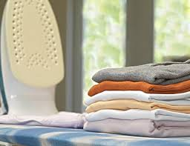
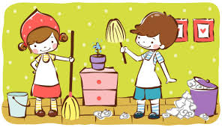
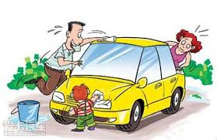
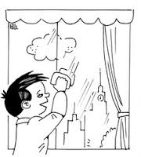
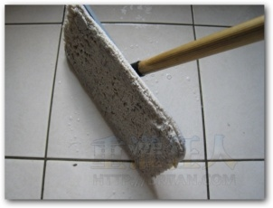
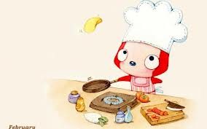
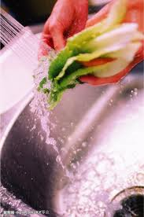
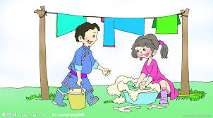
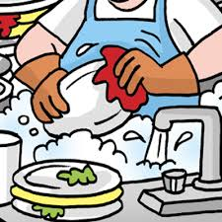
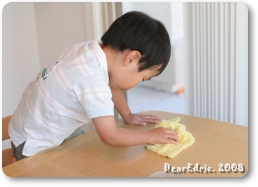
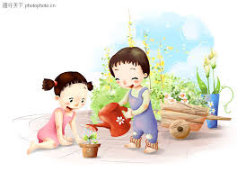
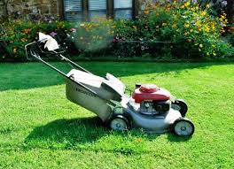

f.总是
TASK 3 Based on the index card your group is assigned, you come to the board, drag the pictures of the household chores and put them under the categories.
a.从来不
b. 有时候
c.平时
d. 通常
e. 常常/经常

