Slide 1
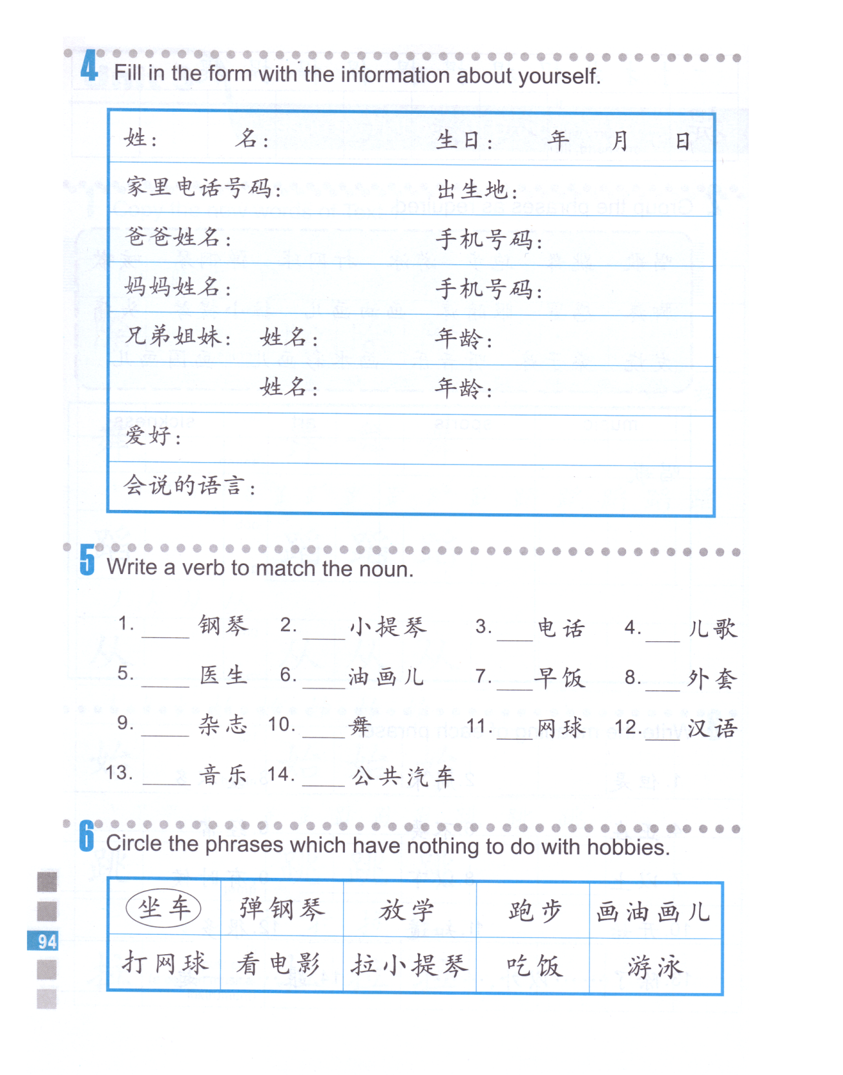
说 跳 听 拉 打
打 穿 弹 看
画 读 唱 吃 坐

Slide 2
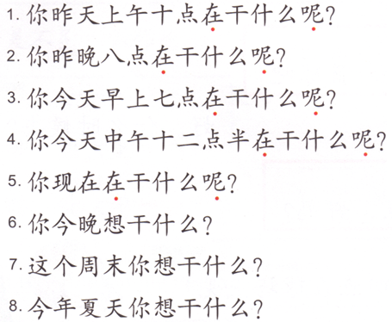
Task 1:
Subject + （正）在干什么（呢）？
What was someone doing at a certain time?
Subject + 想干什么？
What does someone want to do at a certain time?
刷牙 brush teeth 7:00 am
去奶奶家 go to grandma’s this weekend
看电视 watch TV 10:00 am
上中文课 have Chinese class now
打橄榄球 play football tonight
吃午饭 eat lunch 12:30 noon
写作业 do homework 8:00 pm
学游泳 learn to swim this summer

Slide 3
Task 2:
除了…以外，subject + 还…。 Besides…, subject also…
除了中文以外，她还说英文和日语。
Hobby 1
Hobby 2
除了+ Hobby 1 +以外， Subject + 还 + likes + hobby 2.
2. 她，唱歌
3. 我， 五岁
Subject + from + age + start + do something.
A
B
4. 我， 妈妈
A + 经常 + 跟+ B + 一起 + do something
5. 他， 差不多…都
Subject + almost + frequency + 都 + do something.
6. 我们
Subject + don’t really like + doing something.
7. 我， 每天， 都
Subject + almost + frequency + 都 + do something.
8. 我，听音乐
Subject + 一边+ do something + 一边+ do something.
A
B
9.爸爸，弟弟，了
A + 带 + B + see doctor + 了。
10.我
Figure out this sentence on your own.

Slide 4
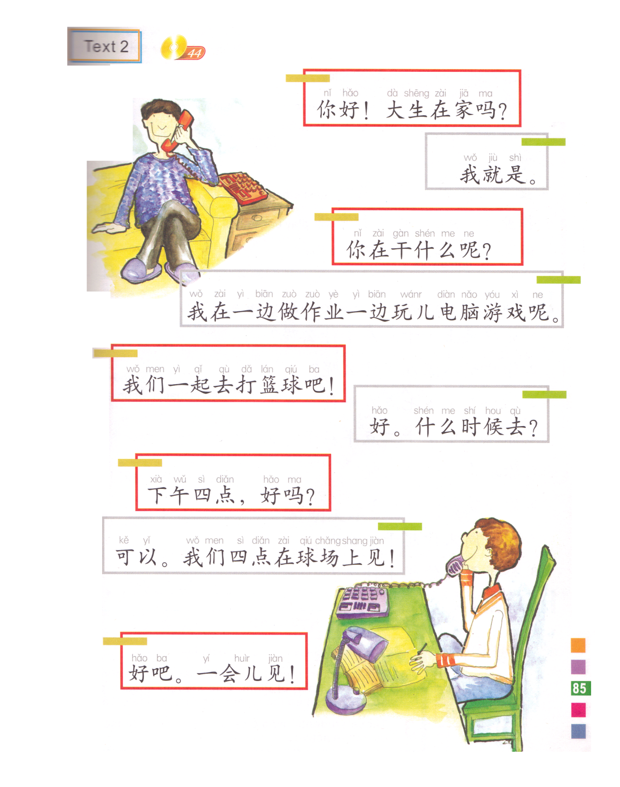
Q:谁是小文？
Hello, is Da Sheng home?
A:他就是。
This is Da sheng. ( exactly)
What are you doing?
I am doing homework at the same time playing computer game.
Let’s play basketball together!
我们
When do we go?
4:00 in the afternoon, is it ok?
在…见-meet in/at…
Fine, we will meet on the court at 4:00!
Ok, I will see you later.
See you later.

Slide 5
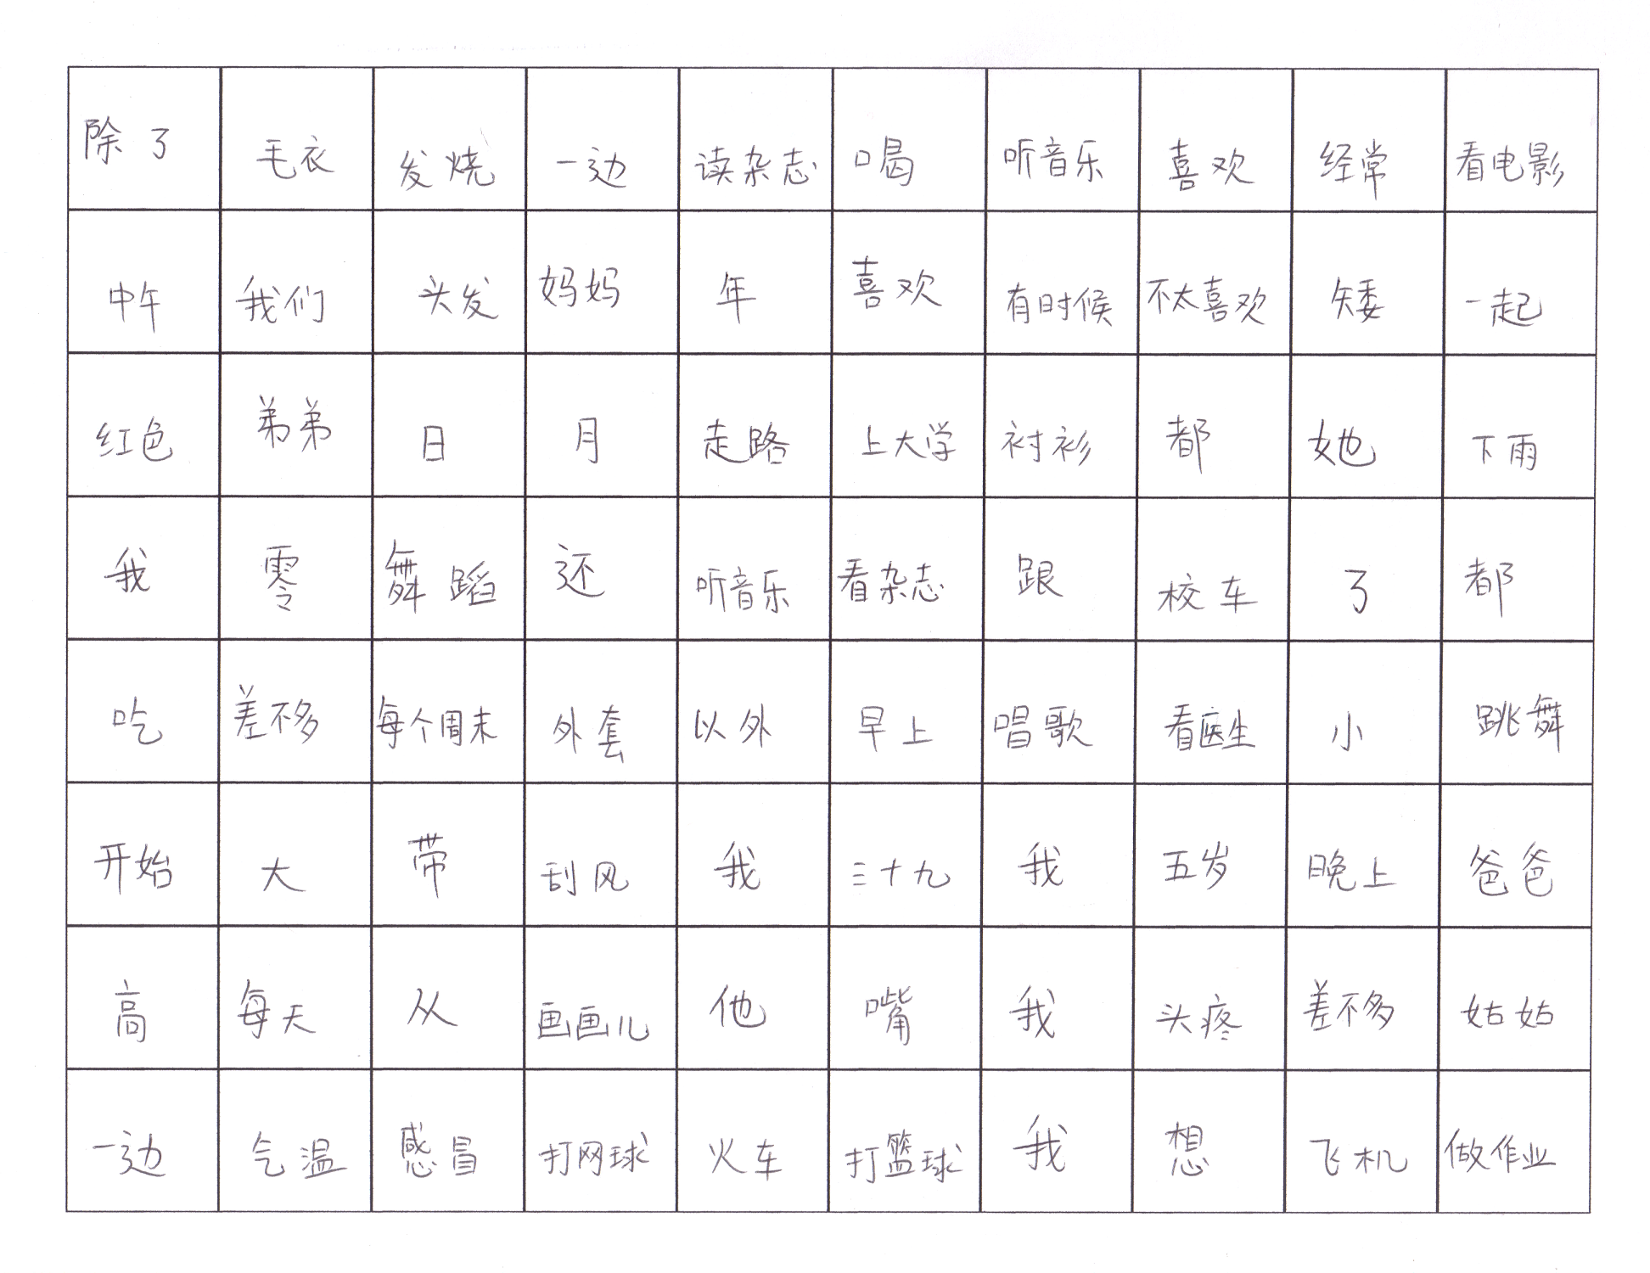

Slide 6
周末
在
上个
干什么
呢
你
你
在
干什么
呢？
上个
周末

Slide 7
Number the words from dislike to love.
喜欢，不喜欢，很喜欢，不太喜欢，非常喜欢，爱
不喜欢，不太喜欢，喜欢，很喜欢，非常喜欢，爱

Slide 8
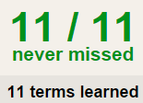
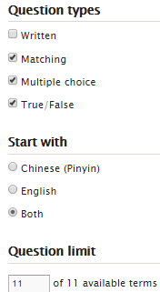
Task 1 QUIZLET instructions – 水果和蔬菜 1 each section is 20%
Learn-Make sure you finish 100%
Speller-Make sure you finish 100%
Scatter-The time needs to be within 35 seconds.
Test- Create New Test after you change the settings to:
20/20
This number has to be 100
This number doesn’t matter.
20/20
The comment doesn’t matter.
20
This number has to be 12
This number has to be less than 40
20 of 20

Slide 9
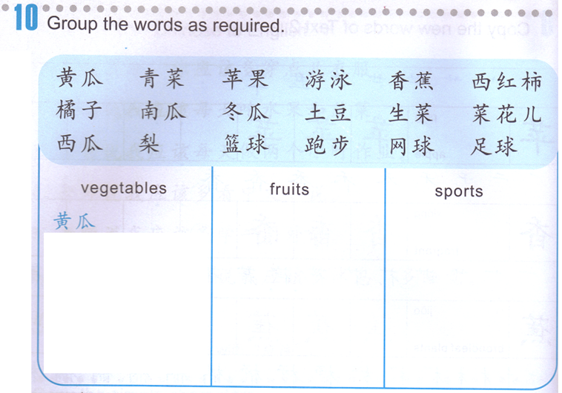
Group Assignment: 1. Categorize the words.
Student1:
Student2:

Slide 10
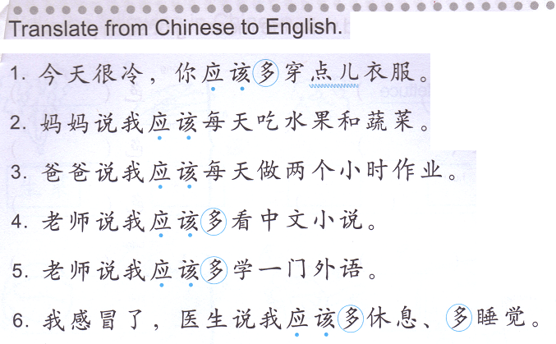
Group Assignment: 2. Translate the words in English.
Subject 应该多do something
Subject should do something more
你们应该多读书。
You guys should read more books.

Slide 11
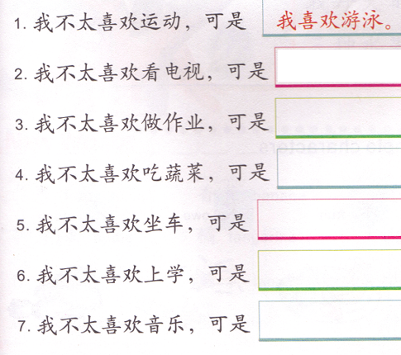
Task 1: Find 1 part for each sentence and write the sentences on a separate sheet of paper.
Task 1: Find 1 part for each sentence and write the sentences on a separate sheet of paper.
我特别喜欢英文歌。
我每天都坐公共汽车上学。
我喜欢星期六的节目(programs)。
我差不多每天都做作业。
我很喜欢开车。
我特别喜欢吃大白菜。
我喜欢我的老师。
我喜欢我的同学。
爸爸说我应该每天吃蔬菜。
我喜欢唱歌。
我喜欢体育节目 (programs)。
老师每天都给我留很多作业。
我喜欢星期六的节目(programs)。
我差不多每天都做作业。
我喜欢体育节目 (programs)。
我很喜欢开车。
我特别喜欢吃大白菜。
我每天都坐公共汽车上学。
我特别喜欢英文歌。
我喜欢我的老师。
我喜欢我的同学。
爸爸说我应该每天吃蔬菜。
我喜欢唱歌。
老师每天都给我留很多作业。

Slide 12
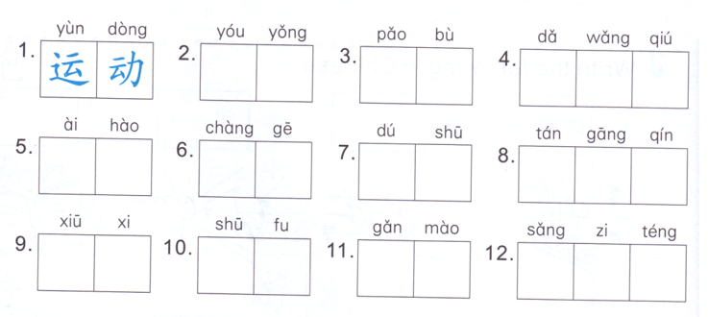
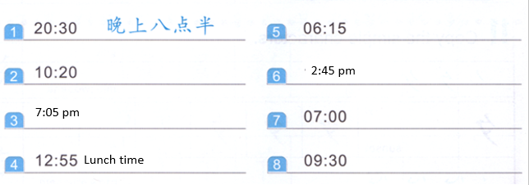
Time of day + time
Time of day:
早上—上午—中午—下午—晚上
Time:
Number + 点 + number + 分
Task 1 Write down the time of the day and the time.
DO NOW: hints 1-8 hobbies.9-12 sickness

Slide 13
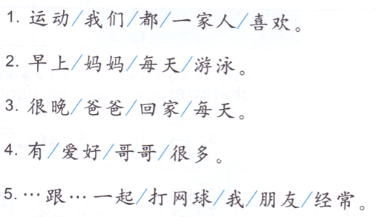
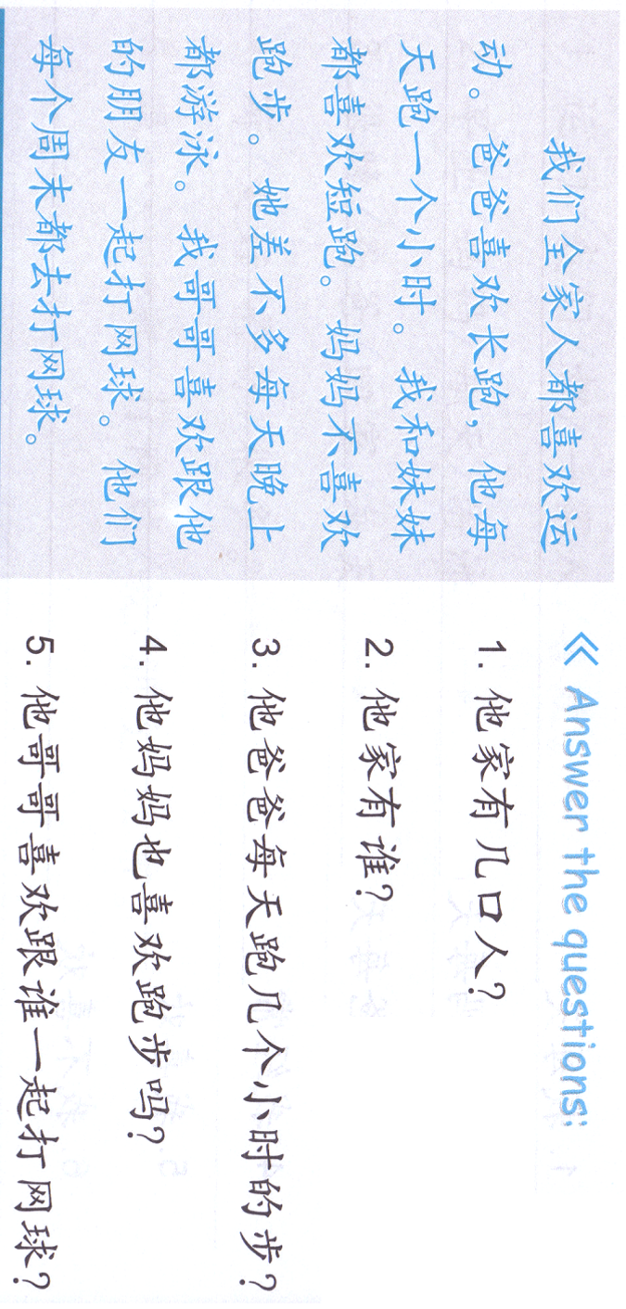
Task 2: Rearrange the words to form sentences and write them on the lines.
Task 3: Reading comprehension, mark down the answers on the paragraph.

Slide 14
