Slide 1
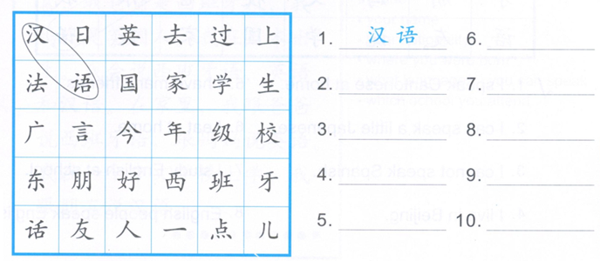
DO NOW: Circle the phrases you learned and write down the English meanings.
汉语Chinese

Slide 2
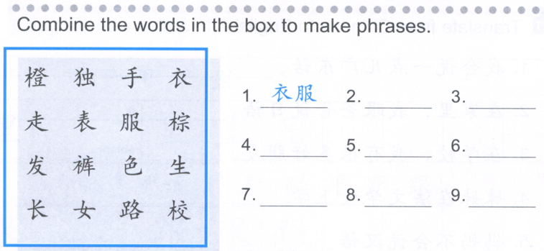
Task 1

Slide 3
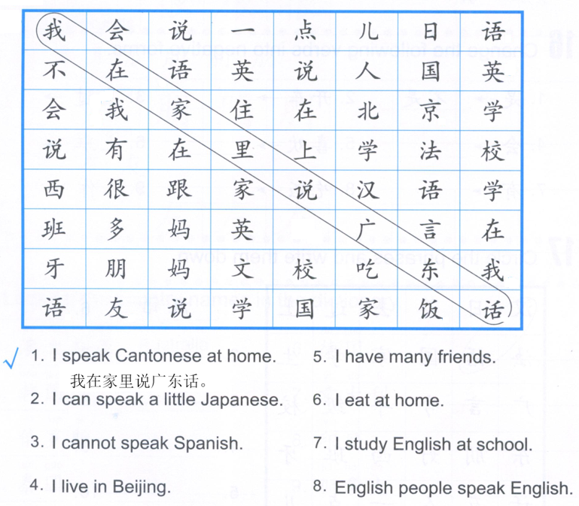
Task 2: Refernce (QUIZLET-03/14 Task 2)

Slide 4
You de… you de…, (hai) you de…
Some …,some …,(and) some …
我的朋友们有的是中国人，有的是美国人，（还）有的是西班牙人。
Some of my friends are Chinese, some are American, and some are Spanish.

Slide 5
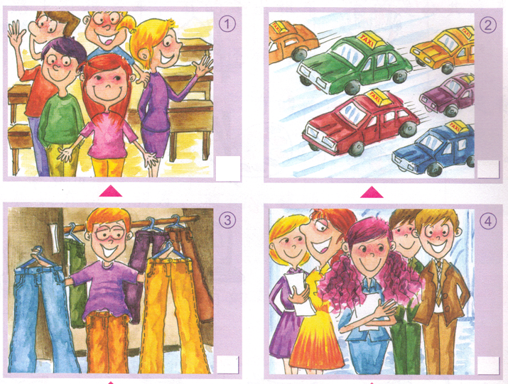
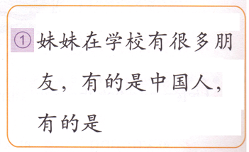
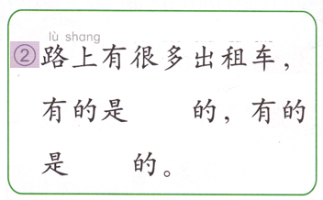
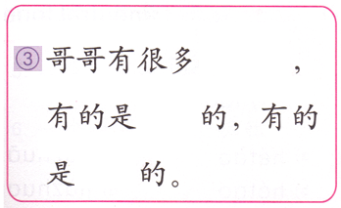
Task 3

Slide 6
Task 4
没去过

