Slide 1
黄色
红色
蓝色
颜色
妈妈
你
爸爸
家
猫
狗
马
动物

Slide 2
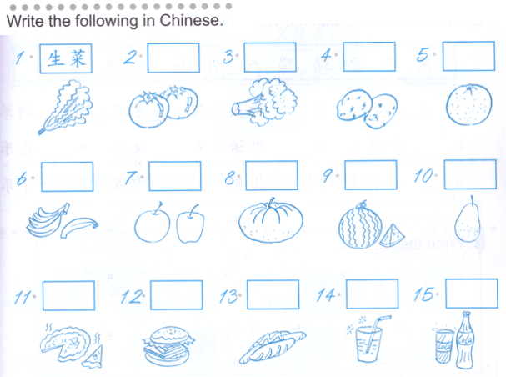
DO NOW:

Slide 3
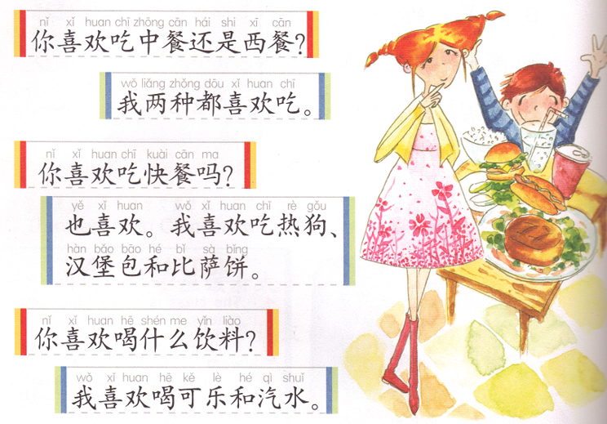

Slide 4
Task 1:

Slide 5
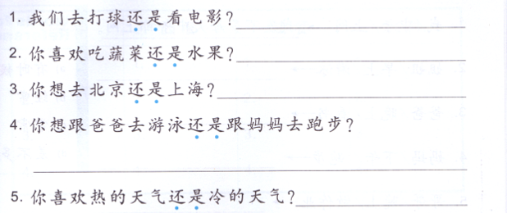
Task 2:
我们去A。 Or 我们去B。 Or 我们都去。
我喜欢吃A 。Or 我喜欢吃B。 Or 我都喜欢吃。
我想去 A。 Or 我喜欢去 B。 Or 我都想去。
我想 A。 Or 我想 B。 Or 我都想去。
我喜欢 A。 Or 我喜欢 B。 Or 我喜欢 A 和 B。

Slide 6
IF you do NOT have any missing assignment, please translate the conversation in characters on the same paper.
A: Does your little brother like eating fruits?
B: He likes fruits very much.
A: What fruits does he like?
B: He likes strawberries, watermelons, apples and bananas. What about you?
A: I don’t like those fruits, I like pears the most.
B: Do you eat fruits everyday?
A: I eat 2 kinds everyday. What about you?
B: I don’t eat fruits everyday. But my mom says that I should eat fruits everyday.
A:
B:
A:
B:
A:
B:
A:
B:

Slide 7
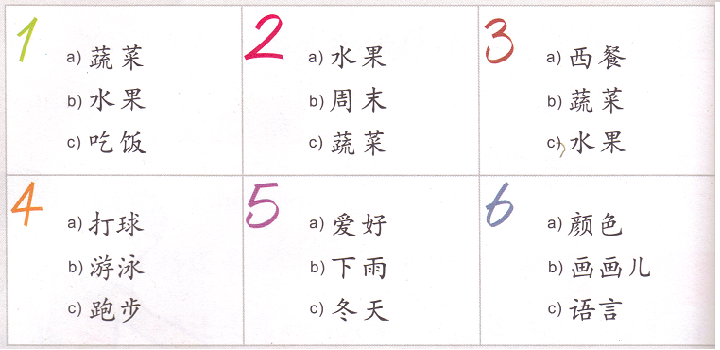
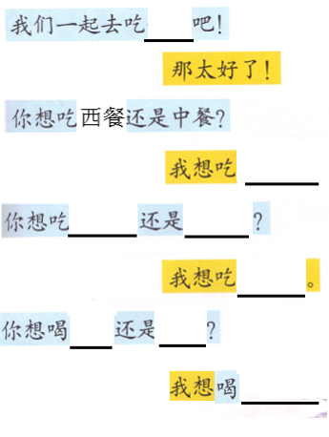
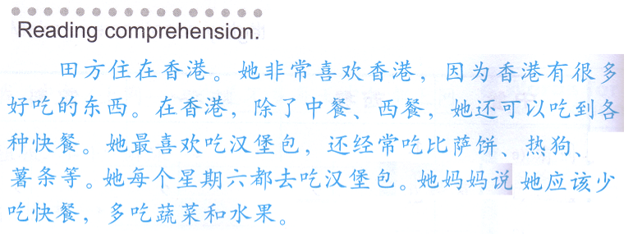
Oral Quiz:
QUIZLET reference
11/05 Oral QUIZ
jfeng1.wix.com/chinese
早饭/午饭/晚饭
10:00 T or F and mark down why in the paragraph.
西餐/中餐
Food 1
Food 2
Food 1or2
Drink 2
Drink 1
Drink 1or2.
1.
2.
3.
4.

Slide 8
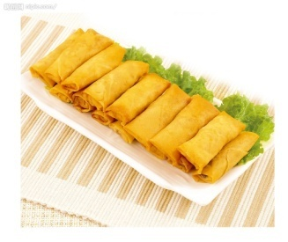
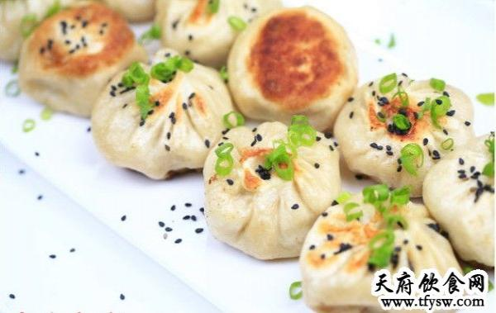
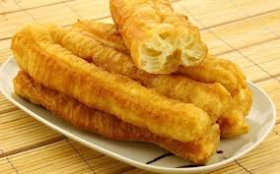
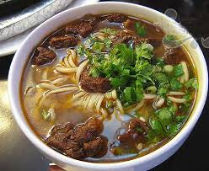
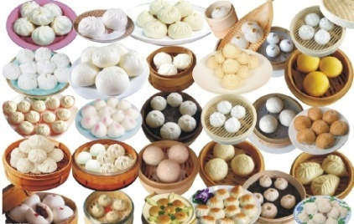
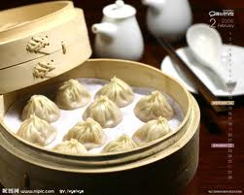
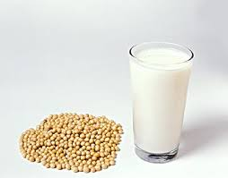
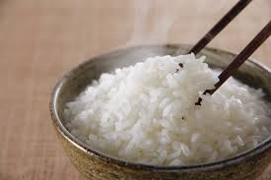
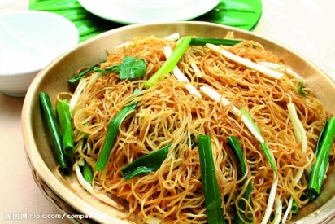
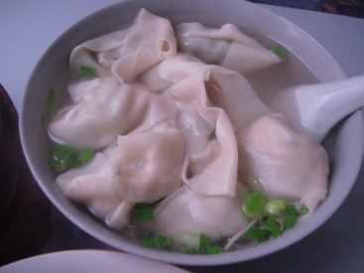
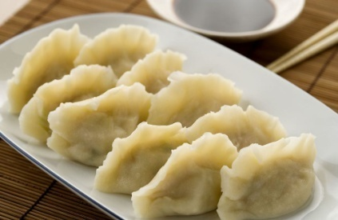
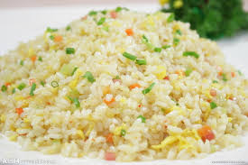
 | 包子 bao zi
 | 小笼包 Xiao long bao
Your task is to:
Do some research and explain what the following Chinese food items are, for each item, you will need to cover:
What is it?
Example:
豆浆：soy milk are both traditional Chinese breakfast foods, served either hot or cold, usually accompanied …
2. Main ingredient(s)?
Example:
饺子：meat, vegetables, flour
3. How do you cook it?
Example:
炒饭：stir fry
4. Mark down the tones for all the characters.
Example:
炒饭：chǎo fàn
This assignment is due next Monday(11/09) and it will count as 1 of your TEST GRADE (35%)
VERY IMPORTANT!!!!
生煎包
Sheng jian bao
春卷 chun juan
油条 you tiao
面条 mian tiao
包子 bao zi
小笼包
Xiao long bao
豆浆 dou jiang
米饭 mi fan
炒面 chao mian
馄饨 hun tun
饺子 jiao zi
炒饭 chao fan

Slide 10
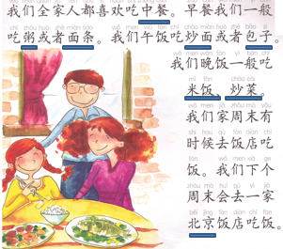
1st Thing: Last time’s paper
4th Thing: Your paper
Write a similar paragraph, change the lined food.
jfeng1.wix.com/chinese
2nd Thing: Your cellphone
Quizlet 做饭1
3nd Thing: Your paper
Write 4 words for each categories
中餐
西餐
快餐
饮料
Ways to cook
Food made with flour
Fruits with seeds
Our whole family all like eating Chinese food.
We normally eat porridge or noodles for breakfast.
We eat stir-fried noodles or steamed stuffed buns for lunch.
We normally eat rice (and) fried dishes for dinner.
Our family go to a restaurant to eat(go out to eat) sometimes on weekends.
We are likely to (going to) go to a BJ restaurant to eat next weekend.

