Slide 1
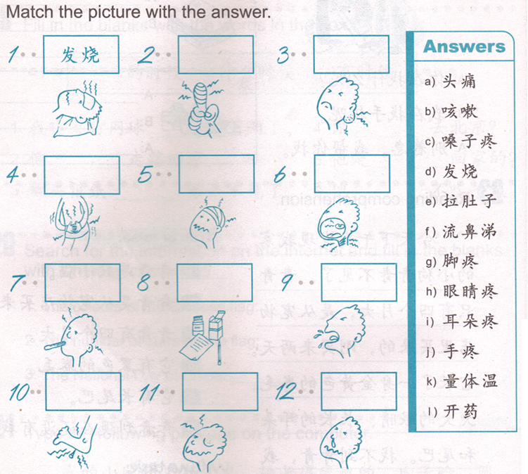
DO NOW:

Slide 2
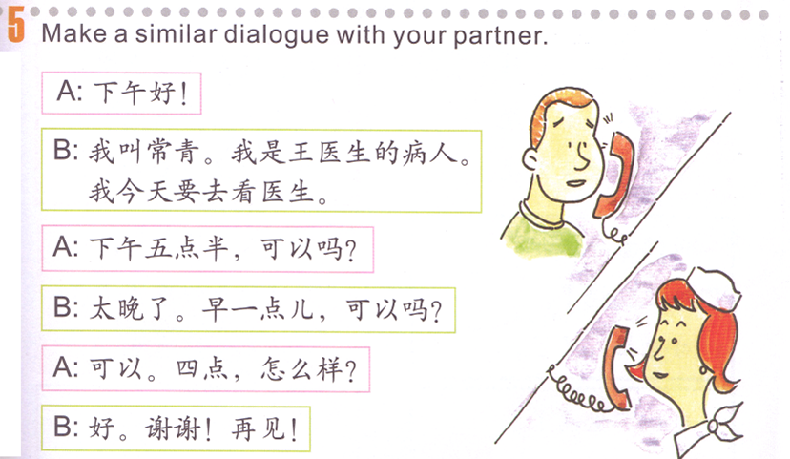
Task 1:
Make up your own lined words
李，张，刘

Slide 3
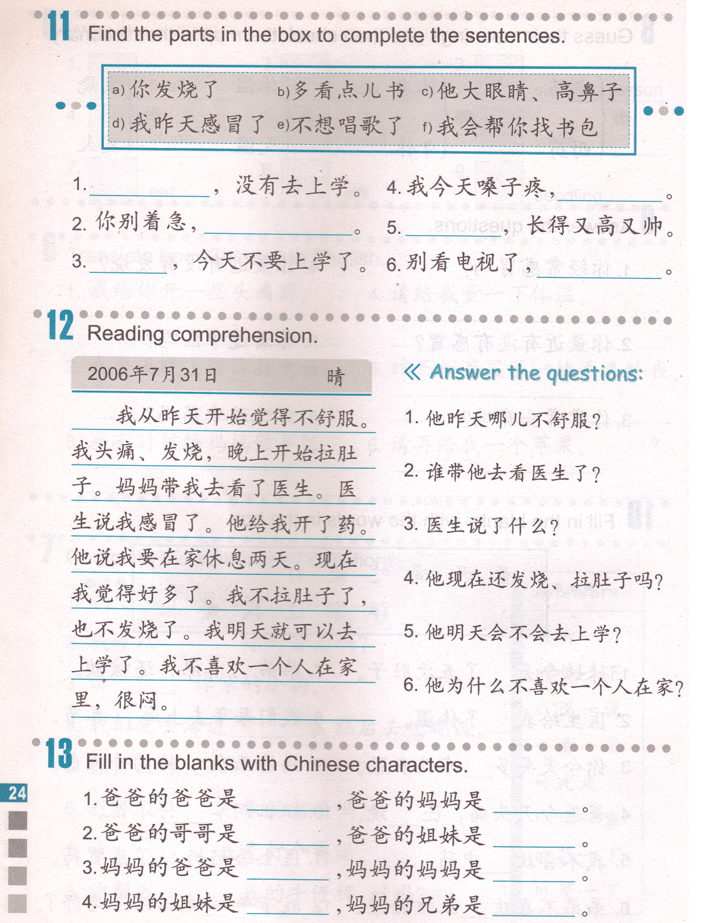
Task2
What’s wrong with him?

Slide 4
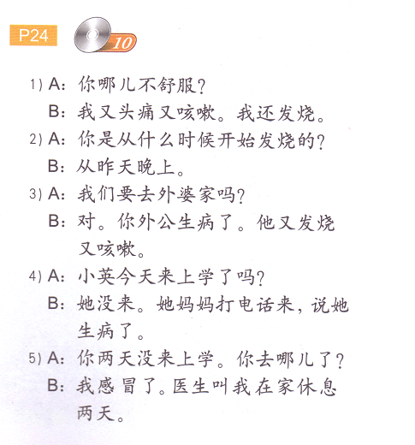
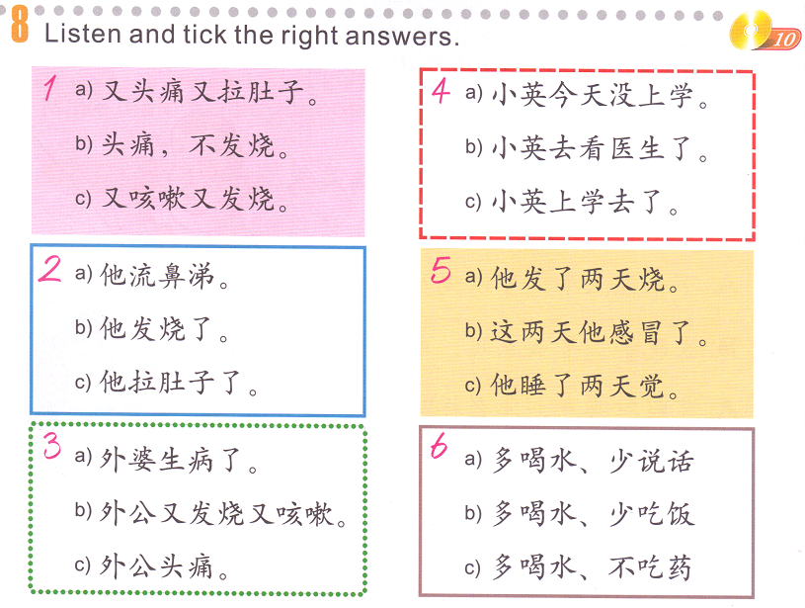
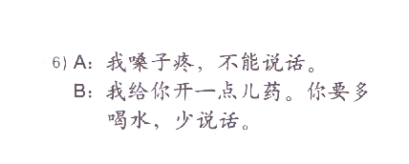
Task 3: Read the conversation and choose the answers.

Slide 5
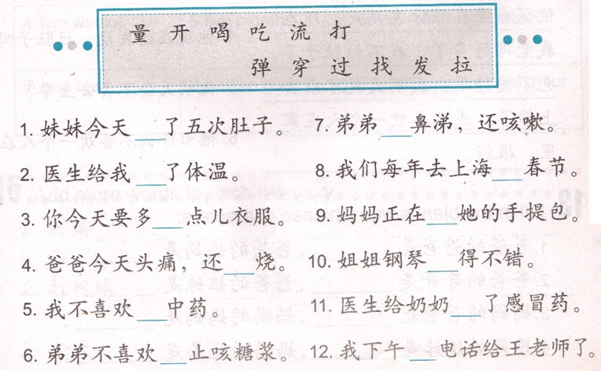
Task 4：quizlet- 03/21 TASK 4
purse
Not bad
Chinese Medicine
Cold medicine
Cough syrup

Slide 6



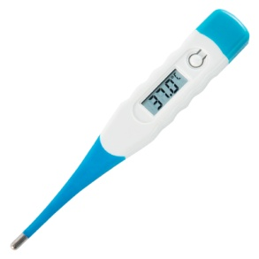
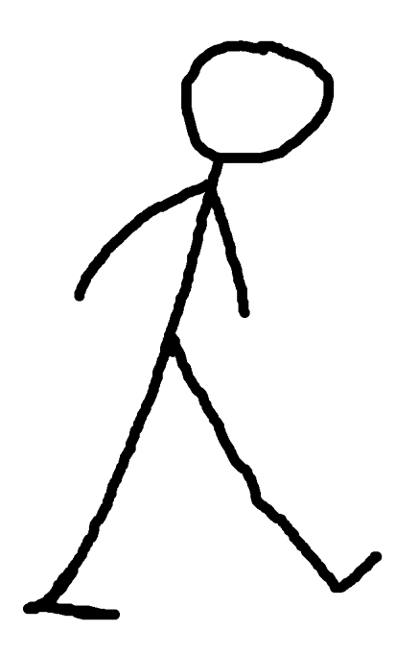
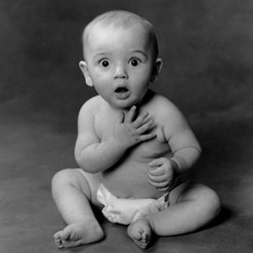
说一说
听一听
看一看
走走
量一下
找一下

Slide 7
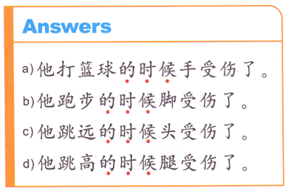



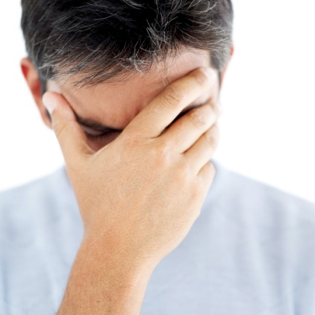
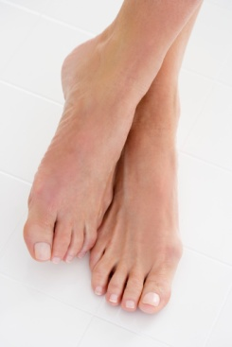
Task 一：
A
Subject V.+ N. 的时候 body part 受伤了。
B
跳远
跳高
D
C

Slide 8

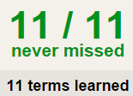

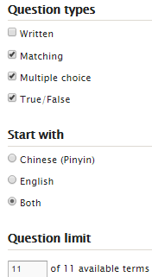
TASK 2 QUIZLET instructions – 生病 2 each section is 20%
Learn-Make sure you finish 100%
Speller-Make sure you finish 100%
Scatter-The time needs to be within 40 seconds.
Test- Create New Test after you change the settings to:
笔记notes:
10/10
This number has to be 100
This number doesn’t matter.
10/10
The comment doesn’t matter.
10
This number has to be 12
This number has to be less than 40
10 of 10

Slide 9
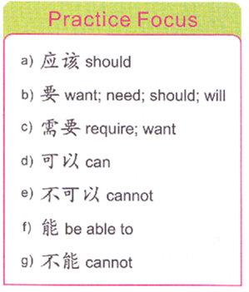
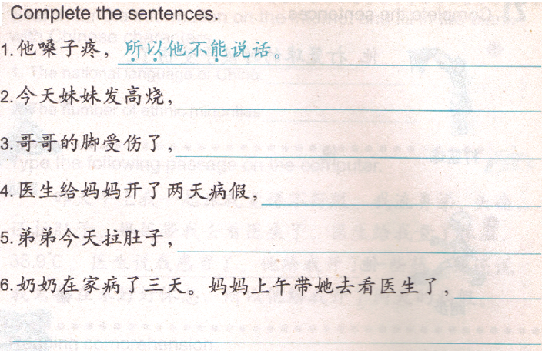
TASK 3:
Finish 5 sentences using 5 words in the box.
所以
所以
所以
所以
所以

Slide 10
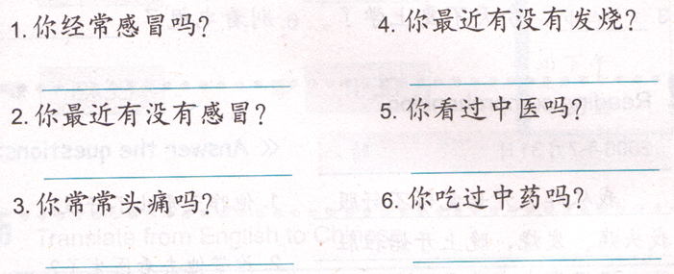
Task 4：
1 & 3：
Yes-change 你 to 我， take out 吗。
No-change 你 to 我， take out 吗，add 不 after 我。
2, 4:
Yes-change 你 to 我， take out 有没有, add 了 at the end.
No-change 你 to 我， take out the first 有.
5, 6:
Yes-change 你 to 我， take out 吗.
No-change 你 to 我， take out 吗, add 没有 after 我。

Slide 11
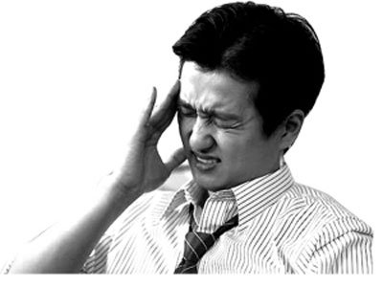
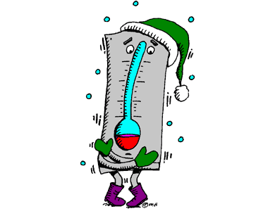
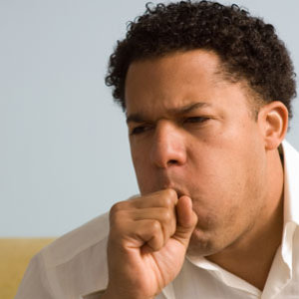
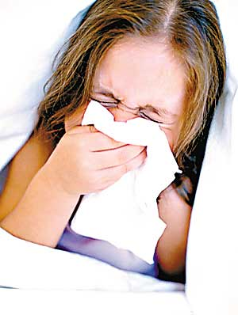

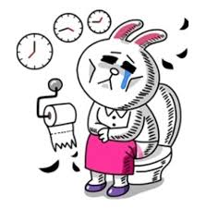
发烧
流鼻涕
咳嗽
医生
拉肚子
头疼

Slide 12
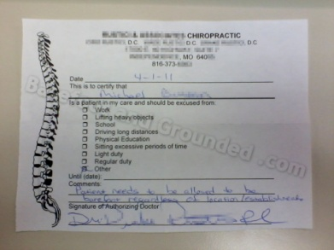

DO NOW
受伤
请病假
踢球
跑步
跳高
跳远

Slide 13
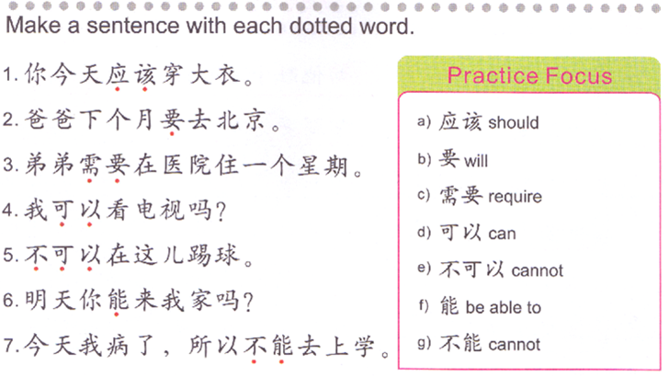
DO NOW/TASK1: Translate the sentences to English.
(ENGLISH MEANINGS ONLY ON YOUR PAPER)
1. You should wear a coat today.
足球。

Slide 14
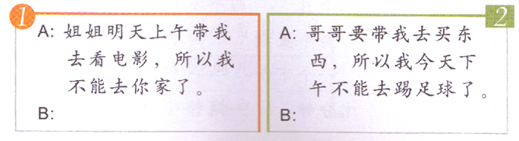
Task 2-
Oral activity : groups of 2 (QUIZLET- 03/28 Oral Task) Due: 1:45 (TODAY)
You will be assigned a number, you will need to make a similar phone conversation to present to Ms. Feng.
A: 你好，我是…，我找…。
B: 你好，我就是，什么事儿？
A: 爸爸明天早上要带我去奶奶家，所以我不能跟你去公园了。
B: 后天早上，可以吗？
A: 可以。
B: 我们几点在哪儿见？
A:八点，在我家见。
B: 好，我们后天一起去公园。八点在你家见。
3.A:妈妈今天晚上要带我去饭店，所以我不能去你家了。
B：
4.A: 舅舅星期五早上要带我去学校，所以我不能和你一起走路上学了。
B:

Slide 15

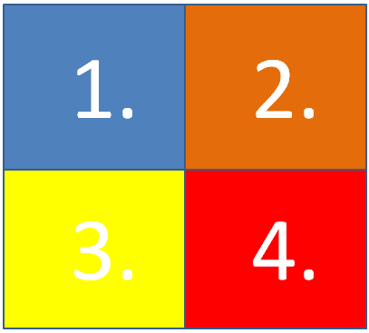
Click on the arrow to start and stop spinner.

Slide 16
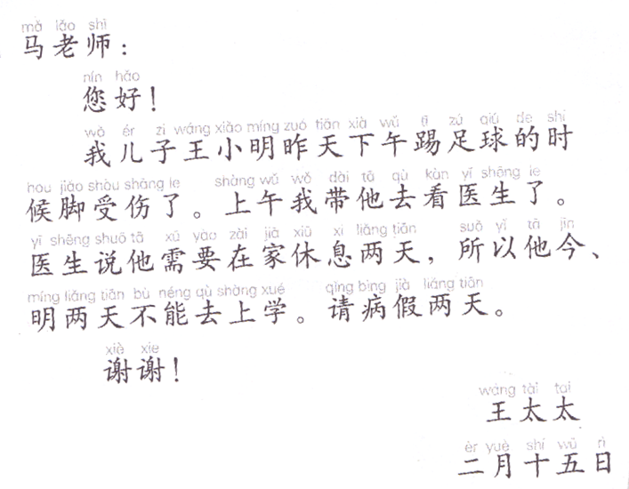
2.
A带B去..=A takes B to…
I took him to see doctor this morning.
1.
2.
3.
4.
3.
Doctor said he needs to rest at home for 2 days, so he can not go to school today and tomorrow.
Subject V.+ N. 的时候 body part 受伤了。
My son (WXM) ‘s foot got injured yesterday afternoon when he was playing soccer.
4.
请病假__天。
(He is taking) 2 days sick leave.
Task 3:
Pretend you are a parent, you are writing a sick leave note for your child to his/her teacher. You must cover:
When did your child get hurt? Where?
What did the doctor say?
How many days is he/she taking?
Make sure you follow the NOTE format.

