Slide 1
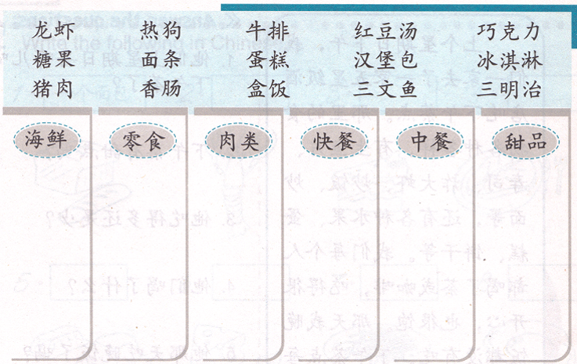
DO NOW / Task 1: Find “肉类” words and put them in the box.

Slide 2

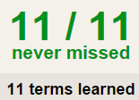

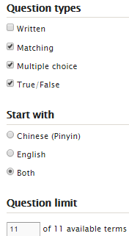
TASK 2 QUIZLET instructions – restaurant food 1 each section is 20%
Learn-Make sure you finish 100%
Speller-Make sure you finish 100%
Scatter-The time needs to be within 35 seconds.
Test- Create New Test after you change the settings to:
笔记notes:
10/10
This number has to be 100
This number doesn’t matter.
10/10
The comment doesn’t matter.
10
This number has to be 12
This number has to be less than 40
10 of 10

Slide 3
Task 3 ( 中餐厅/西餐厅/快餐店)
http://www.yes-chinese.com/card/card_cnpic.jsp
在…，主食你可以吃到…和…, 蔬菜你可以吃到…和…等，你还可以吃到很多甜品，比如有…，…和…。
例子example:
在“明明”中餐厅，主食你可以吃到米饭和面条, 蔬菜你可以吃到生菜和大白菜等，你还可以吃到很多甜品，比如有冰淇淋，苹果派和水果蛋糕。

Slide 4
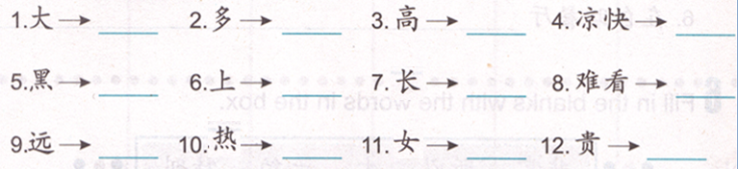
Task 4
小
下
男
便宜
矮
近
白
好看
少
暖和
短
冷

Slide 5
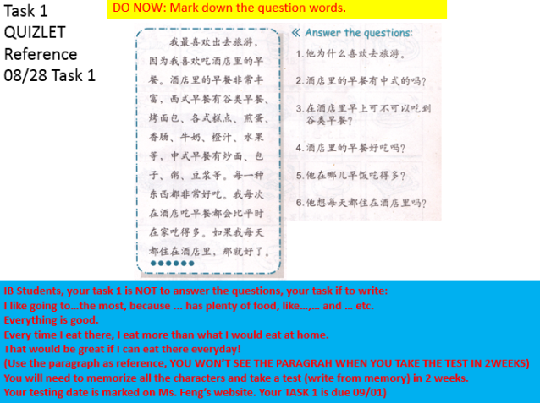
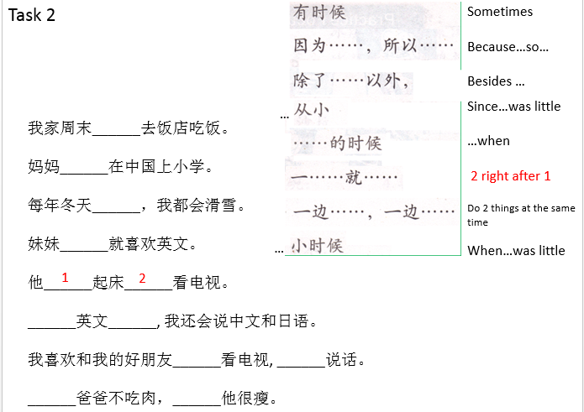
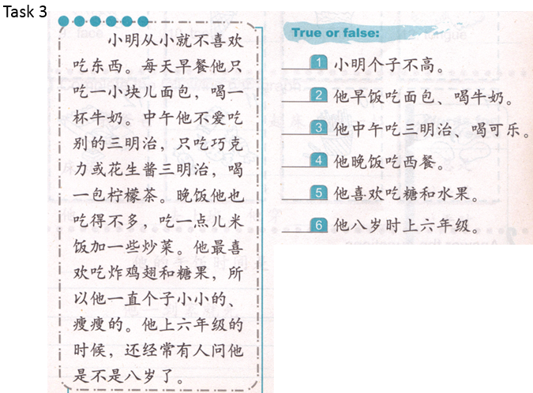
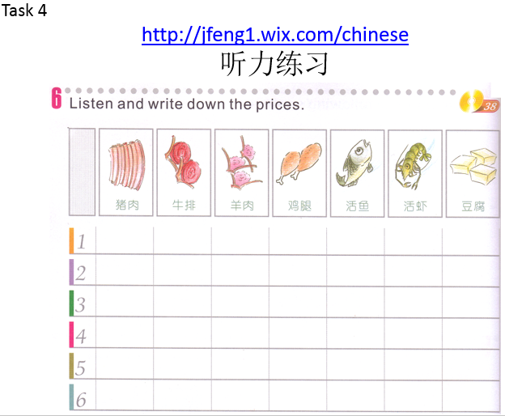
收作业

Slide 6
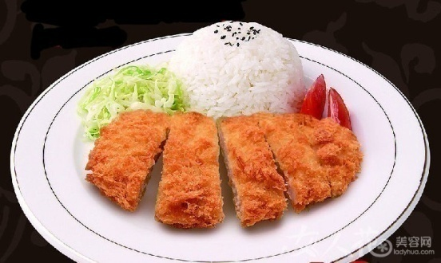
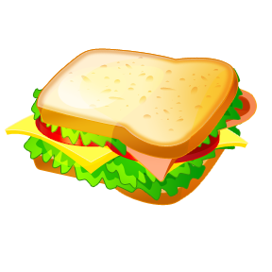
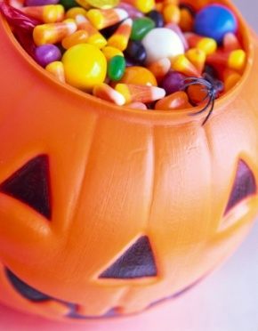
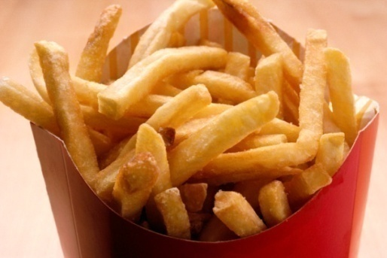
猪排饭
薯条
汉堡包
糖果
三明治
薯片

Slide 7
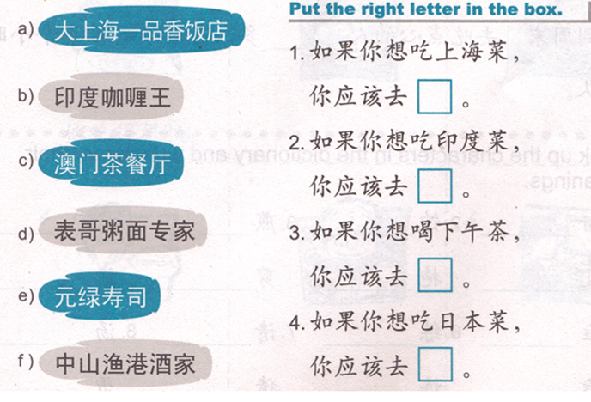

Slide 8
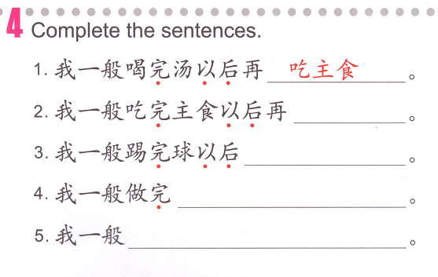
TASK 1
Subject 一般 V. 完 N. 以后（再） V. + N.。
normally
Eat the main dish
drink
soup
eat
Main dish
play
soccer
do

Slide 9
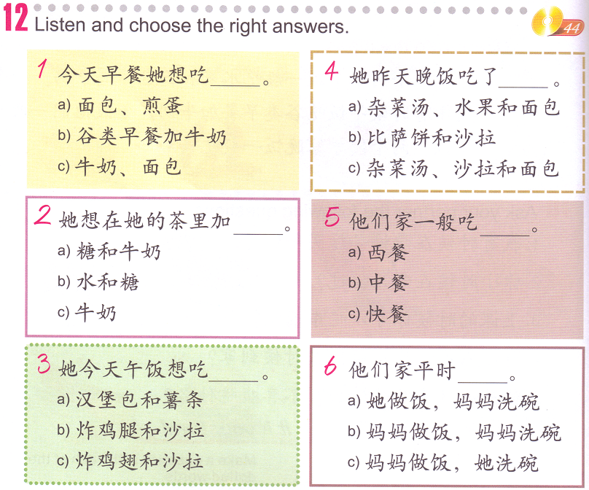
TASK 2
http://jfeng1.wix.com/chinese (YOUR CELLPHONE)

Slide 10
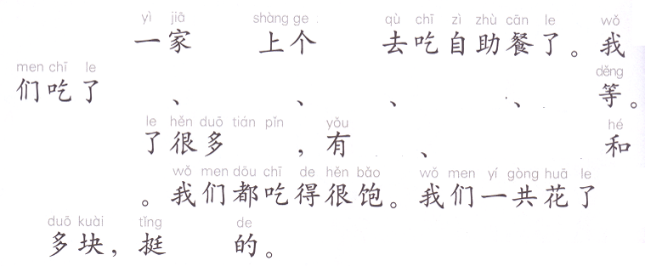
TASK 3
Writing task:
Write about your most recent dining experience, you have to include:
Who went where to eat what.
Describe the food you ate.
Describe if you were full or not.
Describe the price and if you think is expensive or cheap
IB YEAR 1
Make sure you know what you write down, you will have a quiz on this task next Tuesday.
Monday-Sunday
We
几口
Food 1
Food 2
Food 3
Food 4
Food 5
We also eat
category
Food 1
Food 2
Food 3
Money amount
Example:
一百三十二
二百六十
Cheap/
expensive

